Slide 1
The Effects Of Internet Globalization
Andrew Martin

Slide 2
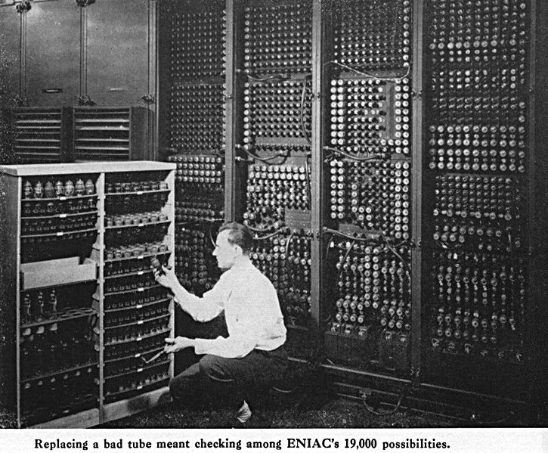
The RISE OF THE INTERNET
Throughout the late fifties and early sixties, research computers were connected to form ARPANET, the first web of computers
The internet became available to the public in the nineties
Now, over half the world’s population has become connected to the internet ("Internet and Globalization.“)

Slide 3
Possible issues
With so many people connected, some people want to misuse the internet for:
Hacking
Illegal purchases
Internet Vandalism

Slide 4
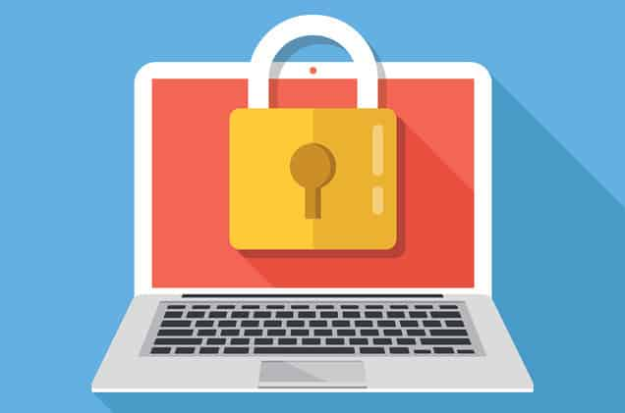
Social Problems
Privacy is a big issue
People feel forced to give up their privacy in order to use services (Schnier)
Decreased wait times
Lower patience threshold and attention span
People are more likely to give up on tasks that don’t immediately give positive feedback (“The Social Dilemma: Social Media and Your Mental Health”)

Slide 5
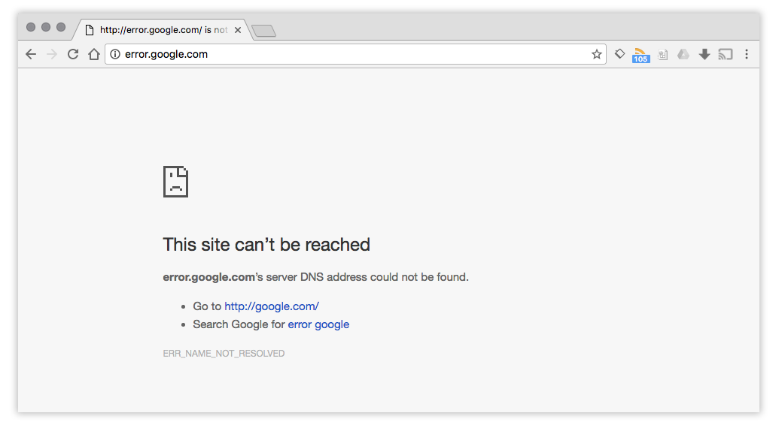
Political ramifications
Election Meddling
Either elect a favorable candidate or puppet leader
Recent election cycles (“Internet and Globalization”)
Censorship
Used to stay in control, slow/stop uprisings
Great firewall of China (“Censorship”)

Slide 6
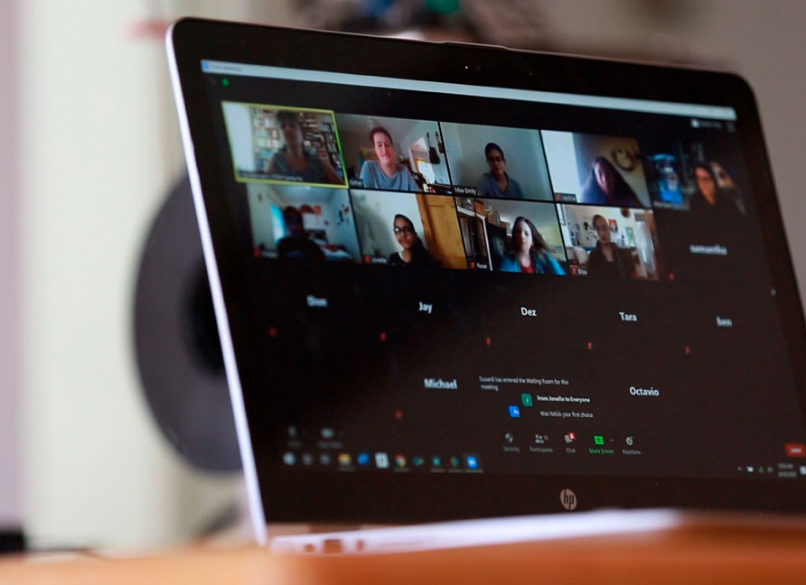
Emotional effects
Social Media
People compare themselves to an unrealistic representation (“The Social Dilemma: Social Media and Your Mental Health”)
Online Learning
Students have difficulty getting the attention they need, so their grades slip, resulting in lower motivation (Stringer)

Slide 7
How can you use the internet responsibly?
Protect your Privacy online
The easiest way to do this is by installing an ad blocker
You can also clear cookies regularly (this may be more complicated)
Be able to identify Censorship and Election meddling
Censorship is easiest to identify
To identify election meddling, you must listen carefully to the news (don’t trust just one source, make sure you hear it from multiple trustworthy sources)
Manage social media
If you find yourself regularly comparing yourself to other’s social media profiles, it might be time for a break

Slide 8
Works cited
"Censorship." Gale in Context: Global Issues, Gale, https://go.gale.com/ps/i.do?p=GIC&u=nhais_401&id=GALE|CX1837900077&v=2.1&it=r&sid=GIC&asid=16b1cf96. Accessed 13 Jan. 2021.
Gilbert, Zecharia. "The Internet's Impact on Our Mental Health." National Alliance on Mental Illness-Cook County Suburban Division, National Alliance on Mental Illness, 16 Oct. 2018, http://namiccns.org/2018/10/16/the-internets-impact-on-our-mental- health/. Accessed 14 Jan. 2021.
"Internet and Globalization." Gale in Context: Global Issues, Gale, https://go.gale.com/ps/i.do?p=GIC&u=nhais_401&id=GALE|CP3208520205&v=2.1&it=r&sid=GIC&asid=29b44283. Accessed 7 Jan. 2021.
Schneier, Bruce. "On Internet Privacy, Be Very Afraid." Interview conducted by The Harvard Gazette. The Harvard Gazette, Harvard University, 24 Aug. 2017, https://news.harvard.edu/gazette/story/2017/08/when-it-comes-to-internet-privacy-be-very- afraid-analyst-suggests/. Accessed 14 Jan. 2021.
"The Social Dilemma: Social Media and Your Mental Health." Mclean Hospital, 10 Nov. 2020, www.mcleanhospital.org/essential/it-or- not-social-medias-affecting-your-mental-health. Accessed 13 Jan. 2021.
Stringer, Heather. "Zoom School's Mental Health Toll on Kids." American Psychological Association, 13 Oct. 2020, www.apa.org/news/apa/2020/10/online-learning-mental-health.

Slide 9
Works cited (Images)
Attanasio, Cedar. “Remote Learning.” NJ Spotlight, NJ Spotlight News, www.njspotlight.com/2020/08/njs-powerful-teachers-union-says- remote-learning-this-fall/.
“Computer with Padlock.” MalwareBytes, MalwareBytes, blog.malwarebytes.com/privacy-2/2019/12/new-consumer-online- privacy-rights-act-copra-would-empower-consumers/.
“ENIAC Changing a Tube.” Wikimedia Commons, 23 Dec. 2009, commons.wikimedia.org/wiki/File:ENIAC-changing_a_tube.jpg.
“Great Firewall of China Blocking Google.com.” Vpnclientapp, VPN Client App, vpnclientapp.com/blog/great-firewall-of-china/.

