Slide 1

FINAL PROJECT
Forecasting Monthly “Time-Series” Related Questions on the Stack Exchange
Stats 415
Andrew Mashhadi
Spring 2023

Slide 2



Introduction
Stack Exchange is a network of Q & A websites.
Since 2008, they have grown as one of the most used networks for programming and mathematics questions.
Every posted question may contain various tags to help locate other interested users.
Time Series Analysis:
Topic within mathematics and statistics that encompasses techniques for examining or modeling data points arranged in chronological order.
The recent surge in machine learning and data science has sparked a renewed interest in this subject.
Also happens to be the topic of this course ☺.
In this study, we aim to analyze and model the monthly count of Stack Exchange questions tagged with “time-series”.

Slide 3
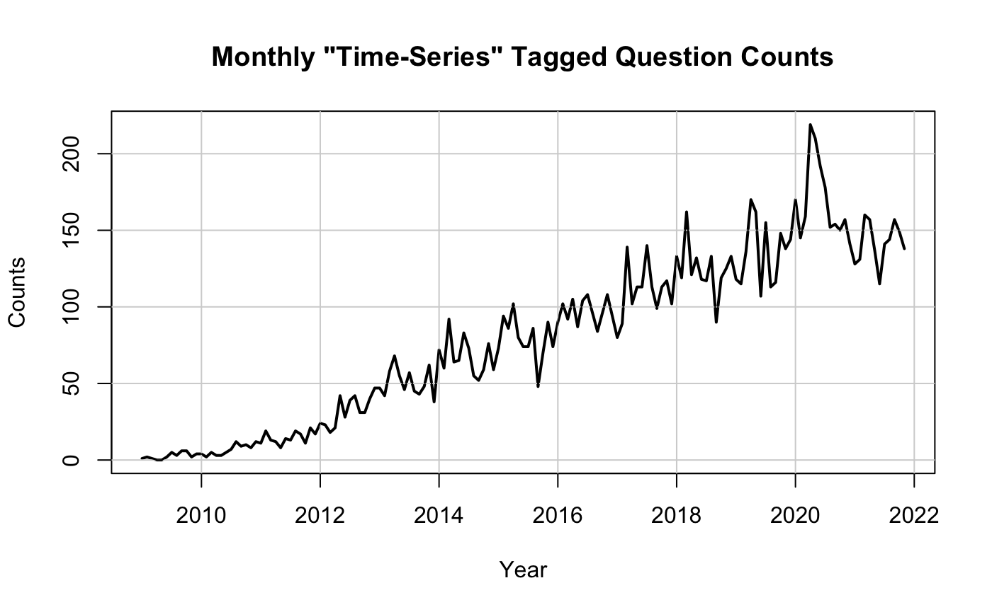
Data
The Stack Exchange provides an open source tool known as the Stack Exchange Data Explorer for running arbitrary SQL queries against public data from the Stack Exchange network.
We collected the monthly counts of Stack Exchange questions tagged with “time-series”. In other words, our data is the number of time series related questions for each available month.
The data consisted of monthly counts from January 2009 to May 2023 (n=173), with no missing entries.
First 90% (Jan. 2009 - Nov. 2021) used for training and remaining 10% (Dec. 2021 - May 2023) was used as ”unseen” testing set.
Notice the rising trend in monthly counts!
COVID-19

Slide 4
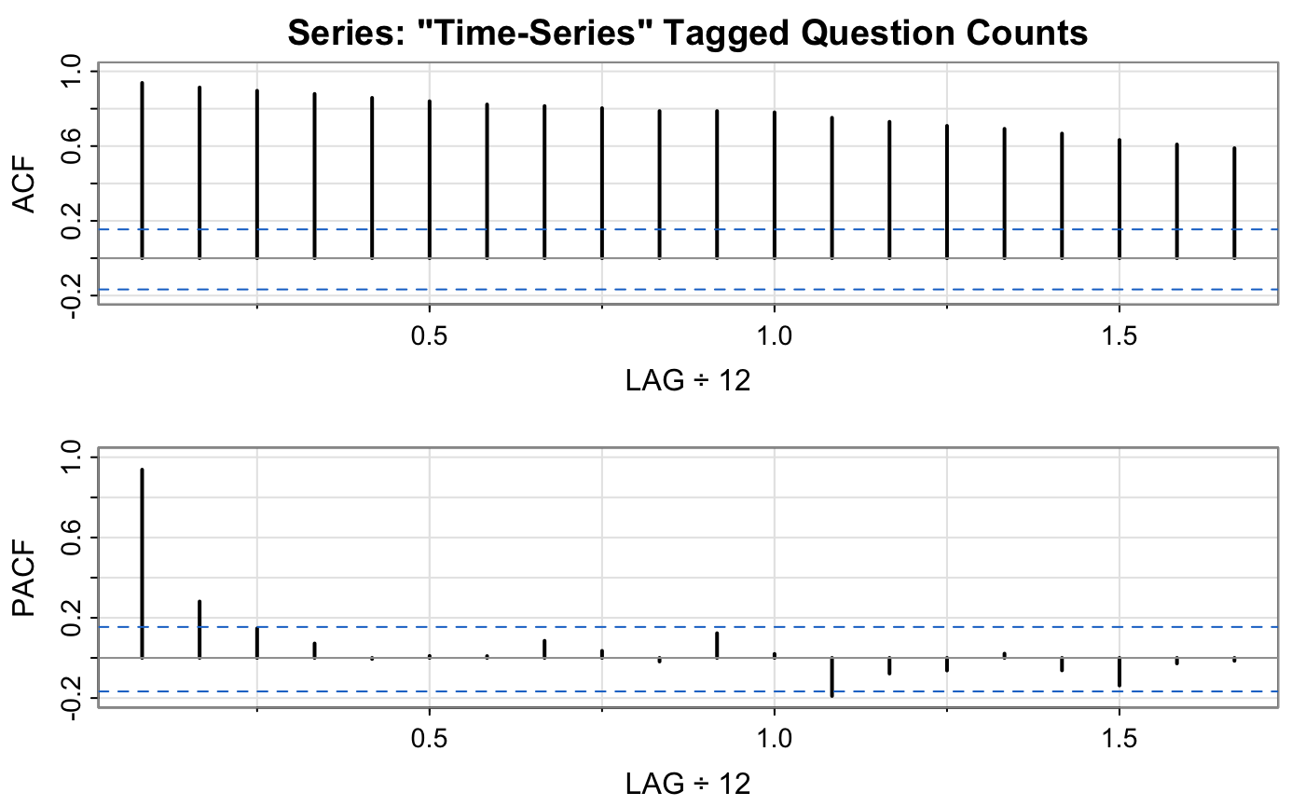
Data
Large ACF values displayed in the top plot indicate that the data is currently being dominated by the trend.
Assuming our data is trend stationary, the strong trend will likely obscure the behavior of the associated stationary process and introduce extremely low frequency components in a periodogram.

Slide 5
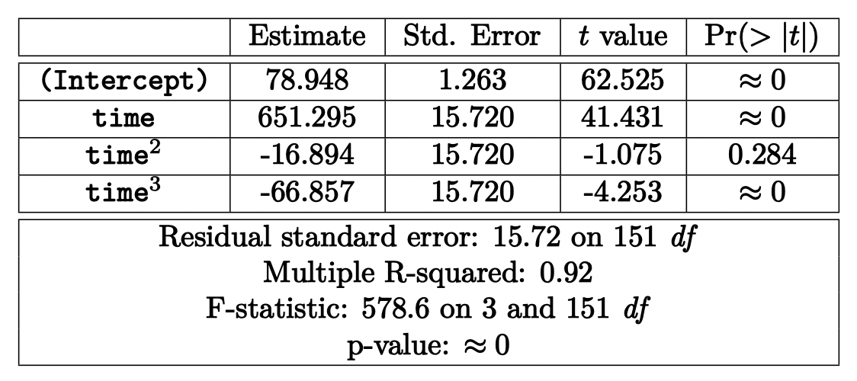
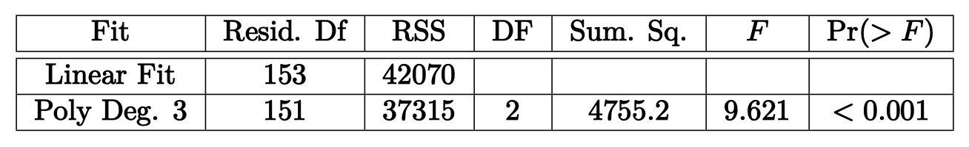
Removing Trend
Trend must be removed before we can conduct much of our analysis and modeling.
Fit a linear model and a 3rd degree polynomial.
Found that the 3rd degree polynomial has a significantly better fit
Polynomial Regression Summary
Analysis of Variance Table

Slide 6
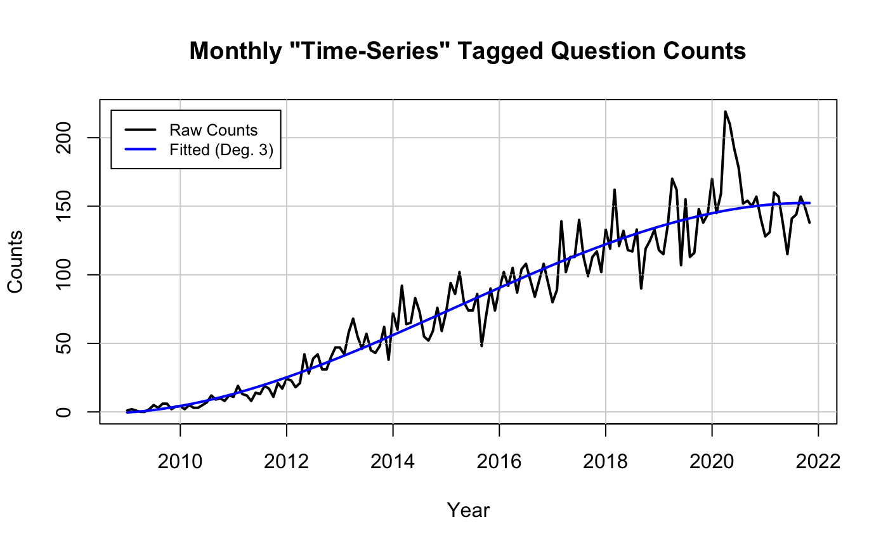
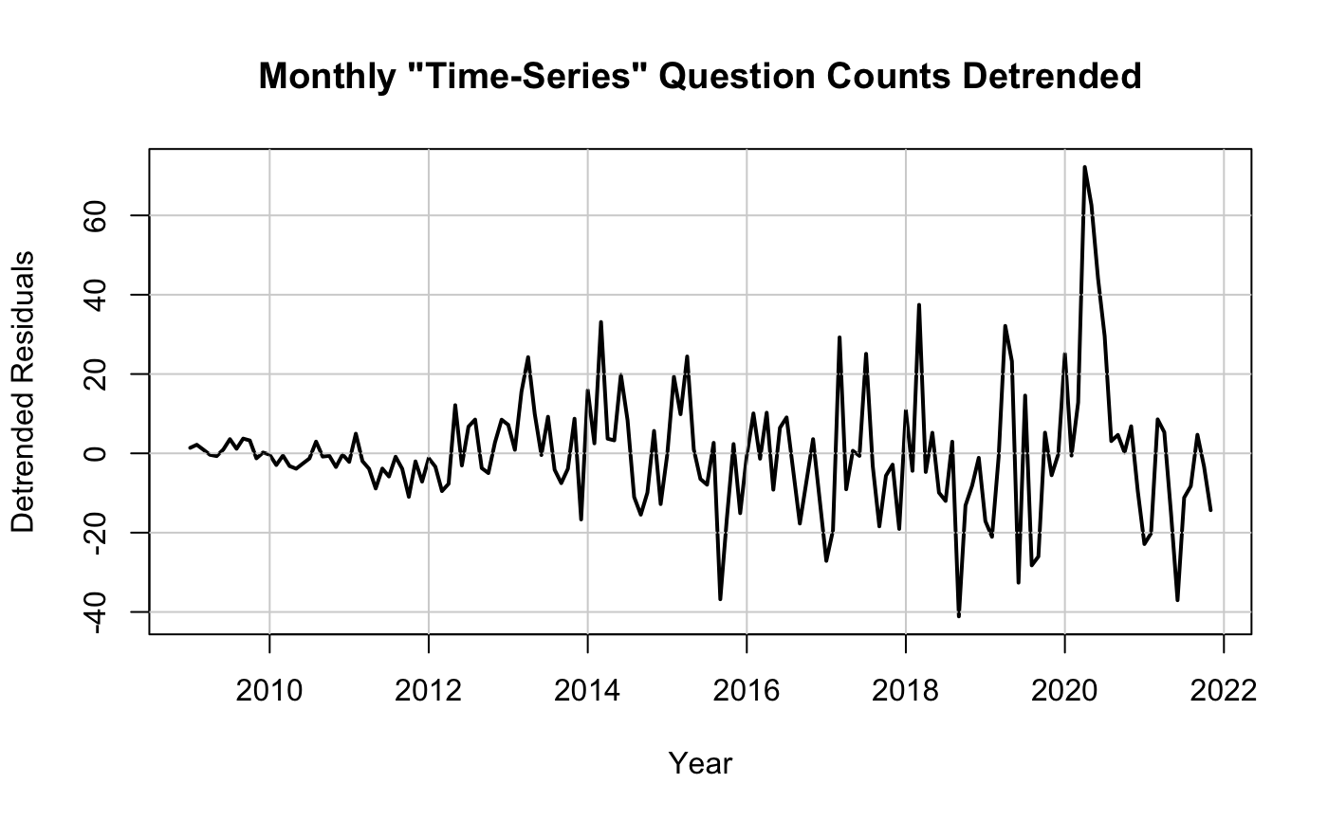
Removing Trend

Slide 7
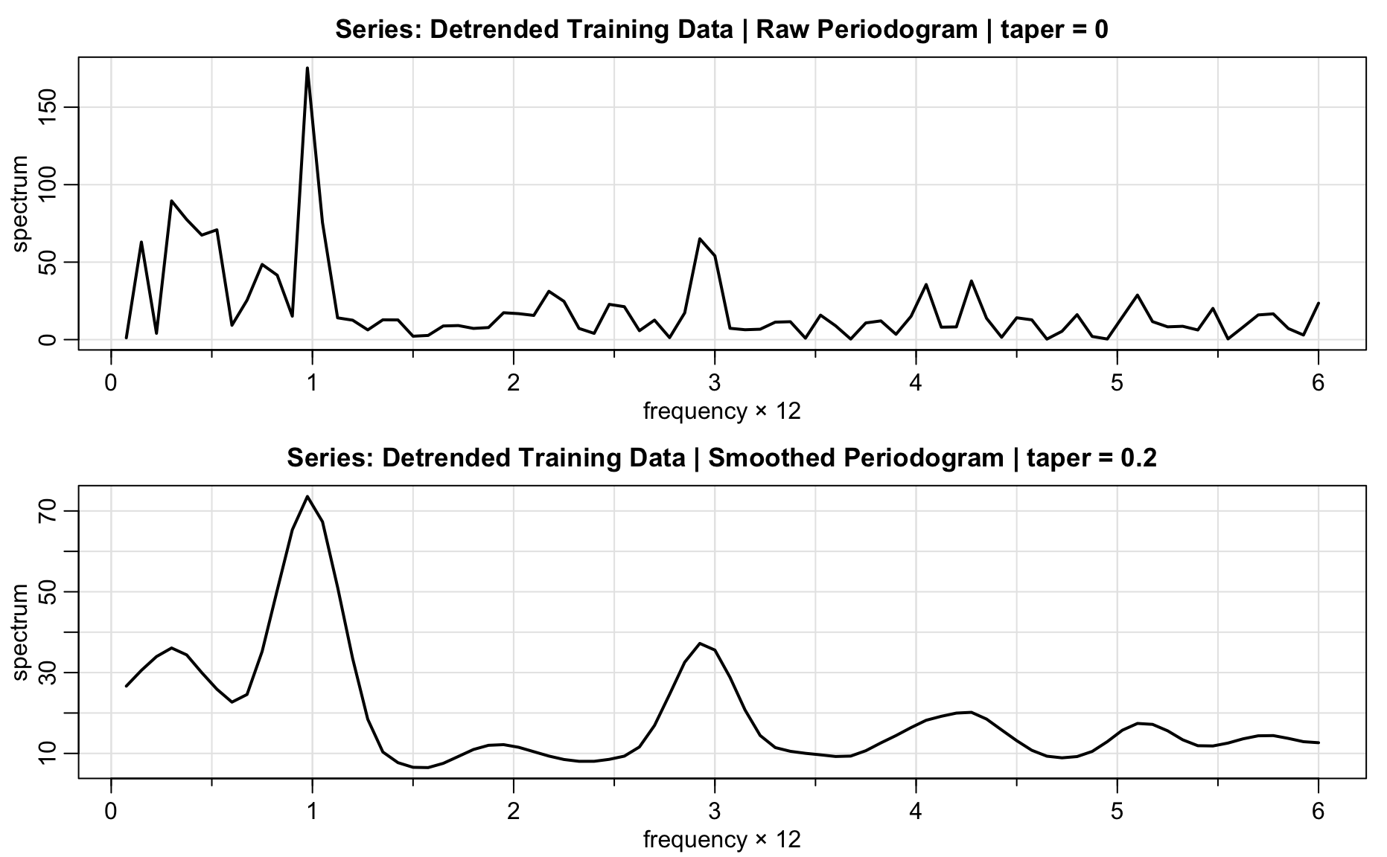
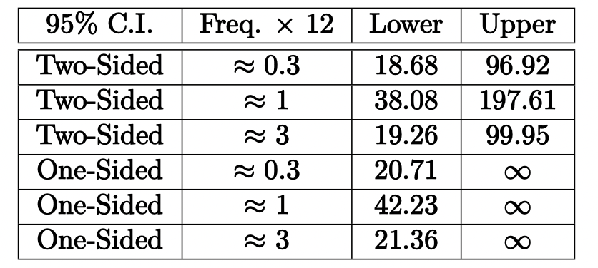
Spectral Analysis
We estimated the spectrum of our detrended training data to help us determine predominant periods and to obtain approximate confidence intervals for the identified periods.
Confidence Intervals (Non-Parametric)

Slide 8
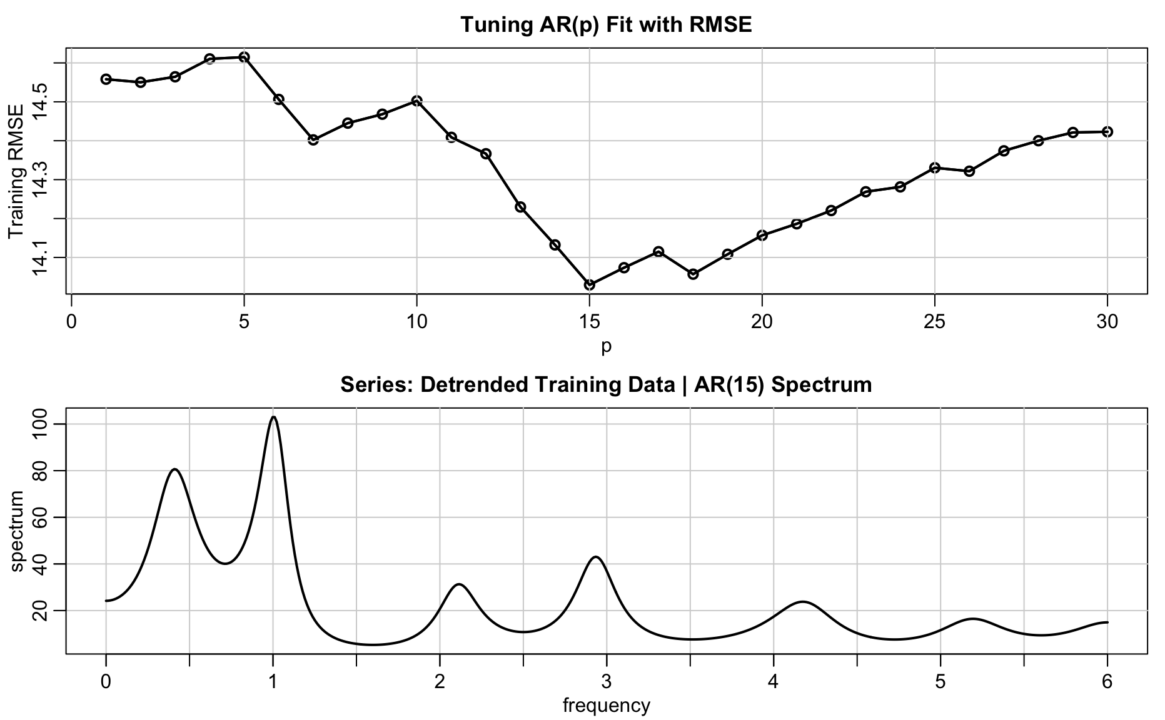
Spectral Analysis
Also used autoregressive spectral estimator, with an AR(15).
Autoregressive spectral estimators generally have superior resolution in problems when several closely spaced narrow spectral peaks are present, giving us more confidence in our identification of the 40-month cycle.
We assessed the possibility that the apparent 4-month cycle is a harmonic.

Slide 9
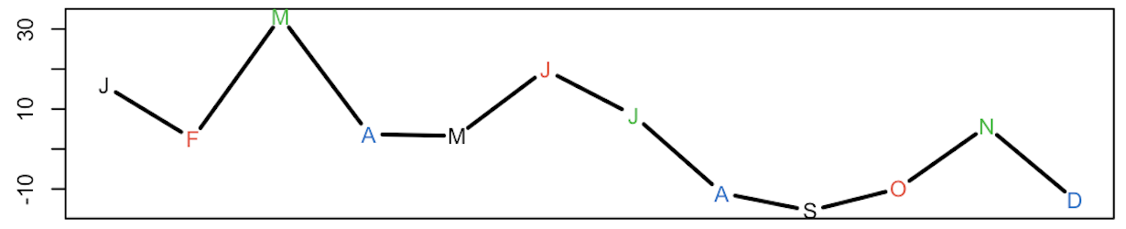
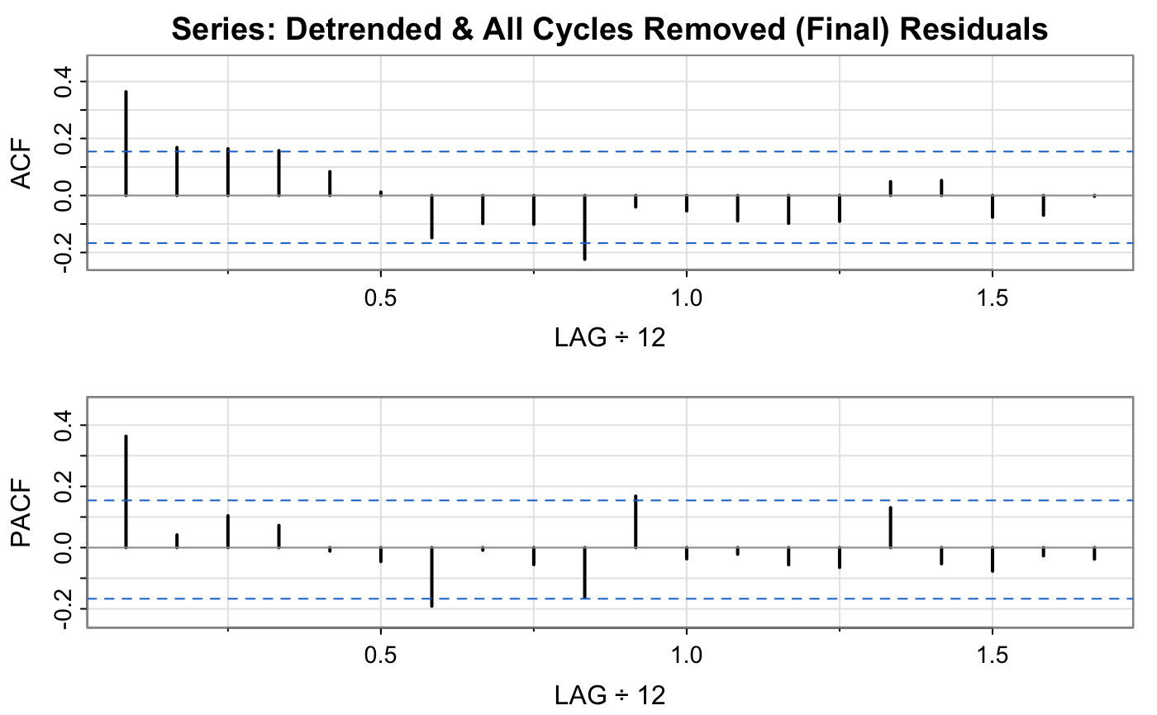
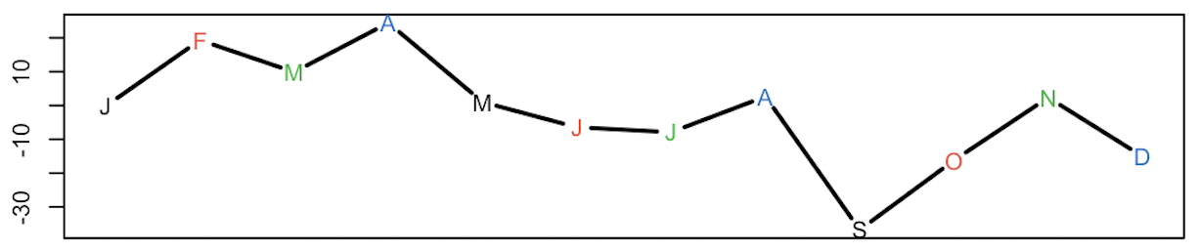
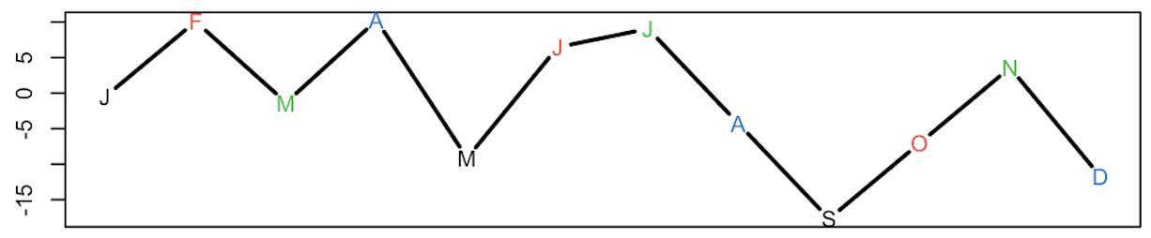
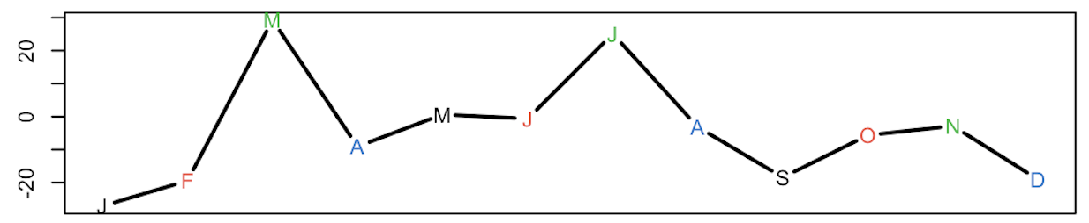
Spectral Analysis
Iteratively removed all three cycles by subtracting the associated monthly averages from the detrended data.
Detrended Residuals from 2014-2017

Slide 10
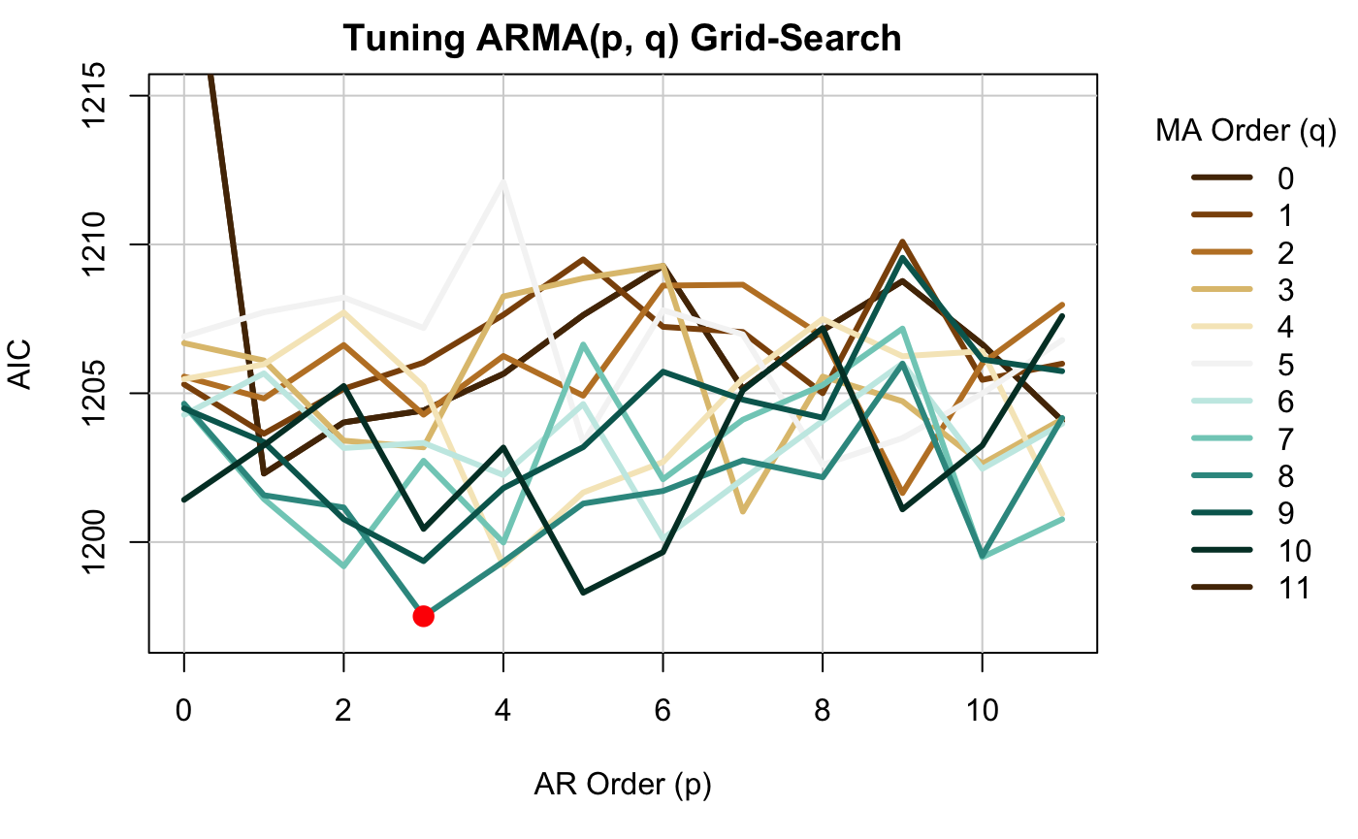
Modeling
We proceeded to fit ARMA models on the detrended and cycle-removed training data.
Used grid search with the Akaike Information Criterion (AIC) as the tuning metric.
The ARMA(3, 8) model achieved the lowest AIC score of 1197.51.
Final Model:

Slide 11
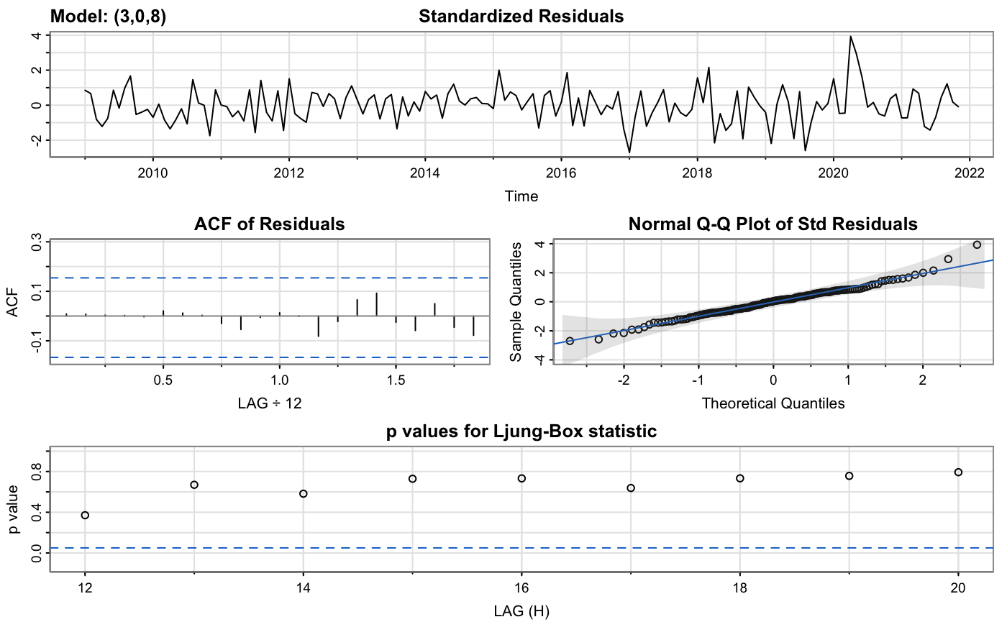
Modeling
No discernible patterns and only one outlier > 3 in 2020
No deviations from our model assumptions
Reasonable adherence to the assumption of normality
Q-statistics remained non-significant across the lags

Slide 12
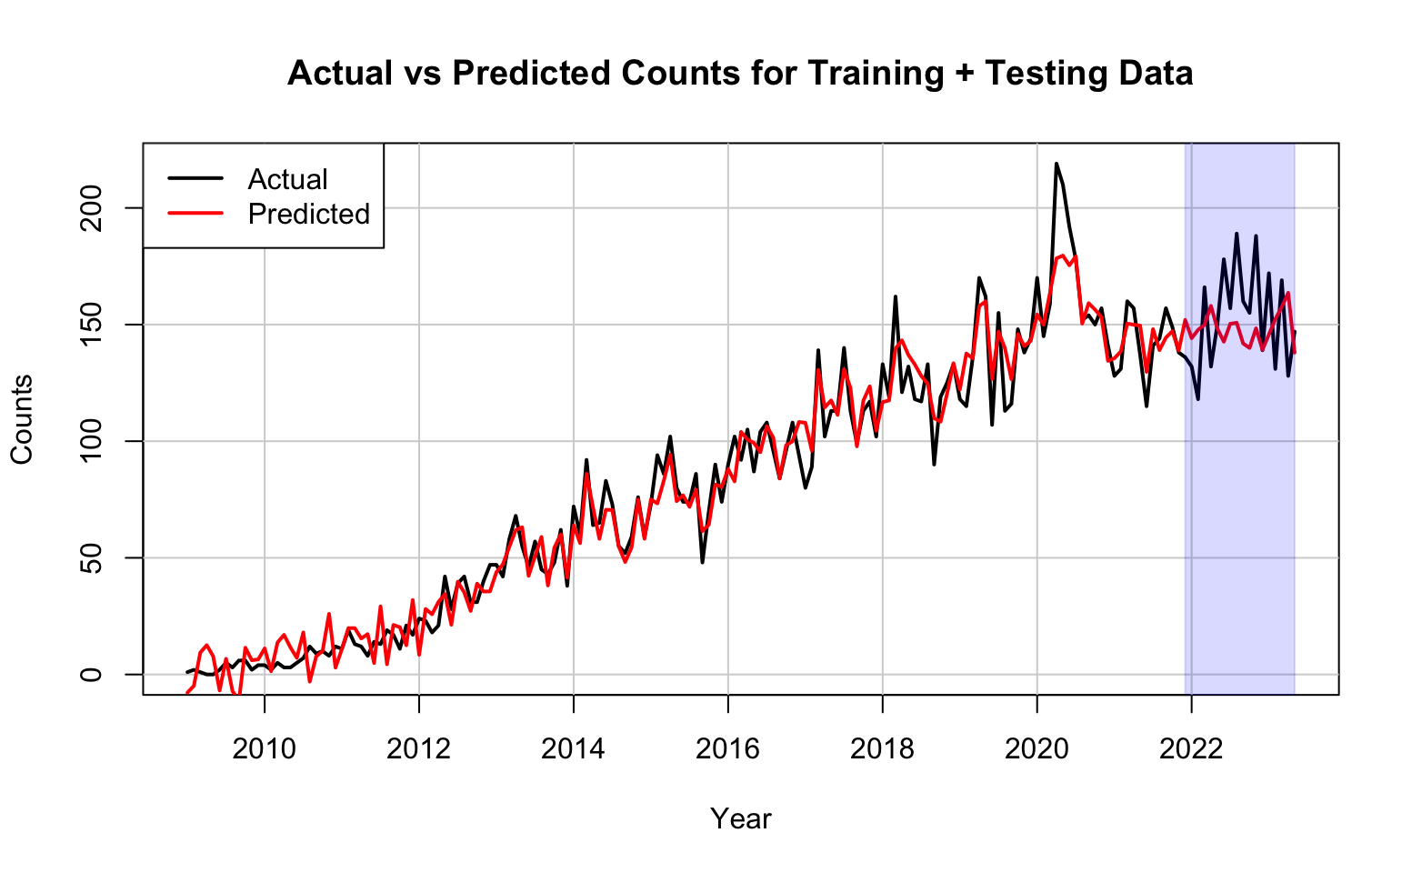
Predictions & Forecasting
Generated predictions from our ARMA(3, 8) model for both the training data and the testing data, with trend and cycles added back.
Predictions for the test set used an 18-step long-term forecast horizon.
Predictions fit the data well, with slightly larger error over the testing range.
Training RMSE = 10.34 counts
Testing RMSE = 23.25 counts
COVID-19 pandemic may have introduced an unanticipated increase in time-series interest.

Slide 13
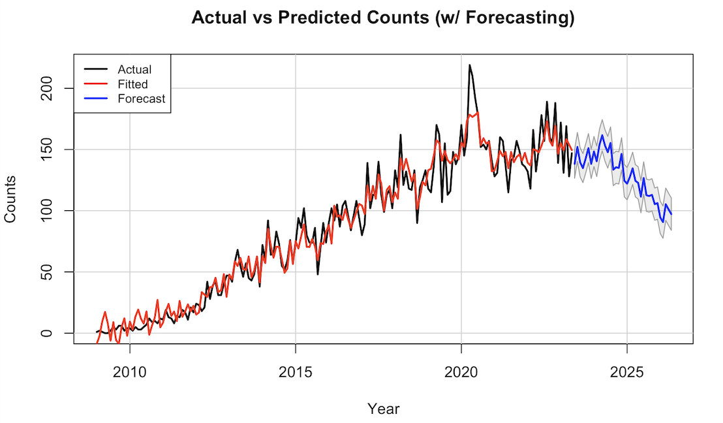
Predictions & Forecasting
Retrained model using all available data to generate forecasts extending up to May 2026.
Retrained with testing data to maximize data utilization and ensure the model’s up-to-dateness prior to forecasting.
Another long-term, 36-step, forecast horizon.
Our 3-year forecast indicates that the number of questions tagged as “time-series” will plateau within the next year and will gradually decline until May 2026.

Slide 14
Conclusion
In summary, we collected the data from the Stack Exchange Data Explorer, removed trend, removed the three observed cycles, then found the optimal ARMA model using the minimum AIC.
We assessed our fitted model’s performance using a variety of plots, diagnostics, tests, and performance metrics. The RMSE scores reported for the training and testing data were 10.34 counts and 23.25 counts, respectively.
These scores, coupled with the generated figures discussed earlier, indicated an excellent fit of our model and reasonable predictive capability for future counts of “time-series” tagged questions.

Slide 15
Future Work
Stack Exchange has only been around since 2008, limiting available data to just n = 173:
Future studies should consider exploring additional data sources with a longer time span or higher frequency of collection (e.g., daily or weekly).
COVID-19 clearly impacted the monthly counts of “time-series” tagged questions:
It would be interesting to conduct a similar analysis specifically for the period after 2020 in order to compare it with our existing model and to assess the impact COVID-19 had on the interest in “time-series”.
The slight downward trend observed in our forecasts may be attributed to the polynomial fit of the trend in our data:
Polynomial fits typically struggle with extrapolation, as they tend to diverge rapidly when extending beyond the observed time range.
Future work should consider alternative methods for trend fitting to mitigate this limitation.

