Slide 1
Exporting Graphs and Tables to PowerPoint from Stata
An example using the Gapminder data set
Andrew M. Camp

Slide 2
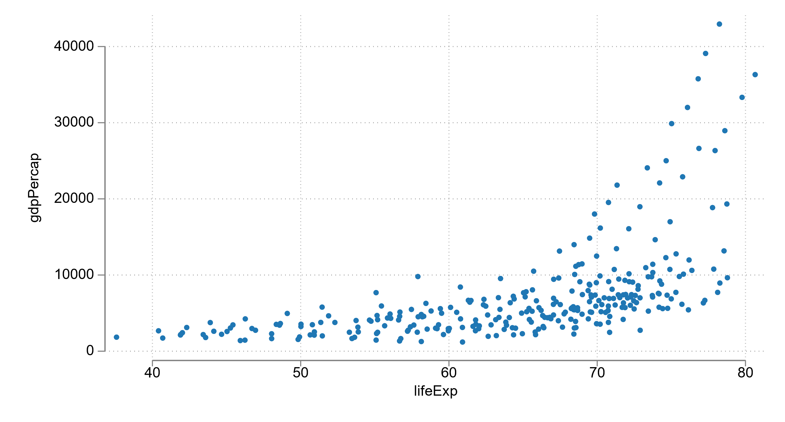

Slide 3
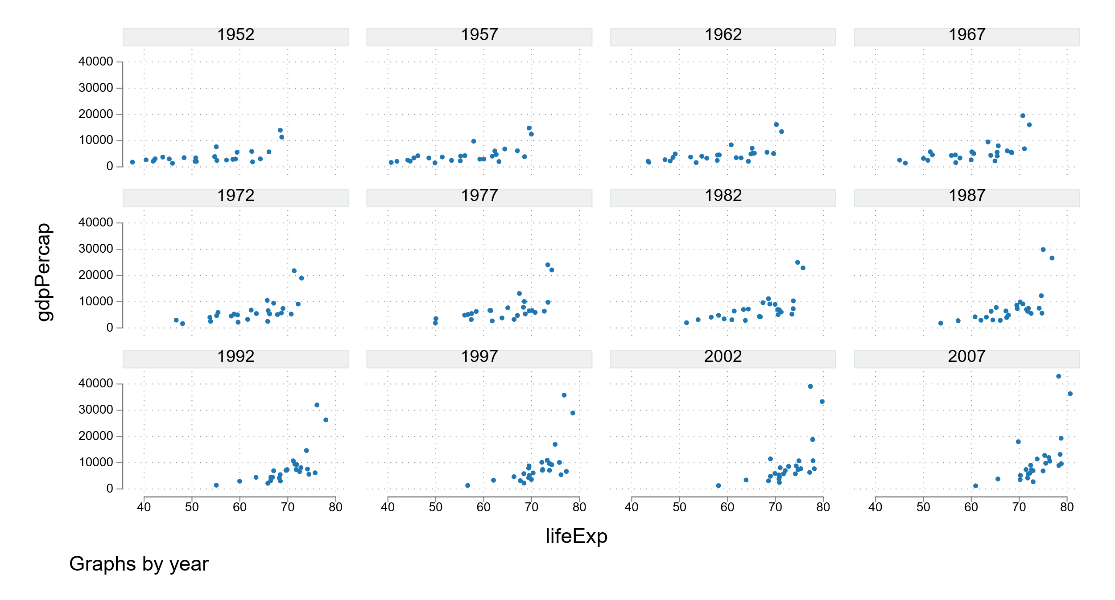

Slide 4
