Slide 1
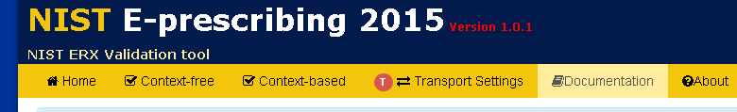
Instructions to Use NIST SUT Simulator
Use 2 Browsers, one will be the System Under Test (SUT), the other NIST ONC Certification Test Plan
You will configure the System Under Test (SUT) with the Username, Password and Endpoint from the NIST ONC Certification Test Plan using Transport Settings Tab in browser 1
-- This allows communication from NIST → SUT
You will configure the NIST SUT Test Plan with the Username, Password and Endpoint from the System Under Test (SUT) using the same tab in in browser 2
– This allows communication from SUT→ NIST
You will start the receiving system in listening mode clicking the green square, the listening system will have a tan box with white square
You will then click the send button in the sending system, the send button is the green square with the arrow with NO tan box
This will continue, and based on whether the system is a sender or recover, you will press the appropriate button

Slide 2
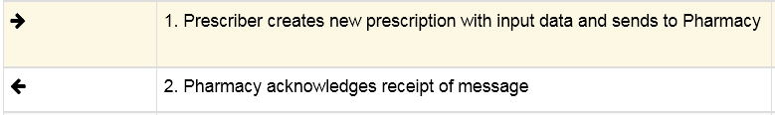

The NIST Test Tool simulates the Pharmacy
The SUT is the Prescriber
SUT
NIST
This direction arrow represents communication from the SUT to the NIST Test tool
This direction arrow represents communication from the NIST Test Tool to the SUT
We will be using the NIST tool playing the role of SUT, this may get confusing.
I recommend you use a different vendor’s browser for the SUT role, so you do not get confused, for example, have the NIST Test tool in Firefox, and the SUT in Chrome.

Slide 3
Instructions (Do each side in order)
NIST Test Tool (Firefox Browser)
Go to http://erx-2015.nist.gov
Click on Transport Settings Tab
SUT (Chrome Browser)
Go to http://dev-erx-testing.nist.gov
Click on Transport Settings Tab

Slide 4
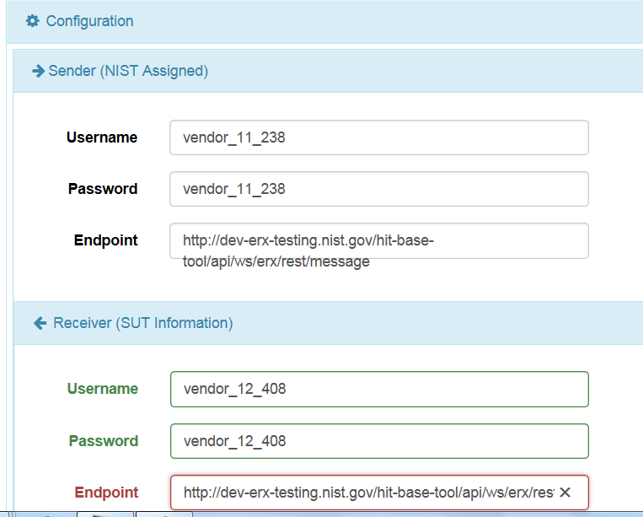
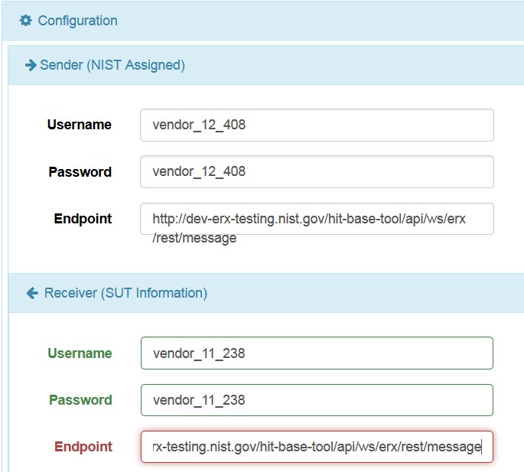
Instructions (Do these one step at a time)
3. Copy-paste endpoints to the other browser
Copy paste from one window to the other

Slide 5
Instructions (Do these one step at a time)
NIST Test Tool (Firefox)
4. Click Save
SUT (Chrome)
5. Click Save
The communication is now established and will remain thorough out the session until you close the browsers. You can run as many scenarios as you like.

Slide 6
Instructions (Do each side in order)
NIST Test Tool (Firefox Browser)
Click Context-based
Click on ONC Certification Test Plan
Click Change Prescription Tests
Click Change Scenario 1
Click on the EDI Text, you will see a Load Test Case button
Click Load Test Case button, all test cases appear
SUT (Chrome Browser)
Click Context-based
Click on SUT Simulator
Click Change Prescription Tests
Click Change Scenario 1
Click on the EDI Text, you will see a Load Test Case button
Click Load Test Case button, all test cases appear

Slide 7

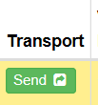

Instructions (Do these one step at a time)
NIST Test Tool (Firefox)
Click Green Listen Button
Message will appear in Validation window and be validated.
21. Click “Next”
SUT (Chrome)
Click Send Button
20. Click “Next”

Slide 8
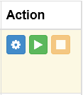
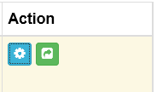

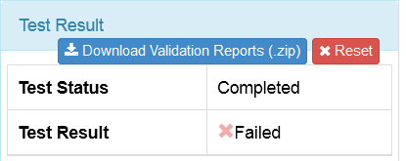
For each subsequent step, you will ping-pong back and forth depending on which system is the
sender and which is the receiver, Listening Steps have the Tan Box.
Make sure systems are ready, no “Next” button, click Next if it is there.
Click the Green button on the Receiver to listen, look for tan box
Click the Green button on the Sender to send message, NO tan box
At the final Step you see the Complete button , Click on it
At top Right you will be able to download all validation reports for each step:
Click “Reset” on both systems to restart the test.
This will work for All scenarios.

Slide 9
For each subsequent step, you will ping-pong back and forth depending on which system is the
sender and which is the receiver, Listening Steps have the Tan Box.
Make sure systems are ready, no “Next” button, click Next if it is there.
Click the Green button on the Receiver to listen, look for tan box
Click the Green button on the Sender to send message, NO tan box
At the final Step you see the Complete button , Click on it
At top Right you will be able to download all validation reports for each step:
Click “Reset” on both systems to restart the test.
This will work for All scenerios.

