Slide 1
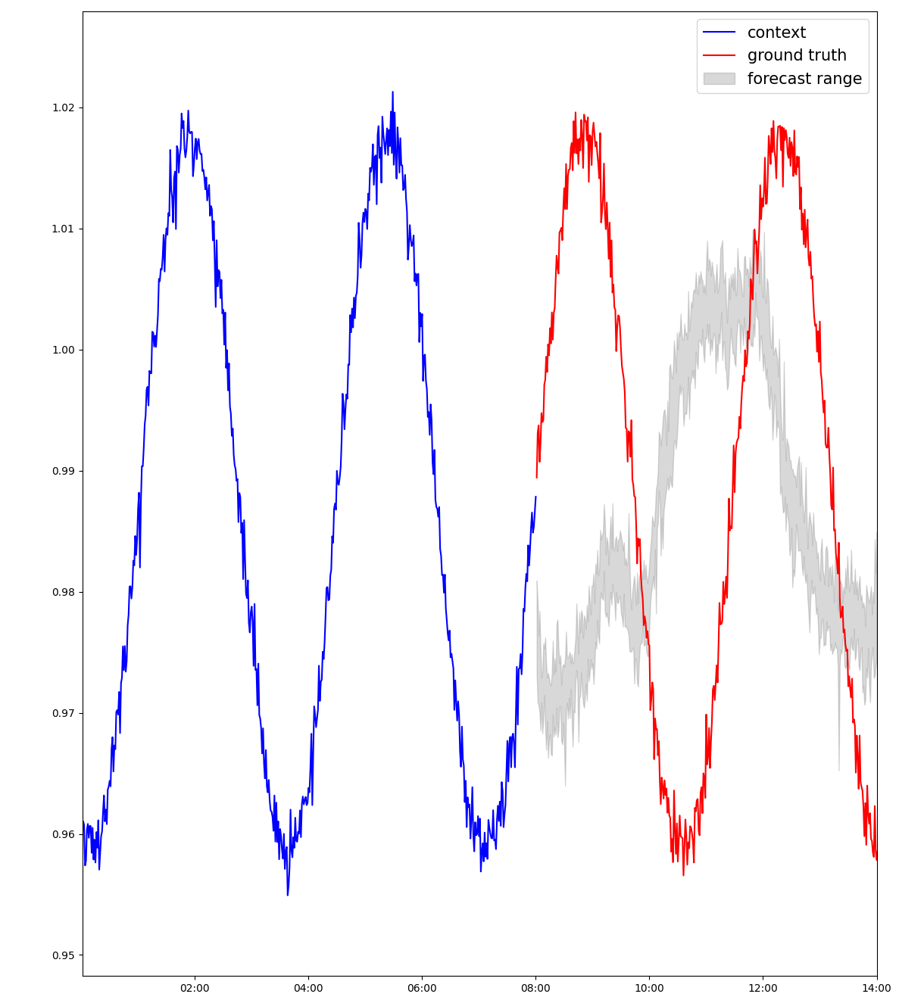
Version 32 checkpoint. 100 epoch
training_data=datasets.train,
validation_data=val_data,
cache_data=True,
shuffle_buffer_length=7000,
num_workers=4,
batch_size=64,
epochs=max_epochs,
learning_rate=1e-4,
early_stopping=True,
checkpoint_callback=checkpoint_callback
ckpt_path="lag-llama/lag-llama.ckpt",
prediction_length=prediction_length,
context_length=context_length,
scaling="mean",
nonnegative_pred_samples=True,
batch_size=64,
num_parallel_samples=num_parallel_samples,
input_size=estimator_args["input_size"],
n_layer=estimator_args["n_layer"],
n_embd_per_head=estimator_args["n_embd_per_head"],
n_head=estimator_args["n_head"],
time_feat=estimator_args["time_feat"],
trainer_kwargs={"max_epochs": max_epochs},

