Slide 1
ceol-gpt
A transformer that writes Irish folk tunes
Andrew McKnight · CS 372 · Spring 2026

Slide 2
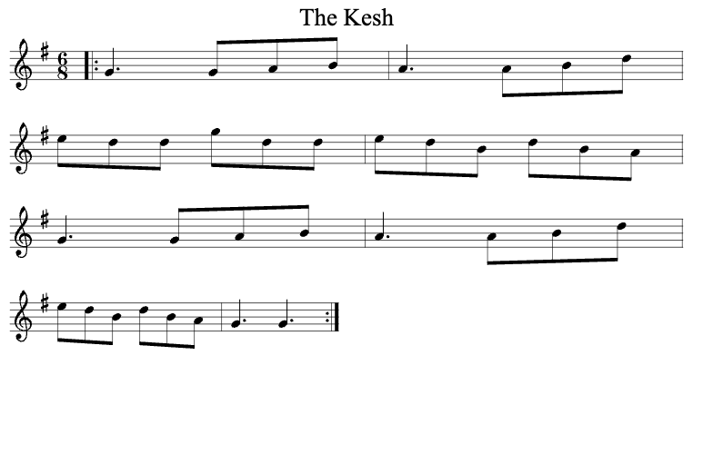
ABC notation: text in, sheet music out
ABC NOTATION (TEXT)
RENDERED SHEET MUSIC
X:1
T:The Kesh
M:6/8
L:1/8
K:Gmaj
|:G3 GAB|A3 ABd|
edd gdd|edB dBA|
G3 GAB|A3 ABd|
edB dBA|G3 G3:|
[ Paste screenshot of the rendered
staff here — abcjs.net/abcjs-editor ]
→
Same tune, two representations. The model reads and writes the left.

Slide 3
Why this is interesting
1
Generative models for structured creative domains
Not just chat or images — symbolic music has its own grammar to learn.
2
A living oral tradition
Composition has always been part of Irish music. New tunes enter the repertoire constantly.
3
A tool for musicians
Give it a tune type and a key, get a starting point you can take to the session.

Slide 4
What works · what still fumbles
WORKS
STILL FUMBLES
✓
Stays in the right key and meter
!
Long-range coherence — B parts can wander
✓
Phrase length and bar structure feel right
!
Occasionally awkward fingering for the instrument
✓
Standard cadences (turning on the dominant)
!
Sometimes generates an unusual ornament choice
✓
Outputs are playable on a real instrument
!
Endings are unnatural at times
Honest take: surprisingly idiomatic for a from-scratch model trained in a single project.

Slide 5
ceol-gpt
Code, model weights, and the technical walkthrough:
github.com/andrewmcknight/ceol-gpt
Thanks for watching.

