Slide 1
Case Study 2 – Attrition at Frito-Lay
Andrew Mejia
DDS Case Study 2

Slide 2
Project Objectives
Find the 3 most influential factors in attrition
Identify any interesting job trends
Provide a model to predict employee turn over (attrition)
Provide a model to predict employee monthly income

Slide 3
Data Set
35 variables
1 target response of Attrition
1 target response of Monthly Income
Examples of variables
Monthly Income (Attrition Model Only)
Distance from home
Gender
Highly imbalanced data set
Large proportion of retains vs attrites
730 Nos Vs 140 yes
Over come this by up-sampling techniques for creating a test train data split for model fitting

Slide 4
Immediate Exclusions
ID
This is the ID of the observation within the data set
Over 18
This is a variable indicating whether the observation, in this case, employee is over the age of 18.
All observations in this data set are over the age of 18

Slide 5
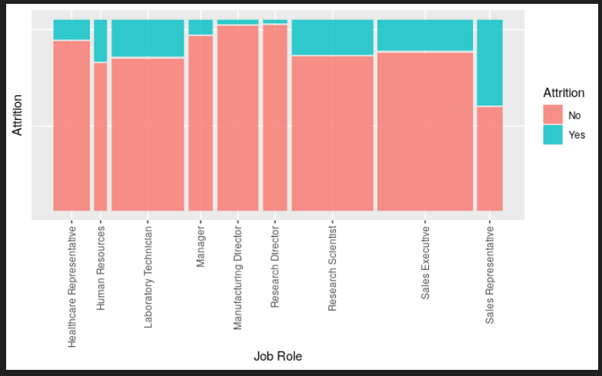
Top 3 Factors leading to Attrition
Lets look at the proportions

Slide 6
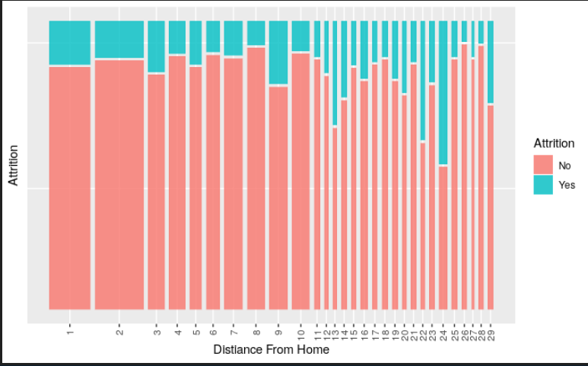
Distance from Home

Slide 7
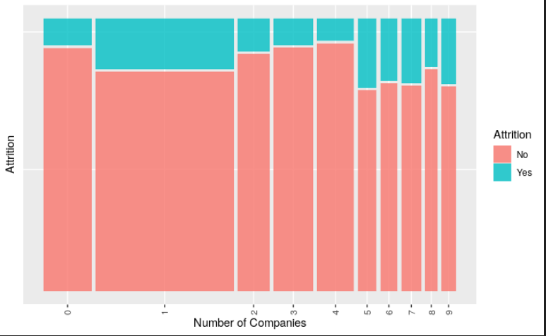
Number of Companies Worked

Slide 8
Model for predicting Attrition
Model Type | Overall Accuracy | Sensitivity | Specificity | Recommend
KNN | 69.30% | 77.31% | 64.93%
NB Model | 71.52% | 62.03% | 81.01%
Logistic Regression | 78.16% | 77.64% | 78.69% | X

Slide 9
Specific Roles
Lets come back to Job Roles
The odds of a research scientist attrites over the odds of a research scientist staying is 6.78 times.
The odds of a research director attrites over the odds of a research director staying is 1.78 times.
Really would want to review the HR job odds ratio, odds of attriting is 8.55 e+6 times over the odds of staying. This could be an outlier and requires further analysis.

Slide 10
Influential variables for salaries
Total Working Years
Job Role
Job Level
Overall model RMSE performance is $1101

Slide 11
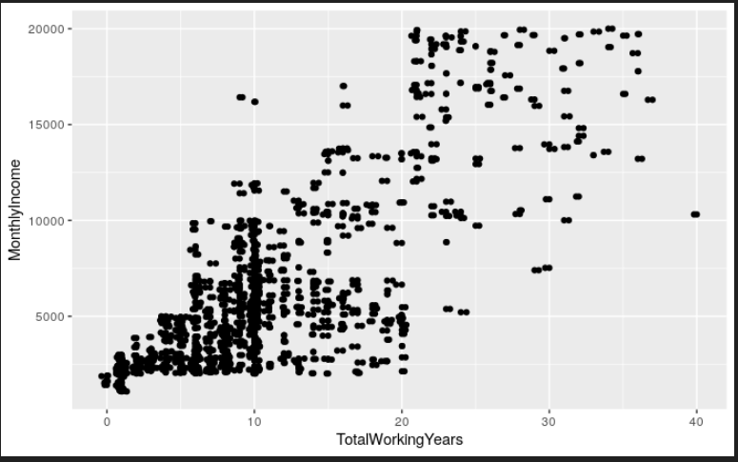
Total Working Years
Strong Linear Relationship
Correlation of 0.779

Slide 12
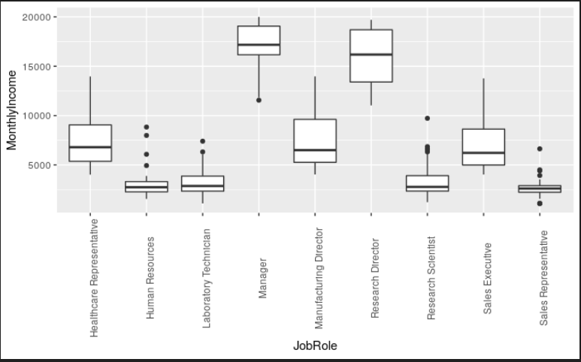
Job Role
.78 correlation

Slide 13
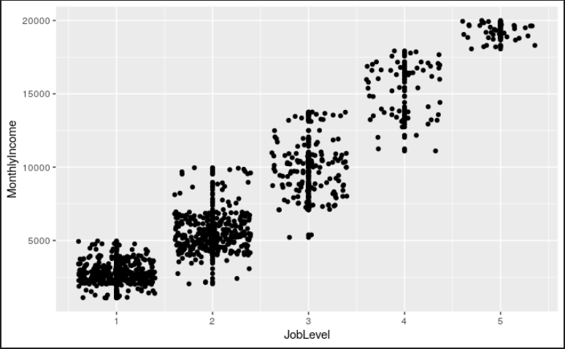
Job Level
.952 Correlation

Slide 14
Further Areas of Research
Review HR job role for outliers
Review high risk odds ratios of attrition

