Slide 1
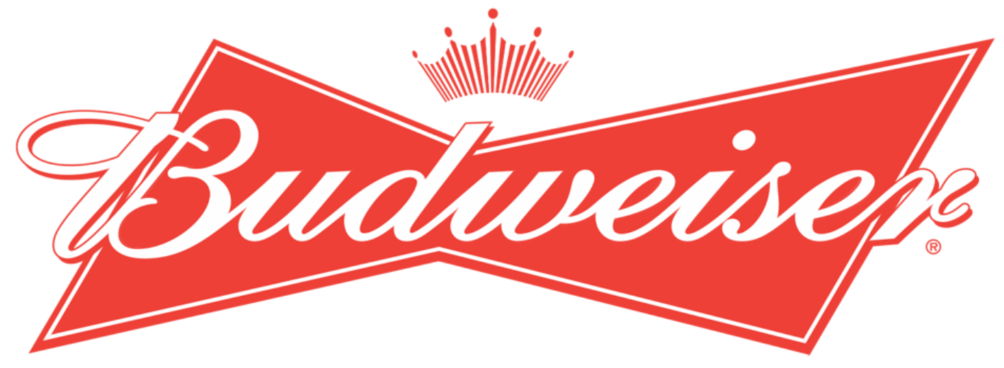
Analytic report for Budweiser
Brewery and Beer analysis
Andrew Mejia, Andrew Larsen and Brian Gaither

Slide 2
Evaluating the datasets
Two datasets were used for this analysis
Beers.csv
Breweries.csv
These datasets were merged on Brewery_id=Brew_ID
Resulting in 2,410 total observations
There are two columns that contains NA's
ABV has 62 NA's
IBU has 1005 NA's
We removed NA's from the dataset when performing classification and correlation using ABV and IBU

Slide 3
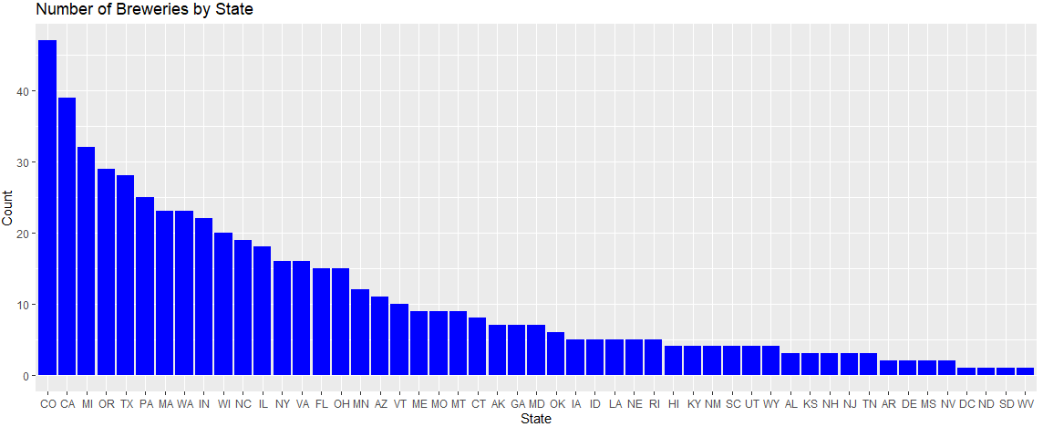
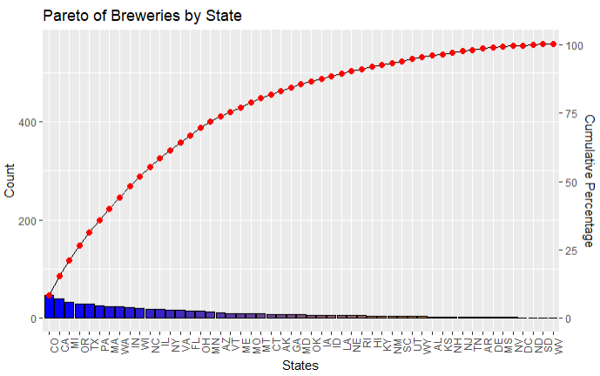
Breweries by State
50% of all Breweries
558 Breweries across all states
Colorado has the largest number of breweries with 47
25% of all breweries are within four states
Colorado
California
Michigan
Oregon
50% of all breweries are within 9 states as noted in top chart
25% of all Breweries

Slide 4
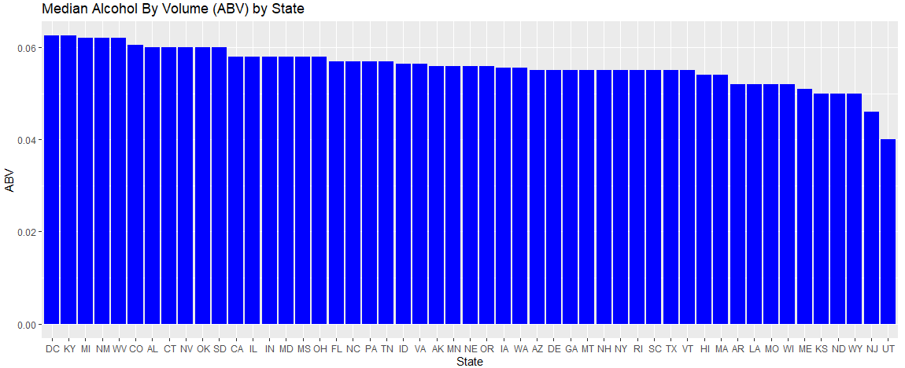
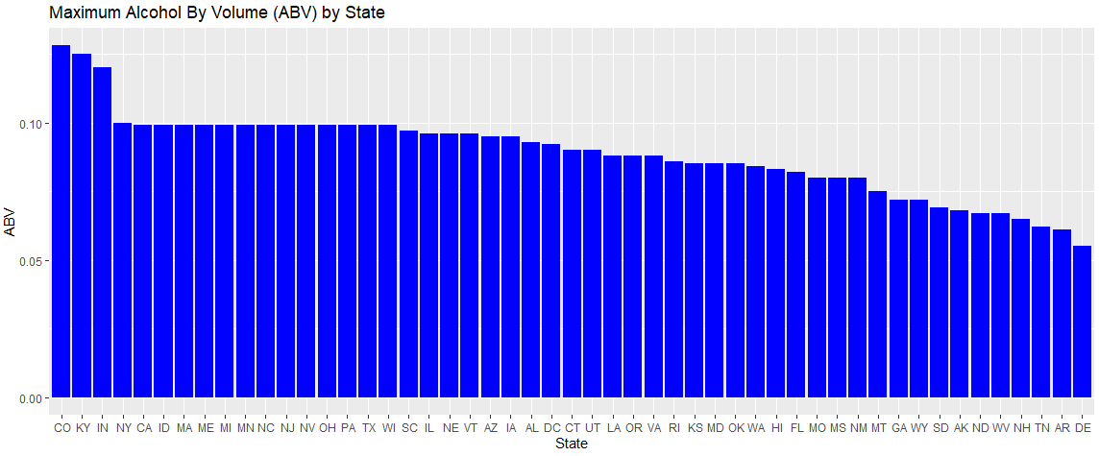
ABV by State comparison
Generally, breweries by state have a relatively similar Median ABV
States like Delaware have low variance across beers with regards to ABV where the max and median are nearly the same

Slide 5
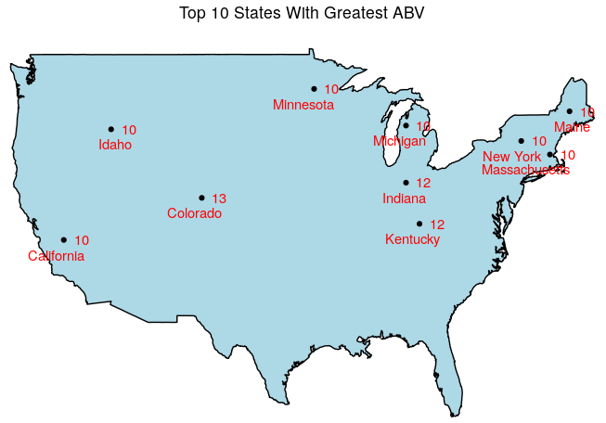
ABV Top 10 state comparison
However, three states have significantly higher Max ABV
Colorado (highest Max ABV at 13%)
Kentucky
Indiana

Slide 6
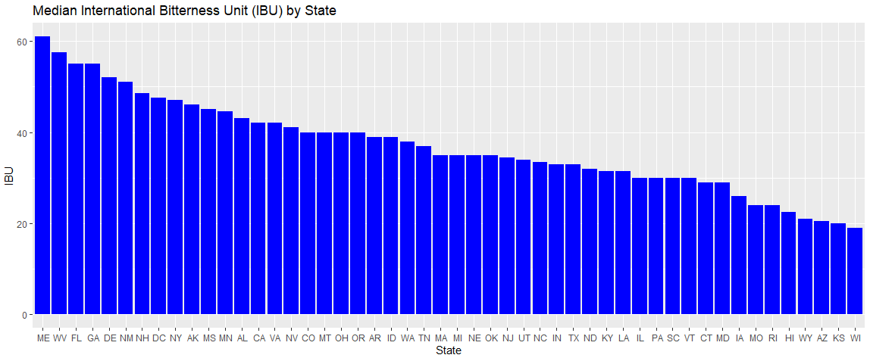
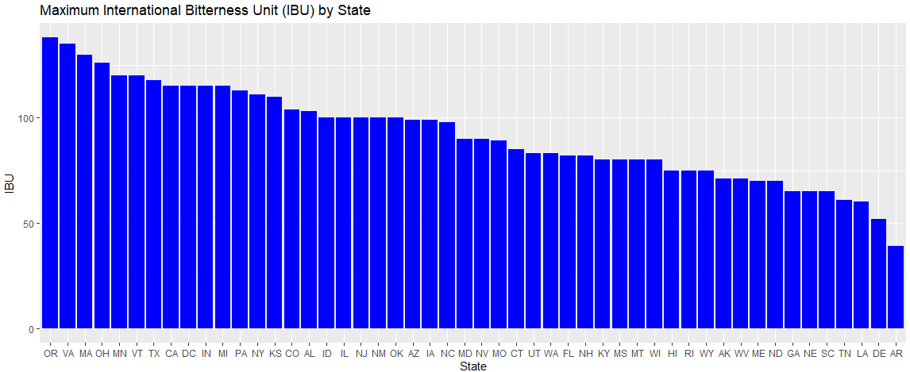
Ibu by state comparison
Median IBU varies drastically across state breweries from 20 to 60 IBUs
Maximum IBU follows a similar trend across state with Oregon having the max IBU at 138

Slide 7
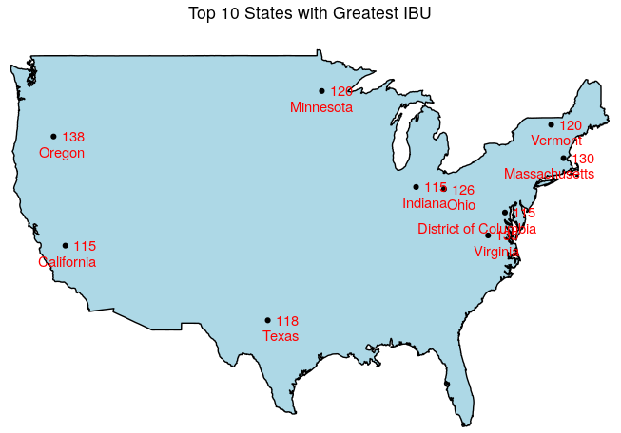
Ibu Top 10 state comparison
Oregon is known for having beer with a lot of hops

Slide 8
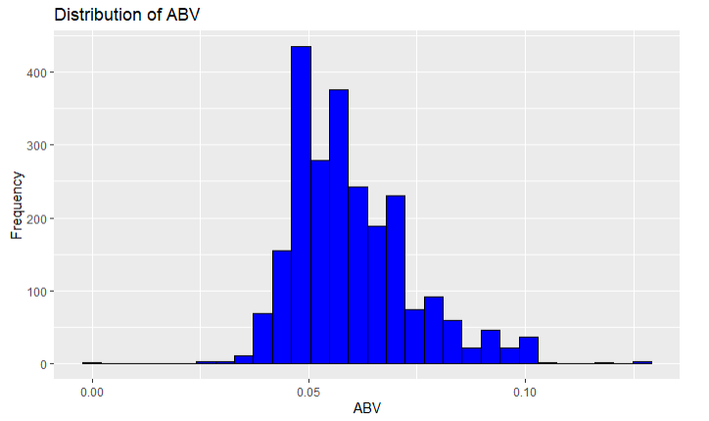
Distribution of abv
Summary of ABV
The mean and median of ABV are nearly equal
The distribution indicates the majority of beers contain roughly 5% ABV which corresponds to the summary of ABV
This would indicate a market preference for beers with around 5% ABV

Slide 9
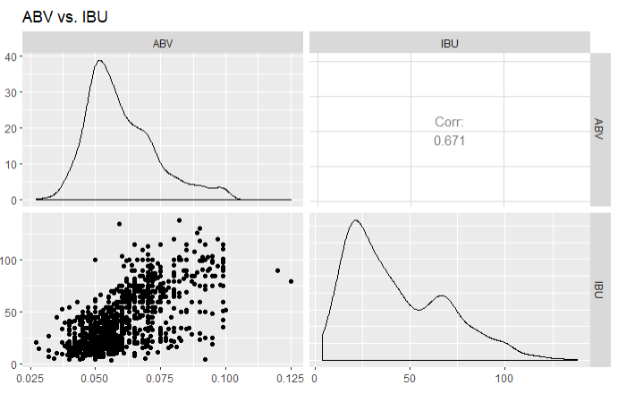
ABV compared to IBU is there a relationship?
We see a positive relationship between IBU to ABV
As the IBU increases, we see an increase in ABV
This suggests that beers that are increasingly bitter also generally have an increase in ABV
The more malted barley you add, the more fermentable sugars are available to the yeast, which generally results in higher ABV. To offset the higher sweetness, brewers throw in more bittering hops to balance beer. ... Balance is everything in a good beer.
https://www.quora.com/Why-do-hoppy-beers-generally-have-a-higher-ABV-1
Notes:
<number>

Slide 10
Classification
KNN versus Naïve Bayes

Slide 11
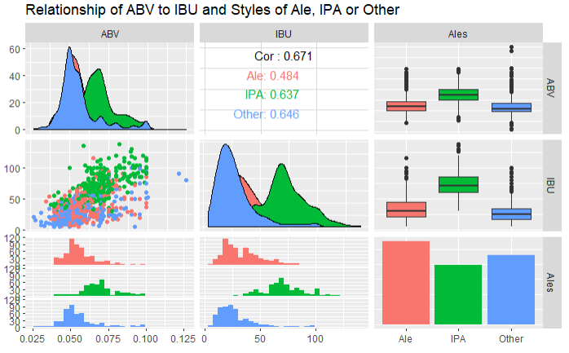
Ales, ipa and other styles vs ABV and IBU
We see that IPA’s have a higher distribution of IBUs than that of Ales and Other styles of beer
We can also see that as IPAs, having a higher IBU, also have a higher distribution of ABV

Slide 12
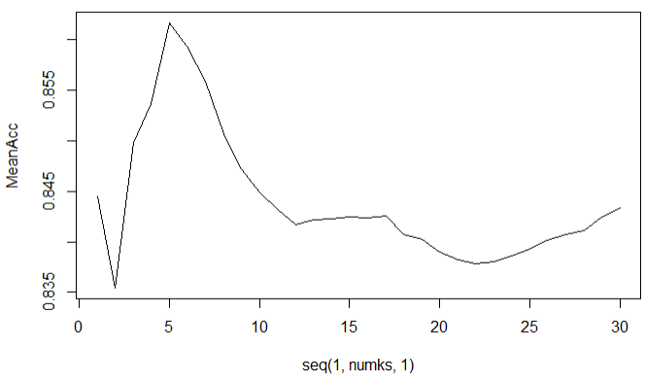
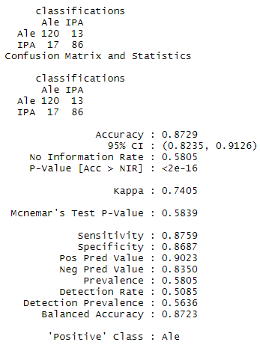
KNN Classification of beers based on ABV and ibu
Finding the optimum k hyperparameter for model
Knowing that IPAs, Ales and Other types of beer generally have different ABV and IBU’s, we can classify beers into these styles given an ABV and IBU
Using a KNN (k=5) classifier, we see that we can classify beers with an 83% accuracy
This is a decent accuracy, but let’s show what a Naïve Bayes classifier looks like next

Slide 13
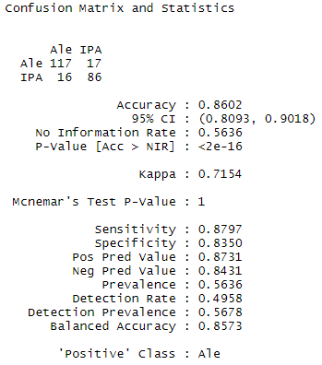
Naïve bayes classification of beers on abv and ibu
Again, knowing that IPAs, Ales and Other styles of beers have different ABV and IBU combinations, we can leverage that information to classify beers into these categories
Here, a Naïve Bayes classifier is used and we see an accuracy of 86%
The Naïve Bayes classifier outperforms the KNN classifier and would be the suggested classifier for Budweiser

Slide 14
Comparison of ABV and IBU
Compare ABV and IBU differences in each region
Northeast, Midwest, South, West
Defined by the Census Regions of the United States
Compare ABV and IBU differences in beer size
12oz vs. 16oz
Is there an interaction term between region and beer size for ABV or IBU?

Slide 15
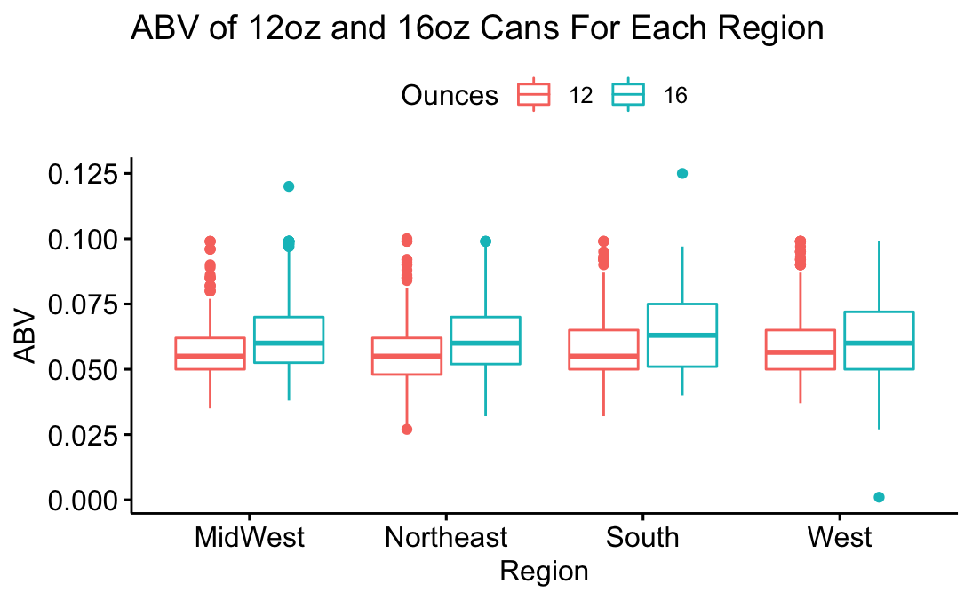
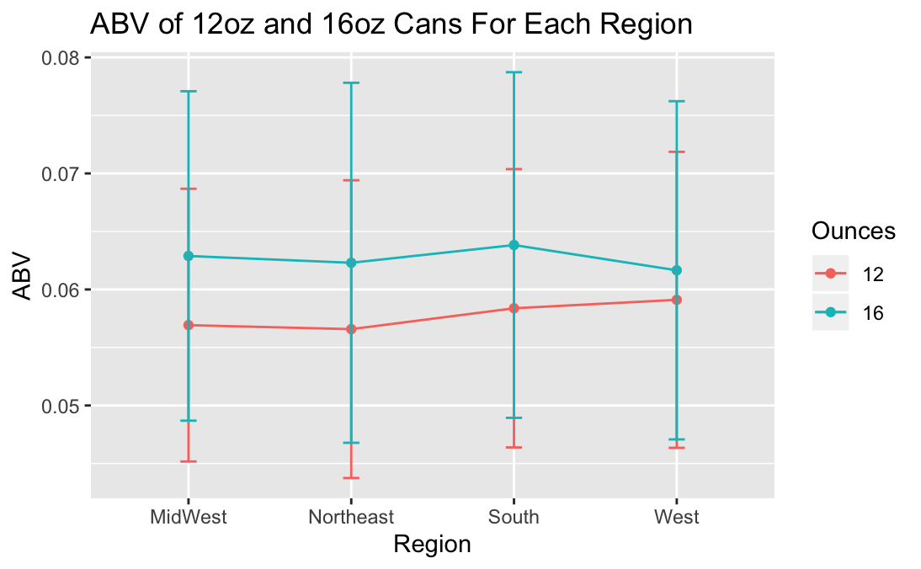
ABV for 12oz cans and 16oz cans for each region
16oz ABV seems to be higher than 12oz ABV in each region
The standard deviation of 12oz and 16oz cans overlap their mean values in each region
Visually, it looks like an additive model

Slide 16
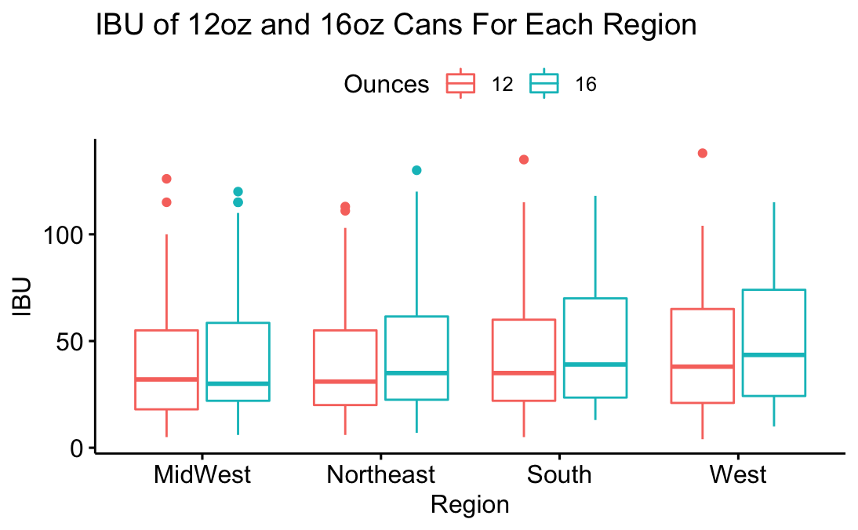
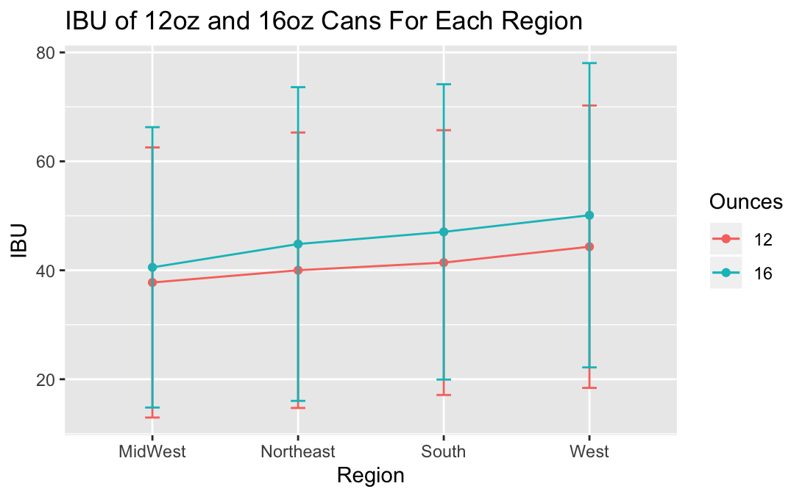
IBU for 12oz cans and 16oz cans for each region
16oz IBU seems to be higher than 12oz IBU in each region, except for Midwest.
The standard deviation of 12oz and 16oz cans overlap their mean values in each region
Visually, this also looks like an additive model

Slide 17
Two-Way ANOVA Conclusions
ABV
The two-way ANOVA test shows that there does not seem to be an interaction term
Ounces is a significant factor in determining ABV, and there is some evidence that region is a factor too
Differences occur between the Northeast and Midwest Regions and the ounces in the beer
IBU
The two-way ANOVA test shows no evidence of an interaction term
Both ounces and region are significant factors in determining IBU
Differences occur between the West and Midwest Regions and the ounces in the beer

Slide 18
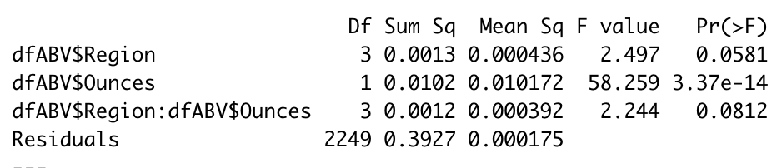
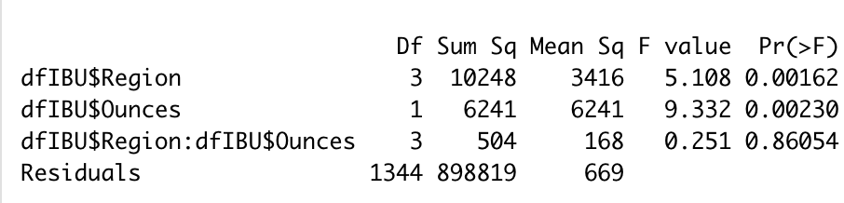
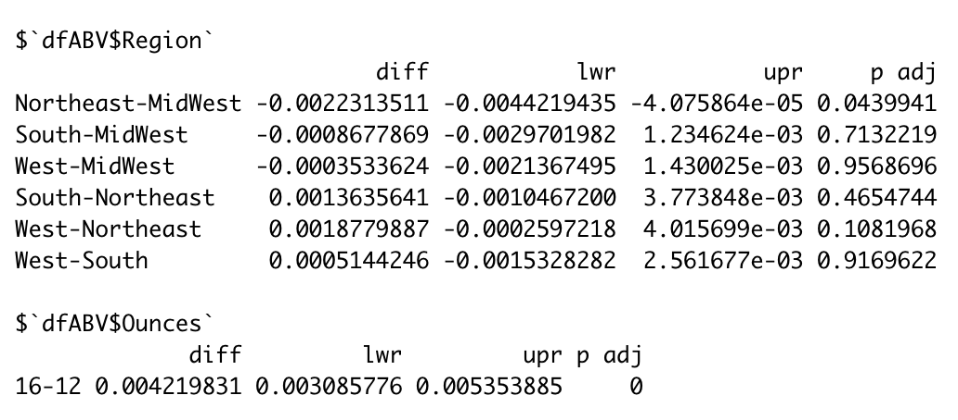
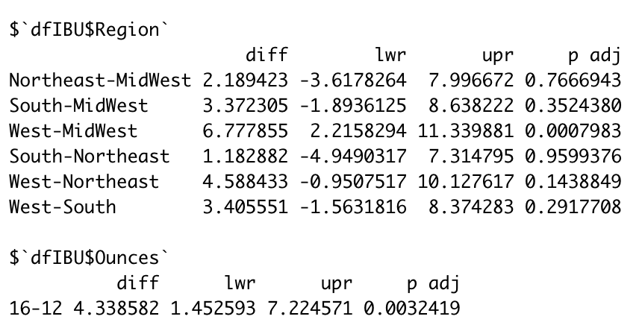
Appendix
Two-Way ANOVA Results for ABV Given Region and Beer Size
Two-Way ANOVA Results for IBU Given Region and Beer Size

