Slide 1
State Machines for Fun AND PROFIT
…or in everyday programming.

Slide 2
What is a State Machine
A model consisting of a collection of conceptual states and associated transitions.
State Machine Diagram: Picture showing above.

Slide 3
State Machine Diagrams

Slide 4
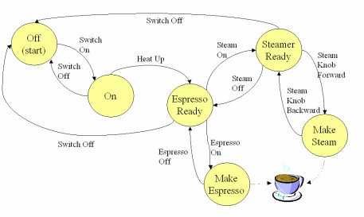
Example - Coffee Machine
https://msdn.microsoft.com/en-us/library/aa478972.aspx

Slide 5
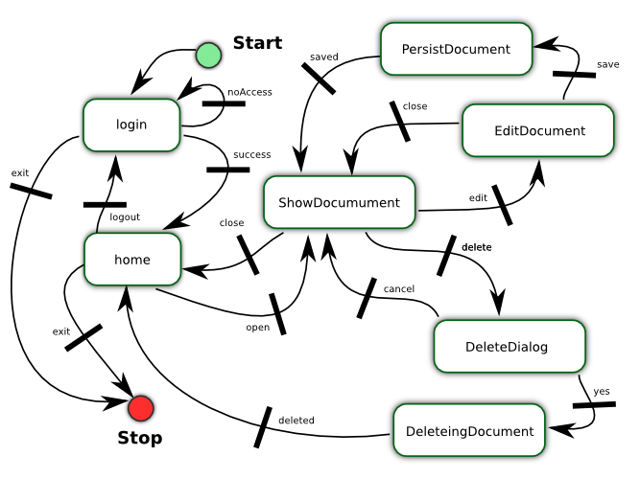
Example - Document Flow
ScaleApp - https://github.com/flosse/scaleApp

Slide 6
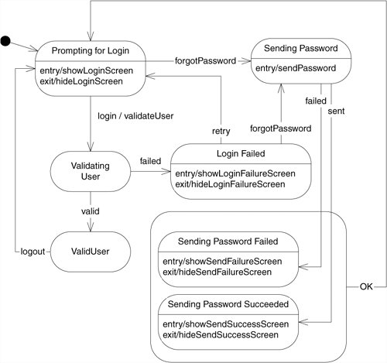
Example – Login Process
http://flylib.com/books/4/444/1/html/2/images/15_1.jpg

Slide 7
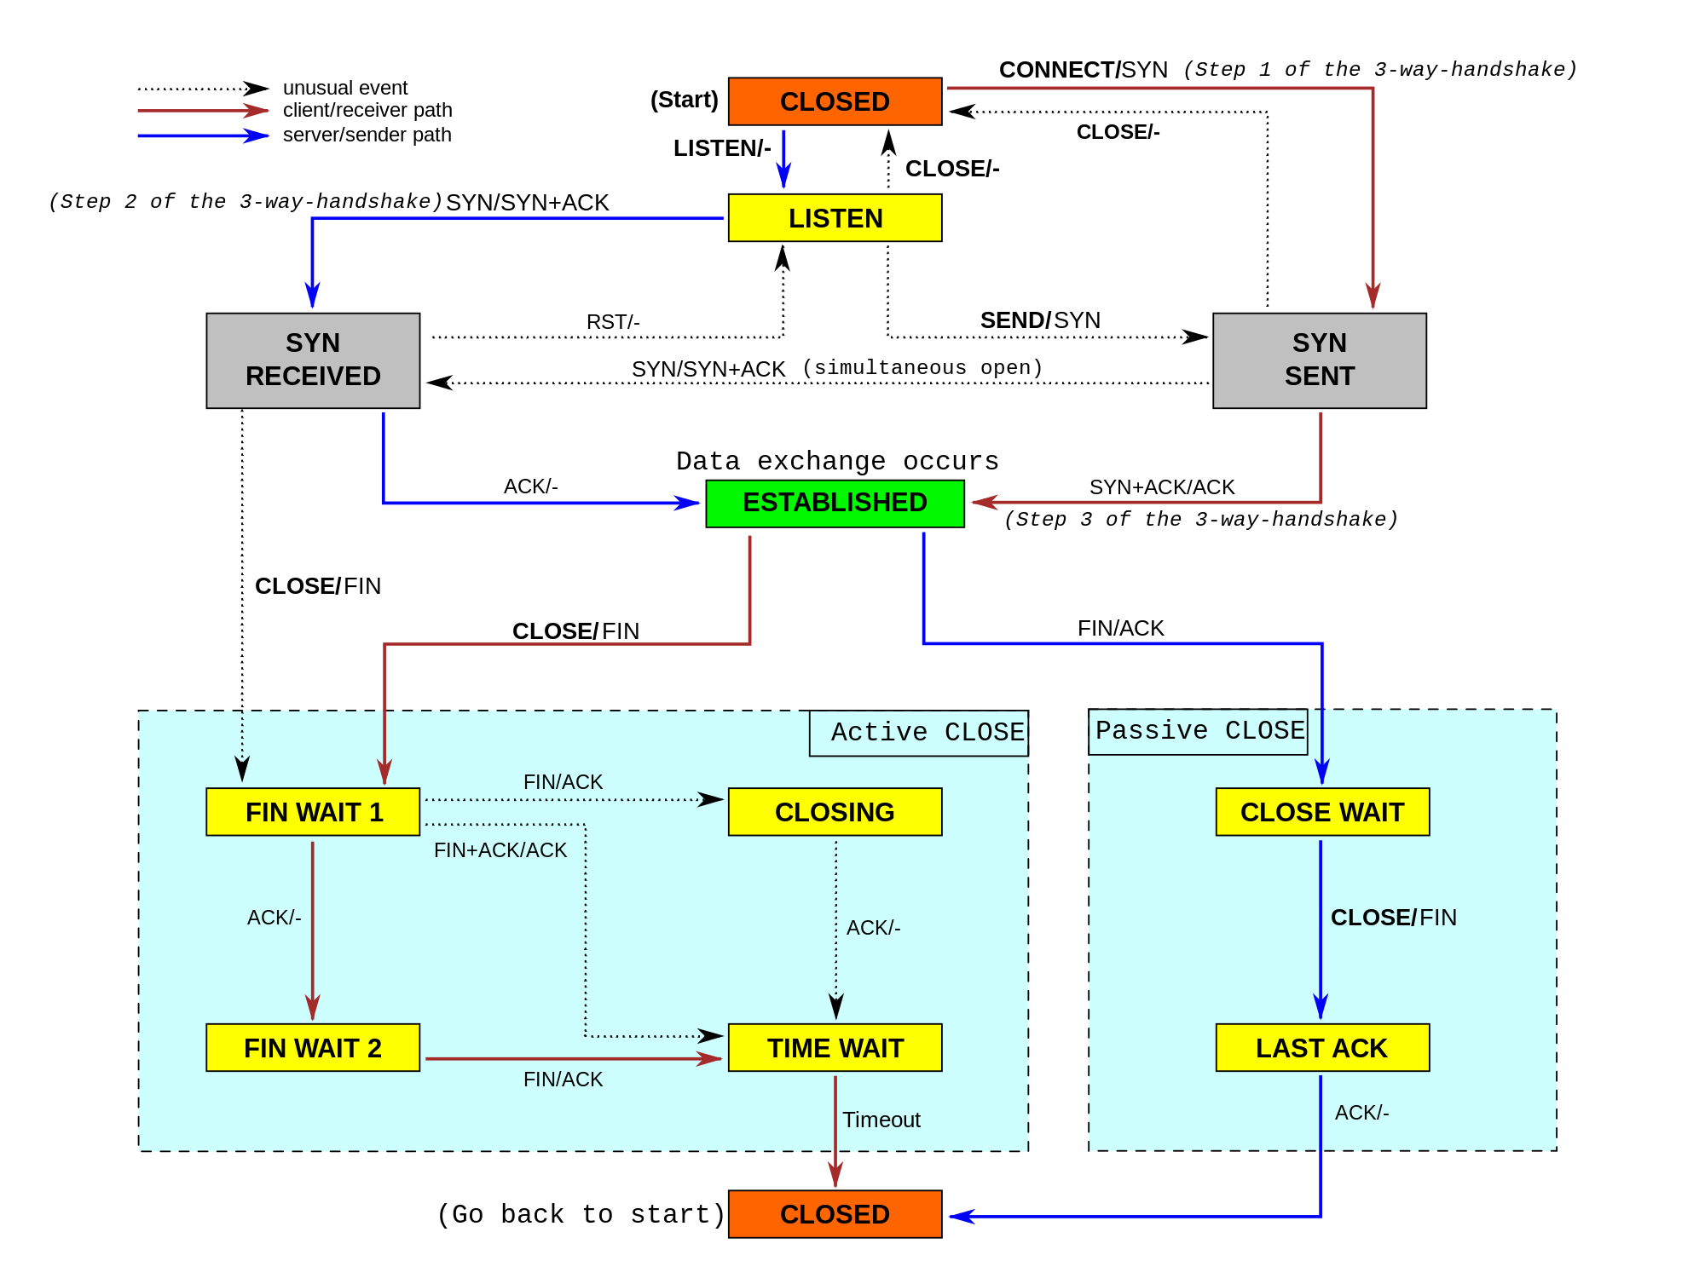
Example – TCP
http://upload.wikimedia.org/wikipedia/commons/thumb/f/f6/Tcp_state_diagram_fixed_new.svg/2000px-Tcp_state_diagram_fixed_new.svg.png

Slide 8
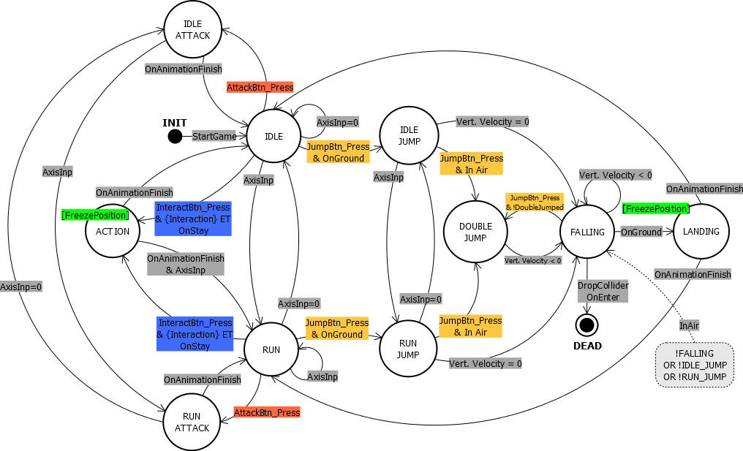
Example – Unity Game Engine
http://sysmagazine.com/posts/206120/

Slide 9
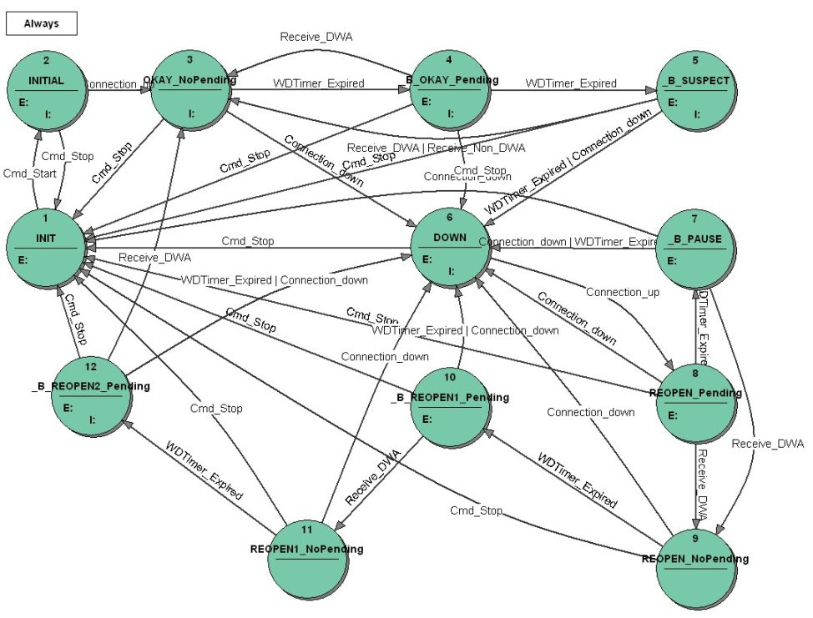
Example – Diameter Fail Over
http://www.stateworks.com/technology/diameter_failover/

Slide 10

Perspective
Tell a user story!
NOT a perfect match to reality
Customer States
Want coffee
First cup
Second cup
Happy!
Waiter States
Ask if they want coffee
Refill!!!
Done

Slide 11
Door

Slide 12
Door - 2

Slide 13
Implicit vs. Explicit

Slide 14
Pasta Machine (Implicit)
( Software is pretty much all state machines)
Smells:
Complex if statements that are invoked periodically
Multi-variable interaction
Not all permutations are interesting
 | A && B | A && !B | !A && B | !A && !B
C (true) | 1 | 2 | X | X
C (false) | 3 | X | 3 | X
if ( A && B && C ) => 1
else if ( A && !B && C ) => 2
else if ( B && !C ) => 3
else => Error

Slide 15
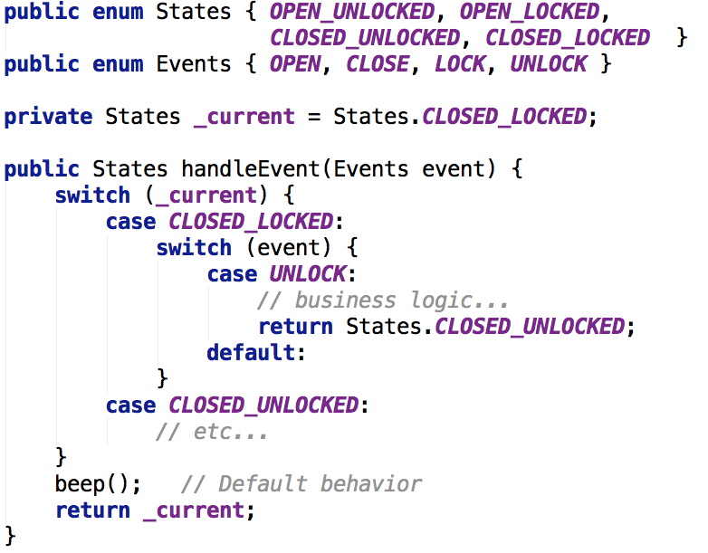
Switch Based Machine

Slide 16
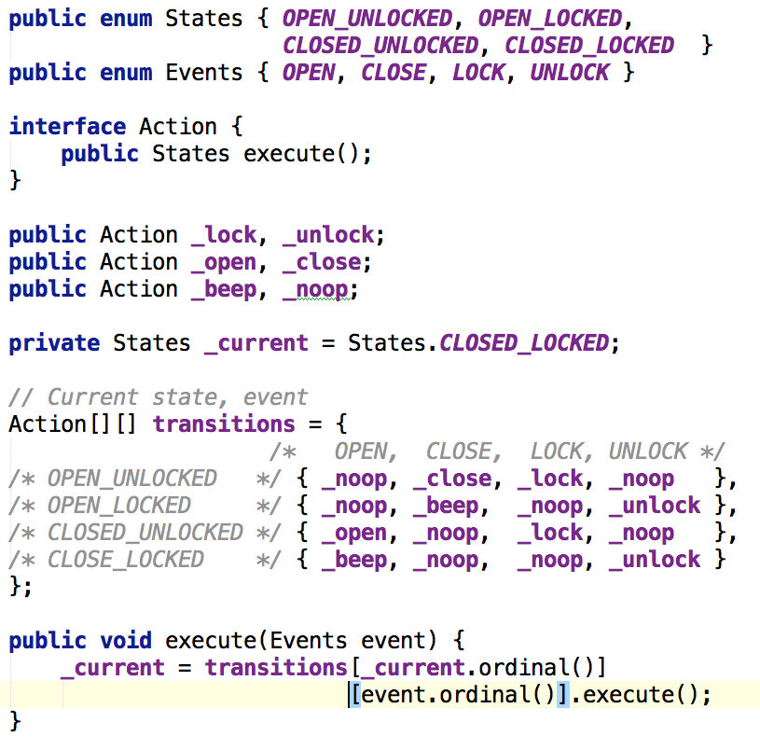
Table Based

Slide 17
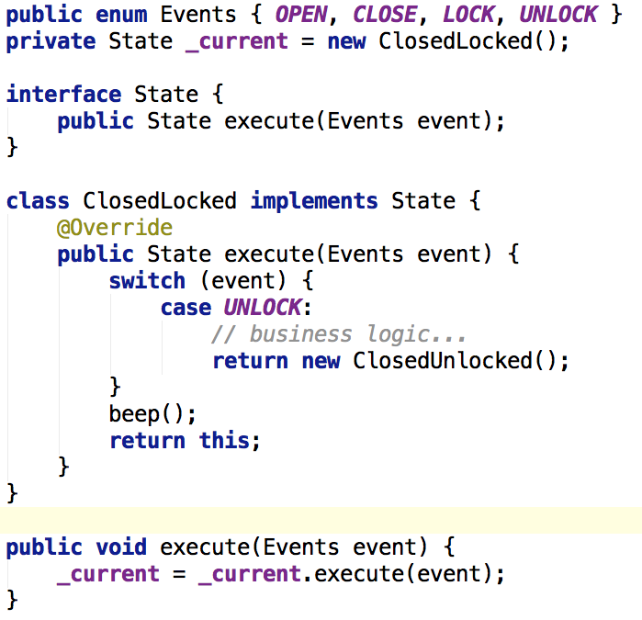
Object Oriented

Slide 18
Runtime Defined - Model

Slide 19
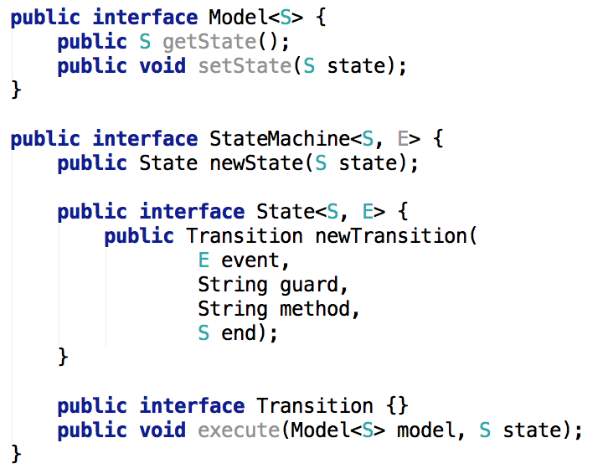
Runtime Defined - Interfaces

Slide 20
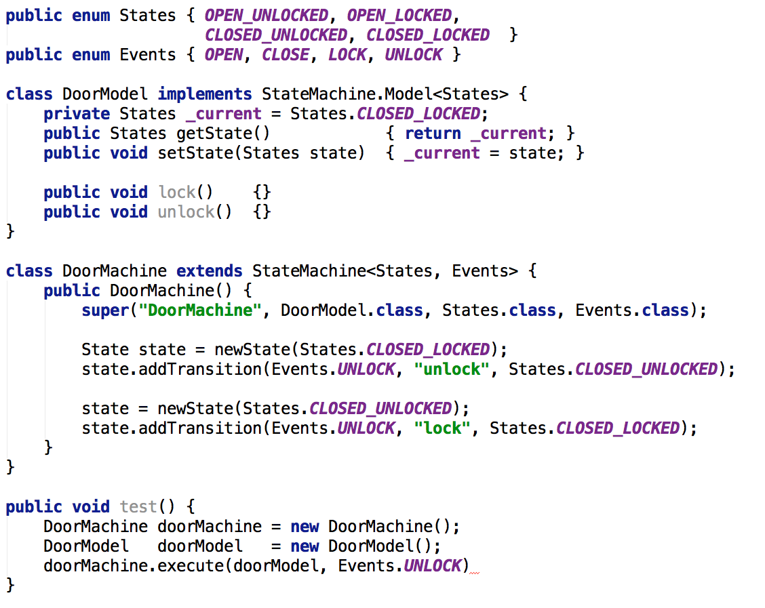
Runtime Defined - Example

Slide 21
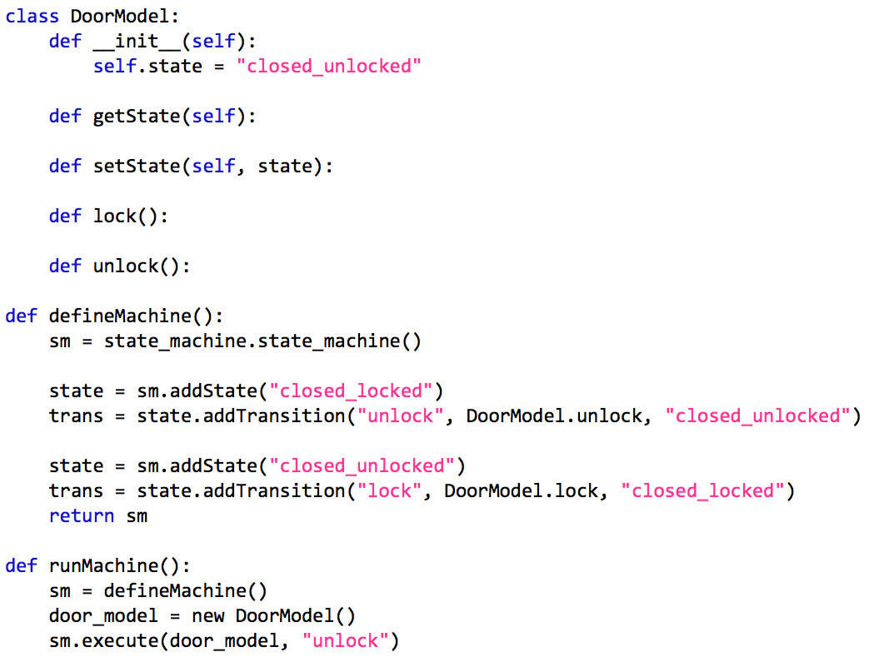
Runtime Defined – Python

Slide 22
Others
Squirrel (Java) – Runtime Defined
https://github.com/hekailiang/squirrel
Fluent Interface ( from, to, when, etc)
Callbacks
MVEL expression language
Tungsten (Java) – Runtime Defined
https://code.google.com/p/tungsten-fsm/
JavaScript
https://github.com/jakesgordon/javascript-state-machine - Table based generator
Python
Many!
C/C++
Boost Statechart (boost::fsm) Library (UML -> C++)

Slide 23
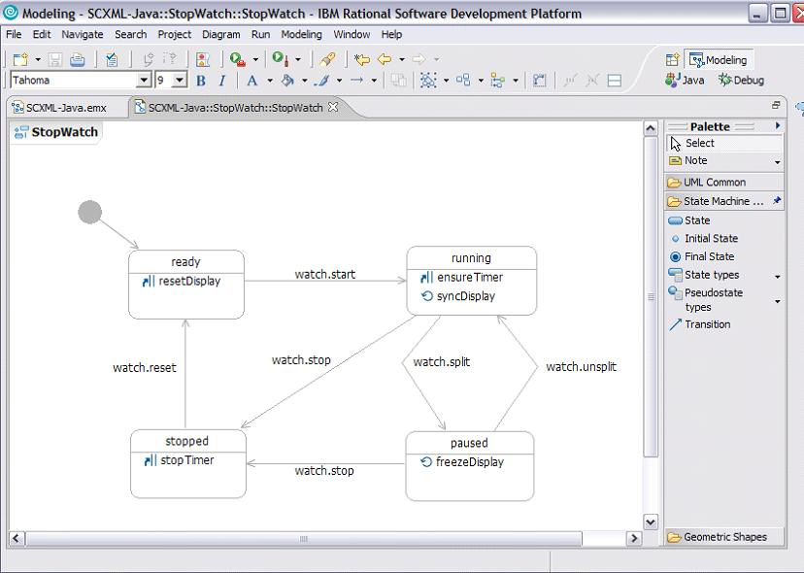
Visual Designers - SCXML
State-Chart XML (SCXML) - W3C Draft Spec
Apache Commons – Java engine for loading and execution

Slide 24
Advanced Topics

Slide 25
Writing Your Own
We all have different needs…
Good experience ( Simple python one < 160 lines)
General Flow
Find current state
Get transitions for event (usually a map)
Check transitions with guards first, else unguarded transition
Execute action on selected transition
Set new state
Analytics support ( e.g. iterable enums vs. strings)
Action and predicate support ( e.g. pointers vs. reflection)
Self documentation - see previous

Slide 26
Analysis and Testing
Have a “validate” method
Does every state get show up in state machine?
Are there any events that are never used?
Are their duplicate transitions? (same event/guards)
missingTransitionHandler()
Generate all possible traces
Great for automatic unit test
Deal smartly with loop breaking
Use a state machine to test another state machine
Model Checkers – Alloy (http://alloy.mit.edu/alloy/)
Continuing research and papers!

Slide 27
Visualization
GraphViz seems to be the standard - http://www.graphviz.org
digraph door
{
rankdir="TB”
OPEN_LOCKED -> OPEN_UNLOCKED [ label=" unlock " ]
OPEN_UNLOCKED -> OPEN_LOCKED [ label=" lock " ]
CLOSED_LOCKED-> CLOSED_UNLOCKED [ label=" unlock " ]
CLOSED_UNLOCKED -> CLOSED_LOCKED [ label=" lock " ]
OPEN_UNLOCKED -> CLOSED_UNLOCKED [ label=" close " ]
CLOSED_UNLOCKED -> OPEN_UNLOCKED [ label=" open " ]
node [ label=“node label” ]
}

Slide 28
Performance
“You don’t know jack until you bench it!”
Don’t prematurely optimize!
Speed or memory?
Use standard good coding practices
Most machines don’t get called that often
Generate code from dynamic machines
Try not to revert to roll-your-own switches

Slide 29
Miscellaneous
Replicating state machines

Slide 30
Thanks!
https://github.com/andrewmellinger

