Slide 1
Total Quality Management
Business Process Engineering

Slide 2
T Q M
Useful text:
‘TQM Text with cases’ John S. Oakland, 3rd edition.
Multiple copies in the library

Slide 3
T Q M
It’s all about the quality
Quality is something that everyone talks about, knows what it means to them personally, but find it difficult to describe in words;-
“Quality is an unusually slippery concept, easy to visualize and yet exasperatingly difficult to define “
(David Garvin, 1988 )

Slide 4

Quality
Many and multiple are the definitions for quality
Zen and the Art of Motorcycle Maintenance: An Inquiry into Values
A 1974 philosophical novel, the first of Robert M. Pirsig's texts in which he explores his Metaphysics of Quality.
The book sold 5 million copies worldwide. (wikipedia)

Slide 5
Quality
The official definition of quality as given by ISO 8402/ISO 9000:
"Quality is the totality of features and characteristics of a product or service that bear on its ability to satisfy stated or implied needs"

Slide 6
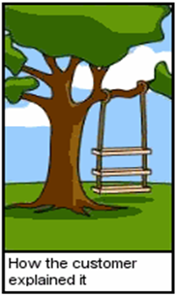
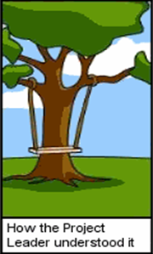
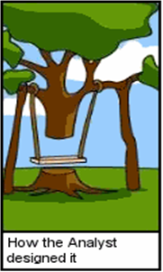




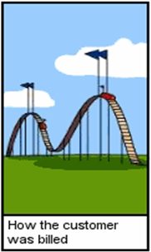

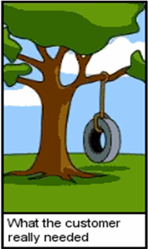
Requirements Engineering

Slide 7
What is TQM?
T.Q.M. is an approach or philosophy of management which again is difficult to define exactly.
Macdonald (1993) referred to T.Q.M. as a journey without a destination since the improvement process continues.
T.Q.M. aims for quality from start to finish of production or service and that everyone in the organisation, not just one person or department is responsible for quality.

Slide 8
TQM
The ‘principles’ of T.Q.M. are subject to much debate also but are seen to cover:
Customer focus
Continuous improvement
Teamwork
Employee involvement
Senior management commitment and
Cultural change

Slide 9
TQM
Composed of three paradigms:
Total: Involving the entire organisation, supply chain, and or product life-cycle
Quality: with the usual definitions and all its complexities
Management: the system of managing (using steps like plan, organise, control, lead, staff, and provide

Slide 10
TQM - Framework
The four Ps and
three Cs of TQM
Performance
Planning
Process
People
Culture
Communication
Commitment

Slide 11
Hard and Soft TQM
Processes are the key to delivering quality of products and services to customers
They form a key linkage between the enablers of planning through people into the performance
The ‘four Ps’ form a simple TQM model, providing the ‘hard management necessities’ for successful modern organisations:
Process
Planning
People
Performance

Slide 12
Hard and Soft TQM
The three Cs form the soft side of TQM:
Culture
Communication
Commitment
The soft side of T.Q.M. has not been as widely researched and includes the management of human resources and the need for culture change
It relies heavily on employee involvement and on employees taking greater responsibility for quality
Greater emphasis is put on teamwork, communication and training.

Slide 13
Hard and Soft TQM
‘Hard’ aspects which reflect the production orientation of the quality gurus, emphasise systems, data collection and measurement. It also includes many production techniques, statistical methods and tools.
Hard T.Q.M. includes the use of quality awards and assessment.

Slide 14
Elements of TQM
Ethics
Integrity
Trust
Training
Teamwork
Leadership
Recognition
Communication

Slide 15
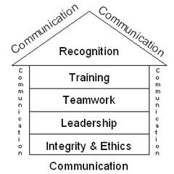
Elements of TQM
Can be divided into four groups:
Foundation: Ethics, Integrity and Trust
Building Bricks: Training, Teamwork and Leadership
Binding Mortar: Communication
Roof: Recognition

Slide 16
Elements of TQM
Foundation:
Fosters openness, fairness and sincerity and allows involvement by everyone.
This is key to unlocking the ultimate potential of TQM.
Ethics: concerned with good and bad in any situation. Organisational and personal.
Integrity: Honesty, moral value, fairness. Characteristics which customers (internal and external) expect.
Trust: A by-product of integrity. It fosters full participation. Without it TQM fails.

Slide 17
Elements of TQM
Bricks:
Building on top of the foundations, these help to reach the roof of recognition.
Training: Critical to support highly productive employees e.g. problem solving, team work, decision making, business and technical skills, TQM.
Teamwork: A key element. Nobody works in isolation.
Leadership: Perhaps most important. Commitment by management. Visibly behind TQM demonstrated by their daily activities. Personal involvement by management.

Slide 18
Elements of TQM
Binding Mortar:
Communication: It binds everything together. A vital link between all elements of TQM. A common understanding of ideas. Communication channels must be left open between management and employees for TQM to succeed. Communication coupled with sharing of correct information is vital.

Slide 19
Elements of TQM
Roof:
Recognition: The last and final element of the TQM system. For both suggestions and achievement of both individuals and teams. A key job of the supervisor is to identify the contributors. Increases self-esteem, productivity and quality. Recognition can come in many ways, places and times.

Slide 20
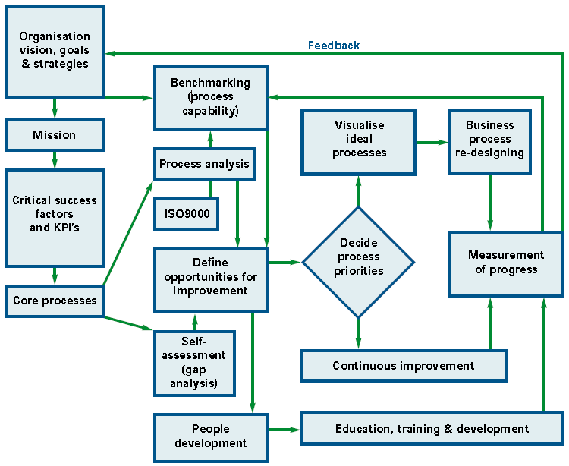
A TQM Implementation Framework

Slide 21
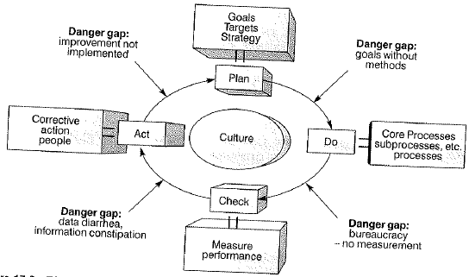
A TQM Implementation Framework (Deming style)

Slide 22
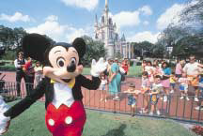
The Quest for Quality
The importance of exceptional quality is demonstrated by the Walt Disney Company in operating its theme parks. The focus of the parks is customer satisfaction.
This is accomplished through meticulous attention to every detail, with particular focus on the role of employees in service delivery. Employees are viewed as the most important organizational resource and great care is taken in employee hiring and training.
All employees are called “cast members,” regardless of whether they are janitors or performers. Employees are extensively trained in customer service, communication, and quality awareness. Continual monitoring of quality is considered important, and employees meet regularly in
teams to evaluate their effectiveness. All employees are shown how the quality of their individual jobs contributes to the success of the park.

Slide 23

A TQM Training Video

