Slide 1
Introduction to Lean Engineering
The Car Industry

Slide 2
Learning Objectives
By the end of this lesson you should be able to:
Describe the foundations of Lean
Describe the role Lean Manufacturing played in the global automobile industry
Understand its relevance in almost any process

Slide 3
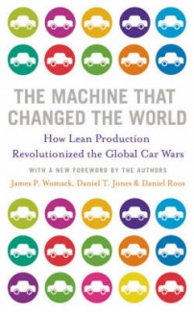
The Origins of Lean Production
“No new idea springs full-blown from a void. Rather, new ideas emerge from a set of conditions in which old ideas no longer seem to work.”
WOMACK, J. P., JONES, D. T. & ROOS, D. 1990.
The Machine That Changed The World: How lean production revolutionized the global car wars.
Simon & Schuster Ltd.
An examination of the global motor vehicle industry. Run out of MIT 1985-1990.

Slide 4
A history of Car Manufacturing
1890s Panhard et Levassor – The world’s leading car company
Secured a license to manufacture a high speed engine (Gottleib Daimler)
P&L design was engine to the front driving the rear wheels
Was still very much a craft-production process
Highly skilled labour
Contractors used slightly different gauges (not identical car parts)
Fitters would have to file down the parts
Resulting in what is now referred to as dimensional creep

Slide 5
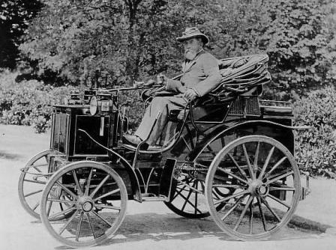
A history of Car Manufacturing
Evelyn Henry Ellis – 1895
First automobile to be driven in England
56 miles in 5 hours 32 minutes
Average speed 9.84 mph

Slide 6
A history of Car Manufacturing
Craft Production characteristics
A workforce highly skilled in design, machine operations, and fitting
Organisations that were extremely decentralised, although concentrated within a single city
The system was coordinated by an owner/entrepreneur in direct contact with everyone involved – customers, employees, and suppliers
General purpose machine tools to perform drilling, grinding, and other operations on metal and wood
Very low production volume – 1,000 or fewer automobiles a year. Very few built to the same design
Craft techniques inherently produced variations.

Slide 7
A history of Car Manufacturing
Competition
By 1905 hundreds of companies in Western Europe and North America were turning out automobiles in small volumes using craft techniques
However, a fatal aspect of the craft process was the inability of these small companies to develop new technologies.
The industry was reaching a plateau, requiring fundamental innovations rather than tinkering to move it along.
Enter Henry Ford…

Slide 8
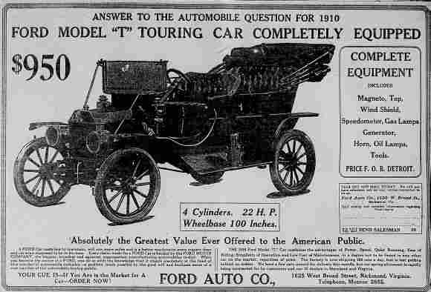
The Ford Model “T”
"I will build a car for the great multitude. It will be large enough for the family, but small enough for the individual to run and care for. It will be constructed of the best materials, by the best men to be hired, after the simplest designs that modern engineering can devise. But it will be so low in price that no man making a good salary will be unable to own one – and enjoy with his family the blessing of hours of pleasure in God's great open spaces”
Henry Ford “My life and my work”, 1922.
“The Customer can have it in any colour
as long as its black”

Slide 9
A history of Car Manufacturing
Mass Production
Ford’s 1908 Model T achieved two objectives:
A car that was designed for manufacture. ‘user-friendly’.
Almost anyone could drive and repair the car without the need for a chauffeur or mechanic
These two conditions laid the ground work for the revolutionary change in direction for the entire motor-vehicle industry.

Slide 10
A history of Car Manufacturing
Key to mass production
Ford’s design allowed for
“… the complete and consistent interchangeability of parts and the simplicity of attaching them to each other”.
Everyone had to use the same gauges.
Advanced machine tool which could work on pre-hardened metals
Overcame the warping problem
Led to new more efficient designs being possible
Reduced the number of parts
Made parts easier to connect

Slide 11
A history of Car Manufacturing
The assembly process in 1903 began with assemble stands on which a whole car was built, often by a single fitter.
Task cycle time for a fitter was 514 minutes (8.56 hours)
Go get the parts
File them down (still not perfectly fitting parts)
Bolt them in place
First enhancement was to deliver the parts to each work station (fitters did not have to leave their station).
Second, to continuously work to get perfect part interchangeability (achieved 1908)

Slide 12
A history of Car Manufacturing
Change in work practices
Assemblers would only perform a single task and move from car to car repeating the same task
Task cycle time now 2.3 minutes
This led to a remarkable increase in production
Why?
However, this went largely unnoticed by the competition.

Slide 13
A history of Car Manufacturing
Ford’s next innovation, the continuous assembly line
(1913 Detroit facility)
Moving the worker was wasting time and causing jam-ups
Instead move the line to the worker!
Cycle time down to 1.19 minutes
All achieved with relatively little investment

Slide 14
Craft versus Mass Production
Minutes of effort to assemble:
Engine -
Magneto -
Axle -
Major components into a complete vehicle -
Late Craft Production
Autumn 1913:
594
20
150
750
Mass Production
Spring 1914:
226
5
26.5
93
Percentage Reduction in Effort:
62
75
83
88
This got people’s attention.
- Ford achieved a reduction in real cost to the consumer
of two thirds!

Slide 15
A history of Car Manufacturing
Other American car manufacturers adopted these new practices and dominated the global car industry to the detriment of the craft production industry which could only survive in specialised niche area e.g. Austin Martin.
In 1955, 7 million cars sold in the United States.
Ford + GM + Chrysler = 95% of market
But it was all down hill after that ….

Slide 16
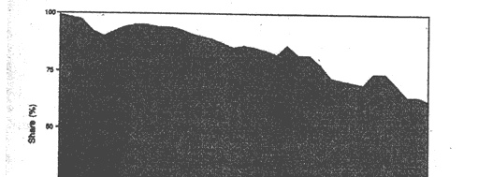
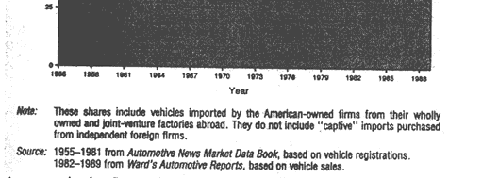
A history of Car Manufacturing
Share of the American car market held by American-owned companies, 1955-1989.

Slide 17
A history of Car Manufacturing
For years, a steady stream of pilgrims to the various Ford plants in the U.S. and also in Europe.
However, in Europe, World War II put all civilian production on hold.
Not until the 1950s did these production techniques start to transfer abroad.
In addition the European market had some different conditions
Lower wages
Higher fuel prices
European manufacturers started then began mixing it up a bit:
Adding on new features
Building smaller, more economical cars

Slide 18
A history of Car Manufacturing
Having adopted the American mass productioin techniques and improved upon them, European manufacturers began to take the market lead.
Until the 1980s…
Increasing wage demands
Dissatisfaction with the unrewarding repetitive work
Unions demanding reduced time on the line
Enter the Japanese…

Slide 19
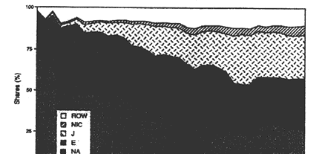
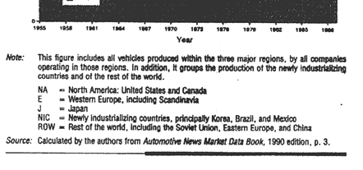
A history of Car Manufacturing
Share of the world motor vehicle production by region, 1955-1989.

Slide 20
Lean Production
Post WWII, America sent over engineering experts to assist in the rebuild of Japanese industry
One such engineer was W. Edwards Deming who taught them the principles of statistical control methods
Along with other management training programmes, these techniques were rapidly learned and adopted by the Japanese
The work Deming did in Japan was so influential that the Union of Japanese Science and Engineering instituted the annual Deming Prizes for achievement in quality and dependability of products.

Slide 21
Lean Production
1950 Eiji Toyoda, a young Japanese engineer, makes a 3 month pilgrimage to Ford’s Detroit plant.
With the help of his production manager Taiichi Ohno, they tried to copy and improve the mass production techniques back in the Toyota company.
However, it quickly became evident that mass production could never work in Japan.
Domestic market was tiny
High demand for a wide range of vehicles for different demographics and uses
Workforce would not tolerate being treated as variable costs
No transient workforce
Post war Japan was starved of capital investment
Outside world was full of huge producers looking to get established in Japan

Slide 22
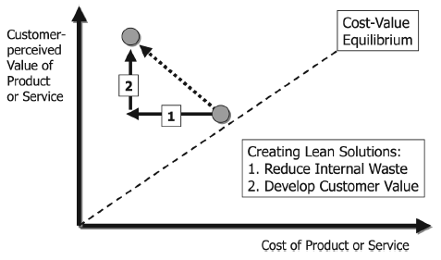
The Toyota Production Process (TPS)
Taiichi Ohno developed a different approach
The focus has to be on creating customer value
All activities should be examined in terms of how they support the creation of that customer value

Slide 23
The Toyota Production Process (TPS)
Eliminating Muda
Ohno saw much opportunity for eliminating the muda (waste) within the western production practices
He categorised work activities into 3 types:
Value-adding activities
Required non-value adding activities
Non-value adding activities

Slide 24
The Toyota Production Process (TPS)
Ohno identified 7 types of process waste:
The waste of over-production
The waste of time on hand (waiting)
The waste of transportation
The waste of over-processing or incorrect processing
The waste of stock on hand (excess inventory)
The waste of movement
The waste of making defective products
The waste of unused employee creativity
(Last one taken from LIKER, J. 2003. The Toyota Way McGraw-Hill)

Slide 25
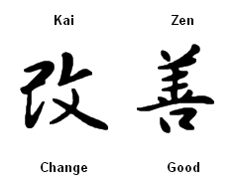
The Toyota Production Process (TPS)
Teamwork
Small teams with a team-lead instead of a foreman
Team is responsible for most aspects of their process area
Time set a side for the team to collaboratively look for ways to improve the process ( Kaizen ).
Kaizen
Small incremental changes
Employees know best
A culture that encourages and
rewards employees

Slide 26
The Toyota Production Process (TPS)
Poka-yoke (mistake proofing)
Define processes that make it impossible for a mistake to happen
Where this is not achievable design the process so that mistakes are easily identifiable
Shigeo Shingo
- One of the world’s leading experts on manufacturing practices

Slide 27
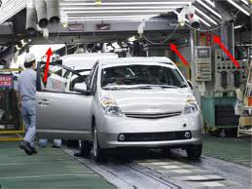
The Toyota Production Process (TPS)
Stop the line
Authority delegated to every worker
All hands on deck

Slide 28
The Toyota Production Process (TPS)
Kanban (signal card)
A process to co-ordinate the flow of parts in the supply system
Toyota adopted this from examining how supermarkets replenish their display shelves
Simple rule: A process step should only supply a part to the next step when the next step needs it. How to implement?
Proved very difficult to implement. Why?
Eliminates almost all inventory
If one small step fails => Whole system stops
Exactly what Ohno wanted (no safety net)!
Took 20 years to perfect the process

Slide 29
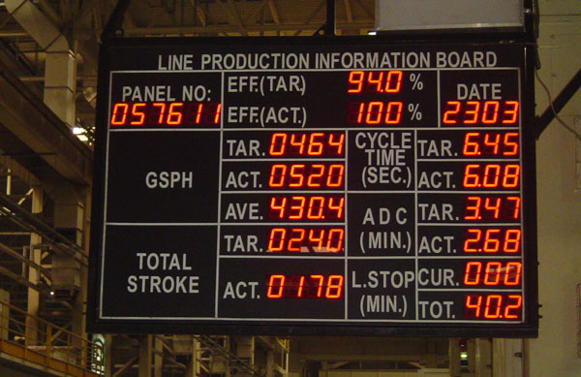
The Toyota Production Process (TPS)
Kanban boards
An extension of the Kanban concept
Provides visibility to everyone on the entire production system

Slide 30
The Toyota Production Process (TPS)
Company as Community
Life-time employment
Pay graded by seniority
Employees to be flexible in terms of work assignment
Employees to seek out process improvements rather than merely responding to problems

Slide 31
The Toyota Production Process (TPS)
Keiretsu
A grouping of companies with interlocking business relationships
Members hold portions of shares in each others companies
Centred around a core bank/financing arrangement
Helps insulate against
stock market fluctuations
Take over attempts
Enables long-term planning of innovative, collaborative projects

Slide 32
The Toyota Production Process (TPS)
Toyota would share personnel with its suppliers
To assist with surges in demand
To take up senior positions to help improve the supplier companies

Slide 33
The Toyota Production Process (TPS)
5 modern lean concepts
Value: It is defined by the customer and it is paramount to have a clear understanding of what that is;
Value Stream: A map that identifies every step in the process and categorises each step in terms of the value it adds;
Flow: It is important that the production process flows continuously;
Pull: Customer orders pull product, ensuring nothing is built before it is needed;
Perfection: You strive for perfection in your process by continuously identifying and removing waste.
However, a 6th concept should also be used, Respect for People (Sugimori et al., 1977)

Slide 34
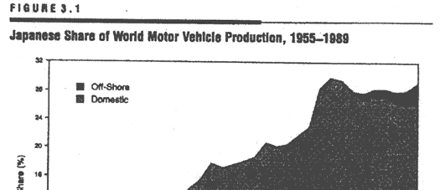
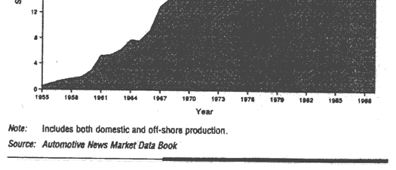
The Toyota Production Process (TPS)
Japanese share of world motor vehicle production,
1955 - 1989
Off-shore

Slide 35
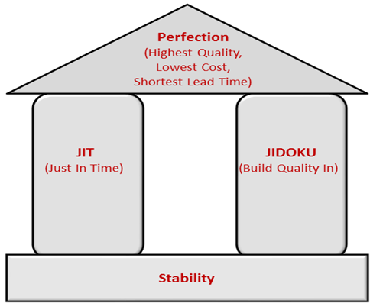
The House of Lean
The goal is “perfection”
Two supporting pillars:
Just-in-time
Jidoku
Foundations of stabilising principles:
Standardised processes
Production levelling
Visual workflow management

