Slide 1

A Collaborative Learning Web Application
Andrew Monaghan
Business Information Systems
09102825

Slide 2
Project Idea
Web application to facilitate collaborative learning among students by providing advanced file sharing functionality, access to study advice and an online study forum.
Promotes collaborative learning among students by encouraging them to share study resources, ask questions and discuss college topics.
Built for a college and it’s students (i.e. not general public)
Admin section for managing users
Student registration process
Built with security in mind
authentication, access control, encryption,

Slide 3
Why Collaborative Learning?
Background in IT Training
Strong interest in E-Learning
Industry estimated at 100 million p.a
Experience as a Class Rep
Identified need for college specific, student orientated collaborative learning applications
File Sharing – Exam revision / Sharing Resources
Discussion Forum – Students already requesting this!
The Client loves the idea
Dr. Mimi Kelly – IBI College

Slide 4
Requirements Elicitation
Main Client Requirements
Promote collaborative learning through sharing study resources and facilitating online discussion.
Simple & minimalistic user interface aimed at a non-technical audience (i.e. not like Moodle!)
Requirement Elicitation Questionnaire
Assessed students previous experience of collaborative learning and the demand for my proposed application
Students also ranked proposed features in order of usefulness
15 completed questionnaires
87% stated my project would help them study better

Slide 5
Overview of Functionality
Upload Files
Public
Personal
Specific User Sharing
Search & Download Files
Search public, personal and specifically shared files
Search by name, description, subject, owner or file type
Study Forum
Discuss any college related topics
Ask questions
Reply / answer previous questions
Manage users
Students need registration code to register
Admin can set & change registration code
Admin can reset student passwords if forgotten

Slide 6
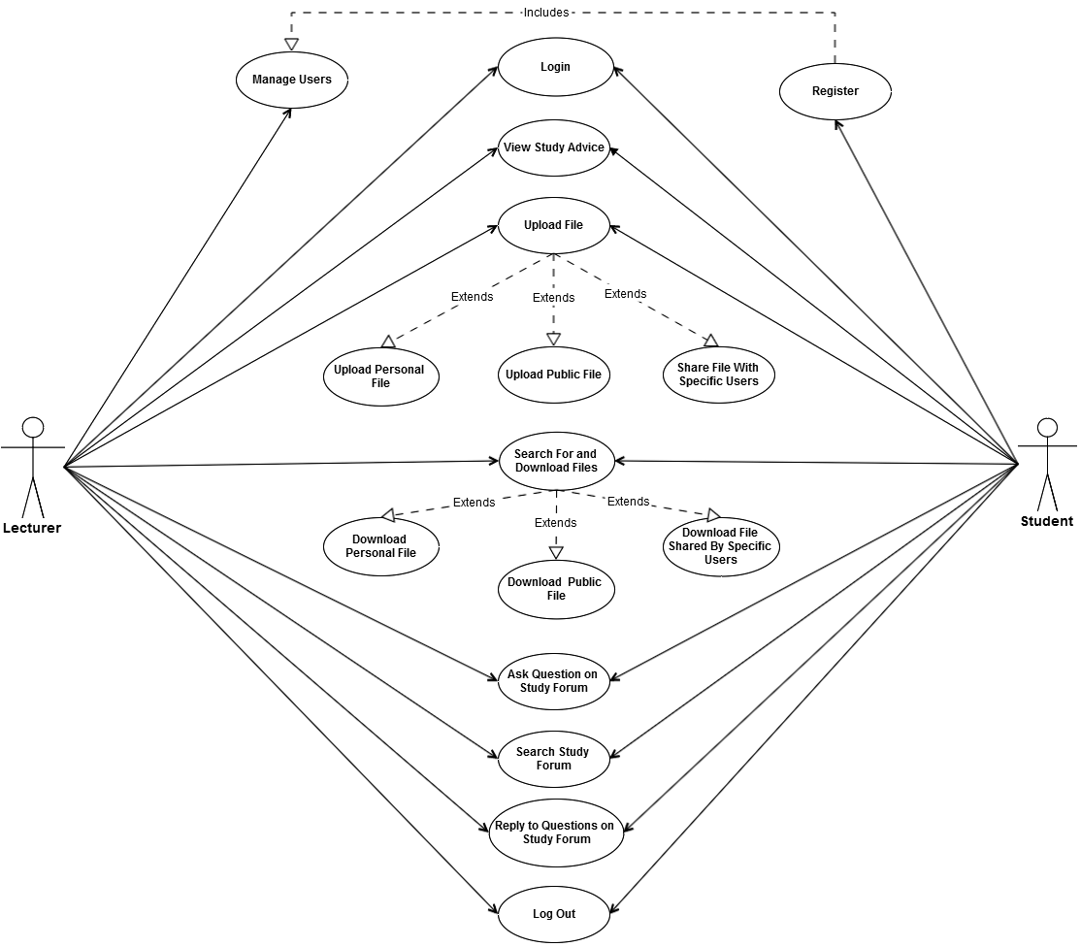
Progress…
50% complete
Front End Design

Slide 7

Prototype

Slide 8
Future Plans
Complete Artefact Development
Specific User Sharing
Delete file functionality
Jquery effects to display file information on click
Manage Users – Allow admin create new “classes”
Study Forum – PHP BB or my own?
End User testing
Purchased domain studybettertogether.com
Find web hosting

Slide 9
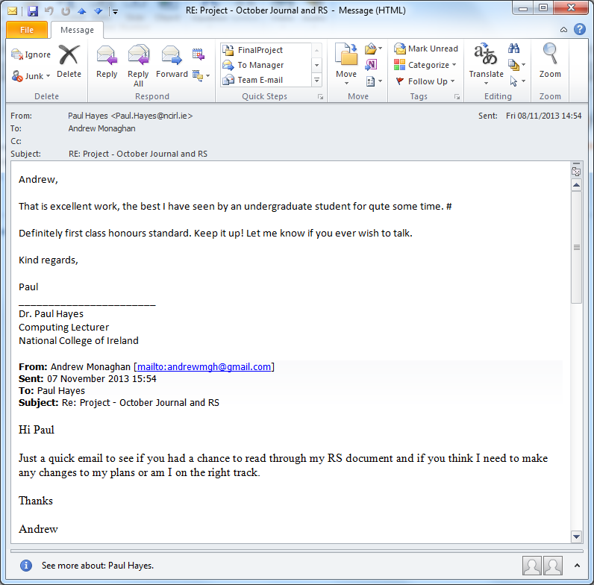
Feedback to Date
Positive feedback received from both supervisor and client.
3 very beneficial client meetings.

Slide 10
Business Model
Target audience
Small colleges (<100 students).
Colleges don’t have current LMS
Packaged Software Model
Web application will sit under college domain.
E.g. www.ncirl.ie/studybettertogether.
Ensures college has full ownership of student files
Package Deal
Once off fee – no recurring charges
College receives software and rights to change code
Web app and database are configured for the college
3 months free technical support

Slide 11

Questions

