Slide 1

BSc in Business Information Systems (BSHBIS4) Business Process Engineering
Value Engineering/Analysis

Slide 2
Learning Objectives
By the end of this lesson you should be able to:
Define Value Engineering
Define value
Explain how to do a Value Analysis
Describe the components of Porter’s Value Chain Analysis

Slide 3
Analysis Tools for Identifying Improvement Priorities

Slide 4

Definition
Canadian Society of Value Analysis (www.scav-csva.org):
Value Analysis is defined as
“a systematic and function-based approach to improving the value of products, projects, or processes”.

Slide 5
What is Value Analysis/Engineering?
Analyzes the functionality of a product
States an estimated cost for each function
Demonstrates a function as compared with that of a competitor's
Forces a product assessment for:
manufacturing processes
parts and materials
design features
Notes:
In many ways BPR is Value Engineering applied to process rather than products.
Developed by GE in 1940’s is essentially a technique to improve product performance through redesign.
Existing product’s design is scrutinised to ensure that every aspect was necessary to deliver the utility of the product.

Slide 6
Good/Bad Value?

Slide 7
Value
All commercial activities are performed with the objective of providing value of some kind, where the value is a combination of the benefits gained from the activity and the cost of achieving these benefits
Value = Worth
Cost

Slide 8
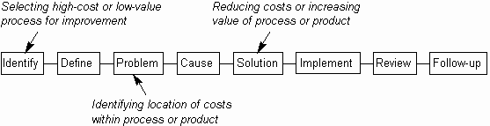
When to use Value Analysis
To identify needed product improvements
To lower product costs
To prioritize product redesign activities
To determine the real value of each component
Notes:
Use it when analyzing a product or process, to determine the real value of each component.
Use it when looking for cost savings, to determine components that may be optimized.
Use it only when the item to be analyzed can be broken down into sub-components and realistic costs and values allocated to these
DIAGRAM - Using Value Analysis in problem solving

Slide 9
How to do a Value Analysis
The construction of the value analysis table may reflect a different set of factors.
The primary concern is to determine functions that have a high cost associated with them.
Competitors' superior designs must be considered in all redesign efforts.
Notes:
The construction of the value analysis table may reflect a different set of factors.
The primary concern is to determine functions that have a high cost associated with them. These functions often call for a redesign priority.
Competitors' superior designs must be considered in all redesign efforts.

Slide 10

Function
The fundamental concept underlying Value Analysis is function – ask yourself:
“What does an object do?”
…rather than…
“How is an object made?”

Slide 11
Simple example
Part: Graphite
Function: Make marks
Part: Metal band
Function: Attach eraser
Part: Paint
Functions: Protect pencil, Improve appearance
Part: Eraser
Function: Remove marks
Part: Wooden case
Function: Hold graphite
Notes:
Figure 7.3: Functions of components of a pencil.
The primary function of a pencil is to make marks on paper – all other functions are secondary to this

Slide 12
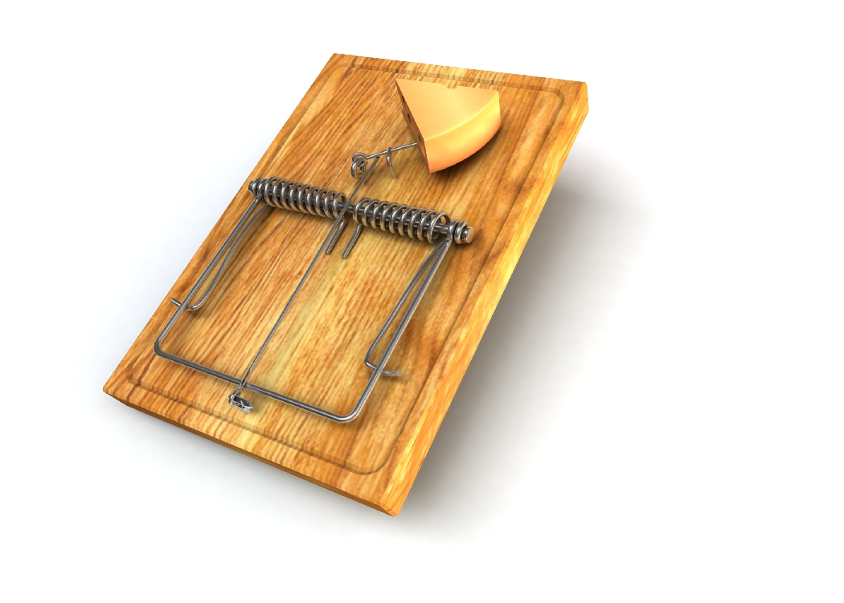
Value Analysis Example – Building a Better Mousetrap
Bait pedal
Spring
Locking bar
Platform
Hammer
Notes:
Figure 7.4: A typical mousetrap

Slide 13
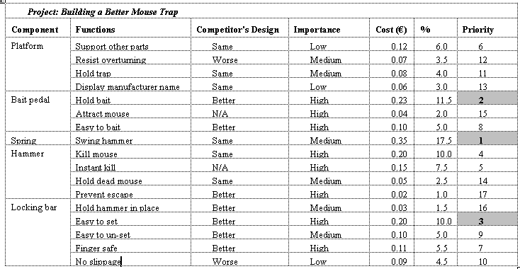
Value Analysis for Building a Better Mouse
Notes:
Anything that did not directly contribute to this utility was eliminated…..
In effect, the product was redesigned to deliver or enhance its value, in customer terms, in the most cost-effective manner possible.

Slide 14

What do you do next?
Re-check your data
Cost of redesigning each function?
Level of difficulty in any redesign project?
Cost-Benefit Analysis

Slide 15

Other Examples
American Airlines
saved a great deal of money by implementing a suggestion to adopt a non-painted livery on their aircraft
Notes:
An example of value engineering illustrates well the savings that can be made by questioning basic design assumptions:
An AA 777 has 50lbs of paint v’s a fully painted 777 that has 475lbs of paint.
Saves fuel through reduced weight
Marketing influence – Painted and partially polished

Slide 16

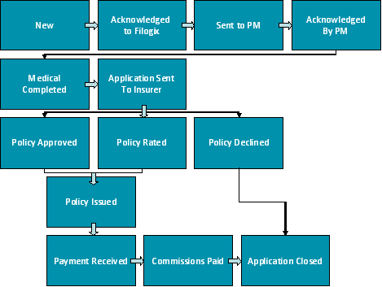
Other Examples
Insurance company:
22 days to process application for insurance
17 minutes of actual work done

Slide 17


Other Examples
Ford
Buys about 2/3s of its parts from o/s suppliers
Employed 500 in accounts payable
By rationalising procedures and installing new computer systems it could reduce head count to 400
Mazda
did the same job with 5 people even after allowing for scale differences.

Slide 18
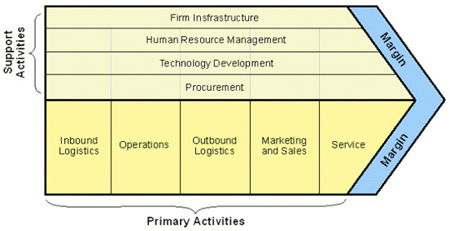
Value Chain Analysis (Porter)
Notes:
Primary Activities - those activities that are directly concerned with creating and delivering a product/service
Support Activities - whilst not directly involved in production, support activities may increase effectiveness or efficiency (e.g. human resource management). It is rare for a business to undertake all primary and support activities.
Procurement – materials & equipment
Firm’s Infrastructure – Culture, Controls
Technology Development – to support value creating activities
Human Resources –hiring. Training etc

