Slide 1
Business Data Analysis
Lecture 7
Student’s t-Test
Dr Eugene F.M. O’Loughlin
Semester 1
2012-2013

Slide 2
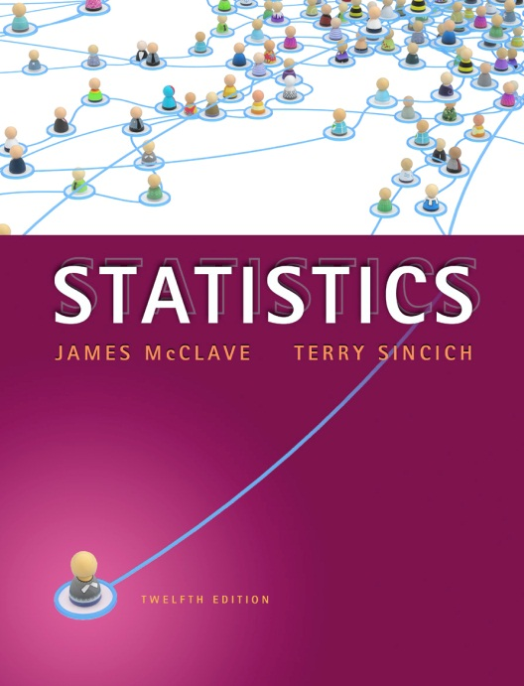
Reading
McClave & Sincich
Chapter 10
Student’s t test

Slide 3

Objective
Be able to compute and interpret test for difference between two group means

Slide 4

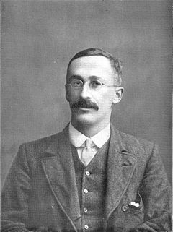
Student’s t test
Student's t-test is used to compare the means of two samples
Developed by William Gosset of Guinness's Brewery
Notes:
“Student” is a pseudonym

Slide 5
Handling smaller samples: the t-distribution
Use when…
Small sample size (n < 30)
Population Mean unknown
Population Standard Deviation unknown
Use Student's t-test when you have one nominal variable and one measurement variable, and you want to compare the mean values of the measurement variable.
The nominal variable must have only two values, such as "male" and "female" or "treated" and "untreated."
Notes:
This and next few slides taken from http://jpkc.njmu.edu.cn/course/tongjixue/file/jxzy/ybzzSD/toc.html (Statistics for Dummies)
For means/proportions, in the case where the sample size is small (and by small, I mean dropping below 30 or so), you have less information on which to base your conclusions.
Another drawback is that you can't rely on the standard normal distribution (Z-distribution) to compare your test statistic, because the central limit theorem hasn't kicked in yet. (The central limit theorem requires sample sizes that are large enough for the results to average out to a bell-shaped curve.
You already know you should disregard results that are based on very small sample sizes (especially those with a sample size of 1).
So, what do you do in those in-between situations, in which the sample size isn't small enough to disregard and isn't large enough to use the standard normal distribution to weigh your evidence?
You use a different distribution, called a t-distribution.

Slide 6
Null hypothesis
The statistical null hypothesis is that the means of the measurement variable are equal for the two categories.
=
Notes:
Level of Measurement
Nominal scale: categorical (e.g., gender, race, experiment group vs. control group)
Ordinal scale: categories that can be ranked (e.g., none, light, moderate, heavy smoker)
Interval scale: continuous, equal distances (e.g., age, reading time)

Slide 7
Level of Measurement (Examples)
Demographical data
Age
Height
Gender
Income
Eye-colour
Employee Survey
Status
Self assessment
Salary
Bonus

Slide 8
Assumptions
The samples being compared should have a reasonably symmetrical distribution
The samples being compared should have a mean which is close to the centre of the distribution
The distribution should have only one mode (highest point in the frequency histogram)
Notes:
You will probably notice that these conditions are very similar to those of a normal distribution.
A t-test works best on normally distributed data.
If the distribution is not normal, but still satisfies the conditions above, (it is flat, for example), then a t-test will still work as long as you have enough values in your sample (25 to 30 is usually okay).
If your data is heavily skewed, then you may need a very large sample before a t-test will work. In such cases, an alternate non-parametric test should be used.

Slide 9
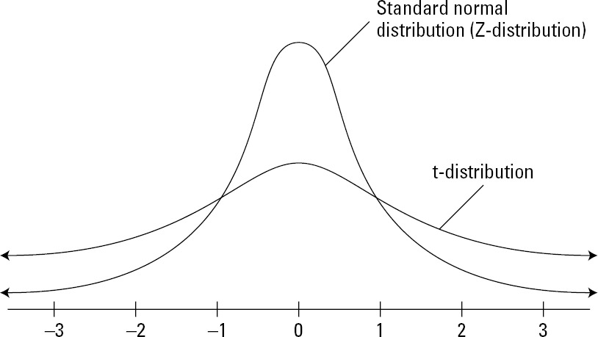
t vs z
Notes:
The t-distribution is basically a shorter, fatter version of the standard normal distribution (Z-distribution).
The idea is, you should have to pay a penalty for having less information, and that penalty is a distribution that has fatter tails.
To make a touchdown (getting into that magic 5% range where H_{o} is rejected) with a smaller sample size is going to mean having to go farther out, proving yourself more, and having stronger evidence than you normally would if you had a larger sample size. The figure above compares the standard normal distribution (Z-distribution) to a t-distribution.

Slide 10
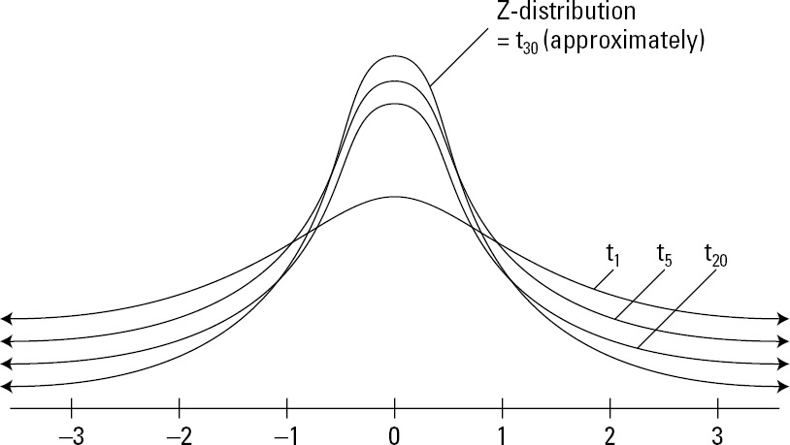
Each sample size has its own t-distribution
Notes:
Each sample size has its own t-distribution. That's because the penalty for having a smaller sample size, like 5, is greater than the penalty for having a larger sample size, like 10 or 20.
Smaller sample sizes have shorter, fatter t-distributions than the larger sample sizes.
And as you may expect, the larger the sample size is, the more the t-distribution looks like a standard normal distribution (Z-distribution); and the point where they become very similar is about the point where the sample size is 30.
Figure above shows what different t-distributions look like for different sample sizes and how they all compare to the standard normal distribution (Z-distribution).

Slide 11

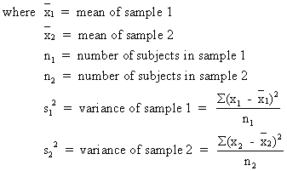
Formula
Notes:
Source: http://easycalculation.com/statistics/ttest-calculator.php
T-test calculation is most commonly applied when the test statistic would follow a normal distribution if the value of a scaling term in the test statistic were known. When the scaling term is unknown and is replaced by an estimate based on the data, the test statistic (under certain conditions) follows a Students t distribution.

Slide 12
Steps
To calculate t statistic, do the following:
Calculate the sample means (x and y) and sample standard deviations (s_{x} and s_{y}) for each sample separately. Let n₁ and n₂ represent the two sample sizes (they need not be equal).
Find the difference between the two sample means, x − y.
Calculate the standard error (denominator).
Save your answer.
Divide your result from Step 2 by your result from Step 3.
Notes:
Source:
http://jpkc.njmu.edu.cn/course/tongjixue/file/jxzy/ybzzSD/LiB0071.html
This test is used when the variable is numerical (for example, income, cholesterol level, or miles per gallon) and two populations or groups are being compared (for example, men versus women, athletes versus non-athletes, or cars versus SUVs).
Two separate random samples need to be selected, one from each population, in order to collect the data needed for this test.
The null hypothesis is that the two population means are the same; in other words, that their difference is equal to 0.
The notation for the null hypothesis is H₀: μ_{x} − μ_{y} = 0, where μ_{x} represents the mean of the first population, and μ_{y} represents the mean of the second population.

Slide 13


Example – Paper Towel Absorption
Suppose you want to compare the absorbency of two brands (Bounty and Viva) of paper towels.
You can make this comparison by looking at the average number of millilitres each brand can absorb before being saturated.
Hypotheses:
H₀: μ_{x} − μ_{y} = 0
H_{a}: μ_{x} − μ_{y} ≠ 0
Notes:
H_{o} says the difference between the average absorbencies is 0 (non-existent), and H_{a} says the difference is not 0.
Here, you have no indication of which paper towel may be more absorbent, so the not-equal-to alternative is the one to use.

Slide 14
Example – Paper Towel Absorption
Suppose you select a random sample of 50 paper towels from each brand and measure the absorbency of each paper towel
Bounty
Mean = 3mls
Standard deviation = 0.9mls
Viva
Mean = 3.5mls
Standard deviation =1.2 mls

Slide 15
Example – Paper Towel Absorption
Data
Bounty
x = 3
s = 0.9
n = 50
Viva
x = 3.5
s = 1.2
n = 50
Notes:
Get students to calculate t

Slide 16
Result – step-by-step
 | Bounty (x) | Viva (y)
N | 50 | 50
Mean | 3.0 | 3.5
Std Dev | 0.9 | 1.2
Calculations
Difference between means | -0.5000
s_{x}² / N | 0.0162
s_{y}² / N | 0.0288
sx2 / N + sy2 / N | 0.0450
Standard error | 0.2121
t statistic | -2.4

Slide 17
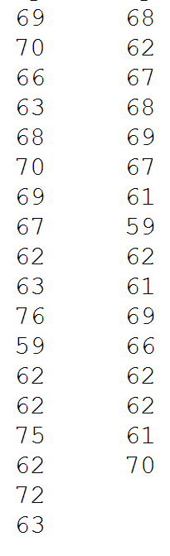
Your Turn…
The heights of each student in two classes were measured (inches)
Are the average heights of the two sections significantly different (p < 0.05)?

Slide 18
t value…
Now what?
Need to convert “t” to a “p” (probability value)
Critical values of t distribution
Notes:
Converting from a t-value to a p-value requires some tricky maths, so statisticians use pre-calculated tables to make it easy.
These tables are called t-tables.A t-table is shown below. Notice that it has a number of columns, each showing a different significance level (p).
T-tables do not tell you the exact value of p. They list a few key values of p and tell you what value of t is required to produce a p-value less than the listed value.

Slide 19
Degrees of Freedom
When you're testing one population's mean and the sample size is n, the degrees of freedom for the corresponding t-distribution is n −1.
So, for example, if your sample size is 10, you use a t-distribution with 10 −1 or 9 degrees of freedom, denoted t₉
Notes:
Degrees of freedom is the number of values in the final calculation of a statistic that are free to vary

Slide 20
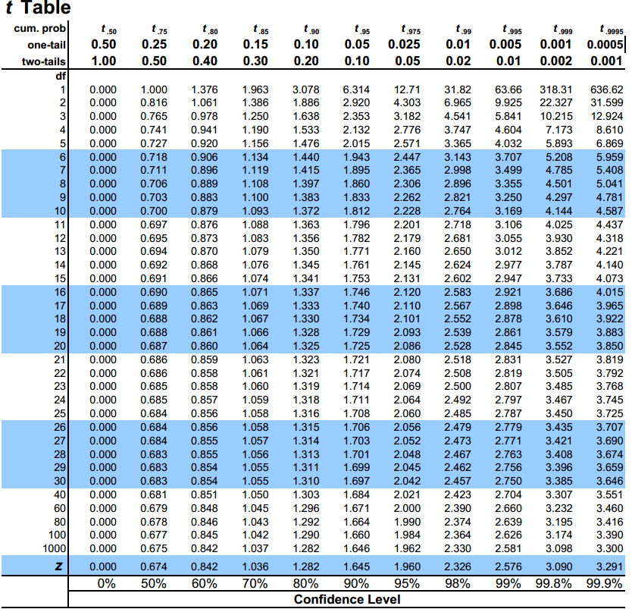
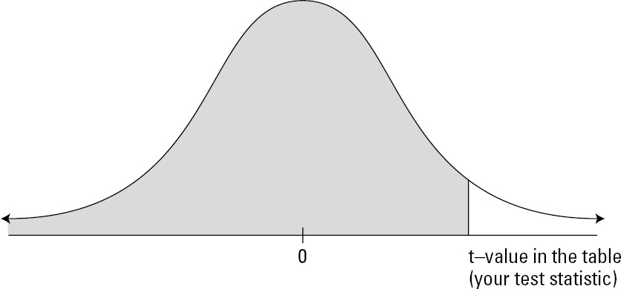
Critical Values of t-distribution
t = - 2.4
Notes:
Suppose your sample size is 10, your test statistic (referred to as the t-value) is 2.5, and your alternative hypothesis, H_{a}, is the greater-than alternative.
Because the sample size is 10, you use the t-distribution with 10 − 1 = 9 degrees of freedom to calculate your p-value.
This means you'll be looking at the row in the t-table that has a 9 in the Degrees of Freedom column.
Your test statistic (2.5) falls between two values: 2.262 (the 97.5th percentile) and 2.821 (the 99th percentile).
Some tables (such as the ones on this page) show a p-value heading for both one and two-tailed tests to make it easier. If your test is one tailed, find the p-value you need in the top row. If your test is two tailed, find your p-value in the second row. Notice how the p-values for the two tailed test are simply double those for the one tailed test.

Slide 21
Using t-Tables
We have learned the following things about a t-test:
The t-test produces a single value, t, which grows larger as the difference between the means of two samples grows larger
t does not cover a fixed range such as 0 to 1 like probabilities do
You can convert a t-value into a probability, called a p-value
The p-value is always between 0 and 1 and it tells you the probability of the difference in your data being due to sampling error
The p-value should be lower than a chosen significance level (0.05 for example) before you can reject your null hypothesis.
Notes:
Source:
http://www.gla.ac.uk/sums/users/narjis/stroke/pandt2.html

Slide 22
Reporting p-Values and t-Values
You report the results of a t-test in the following way:
t(df) = t, p<p
Where df is the degrees of freedom of your data, t is the t-value you found and p is the p-value you found.

Slide 23
Notes:
Source:
http://www.sjsu.edu/faculty/gerstman/StatPrimer/t-table.pdf
ADD TO MOODLE
Converting from a t-value to a p-value requires some tricky maths, so statisticians use pre-calculated tables to make it easy.
These tables are called t-tables.A t-table is shown below. Notice that it has a number of columns, each showing a different significance level (p).
T-tables do not tell you the exact value of p.
They list a few key values of p and tell you what value of t is required to produce a p-value less than the listed value.
It has many rows and each row is marked with a number showing the degrees of freedom (df).

Slide 24
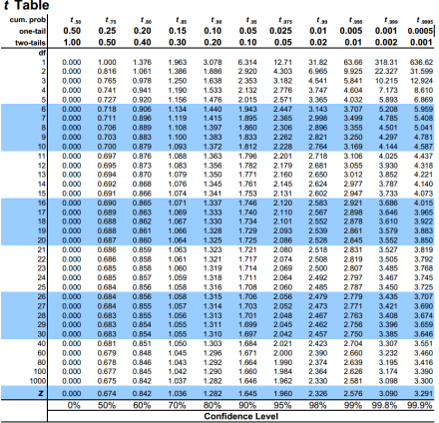
Reading a t Table
Once you have chosen your significance level, p, calculated a value for t, and worked out how many degrees of freedom you have, you can find the entry in the t-table that you need as follows:
Look down the column that corresponds to your chosen value for p
Find the row that corresponds to your degrees of freedom, and where they meet, you will find the value you need.
This value is called the critical value.

Slide 25
Using the Critical Value
The final thing to do is compare the critical value with your value of t:
If your t-value is greater than or equal to this value, then t is significant and you have found a difference
If your t-value is less than this value is then t is not significant.

Slide 26
p < 0.05, t = 3.143, df = 4, tails = 1 What is critical value?
Significant?
t-value is greater than critical value, therefore t is significant and you have found a difference
Notes:
Ask – is there a significant difference or not?

Slide 27
Exercise
Determine the critical value and state whether t is significant in the following three examples:
p < 0.01, df = 12, t = 3.143, Tails = 1
p < 0.05, df = 8, t = 3.143, Tails = 2
p < 0.01, df = 7, t = 3.143, Tails=2

