Slide 1
Business Data Analysis
Lecture 3
Core Concepts
Jer Hayes
Semester 1
2012-2013

Slide 2
Population & samples
Population.
A collection of units being studied. Units can be people, places, objects, epochs, drugs, procedures, or many other things. Much of statistics is concerned with estimating numerical properties (parameters) of an entire population from a random sample of units from the population.
Sample.
A sample is a collection of units from a population.
Unit.
A member of a population.

Slide 3
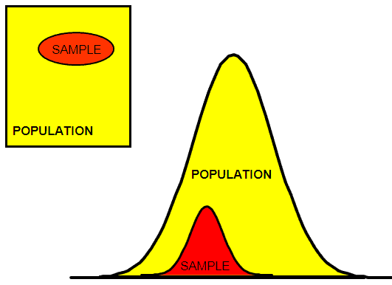
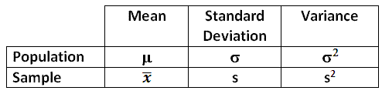
Descriptive measures that describe a POPULATION are called PARAMETERS. Descriptive measures that describe a SAMPLE are called STATISTICS.

Slide 4
Exploring data
So far we have looked at ‘univariate’ data
Univariate.
Having or having to do with a single variable. Some univariate techniques and statistics include the histogram, mean, median, and SD etc.
We used the ‘histogram’ which is just a type of bar chart
Why? It can give us a sense of the distribution of the data. Where do the values fall? Do they group together etc?

Slide 5
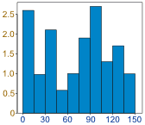
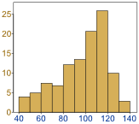
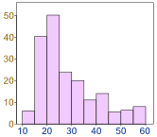
Distribution
Data can be distributed in different ways:
Can you remember what we said about ‘skewed’ distributions and the mean & median?

Slide 6
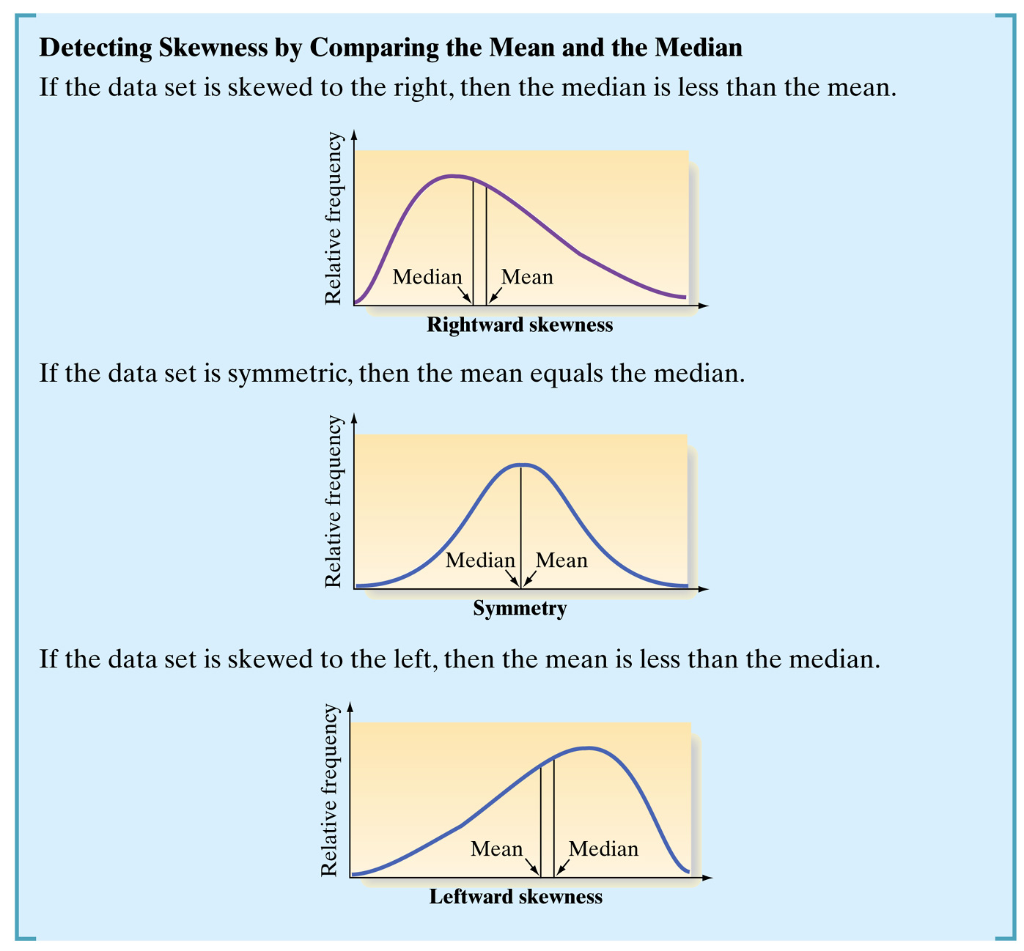

Slide 7
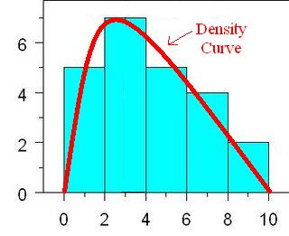
Density Curve
Where do these curves come from?
A density curve is a curve that gives a rough description of a distribution. The curve is smooth, so any small irregularities in the data are ignored.
Density curves are always drawn above the horizontal axis on a graph.
When a distributions density curve is similar enough to a density curve with known properties, we can use those properties to obtain information about the distribution.

Slide 8
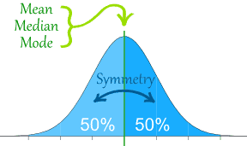
Normal Distribution
…a density curve with known properties?
The Normal Distribution has:
mean = median = mode
symmetry about the centre
50% of values less than the mean
and 50% greater than the mean

Slide 9
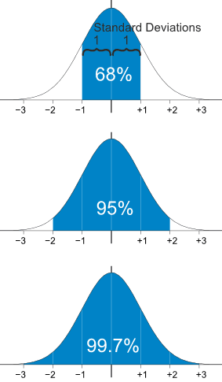
Normal Distribution
68% of values are within 1 standard deviation of the mean
95% are within 2 standard deviations
99.7% are within 3 standard deviations

Slide 10
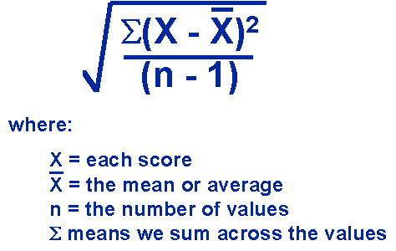
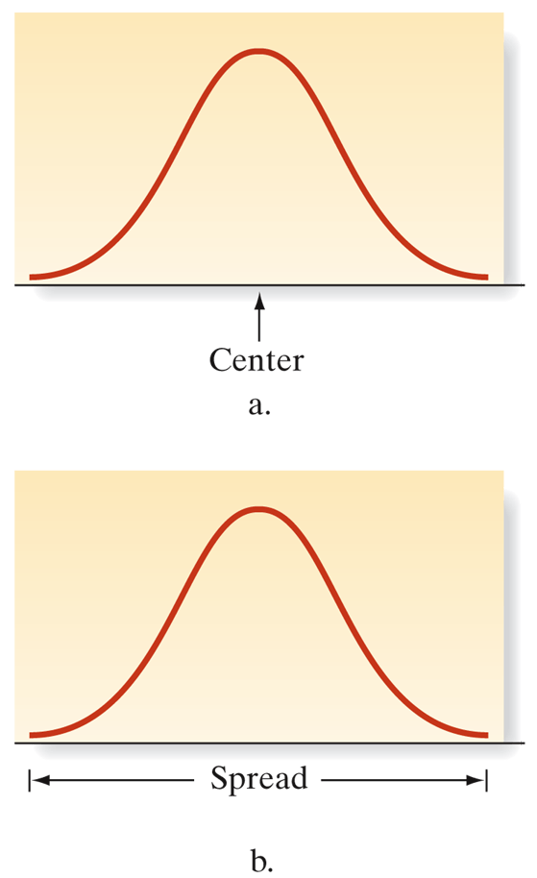
Standard Deviation
Samples
Sample Standard Deviation, S.
The sample standard deviation is a statistic that measures how "spread out" the sample is around the sample mean.

Slide 11
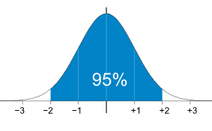
Example
Suppose we know that 95% of students at school are between 1.1m and 1.7m tall. Assuming this data is normally distributed can we calculate the mean and standard deviation?
1.1m
1.7m
Mean? The mean is halfway between 1.1m and 1.7m: Mean = (1.1m + 1.7m) / 2 = 1.4m
95% is 2 standard deviations either side of the mean (a total of 4 standard deviations) so:
1 standard deviation = (1.7m-1.1m) / 4 = 0.6m / 4 = 0.15m
http://www.mathsisfun.com/data/standard-normal-distribution.html

Slide 12
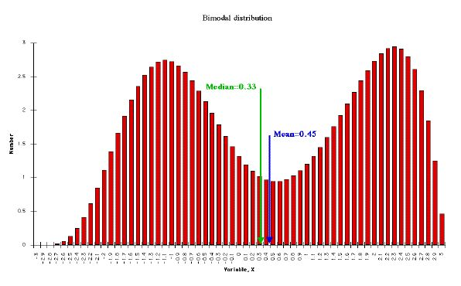
Other Distributions
We are not saying that everything follows a normal distribution.
It’s just one type of distribution.
But later we will see that some ‘tests’ do assume a normal distribution.

Slide 13
Z-score
A Z-score is a measure of the number of standard deviations a particular data point is away from the mean.
Basically - The z-score is simply the signed distance the sample value is from the mean in standard deviations.
So, the mean score on the BDA test is 82, the standard deviation is 7. You got 89 and person beside you only got 75.
Your z score is 1, theirs is -1.

Slide 14


Z-score
Formula is:
Signed: if positive greater than the mean and if negative it’s less

Slide 15
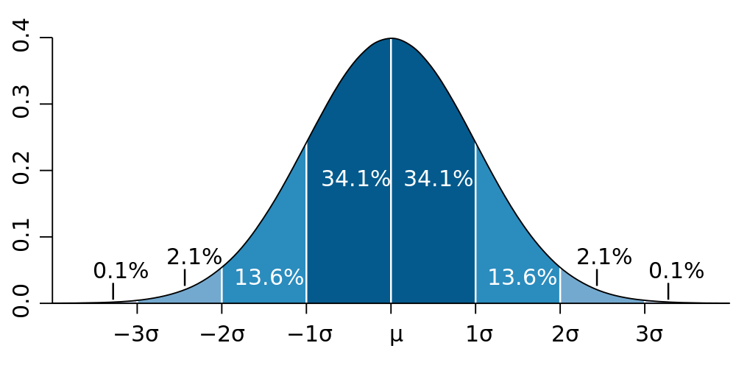
How did you and your neighbour do on the exam?
Your neighbour is here. Better luck next time!
You are here. Well done!

Slide 16

Try these…
On a nationwide math test, the mean was 65 and the standard deviation was 10. If Robert scored 81, what was his z-score?

Slide 17
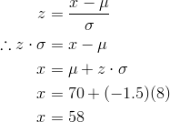
What was the exam score?
Example: On a college entrance exam, the mean was 70, and the standard deviation was 8. If Helen’s z-score was -1.5, what was her exam score?

Slide 18
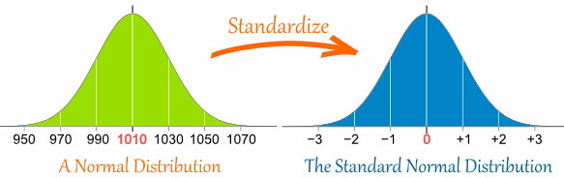
Standardize
z-score is also called a standard score
Why standardize? Consider the exam scores from two history classes with the same content but different instructors and different test formats.
To adequately compare student A's score from class A with Student B's score from class B you need to adjust the scores by the variation (standard deviation) of scores in each class and the distance of each student's score from the average (mean) for the class.

Slide 19
Example
Here are the students results (out of 60 points) of a BDA test:
20, 15, 26, 32, 18, 28, 35, 14, 26, 22, 17
If a pass is 50% most students failed.
The test must have been really hard (or the course poorly taught), so it is decided to Standardize all the scores and only fail people 1 standard deviation below the mean.
How many will fail?

Slide 20
Work it out!
20, 15, 26, 32, 18, 28, 35, 14, 26, 22, 17
The Mean is 23, and the Standard Deviation is 6.6
20: (20-23)/6.6=-0.45
-0.45, -1.21, 0.45, 1.36, -0.76, 0.76, 1.82, -1.36, 0.45, -0.15, -0.91
2 students will fail
15: -1.21
14: -1.36

Slide 21
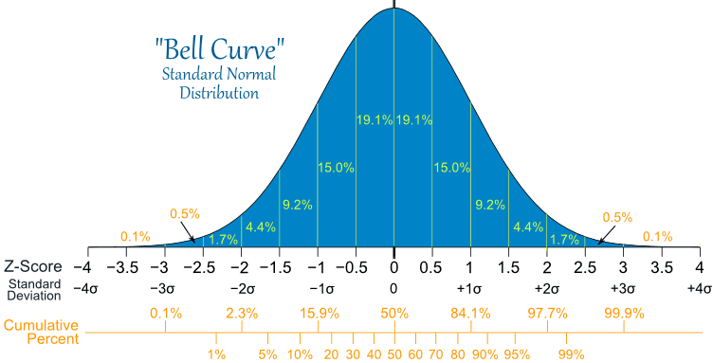
Statistical tables
Standard Normal Distribution with percentages for every half of a standard deviation
There are tables which can be consulted.

