Slide 1

Transaction
Processing

Slide 2
Course Content
Transaction Processing
Audit
Backup and Disaster Recovery
High Availability
Replication
Security

Slide 3
A Bacic Intro …
Link

Slide 4
Transaction
Processing Stages
Authorization – the card issuer approves or declines the transaction
Authentication – establishing the validity of the card
Settlement – merchant deposits the transaction with the acquiring bank and the funds are transferred into the merchants account

Slide 5
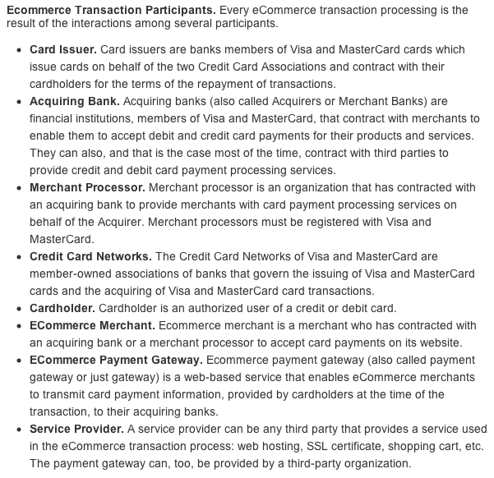

Slide 6
Overview of TPS’s
Every business has both manual and automated transaction processing systems. TPS’s assist in performing and maintaining detailed records, and support business operations such as order entry, payroll, inventory control, and sales. They also assist in adding value to the organization's goods and services.

Slide 7
Traditional TPS
When traditional TPS’s were automated, they began as file-based systems. These traditional systems used input devices that grouped transactions in batches for future batch processing.
The next step was online input, but processing was delayed and transactions were still processed as batches. With online transaction processing, applications are handled more effectively with processing occurring immediately after each Transaction was input online. However, certain applications are more cost-effective processed in batches, particularly high-volume periodic processes such as payroll and billing.

Slide 8
TPS Objectives
Because transaction processing is so important for daily operations and the data are so important for decision support systems, a TPS should accomplish specific objectives, as follows:
process data generated by and about transactions (this is the prime function)
maintain a high degree of accuracy and integrity, including the avoidance of fraudulent
transactions
produce timely documents and reports
increase labour efficiency
help provide increased service
help build and maintain customer loyalty
achieve competitive advantage

Slide 9
TPS Cycle
All TPS’s perform the basic data processing activities of capturing data from internal
and external sources, updating the databases, and producing documents and reports.
The data goes through a transaction processing cycle and consists of the following
activities:
data collection — the first step in the cycle, which may take many forms. Wherever possible, source data automation (SDA) is preferred.
data editing — checks the data against predetermined parameters
data correction — after an error is found, the data are corrected so that they can be re-entered and the set of transactions will be complete
data manipulation — performs arithmetic and logical operations according to the programming. The initial data may be used in many ways for different purposes to produce many outputs.
data storage — updates the database for use in management decision making
document production and reports — produced on hard copy or displayed on-screen

Slide 10
TPS Audit
A TPS audit is no different than any other systems audit. Its objectives are to ensure that the system meets the need for which it was designed and developed, that controls and procedures are adequate and reasonable, and that these controls and procedures are being followed and used properly.
The audit may be conducted by internal auditors or external auditors, and will be as detailed as is deemed necessary under the terms of reference. Some audits include an audit of the programs themselves to ensure they are all in the best interest of the company and perform according to program specifications. Audits include a review of all systems documentation, checking or testing output against input, and reviewing all procedures.

Slide 11
TPS Audit
In order to ensure the propriety and integrity of data processing whereby all outputs can be traced back to source documents, an audit trail is used wherever possible. In the old batch systems, this was generated automatically and was easy to follow. In the modern online systems, an audit trail may be difficult to establish or follow and may not exist due to the real-time nature of many online systems.

Slide 12
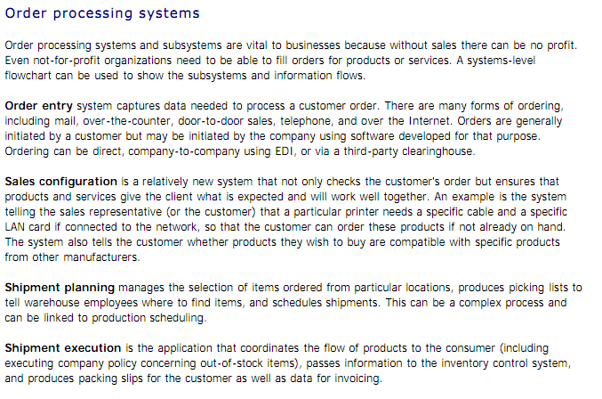
Order Processing Systems

Slide 13
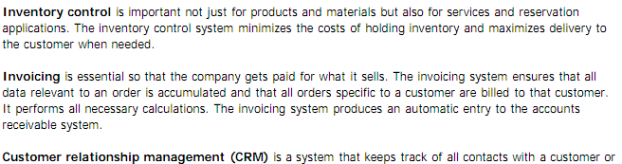
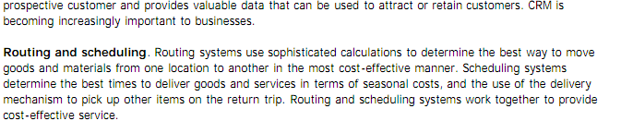
Order Processing Systems

Slide 14
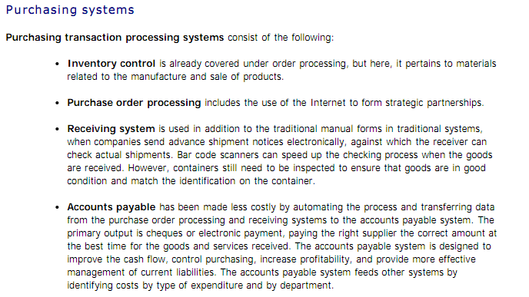
Purchasing Systems

Slide 15
Traditional Transaction Processing Methods
Batch processing – method of computerized processing in which business transactions are accumulated over a period of time and prepared for processing as a single unit
On-line transaction processing (OLTP) - method of computerized processing in which each transaction is processed immediately and the affected records are updated

Slide 16
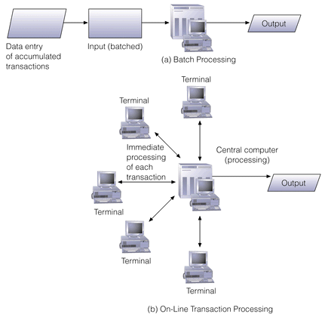
Batch V Online Processing

Slide 17
Transaction Processing Activities
Data collection: Capturing data necessary for the transaction
Data editing: Check validity and completeness
  Ex: 400 hours/week instead of 40 hours/week
Data correction: Correct the wrong data
Data manipulation: Calculate, summarize
Data storage: Update transactions
Document production and reports: Create end results (paychecks)

Slide 18
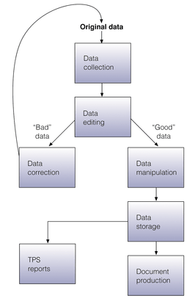
Data Processing Required

Slide 19
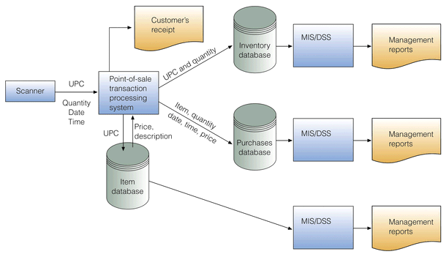
POS Transaction System

Slide 20
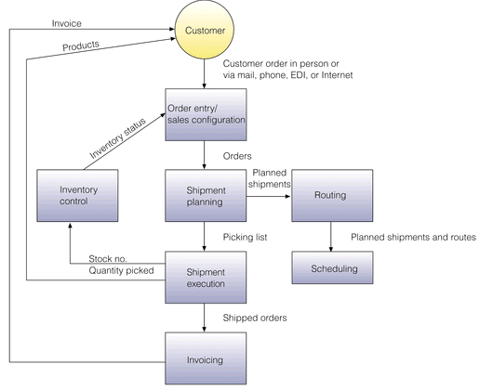
Order Processing System

Slide 21
International Issues
Key international issues resulting from the increasing number of international corporations and partnerships include;
different languages and cultures
differences in information systems infrastructures
varying customs and rules
multiple currencies

Slide 22
Next week…
mCommerce and Pervasive Computing

