Slide 1

Business Data Analysis
Lecture 1
Statistics, Data, and Statistical Thinking
Jer Hayes
Notes by Dr Eugene F.M. O’Loughlin
Semester 1
2013-2014

Slide 2
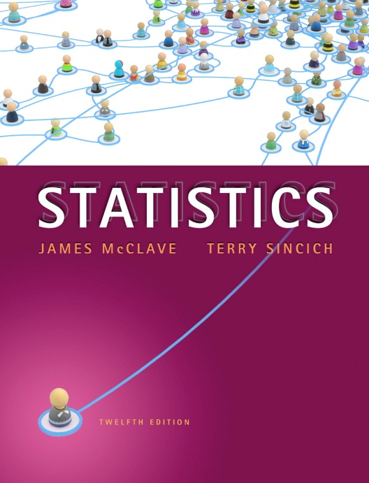
Reading
McClave & Sincich
Chapter 1
Statistics, Data, and Statistical Thinking

Slide 3
Where We’re Going
Introduction to the field of statistics
How statistics applies to real-world problems
Establish the link between statistics and data
Differentiate between population and sample data
Differentiate between descriptive and inferential statistics

Slide 4
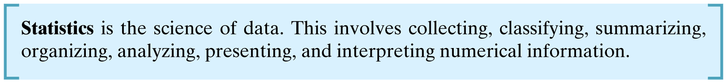
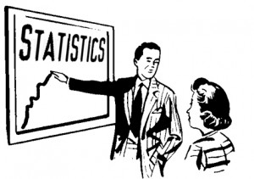
The Science of Statistics

Slide 5
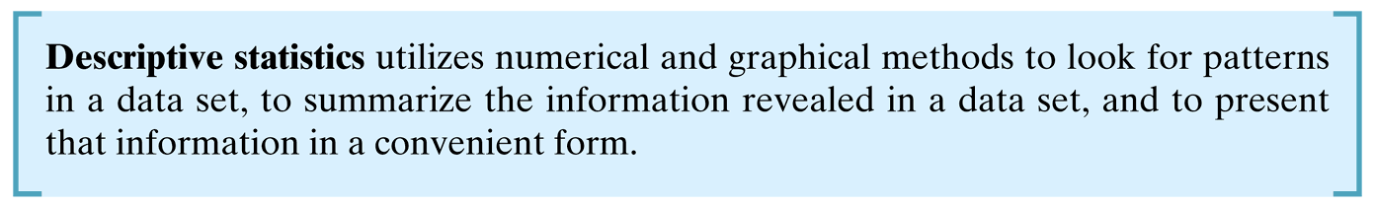
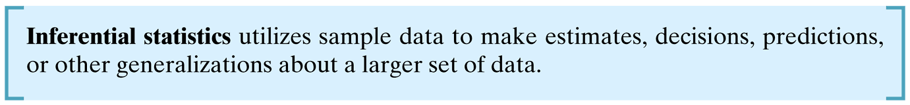
Types of Statistical Applications

Slide 6
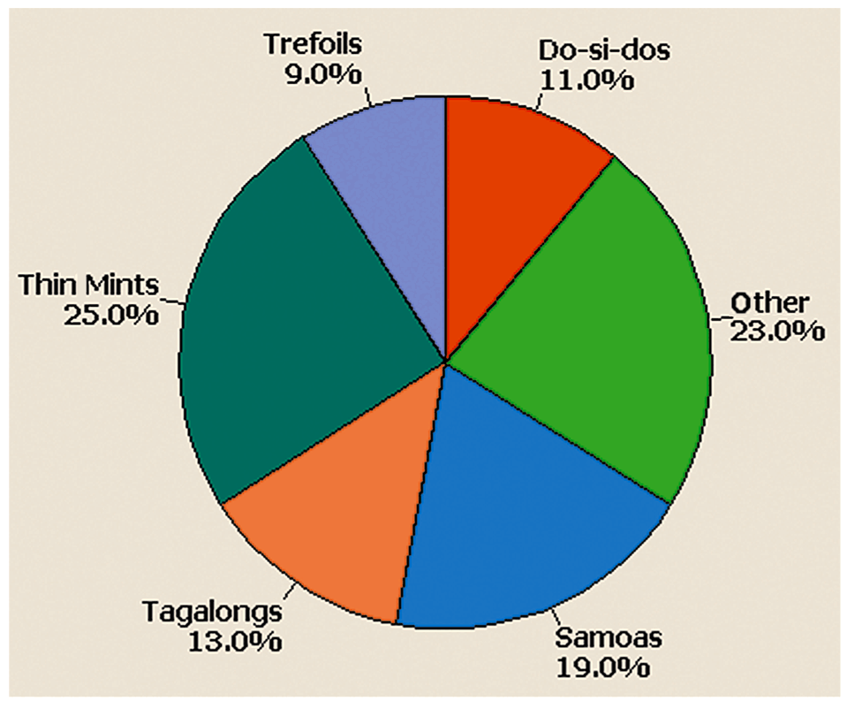
Best-selling Girl Scout Cookies
Example of descriptive statistics

Slide 7
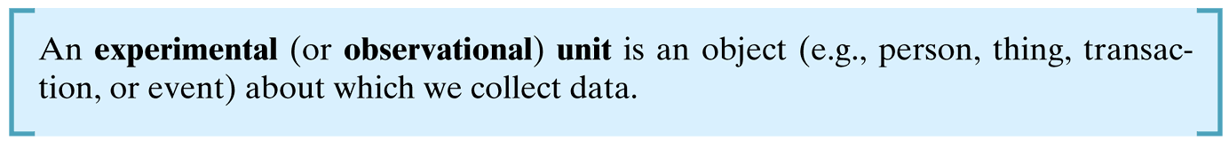
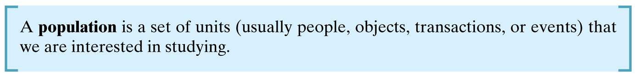
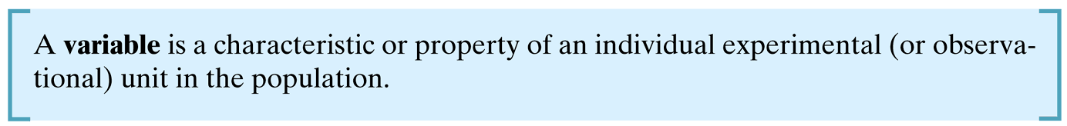
Fundamental Elements of Statistics

Slide 8
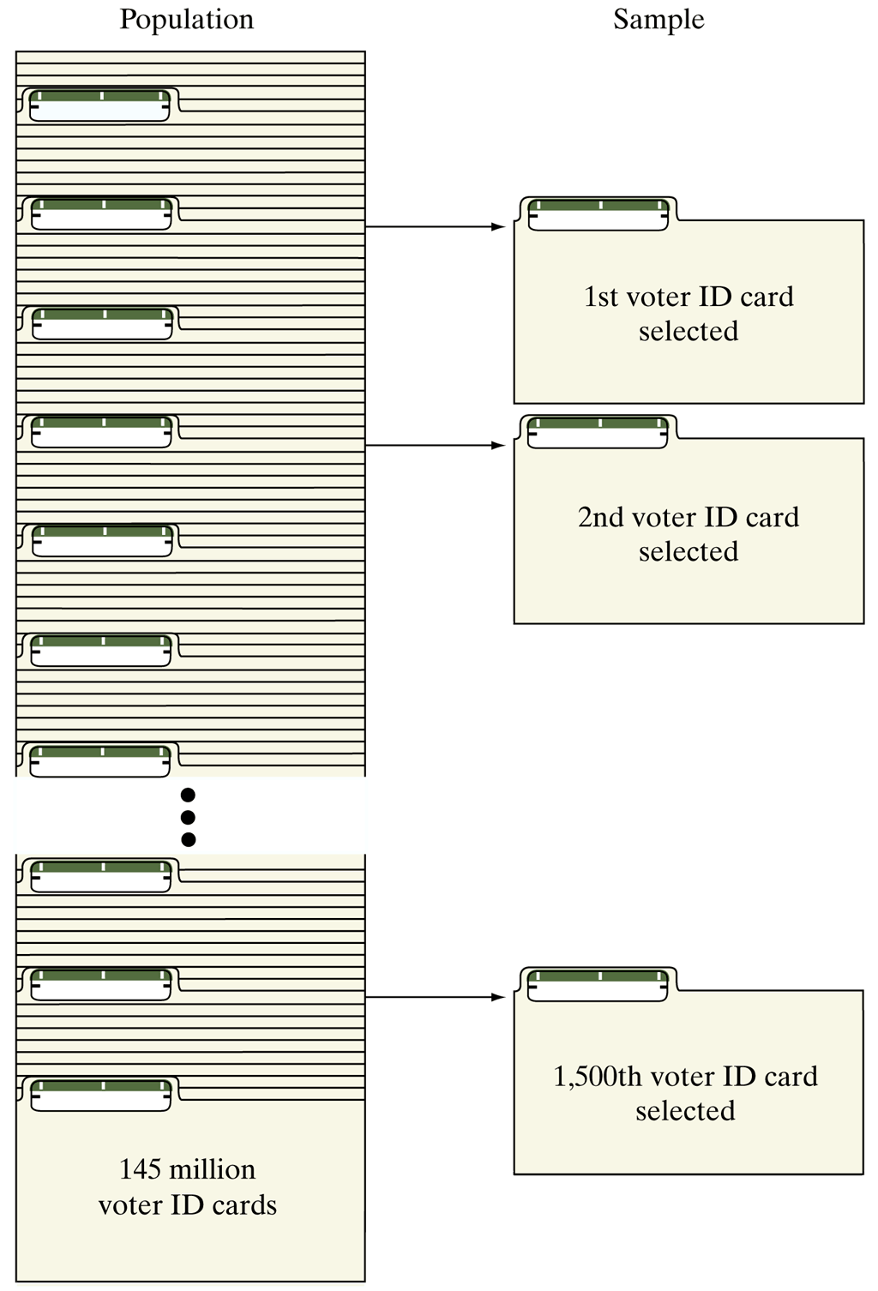
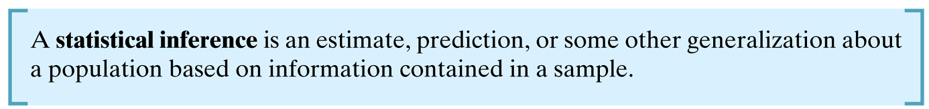
A sample of voter registration cards for all registered voters

Slide 9
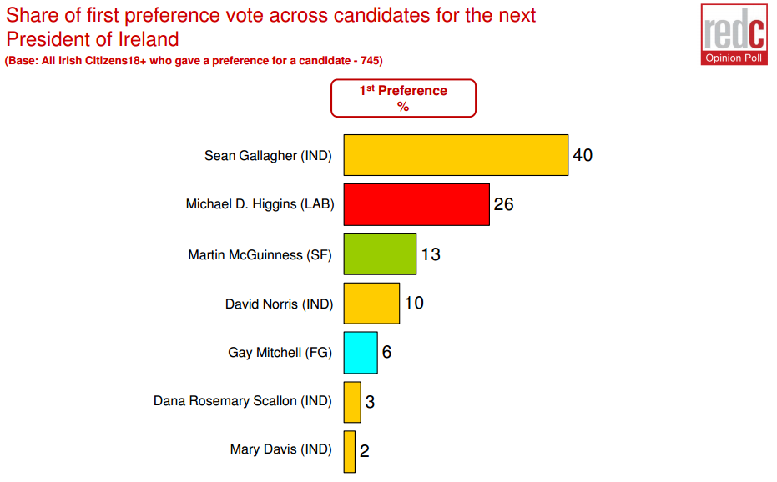
2011 Presidential Election
Final pre-election Poll (25th October)
Source: http://redcresearch.ie/wp-content/uploads/2011/10/SBP-President-Poll-23rd-Oct-2011.pdf

Slide 10
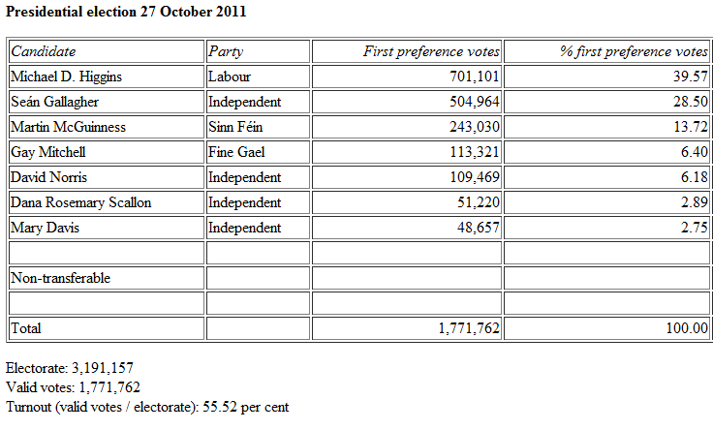
2011 Presidential Election
Actual result
Source: http://www.tcd.ie/Political_Science/staff/michael_gallagher/Election2011.php

Slide 11
Fundamental Elements of Statistics
A measure of reliability is a statement about the degree of uncertainty associated with a statistical inference.
Based on our analysis, we think 56% of soda drinkers prefer Pepsi to Coke, ± 5%.

Slide 12
Fundamental Elements of Statistics
Descriptive Statistics
Inferential Statistics
The population or sample of interest
One or more variables to be investigated
Tables, graphs or numerical summary tools
Identification of patterns in the data
Population of interest
One or more variables to be investigated
The sample of population units
The inference about the population based on the sample data
A measure of reliability of the inference

Slide 13
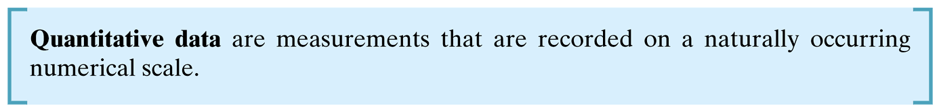
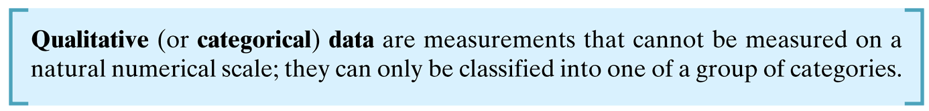
Types of Data
Examples of each????
Notes:
Ask for some examples of each:
Quantitative data eg
Temperature
Unemployment rate
Test scores
Number of murders commited per year
Qualitative data eg
Political party affiliation (FF/FG/Lab/SF...)
Defect status (defective or not)
Model of car – Ford: Ka, Focus, Mondeo, Kuga....
Ratings – Very good, Good, Neutral Poor, Very Poor

Slide 14
Collecting Data
Published source
Designed experiment
Observational study
Find...
  Marriage rates from 2006 Irish census
  Closing stock prices for Facebook since IPO
  League goals per game scored by Wayne Rooney for last 5 seasons

Slide 15
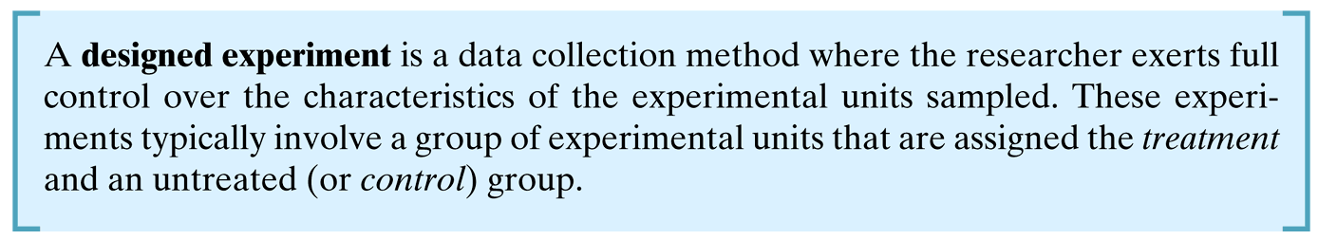
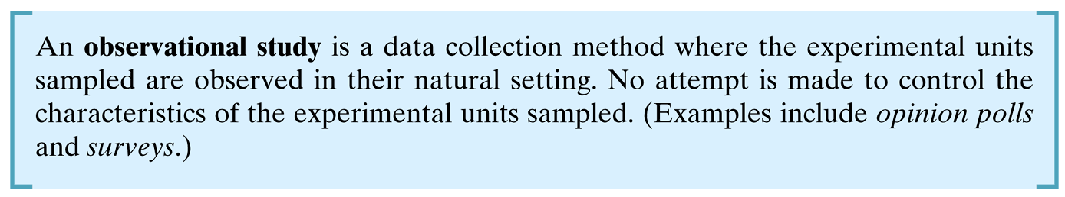
Collecting Data

Slide 16
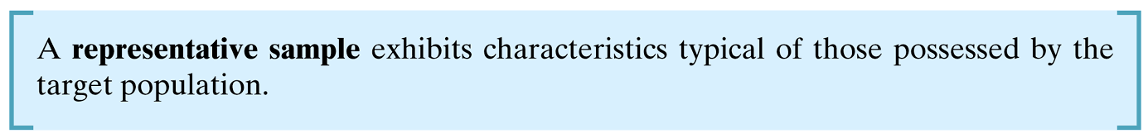

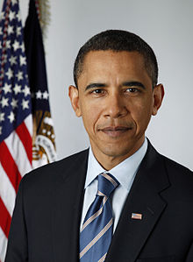
Samples
Opinion poll in Hawaii for President Obama?
Notes:
Avoid bias in sampling

Slide 17
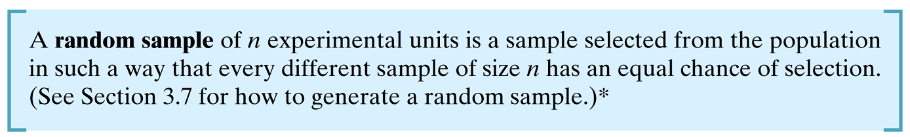
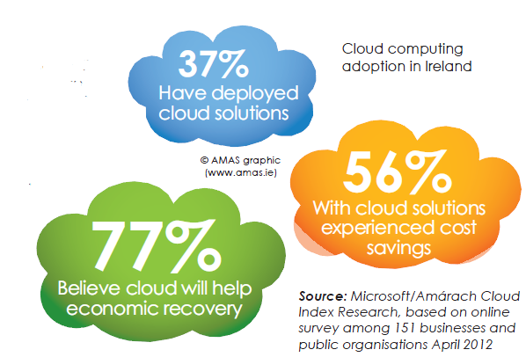
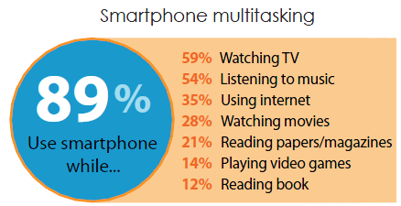
Samples
State of the Net (IIA)
Source: http://www.iia.ie/resources/download/586/
Notes:
IIA – Irish Internet Association

Slide 18
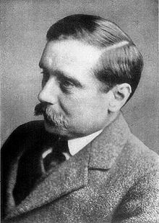
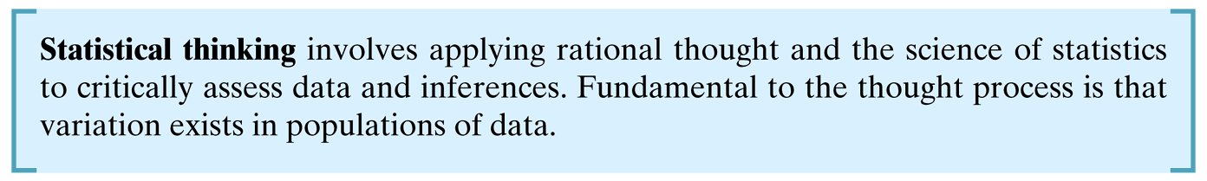
The Role of Statistics in Critical Thinking and Ethics
“Statistical thinking will one day be as necessary for efficient citizenship as the ability to read and write”
Notes:
H.G. Wells (1866-1946)

Slide 19

Helmet Laws - USA
Should motorcyclists be required
by law to wear helmets?
Survey by Editor of a Harley-Davidson magazine (1995):
“nine states without helmet laws had a lower fatality rate (3.05 deaths
per 10,000 motorcycles) than those that mandated helmets (3.38)”
“in a survey of 2,500 [at a rally], 98% of the respondents opposed such laws”
American Statistical Association – dramatic decline in motorcycle crash deaths after California passed a helmet law.
Notes:
Source of above:
http://people.cst.cmich.edu/lanfe1c/ReadingStats.html
In "The Case for NO Helmets" (New York Times, June 17, 1995), Dick Teresi, editor of a magazine for Harley-Davidson bikers argued that helmets may actually kill, since in collisions at speeds greater that 15 miles an hour the heavy helmet may protect the head but snap the spine. [Teresi] citing a "study," said "nine states without helmet laws had a lower fatality rate (3.05 deaths per 10,000 motorcycles) than those that mandated helmets (3.38)," and "in a survey of 2,500 [at a rally], 98% of the respondents opposed such laws."
Bias becasue of use of non-random samples

Slide 20
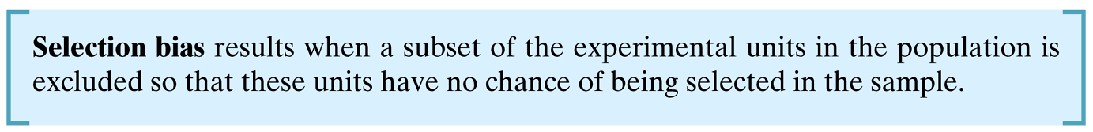
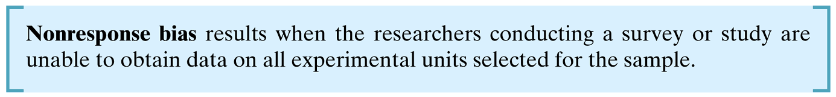
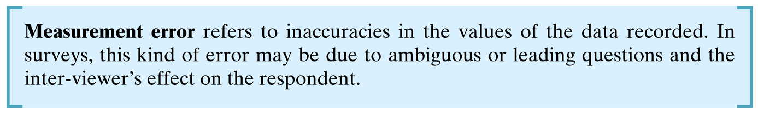
Bias

