Slide 1
Civil Justice as Code
AI For Good project – to help people who can’t afford a lawyer
Andrew Cohen • Board Member, Bay Area Legal Aid
Working Document • June 2026
© 2026 Andrew Cohen. All rights reserved.

Slide 2
THE PROBLEM — THE JUSTICE GAP: DECADES OLD & CORROSIVE TO DEMOCRACY
10s of millions face cascading civil legal crises — without a lawyer
92%
39%
3.6M
70%+
of low-income civil legal needs get no help
of low-income households face 5+ legal problems at once
eviction filings a year; fewer than 5% of tenants have a lawyer
of debt suits end in default against the unrepresented
Before May 2026 — no shared legal-tech infrastructure. Legal aid agencies and courts – creative embrace of AI but fragmented: reinventing the wheel 1 isolated expensive AI pilot at a time
That just changed. →
THE PROBLEM
© 2026 Andrew Cohen. All rights reserved.
2

Slide 3

WHAT CHANGED IN MAY 2026 - LAWYERS NOW HAVE WHAT OTHER INDUSTRIES HAVE LONG HAD
Anthropic’s new legal infrastructure/platform
For the first time, legal tech has common shareable building blocks
Built once, improved by everyone — open sourced— the way Linux, FHIR, Kubernetes and CfA became standard continuously improving software infrastructure in their fields.
Healthcare
HL7 / FHIR
Each hospital had its own data formats
→
FHIR - data standards
Cloud
CNCF
Each company had its own way to build and operate software
→
CNCF - shared standards & certification
Benefits
CfA Playbooks
Each state built its own benefits intake from scratch
→
Code for America - reusable playbooks
Civil Justice
Claude for Legal
Every agency builds legal-help AI from scratch
→
Anthropic - shared legal infrastructure. Other AI models likely to follow.
WHAT CHANGED
© 2026 Andrew Cohen. All rights reserved.
3

Slide 4









POWERFUL NEW LEGAL AI INFRASTRUCTURE
Shared nonprofit legal AI infrastructure
AUTHORITATIVE LAW
TIER 2 (LEGAL)
Statutes
Connectors
Legal-aid worker
Live, deterministic lookups — the law as it is today.
Review & oversee
Case law
Impacted person
Court systems
Needs safe, usable help
Skills & plugins
Workflows: intake, eligibility, drafting, deadlines.
TIER 1 (AI)
AI foundation: translation · reasoning · drafting (“predictive”)
TIER 2 (SAFETY)
PROCESS GUARDRAILS WRAP THE WHOLE SYSTEM: multi-layer testing · PII & privacy · mandatory human-attorney review · published accuracy standards.
LEGAL AI INFRASTRUCTURE
4
© 2026 Andrew Cohen. All rights reserved.
Notes:
Claude legal for nonprofits - other AI models sure to follow

Slide 5



T3 · Rules
INFRASTRUCTURE, TIER 1 — THE CORE AI (PREDICTIVE)
Tier 1 AI layer: translation, drafting, and reasoning
T2 · Legal
T1 · AI
A continuously improving AI model is the engine — powerful, but not fully trustworthy for law on its own, including because it is “predictive” and reasons from memory. The legal layer (next) makes it more reliable.
Translation
Drafting
Reasoning
Turns a person's plain-language description into structured legal concepts — and turns legal complexity back into plain language.
Generates court filings, letters, and responses – in seconds for human review.
Works through multi-step legal logic — conditions, exceptions, sequences.
LEGAL AI INFRASTRUCTURE
5
© 2026 Andrew Cohen. All rights reserved.

Slide 6

INFRASTRUCTURE, TIER 2 — LEGAL & SAFETY LAYER
T3 · Rules
T2 · Legal
Tier 2 legal & safety layer: more accurate, improving
T1 · AI
Three shared components sit on the AI model - reusable across jurisdictions, organizations, and AI providers.
Connectors to authoritative law
Skills & plugins
Safety & validation tooling
Live links to statutes, case law, and court systems — looks up real sources.
Reusable, shareable workflow modules — library of best practices written in English but operate as code
Built-in guardrails, PII handling, and testing capability.
IMPACT: PREDICTIVE to DETERMINISTIC — past AI guessed the law from memory; now it looks up the law live
IMPACT: the open contribution of expert prompts; continuous improvement
IMPACT: baseline standards for trustworthy deployment, human in the loop
LEGAL AI INFRASTRUCTURE
© 2026 Andrew Cohen. All rights reserved.
6
Notes:
SAFETY & VALIDATION TOOLING (answer to the note). Anthropic provides safeguards at two levels: platform-wide (apply to legal too) and legal-specific. Key point: these are BEHAVIORAL safeguards (how the model behaves) — they complement, not replace, the SUBSTANTIVE rules-accuracy validation our project adds. GENERAL: (1) Constitutional AI + the 2026 Constitution — Claude is trained on an internal framework guiding how it reasons; the 2026 revision trains it to err toward cautious responses when intent or downstream impact is unclear (relevant to A2J). (2) Constitutional Classifiers — input/output classifiers that filter the large majority of jailbreaks with minimal over-refusal, monitoring inputs and outputs. (3) Developer/API safeguards — detection models flagging harmful content against the Usage Policy; prompt safety filters; free real-time moderation tooling; user-ID tracking and throttling of repeat violators; ability to restrict end users to a limited prompt set or a specific knowledge corpus. (4) Agent guardrails — Claude Code 'auto mode' flags and blocks dangerous actions (deleting files, leaking data) before they execute, addressing prompt-injection risk. LEGAL-SPECIFIC: (5) The claude-for-legal repo itself states the plugins are aids to the reviewing attorney's own analysis — the attorney, not the plugin and not Anthropic, is responsible for the legal positions taken. This is the platform analogue of our UPL guardrail (human in the loop for anything case-specific). (6) The field is converging on the same model — the evolving role as 'legal engineering,' where human judgment centers on validation and oversight rather than first-pass execution. HONEST CAVEAT: Anthropic is explicit that no AI system on the market has perfectly robust defenses. That is exactly why our project adds a substantive validation layer (rules accuracy, openly measured) on top of these behavioral safeguards. Anthropic's tooling governs how the model BEHAVES; our validation governs whether the legal RULES are correct. SOURCES (verify before external use): Anthropic 2026 Constitution (Jan 2026); Constitutional Classifiers (anthropic.com/research); 'Our Approach to User Safety' and 'API Safeguards Tools' (support.claude.com, 2026); auto-mode guardrails for Claude Code (Mar 2026); claude-for-legal repo disclaimer (github.com/anthropics/claude-for-legal, May 2026).

Slide 7
A 5-MINUTE DEMO — TO SHOW THE POWER OF THE INFRASTRUCTURE, AND WHAT'S NOW POSSIBLE
A working AI eviction-defense tool — built by a non-engineer attorney, in 3 days, for $0
1
3 days
$0
attorney —
no software coding
from idea to
working prototype
versus six figures and
multi-month projects, before
THE EVICTION NOTICE VALIDATOR
What changed isn't a legal AI app — it's a legal infrastructure
New way is more accessible, accurate, scalable & impactful
Retrieves current California statutes — live
Applies structured legal decision logic across multiple states
Flags procedural defects in an eviction notice, with citations
Returns plain-language guidance a tenant can act on
[ link to demo ]
DEMO
© 2026 Andrew Cohen. All rights reserved.
7

Slide 8
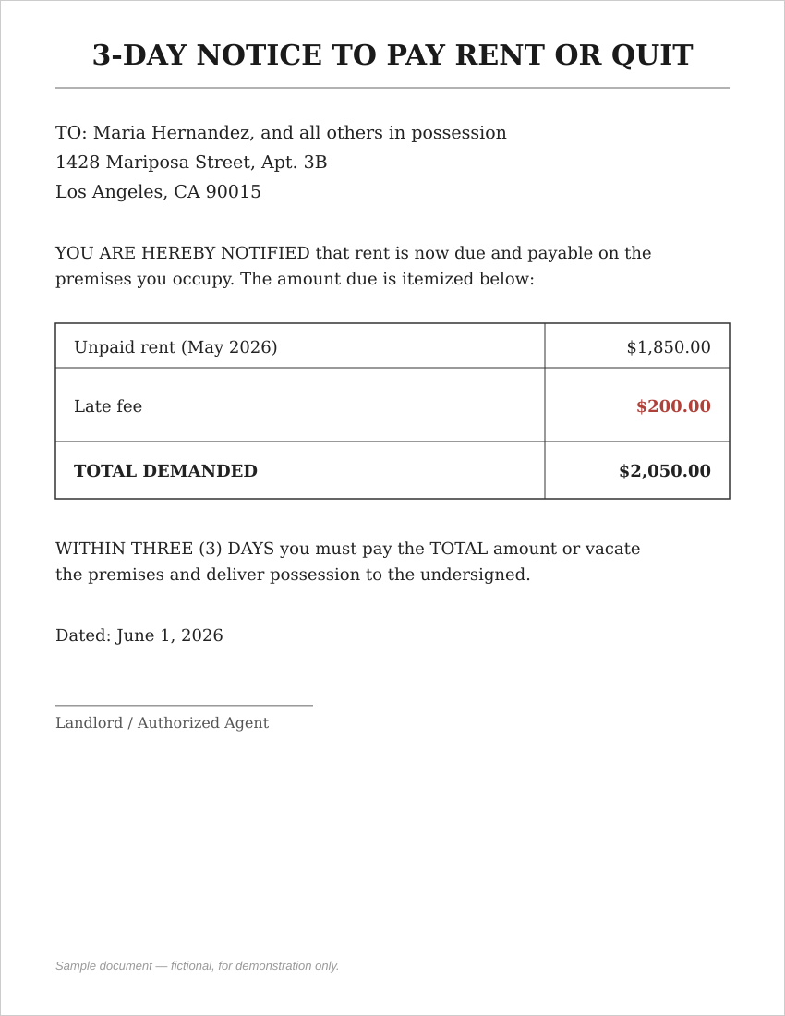
IT'S 10 PM. MARIA JUST GOT THIS - A 3 DAY NOTICE TO PAY OR LEAVE
Demo
Maria has 3 days, and a demand for $2,050 that she doesn't have.
In fact, the notice is defective — CA law forbids demanding late fees in a pay-or-quit notice. An eviction lawyer would catch this, but Maria can’t afford a lawyer.
This is the story of 10s of millions of Americans — and, now, of what we can finally do about it
DEMO
© 2026 Andrew Cohen. All rights reserved.
8

Slide 9

WHAT I LEARNED BUILDING IT
Powerful infrastructure, but it’s missing decision logic
Connected to live in minutes
Legal workflows built-in, & logic works x-jurisdictions
Lack of decision logic
From my desktop using the platform's built-in legal connectors linked to live statutory databases
I reused pre-built prompts instead of writing them from scratch; logic for CA worked for TX and NY
Statute + AI alone can be incomplete. I built a rules file encoding AI-synthesized legal doctrine — how courts apply the statute to specific facts.
The realization: the statute states what the law says about many kinds of notices. The decision logic is what tells Maria that her notice is defective — and what she can do about it. Civil Justice as Code.
DEMO - LEARNINGS
9

Slide 10
JSON DECISION LOGIC
Plugin · Skills
Encoding what the law REQUIRES — not just what it SAYS
T2 · Legal
The JSON decision logic used for the demo:
T1 · AI
A connector tells you what the law SAYS. It can return the full text of CCP §1161.
ca_eviction_v1.2.json
"notice_types": {
"pay_or_quit": {
"tenancy_over_1yr": {
"days": 15,
"statute": "CCP §1161(2),
AB 1482" }}},
"notice_defects": [
{ "defect": "includes_late_fees",
"result": "INVALID" }],
"local_overlays": {
"los_angeles": {
"just_cause_required": true }}
The rules layer tells you what the law REQUIRES — that this notice is void because it demands late fees, and that Maria has a defense. The if-then consequence is the decision logic.
The Civil Justice as Code Project: draft decision-logic rules (JSON) for eviction in all 50 states, published on GitHub. Next step: rigorous validation.
DEMO - LEARNINGS
© 2026 Andrew Cohen. All rights reserved.
10
Notes:
JSON (JavaScript Object Notation) - text-based format used to store and transport structured data. Both easy to read and simple for machines to parse, it is a standard way for exchanging data between web servers and applications

Slide 11
SAME INFRASTRUCTURE. THE PLUGIN WE’RE BUILDING:
Civil Justice as Code
AUTHORITATIVE LAW
Statutes
Connectors
Live, deterministic lookups — the law as it is today.
Legal-aid worker
Review & oversee
PLUGIN
Case law
Civil Justice as Code — Eviction Defense Plugin
Decision logic · Workflow · Safety guardrails
The person
Court systems
Gets safe, usable help
Skills & plugins
Workflows: intake, eligibility, drafting, deadlines.
AI foundation: translation · reasoning · drafting (“predictive”)
PROCESS GUARDRAILS WRAP THE WHOLE SYSTEM: multi-layer testing · PII & privacy · mandatory human-attorney review · published accuracy standards.
INFRASTRUCTURE
© 2026 Andrew Cohen. All rights reserved.
11

Slide 12


CIVIL JUSTICE AS CODE PROJECT
Outline of the project process / steps
AI Assisted Generation – machine readable code (JSON) – v.1 draft rules for eviction statutes in all 50 states [link to github]
1
Incremental / Transparent – generate next a2j rules layer only after proving the accuracy / validity of the eviction rules
2
7 layer validation – rigorous best practices (used to validate AI-generated software) – automated & attorney expert testing; published error rates
3
PROJECT
12

Slide 13
CIVIL JUSTICE AS CODE
Project status
Published 50 state eviction rules library; initiated AI validation process. [ insert GitHub link ]
1
2
3
AI-assisted rules layer generation
Incremental & Transparent
Layered validation
Project roadmap
→
→
→
EVICTION
BENEFITS & DEBT
RECORD SEALING
DV & IMMIGRATION
now — prove the method
next — high-volume, bright-line
once we have a track record
last — highest-stakes, most judgment
PROJECT
© 2026 Andrew Cohen. All rights reserved.
13
Notes:
AI Assisted Generation – machine readable code (JSON) – v.1 draft rules for eviction statutes in all 50 states [link to github]
Incremental / Transparent – generate next a2j rules layer only after proving the accuracy / validity of the eviction rules
7 layer validation – rigorous best practices (used to validate AI-generated software) – automated & attorney expert testing; published error rates
Every file labeled DRAFT, VALIDATED, or CERTIFIED per published standards.

Slide 14
EARN TRUST
Seven layers of validation
The discipline of modern enterprise software testing, applied to legal rules — automated checks first, then expert human review.
1
Live statutory grounding
2
Multi-model consensus
Every citation verified against current text
Independent generation; divergence flagged
3
Internal consistency logic
4
Golden-set behavioral tests
Structural & range checks, no expertise needed
Known-correct fact patterns per state
5
Cross-jurisdiction anomaly detection
6
Temporal freshness monitoring
Catches omissions other states reveal
Law-change drift becomes a managed queue
Stratified expert human review — a statistically powered sample, with published error rates and confidence intervals (the autonomous-vehicle standard, applied to legal information).
7
PROJECT
© 2026 Andrew Cohen. All rights reserved.
14
Notes:
hard question isn't can you generate rules, it's how you know they're right. We borrow the discipline enterprise software teams already use to validate AI-generated code: automated checks at machine speed, then expert human review where accountability rests. This is the emerging standard for AI-generated work, applied to law. THE SEVEN LAYERS: (1) Live statutory grounding — every citation checked against current statutory text via a live connector; a changed statute fails the check (continuous-testing practice). (2) Multi-model consensus — multiple frontier models generate each file independently; disagreements routed to human review (differential testing). (3) Internal consistency logic — automated structural, range, completeness, citation-format checks (static analysis). (4) Golden-set behavioral tests — known-correct fact patterns per state; must pass to advance (unit testing vs. a golden dataset). (5) Cross-jurisdiction anomaly detection — each file compared against all others for outliers (property/regression testing). (6) Temporal freshness monitoring — legislative trackers watch cited statutes; drift becomes a managed queue (CI w/ dependency alerts). (7) Stratified expert human review — a statistically powered sample reviewed by named senior practitioners; published error rate with confidence intervals; inter-reviewer reliability measured via Cohen's kappa. This is the layer that turns a plausible draft into something a person can rely on. WHY THIS IS CREDIBLE (best-practice justification): (a) Automated-first, human for the high-stakes remainder — industry analysis finds automated scanners catch ~70% of serious defect classes in AI-generated code, with ~30% needing manual expert analysis (Apiiro 2025, via ShiftAsia Apr 2026). Our layers 1-6 screen; experts handle what automation misses. (b) AI fails on edge cases, not the happy path — same research; this is why our golden sets and anomaly detection target edge cases. (c) High-stakes code is never accepted without expert review — for catastrophic-error domains (canonically cryptography) human review is a rule, not a guideline (ShiftAsia). Eviction defense is our cryptography. (d) Multi-model consensus with a critical caveat: a 2025 study found LLM cross-validators have very high true-positive rates (>96%) but low true-negative rates (often under 25%) — an agreeableness bias (arXiv 2510.11822). That is exactly why consensus is a routing signal to humans, not a verdict. Citing a documented weakness and building around it is itself evidence of rigor. (e) Golden datasets are the accepted ground-truth backbone of LLM evaluation (Arize, Deepchecks, Klu 2024-26). (f) Continuous, not one-time testing, because law changes (Testkube Jan 2026; Evozon Feb 2026). THE DISANALOGY WE'RE EXPLICIT ABOUT: in software, tests verify code against a spec the team controls; here the spec is the law itself — external, sometimes contested, changing. So the automated layers are bounded by, not a substitute for, expert human review. THE STANDARD WE CLAIM: not perfection (no legal-info source is error-free) but a documented, continuously monitored accuracy rate, materially better than the alternative, by a methodology experts would call prudent — the autonomous-vehicle standard: certified performance under defined conditions, openly measured. The honest comparator isn't a perfect lawyer; it's the help Maria gets today, which is usually none. SOURCES (verify before external use): ShiftAsia Apr 2026 (Apiiro analysis); arXiv 2510.11822 (agreeableness bias); Testkube Jan 2026; Arize/Deepchecks/Klu (golden datasets); Evozon Feb 2026; Veracode Feb 2026; Cohen's kappa for inter-rater reliability.

Slide 15


WHY THIS RULES LAYER IS WORTH BUILDING
Improve the infrastructure and help people
Novel
Durable
Defensible
Achievable
Longstanding efforts to code the law, but no one has yet done it for a2j / legal aid.
Validated legal decision-logic is an a2j community asset.
Rigorous accuracy standard (7-layers); with ultimate validation by attorneys
AI draft rules generation is fast — hours, validation is challenging, but achievable
PROJECT
© 2026 Andrew Cohen. All rights reserved.
15
Notes:
WHY “NOVEL” HOLDS UP (background on past law-coding efforts): Encoding law as code is not new — it has a decades-long track record OUTSIDE legal aid. (1) Computational law / “Rules as Code” has roots going back to the 1970s-80s (Layman Allen on law and logic; later Genesereth, Surden) and matured in govtech: New Zealand’s “Better Rules” program (from 2018, with Inland Revenue and others) and the OpenFisca rules engine encoded benefits and entitlement formulas into machine-readable, reusable code; Jersey has used it in legal drafting; Germany’s Law-as-Code / Rulemapping work continues today. (2) Compliance domains (e.g., construction Automated Compliance Checking) routinely translate regulations into executable logic. KEY POINT: these efforts target government benefits, tax, and regulatory compliance — not civil legal aid / a2j. WHAT a2j ALREADY HAS: guided-interview DOCUMENT ASSEMBLY — A2J Author (Chicago-Kent/CALI, 2004), HotDocs, and LawHelp Interactive (Pro Bono Net), used in 40+ states; these encode interview/branching logic to help self-represented litigants fill court forms, authored by legal-aid subject-matter experts. THE GAP WE FILL: no one has built an open, shareable, independently VALIDATED layer of substantive legal DECISION LOGIC (what the law requires, not just form-filling or what it says) for legal aid, designed to sit on top of modern AI infrastructure. Document assembly tells you how to complete a form; our rules layer tells you whether Maria’s notice is defective and what defense she has. That combination — a2j-specific, decision-logic, open-source, AI-native, with published error rates — is what is new. SOURCES (verify before external use): MIT Computational Law Report (X2RL; Governing Digital Legal Systems); NZ Service Innovation Lab — Legislation as Code / Better Rules; OpenFisca; law-as-code.org (Rulemapping Group, Germany); Jessica Frank, “A2J Author, Legal Aid Organizations, and Courts,” 39 W. New Eng. L. Rev.; Pro Bono Net / LawHelp Interactive; A2J Author (a2jauthor.org).

Slide 16


LEGAL ETHICS
Legal information — not the practice of law
What the rules layer does
Where the line into advice is
Encodes what statutes require — legal reference, routinely publishes this on legal aid websites. The machine-readable form doesn't change its character as reference data.
A system can't render a conclusion about a specific person's situation (which raises UPL issues) — and workflow guardrails and mandatory human-attorney review provide protection.
Reference data on what the law generally requires is permitted, but humans must be in the loop for anything case-specific.
INFRASTRUCTURE
© 2026 Andrew Cohen. All rights reserved.
16

Slide 17

NEXT STEPS
Help / partnership that could change the trajectory
MODEL AI AND LEGAL TECH LEADERS, LAW SCHOOL CLINICS, A2J COMMUNITY LEADERS…
The Ask: 10 minutes – review the civil justice as code plan (this deck) – if you see value, engagement / help with execution
AI FOR GOOD
AI platforms already handle sensitive domains like health information with careful guardrails. We can do the same for legal — to help millions in need, for fairness, and to promote a healthy democracy.
THE ASK
17
© 2026 Andrew Cohen. All rights reserved.

Slide 18



Goal: improve the infrastructure to deliver legal help to 1 million people who can't afford a lawyer.
infrastructure → one million
I'm looking for help to make this real, in 2026.
Thank you.
Andrew Cohen • andrewmichaelcohen@gmail.com • Board Member, Bay Area Legal Aid
© 2026 Andrew Cohen. All rights reserved.
18

