Slide 1
“AN OPTIMIZED ALGORITHM FOR ASSOCIATION RULE MINING USING FP TREE”

Slide 2
FP-GROWTH:
The FP-Growth Algorithm, proposed by Han in, is an efficient and scalable method for mining the complete set of frequent patterns by pattern fragment growth, using an extended prefix-tree structure for storing compressed and crucial information about frequent patterns named frequent-pattern tree (FP-tree).

Slide 3
ASSOCIATION RULE:
Association rule mining is a procedure which is meant to find frequent patterns, correlations, associations, or causal structures from data sets found in various kinds of databases such as relational databases, transactional databases, and other forms of data repositories.

Slide 4
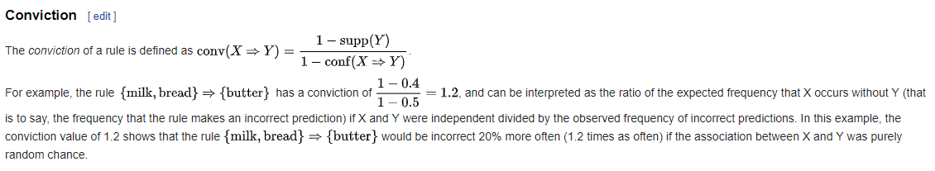
CONVICTION RULE:
DEF:

Slide 5
Advantages of FP-Growth
Only 2 passes over data-set
“Compresses” data-set
No candidate generation
Much faster than Apriori
Disadvantages of FP-Growth
FP-Tree may not fit in memory!!
FP-Tree is expensive to build

Slide 6
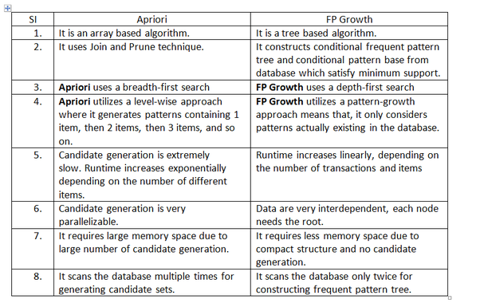

Slide 7
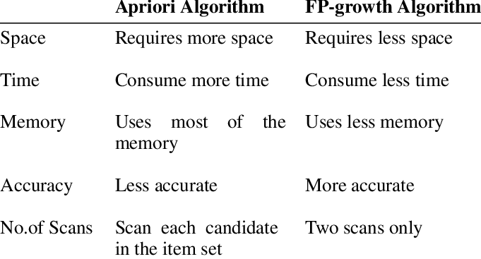

Slide 8

