Slide 1


Theme Park Evaluation Criteria
KPIs
Geographic Criteria
1
Attendance & Visitor Spend Metrics
Projected Annual Attendance – Benchmarked against comps (e.g., Six Flags, Cedar Fair, Comcast, Disney)
Per Capita Spending – Spend on admissions, in-park spending (food & beverage, merch, experiences)
Mix of Single-Day tickets and Season Passes – Impacts recurring revenue and customer-lifetime-value (CLV)
Market Demand & Demographics
Population Density – Areas with large metropolitan populations (e.g., NYC, LA, Chicago)
Tourism Volume – high inbound tourism hubs (e.g., Orlando, Las Vegas, Nashville)
Income level / Disposable Income – Determines willingness to pay for premium experiences
Local & Regional Competition – Saturation of existing theme parks
Financial Metrics
Total Revenue Potential – Admissions and in-park spending
Operating Income (EBITDA) Margins – shows core operational profitability
Capex & Payback Period – estimated development costs and the time to break even
IRR or ROI – Rate of return to assess investment viability
Capital Structure – Affects the IRR and PV of cash flows
2
Infrastructure & Accessibility
Proximity to Major Airports – Facilitates national and international travel
Highway and public transport access – ensures regional visitor flow
Available Land & Zoning Laws – Cost and feasibility of large-scale developments
Climate & Seasonality – Year-round operating potential in mild and warmer climates (e.g., FL, TX, CA); seasonal operations could lead to <175 operating days per year
Weather Risks – Hurricanes, extreme cold, or high heat could impact attendance, park infrastructure, and operating days
Indoor vs. Outdoor Attractions – mitigates climate-dependency
3
Operational & Other Considerations
Labor Market & Costs – Higher in major metropolitan areas
Regulatory & Tax Environment – Incentives from state & local governments
Smaller & regional park vs. larger destination park – mega-parks typically feature lower project-level returns compared to mid-sized and small parks¹
Thematic/Franchise Synergies – Integrations with IP, cross selling opportunities, and other revenue & cost synergies
Existing Licensing Agreements – Existing Licensing Agreements – Some IPs may be licensed to third parties (e.g., WBD’s Harry Potter to Universal); evaluating contract terms and licensing constraints is crucial for developing proprietary attractions or renegotiating rights
¹https://www.theparkdb.com/blog/the-business-of-theme-parks-part-ii-how-much-do-they-cost-and-earn/

Slide 2


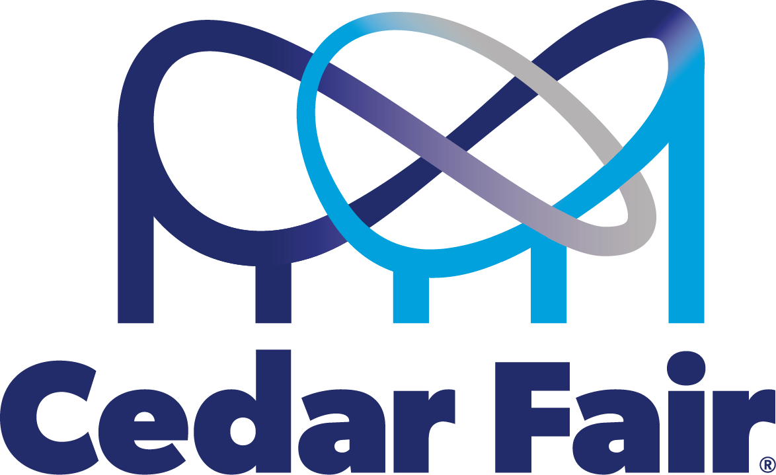


A strategic investor should be willing to pay ~$1.3B to invest in the project
Financial Model
PV of FCFs: $1,314M IRR: 9.9%
Strategy: Mid-scale destination park with strong in-park revenue focus
NOTE** IRR is lower than 10% Discount Rate
Key Model Assumptions
Model Output
1
Admissions and Ticket Pricing
The park sells single-day tickets and season passes; starting prices are $100 and $250, respectively, increasing 2% YoY
Season pass mix starts at 40%, increasing to 59% in Y20, in-line with Six Flags’ ticket mix
Attendance
Season pass holders attend the park 3x per year
250 operating days per year; daily attendance starts at 12k per day, growing to 17.5k in Y20
In-Park Spending Revenues
In-park purchases (i.e., food & beverage, merch, experiences) starts at $60 per visit, in-line with Cedar Fair
Park Development
$750M in development costs, a premium to regional parks (Cedar Fair, Six Flags), but a discount to destination parks (Disney, Universal); useful life of 50 years
Breakeven year
Financial Overview
Revenue Breakdown (m)
2
3
4
KPIs
Annual Attendance (m)
Theme Park Comps¹
Season Pass Mix
40% | 42% | 44% | 46% | 48% | 50% | 52% | 54% | 56% | 58%
$100 | $104 | $108 | $113 | $117 | $122 | $127 | $132 | $137 | $143
$250 | $260 | $271 | $282 | $293 | $305 | $317 | $330 | $343 | $357
Single Ticket Price
Season Pass Price
¹https://www.theparkdb.com/blog/the-business-of-theme-parks-part-ii-how-much-do-they-cost-and-earn/

Slide 3





O&O vs. Licensing
Licensing provides financial upside with lower risk, though optimal terms are required for significant advantage vs. O&O
Qualitative Criteria
Example Licensing Agreement
Cumulative licensing profit: $1,693M
Goals of Licensing Agreement
Control of . . .
Creative Vision – Ensures the park reflects the brand and IP
Quality – Maintain high standards for guest experience and safety
Profits – IP owner would retain all profits in O&O scenario
Data – IP owner can gain valuable insights into consumer preferences and behavior
Favorable Terms for Licensing Agreement
Non-exclusivity – Allows for IP owner to partner with multiple parks in various locations, utilizing existing theme park facilities and resources
Scope of IP Rights – IP owner should define which IP can be used and how it can be incorporated into the park
Approval Rights – IP owner should maintain oversight on park design, development and operations
Royalty structure – Could include minimum guarantees, pre/post-recoupment profit-splits, or tiered systems based on park attendance or revenue
Marketing and Promotion – Collaborate with partner on marketing and leverage IP owner’s media platforms
Term and Termination – Clear timeframe for the agreement with options for renewal, extension, and termination
Assumptions
IP owner agrees to license its IP in return for 15% share of pre-tax cash flow of the project; once the project recoups the development cost, then IP owner retains 50% of pre-tax cash flow
Other Assumptions remain the same between O&O model and licensing model
PV of Cumulative Licensing Profit (m)
Pre-Recoupment Share
Other Considerations
Reduced financial risk
Existing Licensing Agreements
 | 5% | 10% | 15% | 20% | 25% | 30%
30% | $501.0 | $522.6 | $544.2 | $558.1 | $583.6 | $609.0
40% | $660.9 | $682.5 | $704.1 | $710.2 | $735.6 | $761.1
50% | $820.7 | $842.3 | $863.9 | $862.2 | $887.7 | $913.2
60% | $980.5 | $1,002.1 | $1,023.7 | $1,014.3 | $1,039.8 | $1,065.2
70% | $1,140.3 | $1,161.9 | $1,183.5 | $1,166.4 | $1,191.9 | $1,217.3
80% | $1,300.1 | $1,321.7 | $1,343.3 | $1,318.5 | $1,343.9 | $1,369.4
Wider Reach
Post-Recoupment Share
Focus on Core Competencies
3
Licensing terms at which it is more profitable to license (vs. O&O)

