Slide 1
BNP VIABILITY
Bounded noise becomes usable
when the released statistic fits the bound
EPRI Ckt5 evidence, with a direct comparison to analytic Gaussian noise
Saved v4 metrics · δ = 0.02 · two saved seeds
Notes:
Visual reference: C:/Users/15397/Downloads/bnp_correctness_and_comparison (1).pptx
Evidence source: C:\Users\15397\Desktop\dp_voltage_replication\results\bnp_circuit_regime_20260917_v4\metrics.json

Slide 2
THE MECHANISM
BNP offers a hard error bound, then charges for sensitivity
noise ~ Uniform[-B, B] δ = S / 2B
S is the sensitivity of the released statistic. B is the maximum perturbation.
What BNP guarantees
Why the 15-minute covariance failed
• Every released value stays within B of its true value.
• The guarantee comes from the support of the distribution.
• The bound holds at every draw, rather than with high probability.
• A 96-step covariance release has high sensitivity.
• At δ = 0.02, uniform noise was large relative to the small covariance entries that carry temporal structure.
• The mechanism stayed correct, but the release target was too rich for the bound.
02
Notes:
Mechanism definition and guarantee follow the existing privacy implementation and the reference deck.
Evidence source: C:\Users\15397\Desktop\dp_voltage_replication\results\bnp_circuit_regime_20260917_v4\metrics.json

Slide 3
THE DESIGN CHANGE
The mechanism stayed fixed. The release design changed
Viability came from matching the statistic's sensitivity to the hard bound.
1
2
3
4
Feeder and records
Temporal dimension
Clip norm
Predeclared screen
Use the EPRI Ckt5 load model with load-object-day records so the release represents a bounded load statistic.
Move from 15-minute vectors (T=96) to hourly vectors (T=24). Fewer coordinates reduce sensitivity.
Use C=3 for the hourly regime instead of C=6. The smaller clip norm lowers the calibrated bound.
Require noise/signal ≤ 1 and covariance lag-1 change ≤ 0.05. This makes usefulness measurable.
Measured effect: BNP parameter noise / signal falls from 0.840 at T=96,C=6 to 0.074 at T=24,C=3.
03
Notes:
The four changes are the actual Ckt5 v4 protocol choices. The BNP distribution, analytic Gaussian calibration, and eigenvalue floor were unchanged.
Evidence source: C:\Users\15397\Desktop\dp_voltage_replication\results\bnp_circuit_regime_20260917_v4\metrics.json

Slide 4
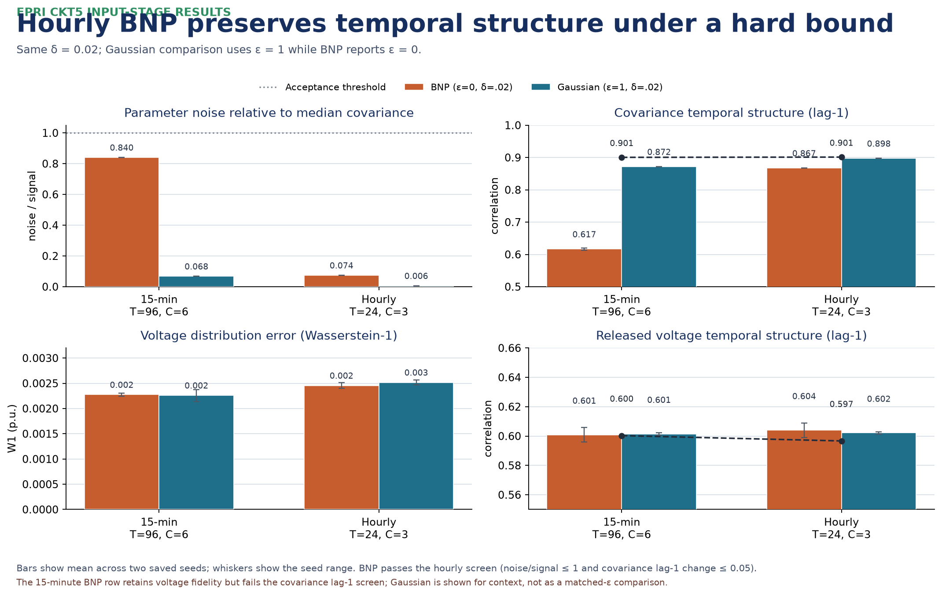
MEASURED COMPARISON
Hourly BNP keeps the temporal signal within the acceptance screen
04
Notes:
Figure embedded from C:\Users\15397\Desktop\dp_voltage_replication\figures\bnp_ckt5_gaussian_comparison.png. The figure reads only C:\Users\15397\Desktop\dp_voltage_replication\results\bnp_circuit_regime_20260917_v4\metrics.json; no experiment was rerun.

Slide 5
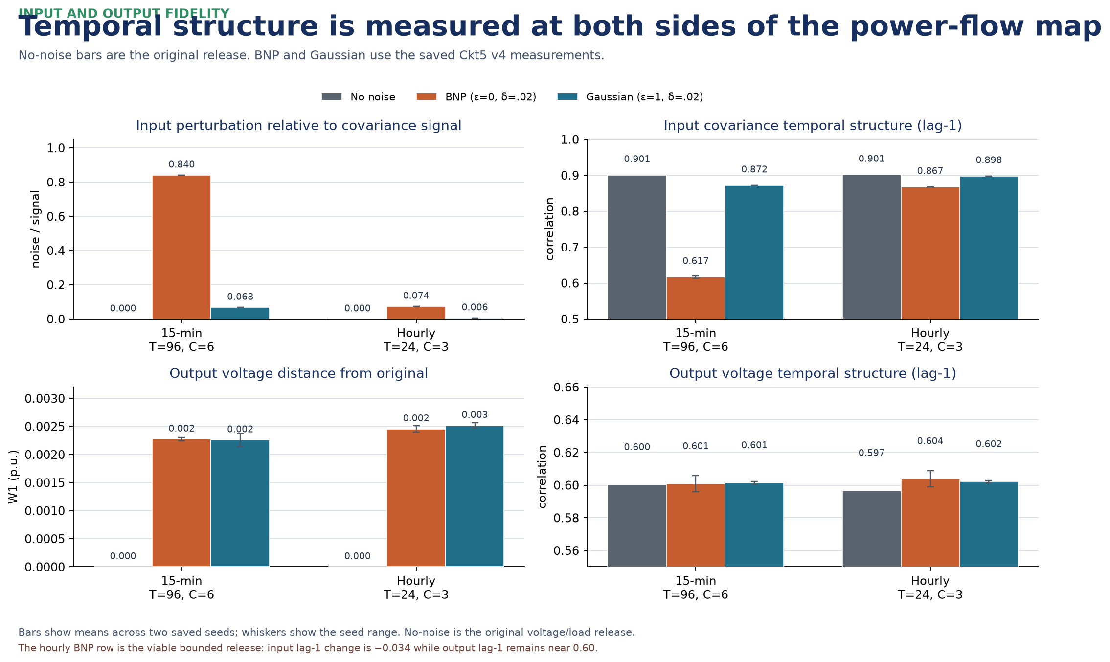
INPUT AND OUTPUT FIDELITY
Temporal structure is measured at both sides of the power-flow map
The gray bars are the original release. Colored bars show the same input-stage perturbations after power flow.
05
Notes:
Figure embedded from C:\Users\15397\Desktop\dp_voltage_replication\figures\bnp_ckt5_input_output_baseline.png. It reads only C:\Users\15397\Desktop\dp_voltage_replication\results\bnp_circuit_regime_20260917_v4\metrics.json; no experiment was rerun. Input metrics are covariance noise/signal and covariance lag-1. Output metrics are voltage W1 and voltage lag-1.

Slide 6
READING THE RESULT
Hourly Ckt5 is the viable BNP regime under the stated screen
Means across two saved seeds. Covariance lag-1 is measured after the existing eigenvalue floor.
Regime | BNP noise / signal | BNP covariance lag-1 | Truth covariance lag-1 | Screen
15-min T=96,C=6 | 0.840 | 0.617 | 0.901 | FAIL
Hourly T=24,C=3 | 0.074 | 0.867 | 0.901 | PASS
Gaussian 15-min | 0.068 | 0.872 | 0.901 | PASS
Gaussian hourly | 0.006 | 0.898 | 0.901 | PASS
What changed in practice
Hourly BNP:
• 0.074 noise / signal
• 0.867 covariance lag-1
• -0.034 lag-1 change
• voltage lag-1 stays near 0.60
This meets the predefined screen for the bounded hourly release.
Gaussian remains the lower-noise option in this comparison. BNP's distinct benefit is the hard error bound, when the release is scoped tightly enough.
06
Notes:
Table values are means across the two saved seeds in C:\Users\15397\Desktop\dp_voltage_replication\results\bnp_circuit_regime_20260917_v4\metrics.json. Gaussian rows use ε=1, δ=0.02; BNP rows use ε=0, δ=0.02. This is not a matched-ε comparison.

Slide 7
SCOPE AND LIMITS
The claim is viability for one bounded release
Supported by the measurements
Still open
• Ckt5 hourly load-shape covariance, T=24 and C=3, passes the screen for both saved seeds.
• BNP still gives an exact bounded-noise guarantee at δ=0.02.
• Voltage W1 and voltage lag-1 remain close to the nonprivate release.
• BNP is not superior to Gaussian on parameter noise.
• The 15-minute Ckt5 covariance row fails the temporal screen.
• Full IEEE 123-bus covariance and voltage-trajectory releases remain harder targets.
BNP is a good choice when the application values a hard error tolerance and can release a lower-sensitivity statistic.
07
Notes:
Scope statement based on the saved Ckt5 v4 measurements in C:\Users\15397\Desktop\dp_voltage_replication\results\bnp_circuit_regime_20260917_v4\metrics.json. The original IEEE 123-bus measurements remain historical and were not modified.

