Slide 1
Linear

Slide 2
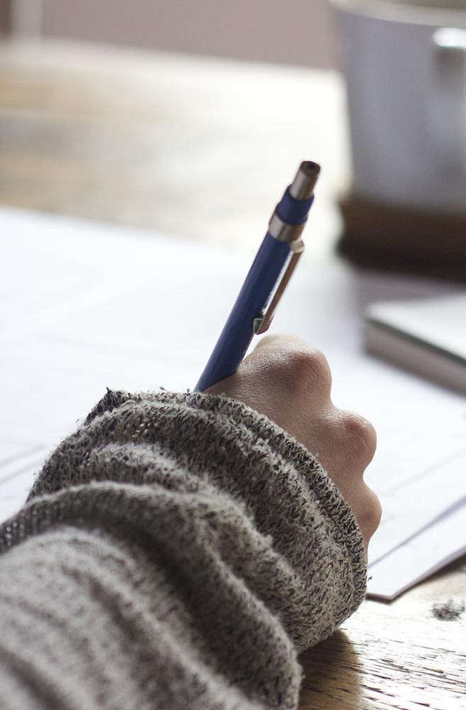
We eliminate writer’s block by providing a machine assisted writing tool, to help people create.

Slide 3
Problem

Slide 4
Help get your thoughts written down quickly and accurately

Slide 5
Paper
Meaningful suggestions
Easy to use interface

Slide 6
181 Million

Slide 7
5000+ daily

Slide 8
Business Model
Andrew D information goes here
And a nice chart can go here

Slide 9
Competition
First
Second
Third

Slide 10
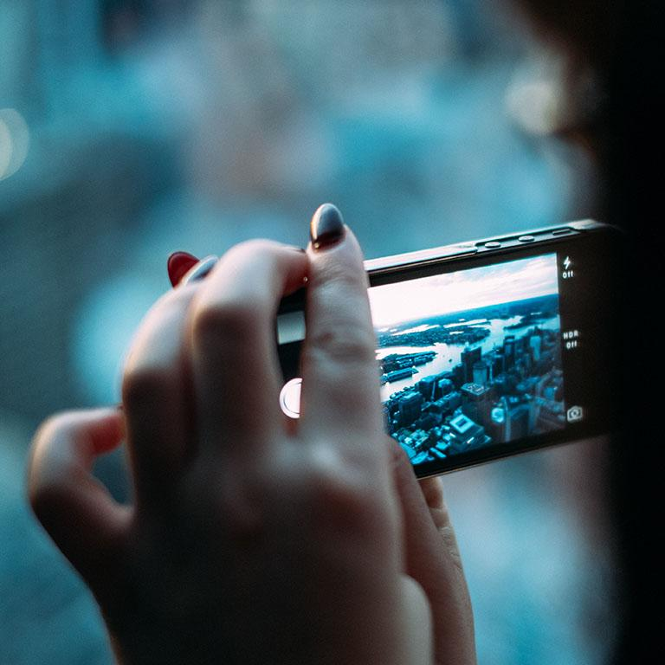
Marketing Stratgey
Also from Andrew D

Slide 11
Team
Andrew
Josh
Andrew
Notes:
We’ll definitely want to put a bio here or something

Slide 12
Projected Earnings
 | A | B | C
Yellow | 10 | 20 | 7
Blue | 30 | 15 | 10
Orange | 5 | 24 | 16

Slide 13
MAPS
Our Office

Slide 14
$5,000
Why us?

Slide 15
$5,000
$Expense USERS
100%
Funding
And a lot of users
Total success!

Slide 16
Timeline
Development
Launch
Profit?

Slide 17
Summary
Yellow
Is the color of gold, butter and ripe lemons. In the spectrum of visible light, yellow is found between green and orange.
Blue
Is the colour of the clear sky and the deep sea. It is located between violet and green on the optical spectrum.
Red
Is the color of blood, and because of this it has historically been associated with sacrifice, danger and courage.
Yellow
Is the color of gold, butter and ripe lemons. In the spectrum of visible light, yellow is found between green and orange.
Blue
Is the colour of the clear sky and the deep sea. It is located between violet and green on the optical spectrum.
Red
Is the color of blood, and because of this it has historically been associated with sacrifice, danger and courage.

Slide 18
Demo
Video/Gif
Show and explain your web, app or software projects using these gadget templates.
Place your screenshot here

Slide 19
THANKS!
Contact
andrewcarr06@gmail.com
Other emails

