Slide 1

DS3000 Practicum 1
Group 25: Andrew Nee, Nhi Tran, Alex Kowalewski
Data Science Question: Does more traffic at the destination airports correlate to the departure delay, for top 20 most frequently traffic destination?

Slide 2
Data Introduction
The dataset is the record of all domestic USA flights in 2019. It tracks flight data such as how long the flight was in time and distance, when and where it departed from and where it arrived. It also has information on the plane such as airline, tail, flight number.
Sufficiently large dataset: over 1 million rows and 14 columns
Most important: have delays time (departure and arrival)

Slide 3
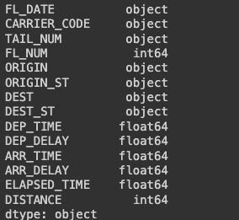
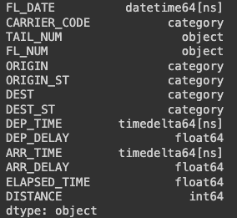
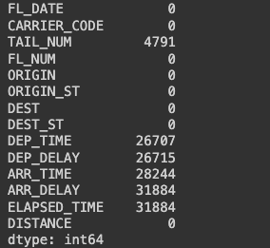
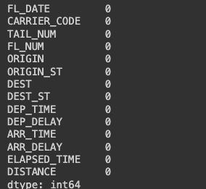
Data Cleaning
Data Conversion
What did we see?
Missing data
Incorrect data types
How did we fix it?
Imputation vs deletion
Classification of data
How does this help our analysis?
Consistent data
Less skewness present in the data
Invalid values will not be included in the analysis
Missing Data
Notes:
When we received the data it was not in the best shape. Some data was missing and most if not all of the data types were classified incorrectly. So how did we get the data ready for analysis? First, we decided to attack the missing data. Since the dataset was so large and many of the flights were the same flight just on different days, we noticed that many of the flights that had missing data had a counterpart with no missing flight data. Thus, we decided to use the deletion strategy in preparing our data to get rid of the incomplete entries. We ensured that this was the right strategy by graphing results before and after the deletion and we saw that there was minimal change in the data, so we proceeded to the data types. During this part of the cleaning process we went through each column to ensure that it was converted to the correct type. We decided that a lot of the data could be classified as categorical data like airport names, state names, and airlines. Other data types that we converted were the times and dates which we converted to date-time for easier analysis. Lastly, we did not change Tail or flight number, as well as delay times as it was easier to manipulate them as strings and floats respectively. These changes allowed us to have more consistent data in our analysis which led to fewer skews in the data. This cleaning process also negated any invalid flights that may have been accidentally or wrongly recorded.

Slide 4
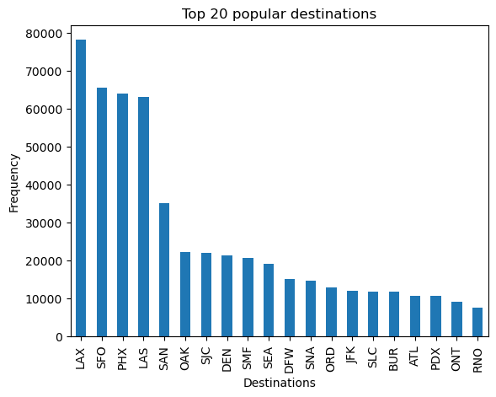
First, need to see the trend of traffic before make another visualization to see if the trend makes sense
LAX, SFO, PHX, and LAS highest traffic
California is popular state destination (LAX, SFO, OAK, SJC, …)
Tourist area: Disneyland, Casino, Hollywood, …
International airports: popular transfer location, depart to different countries
Notes:
Based on our data science question, we found out that LAX, SFO, PHX, and LAS are significantly higher in term of traffic than any other destinations (all more than half). Putting aside the fact that lots of people come to California (LAX, SFO) for tourists area, these airports also go international. Lots came to these airports to travel to a different country, thus, it makes sense why they have large amount of traffic

Slide 5
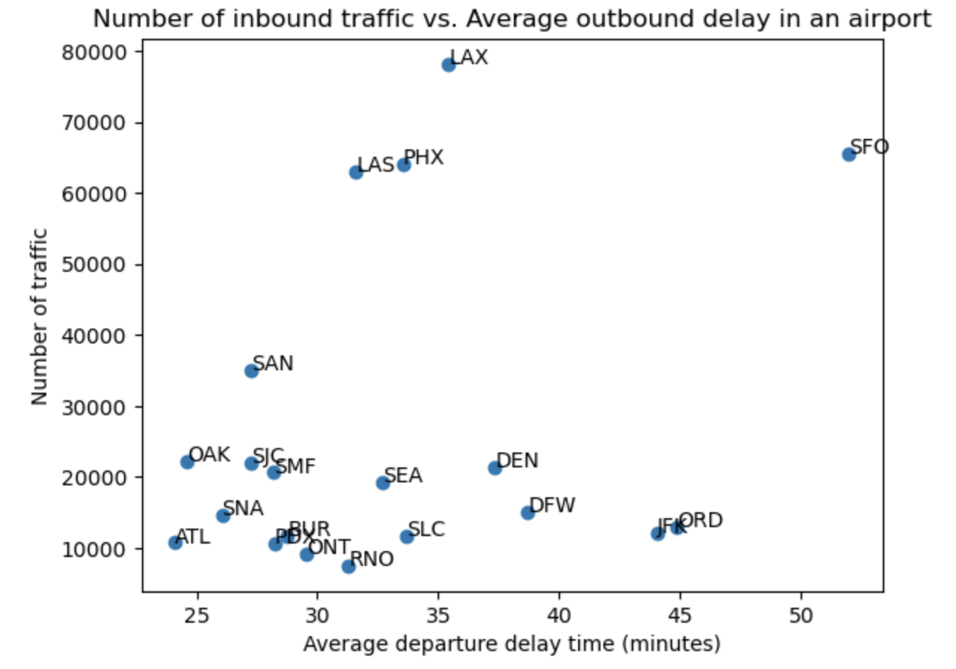
No clear correlation
Intuitively, more traffic = high average delays
Less place to park planes
Potential malfunctions
Issue with passengers
So why don’t we see a correlation?
Traffic effects airports different
Only gives big picture, could be airlines that skew the correlation
Airlines have different average outbound delay
How can we better our research problem?
Factor in airlines
Factor in the various sizes of airports
Notes:
As we can see, even without a linear regression line, there is no correlation between number of traffic at an airport and the average arrival delay in that airport. It is true that the more concentrated an airport (destination), the more likely for delay to occur, as there are more air traffic, less place to park the planes, as well as potential malfunction or issue with the passengers on the plane that caused the plane to not leave on time for the arrival planes. However, this only give the big picture, the airlines could have been the reason why there are no trend as some tend to delay more than others, making the average arrival delay perhaps not represent the entire airport accurately.text

Slide 6
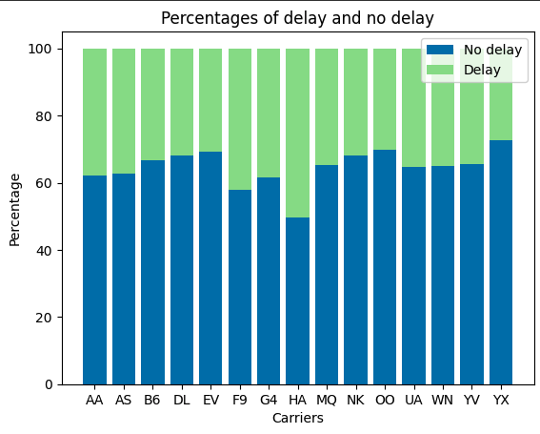
Every airline experiences delays
Some more than others
Could delays have something to do with airlines and not the airports?
Plane maintenance
Crew shortages
Poor management and communication
Weather on common routes
Hawaiian Airlines
Southwest Airlines
Notes:
As concluded in the previous slide, airport traffic does not have that much correlation with delay times. So are delays the fault of the individual airlines themselves? As seen in the graph, every carrier in the data experiences delays in some shape or form. Some carriers also experience delays much more than others do. This could be due to plane maintenance, crew shortages, or even poor management and communication by the airlines or pilots. Airlines like Hawaiian airlines who are delayed frequently could experience delays due to many of these issues, though it is unclear in the data if any of these are specifically the case. Routes to Hawaii are frequently bumpy as well and sometimes necessitate slower flight speeds for safety reasons. Though, Southwest airlines, who experiences less delays, flies routes to places like Denver and Phoenix that also experience bumpy rides. So, there is not a crystal clear picture that can be painted by this data alone. Moving forward, if delays are random, the best thing for an airline to do would be to make up time in the air. We will discuss that in the next slide.

Slide 7
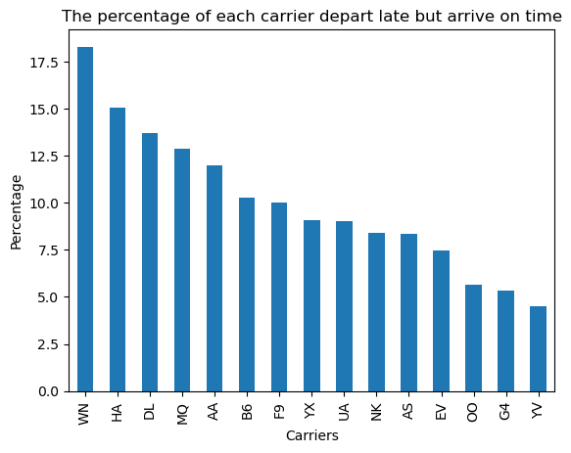
Average Departure Delay
Delays in dep don’t always mean delayed arrival
Passenger Arrival Strategies
Southwest
Hawaiian
Delta
Customer Considerations
Busy airports
Consider various airlines
Price vs Delay
Notes:
Here we have the percentage of flights that depart delayed but still arrive on time for each airline. As we can see, just because the aircraft is delayed on departure does not necessarily mean that it will still be arriving delayed. Many aircraft can make up time in the air based on weather conditions, flight patterns, air traffic, and weight on board. So how does this relate to our data science problem? Well, as we saw in the last graph, there is no correlation between airport traffic and delay times. Similarly here, we can infer that even though there may be a delay on departure, it does not always mean that it will be delayed overall. This is arguably the more important factor out of the two delays as some passengers may have connecting flights and other obligations they may need to get to when they land. Using this information, passengers who have these obligations can select an airport near them that may have less delays such as choosing OAK over SFO and then also choose an airline like Southwest that has a tendency to “beat the delay” in the air and still arrive on time.

Slide 8
Conclusion and Limitations
Conclusion: There is no real correlation between the number of traffic and departure delay time.
Most airlines have a similar average delay time
Traffic affects airport differently
Limitations:
The individual airlines could have affected the delay time (some airlines might be prone to delay longer, or some have very small delay time)
Should have factor in the airlines
Also considered the size of the airports
Not taking into account airplanes that depart late but still arrive on time (if there seems to be a correlation for our question, it would not be valid as it cannot be concluded that high traffic airport would lead to delay as the passengers can still make it on time; thus, there is no reason to avoid certain airport because of delay time)
Notes:
What can we conclude from this? Well, we believe that there is no correlation between air traffic and departure delay time as most airlines have similar average delay times. We think that the vast majority of delays are due to external factors such as maintenance, weather, construction, etc. We also think that traffic affects different airports in different ways as some may handle it better than others as no two airports are alike. Though, there are some limitations we have to take into consideration on this issue. Some airlines may be more prone to delays due to a number of reasons such as plane type, hub airports, and number of passengers. The data should have factored in airlines as well as the physical size of the airports. Also, not taking into account planes that depart late but arrive on time could skew the correlation in delay data if one is to only look at departure or arrival delays alone. To accurately look at the delays here, one must look at the overall delay and not just one or the other.

