Slide 1
2017 New York City Crime Analysis

Slide 2
Analysis Types Overview
Descriptive
Demographic (Age Group, Gender)
Geographic (Longitude/Latitude, Premise Type)
Temporal (Hour, Day Of Week)
Diagnostic (Future Work)
Predictive (Future Work)
Prescriptive (Future Work)
Adaptive/Autonomous (Future Work)

Slide 3
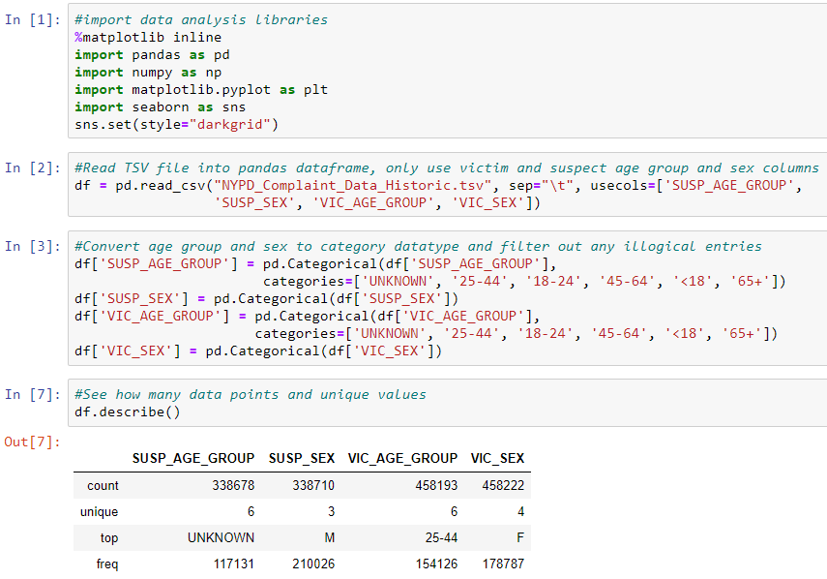
Demographic Analysis - Preparation

Slide 4
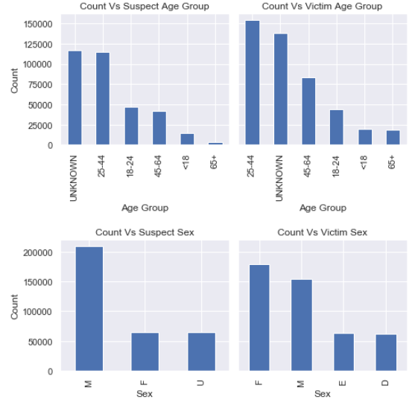
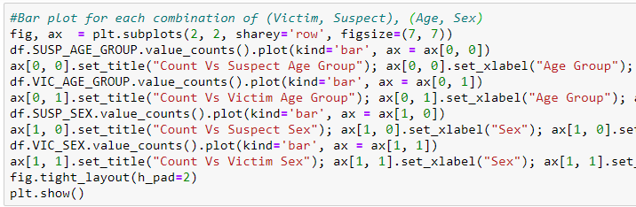
Demographic Analysis - Preparation
UNKNOWN is high in Age Group plots
Based on Baruch College NYCData:
Gender in NYC is ~ 53% Female, 47% Male
Age in NYC is ~ 22.8% <19, 6.7% 20-24, 31.7% 25-44, 24.5% 45-64, 14.4% 65+

Slide 5
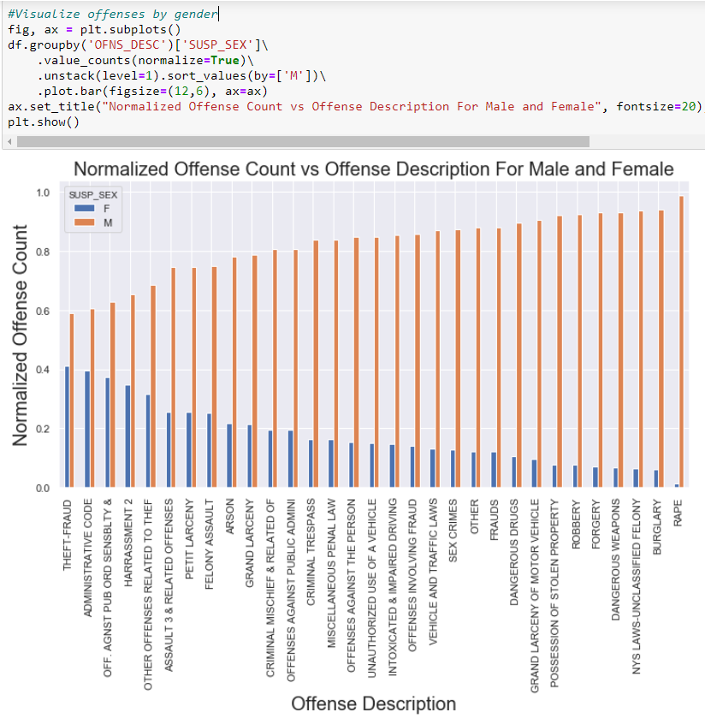
Demographic Analysis – Key Findings
Male suspect dominated offenses (weapons, theft using force, rape)
Offenses with high female involvement (theft without force, harassment, public order offenses)

Slide 6
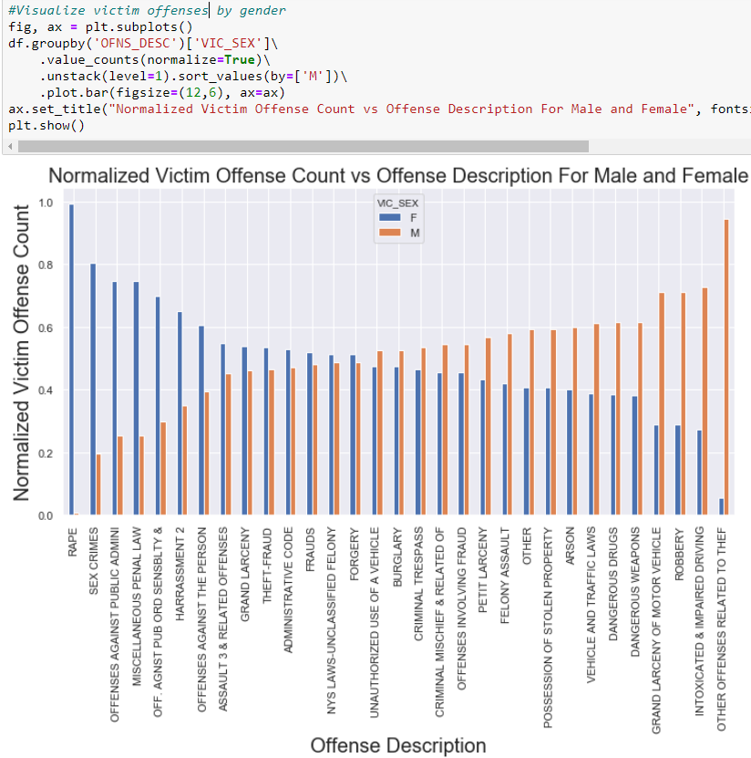
Demographic Analysis – Key Findings
Male victim offenses (weapons, theft using force)
Offenses with high female victims (rape/sex crimes, harassment)

Slide 7
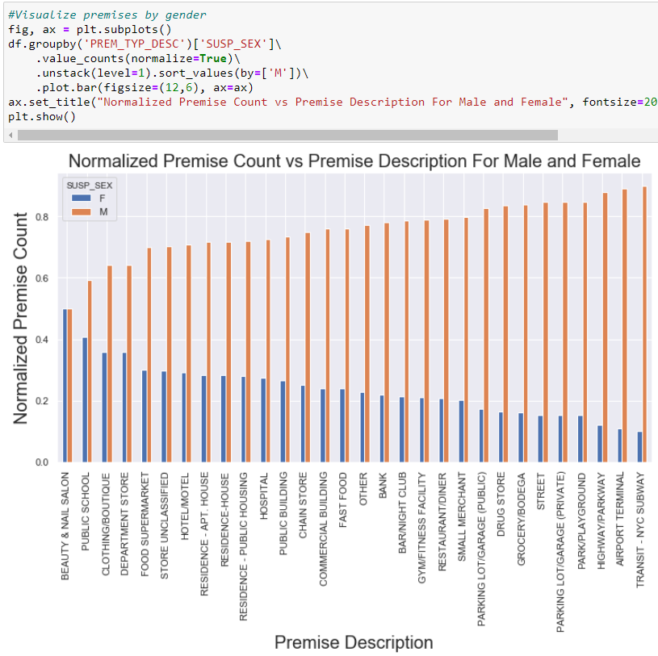
Demographic Analysis – Key Findings
Male suspect dominated premises (transportation areas, corner stores, parks)
Premises with high female involvement (stores, beauty salons, public schools)

Slide 8
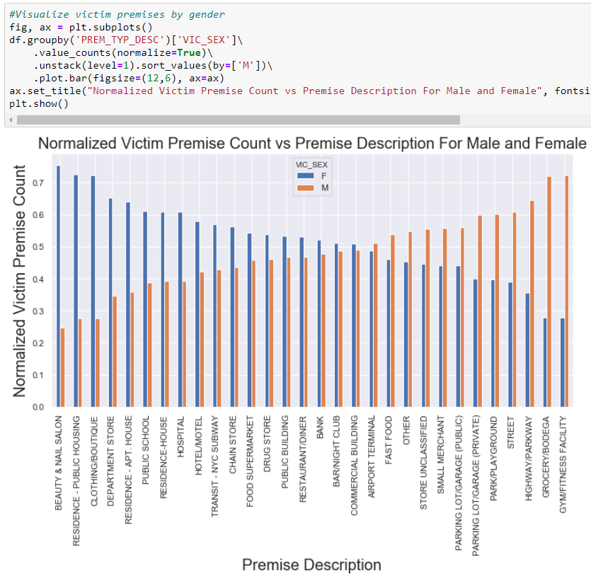
Demographic Analysis – Key Findings
Male victim premises (gyms, corner stores, streets)
Premises with high female victims (public housing/apartment house, stores, beauty salons)

Slide 9
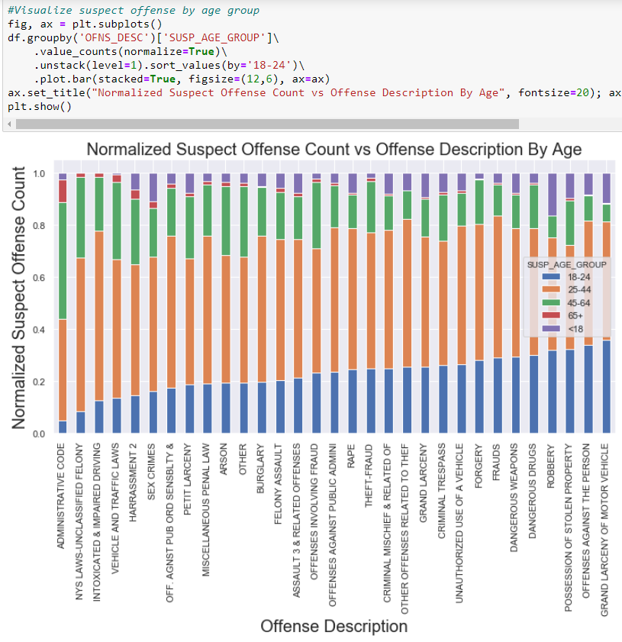
Demographic Analysis – Key Findings
High Suspect Offense Types:
< 18 -> robbery, sex crimes
18-24 year old -> high value stealing (vehicles)
25-44 year old -> intoxicated driving

Slide 10
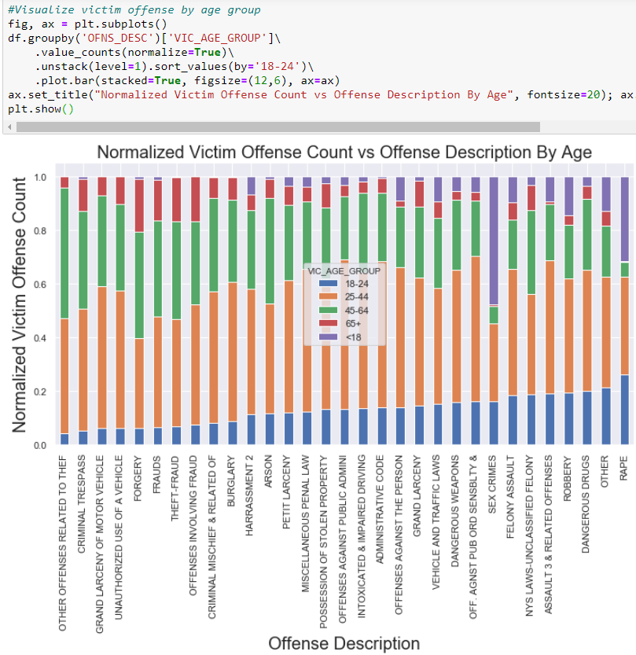
Demographic Analysis – Key Findings
High Victim Offense Types:
< 18 -> sex crimes/rape
18-24 year old -> drugs, rape
45-64 year old -> theft
65 + -> forgery/fraud, theft

Slide 11
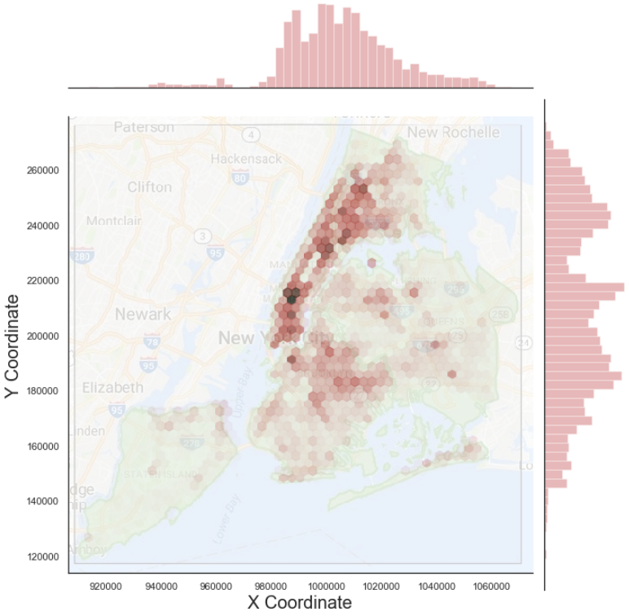
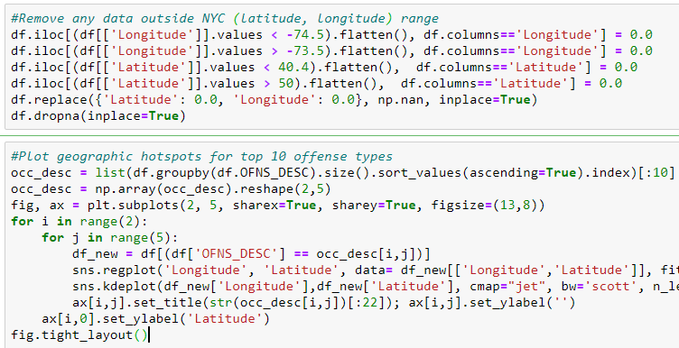
Geographic Analysis – Preparation
Crime Density

Slide 12
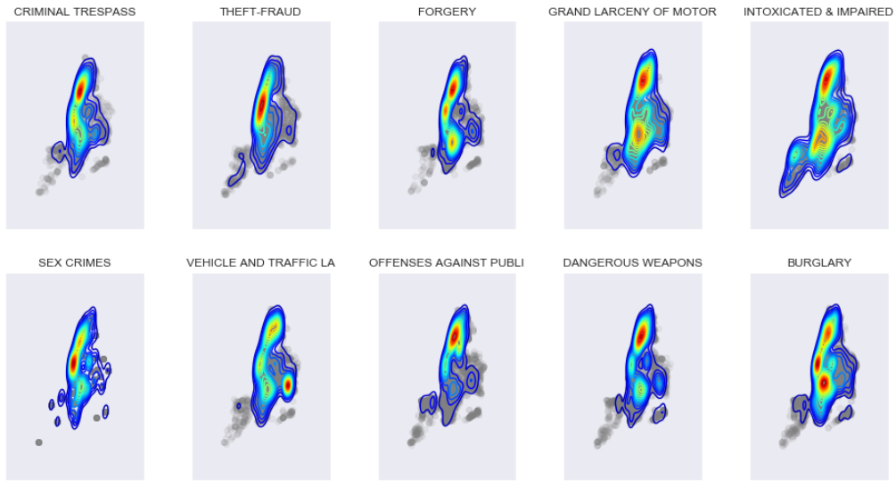
Geographic Analysis – Key Findings
Location Frequency for Different Offense Types
Hotspots appear to vary based on offense type

Slide 13
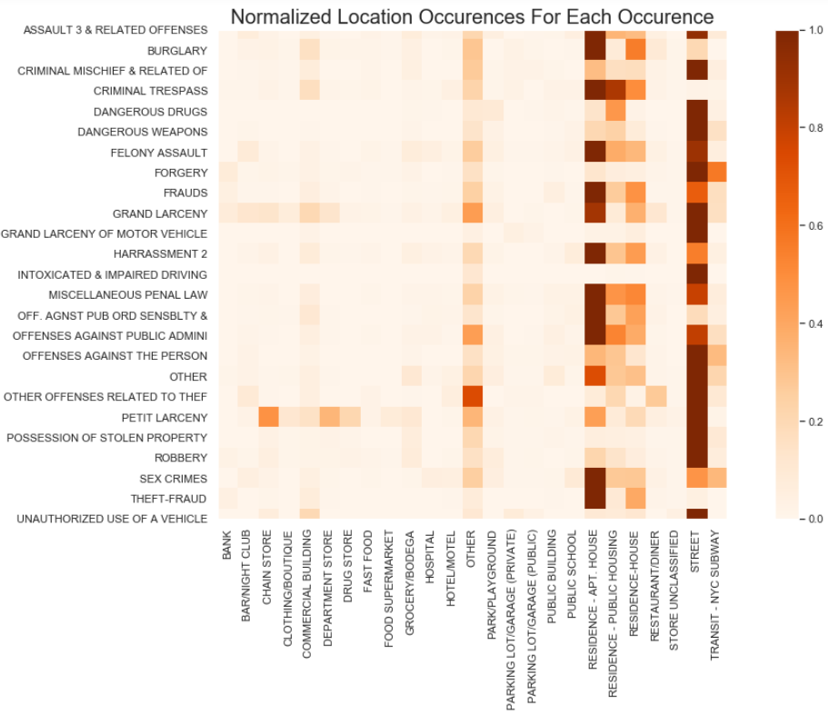
Geographic Analysis – Key Findings
Premise location type appears to vary based on offense type

Slide 14
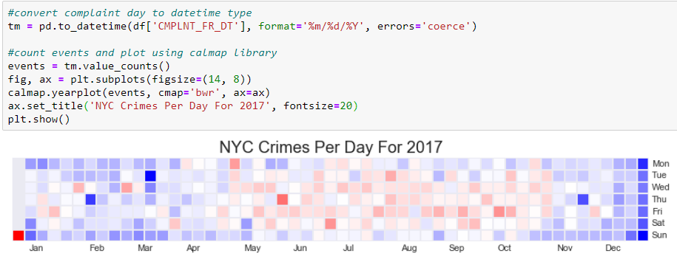
Temporal Analysis – Preparation
Possible crime concentration during Tuesday-Saturday

Slide 15

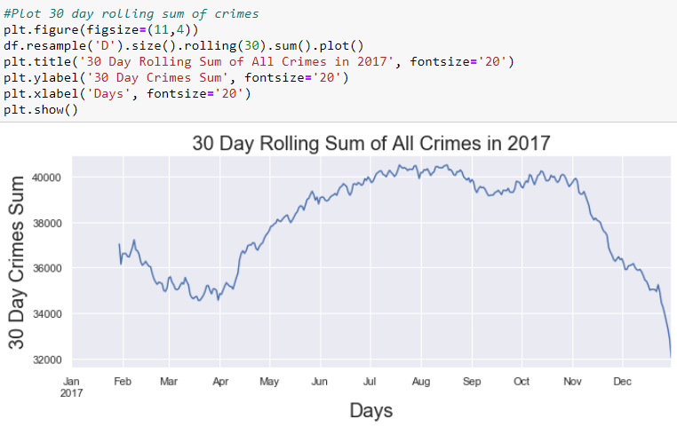
Temporal Analysis – Preparation
Possible crime concentration during summer months

Slide 16
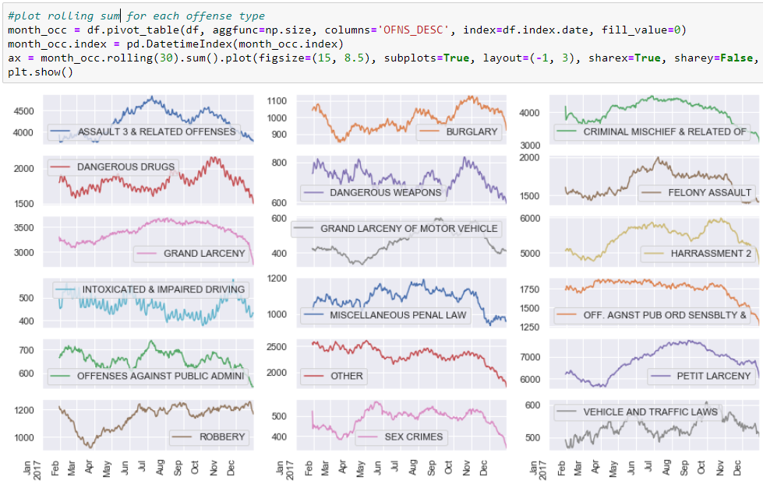
Temporal Analysis – Key Findings
Uptrend in petty larceny and vehicle/traffic laws
Downtrend in public order/sensibility offenses

Slide 17
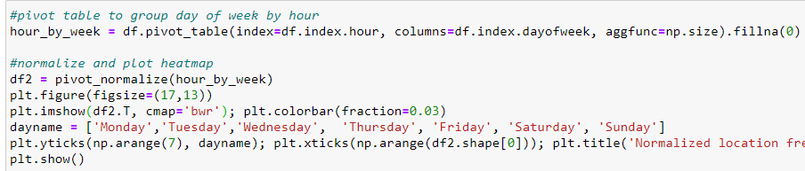
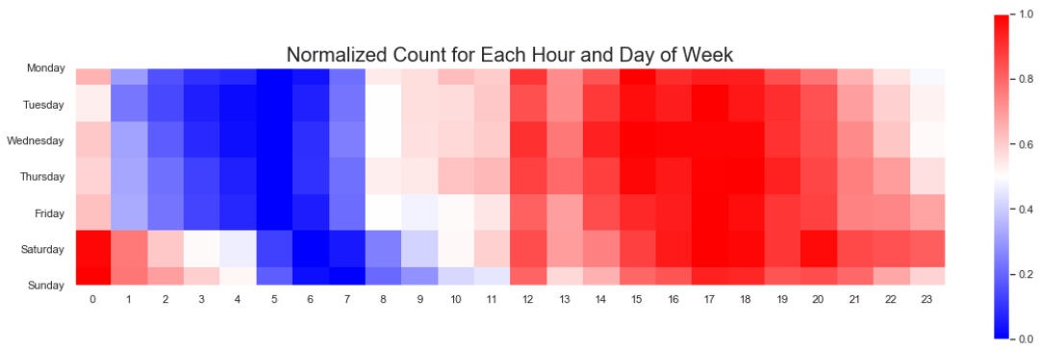
Temporal Analysis – Key Findings
Shift in hour crime committed based on weekday vs weekend

Slide 18
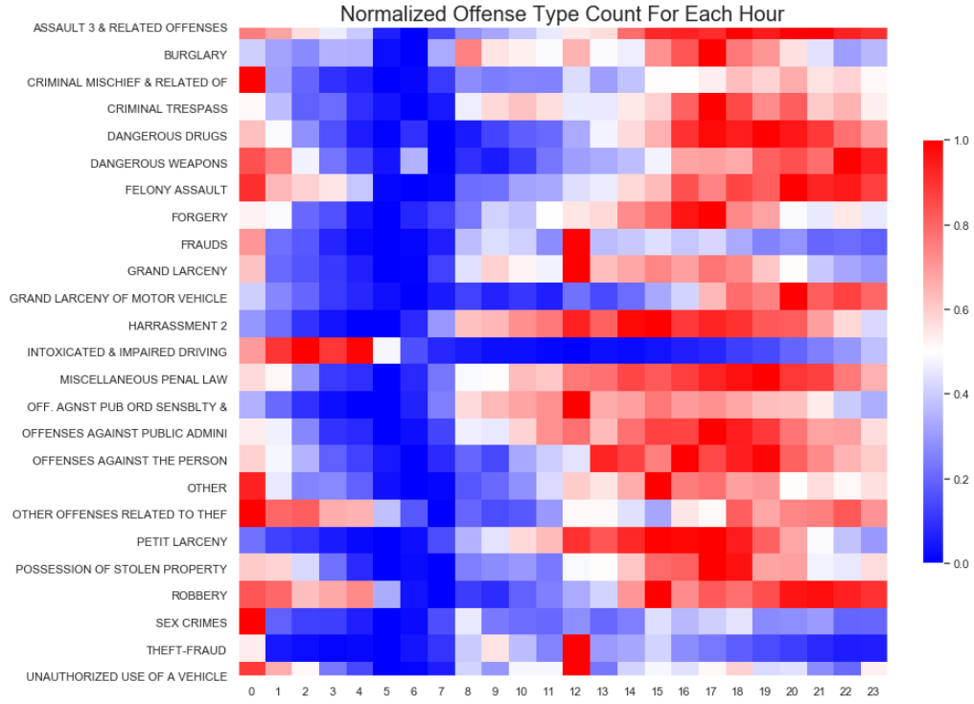
Temporal Analysis – Key Findings
Change in hour crime committed based on offense type
High Crime Times:
Intoxicated driving -> 12AM-4AM
Petit larceny -> 12PM-7PM

Slide 19
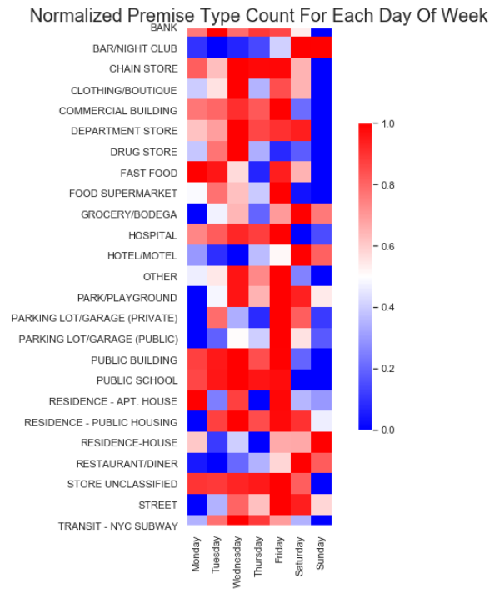
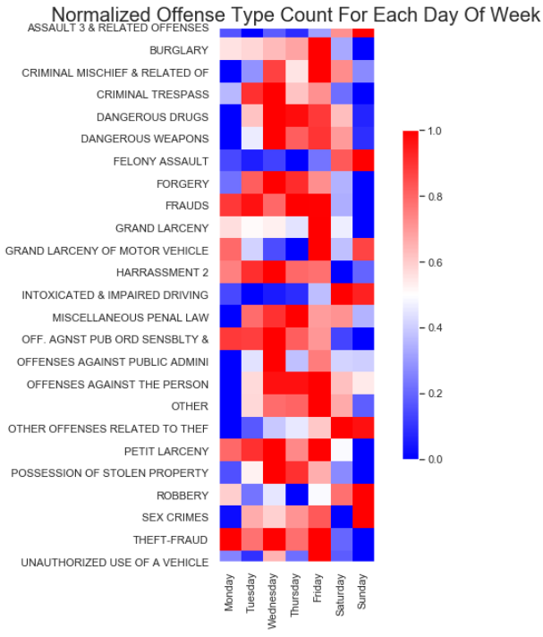
Temporal Analysis – Key Findings
High crime rate at fast food store on Monday and Tuesday
High felony assault/assault 3 and intoxicated driving on weekends

Slide 20
Diagnostic Analysis - Ideas
Why are some offense types concentrated in certain areas?
Why do some offense types occur in higher frequency on certain days of the week?
Why are some offense types more male dominated, while others have higher female involvement?

Slide 21
Predictive Analysis - Ideas
What areas will have the largest increase in crime rate (time series regression)?
What offense types will have the largest increase in frequency?
Predict the offense type given a premise description (classification)

Slide 22
Prescriptive Analysis - Ideas
If more law enforcement officers are added to certain areas, how will the crime change in those areas and the surrounding areas?
If programs are funded to involve more children in sports, mentorship, and other activities, how will crime rates change?
If jail sentencing changes, how will crime rates change?

Slide 23
Adaptive/Autonomous Analysis - Ideas
Real time crime prediction police dashboard based on 911 calls to route police to next probable crime area
Predict next crime type and location

