Slide 1





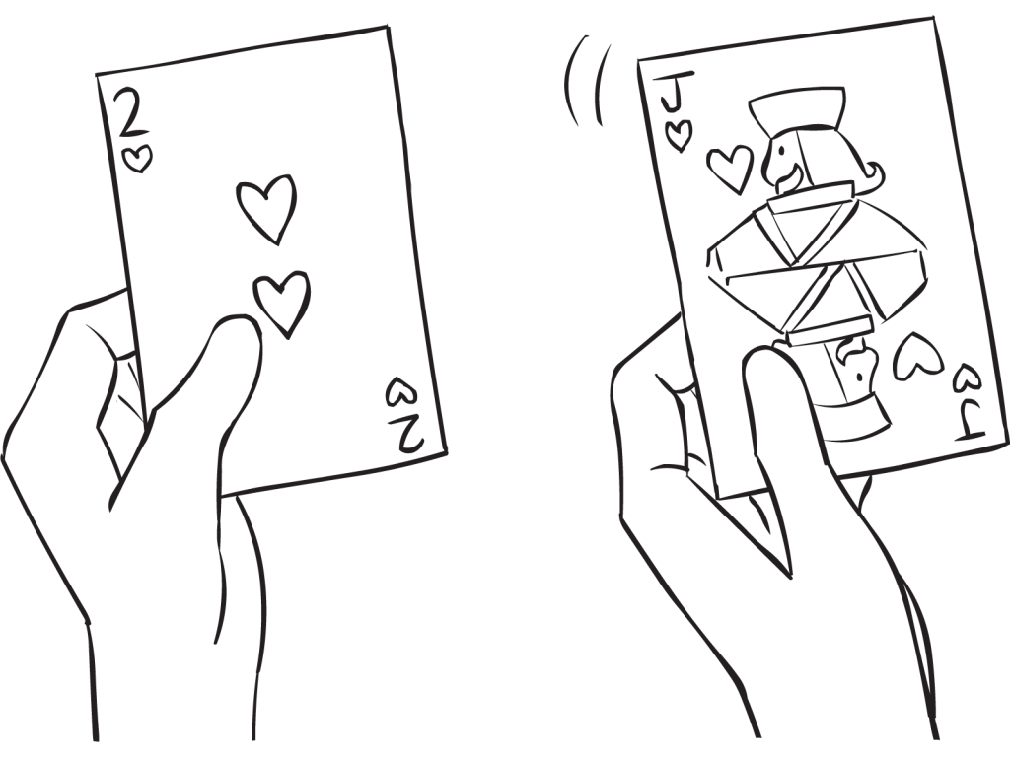


TRY IT NOW!
Have you ever been in the situation where you are with friends or family and have run out of things to do?
Fancy playing a card game, but forgot to bring playing cards?
Applications from the app store only caters to one specific card game?
Too much hassle installing the game on everybody’s phone?
We feel your pain!
PartyCards is a collection of popular card games that you can play on your web browser with your friends!
Games Available:
Cheat
Taiti
Bridge
Hearts
Features Include:
Friendly User Interface – easy to navigate and use
Mobile Friendly – PartyCards is designed to work on both landscape orientations(desktops) and portrait orientations(mobile phones)
Disconnection/Reconnection – if a user disconnects, simply reconnect using the same Game PIN, no progress will be lost!

