Slide 1
Chariot Day 2019
(An attempt of) Becoming proficient in Rust
by way of
implementing (features of) a
Hierarchical Deterministic crypto wallet

Slide 2
Background
Java since back when Applets were considered cool.
Some other JVM stuff; <3 “mechanical sympathy”
Erlang (in order to improve m/r perf in Riak)
Made “proficient in Rust” one of my 2018 New Year’s resolutions.

Slide 3
Why Rust?
I like Java. It’s intentionally blue collar and the ecosystem is huge.
I don’t like Java. Fighting w/ JVM tuning isn’t exactly fun, and the world’s simply not stagnant.
Enter Rust: super fast, predictable, safe
I like Mozilla’s mission

Slide 4
Crypto currency
Late to the Bitcoin game, :( but find its scope fascincating.
After reading about wallet tech, thought it would be a reasonable challenge to implement one.
The tech requirements are quite comprehensive.
Quickly realized full featured was beyond what I was willing/able to commit.

Slide 5
Crypto wallets
Don’t actually hold digital currency.
Instead, they contain the keys that prove ownership of transactions on the blockchain.
The original reference implementation works, but it has warts.
It’s known as nondeterministic.

Slide 6
nondeterministic wallets
Keys are generated from random numbers.
A predetermined amount are generated and then as they get used, more are generated.
In order to maintain privacy, you should avoid reusing an address (this is how “the man” can track you down*).
To follow the above requires constant back ups of all keys, thus making ex/imports cumbersome.

Slide 7
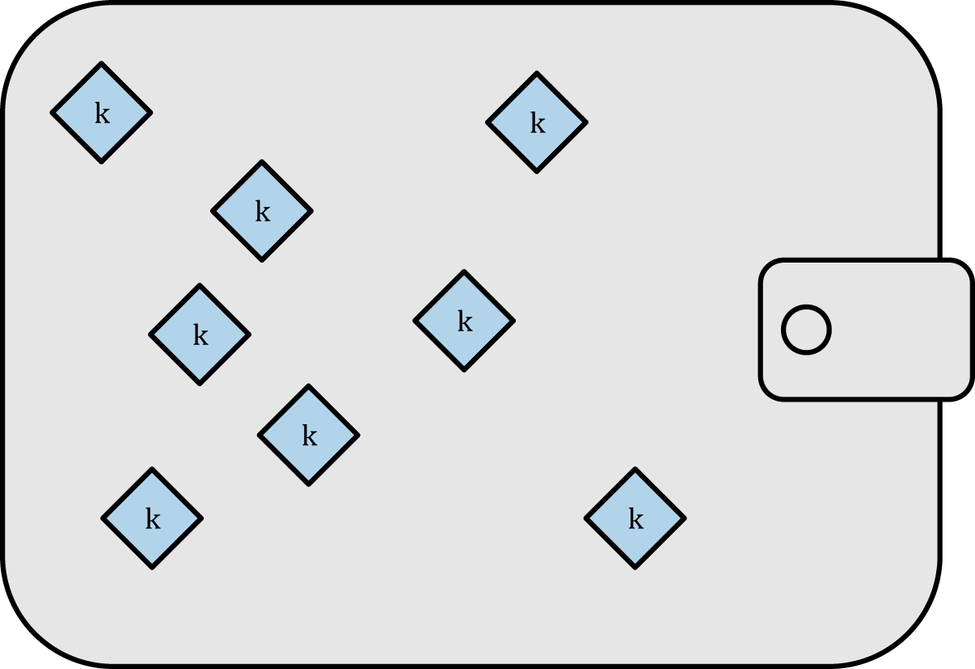
JBOK (just a bunch of keys):

Slide 8
deterministic wallets
All the wallet’s private keys are derived from a single seed using one-way hash functions.
This makes ex/import rather easy; just back up the original seed.

Slide 9
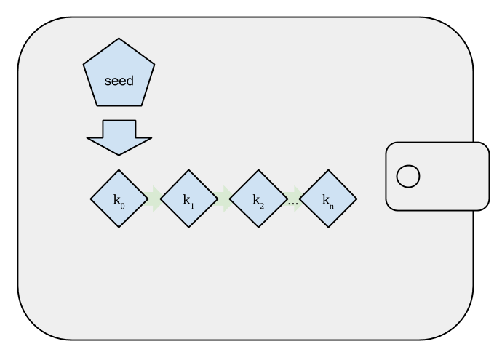
single seed deterministic wallet

Slide 10
hierarchical deterministic wallets
Specification in BIP-32.
Improves on deterministic by defining an organizational hierarchy of branches from which the private keys are generated.
Enables public key generation without knowing the matching private keys. This is useful for receivable addresses.

Slide 11
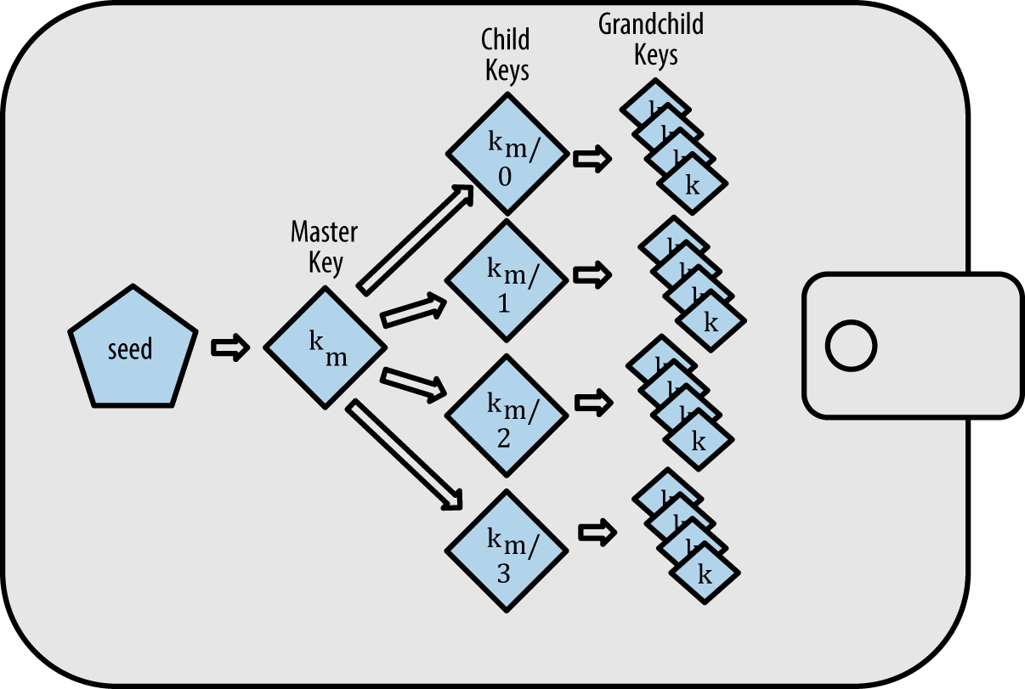
HD wallet

Slide 12
Augmenting deterministic: BIP-39
Seeds are generated from mnemonic terms.
Basically the standard across major currencies.
Includes optional password salt, enabling it to be used “under duress”.
Using your established mnemonic terms, enter a password that creates a seed for which you have minimal associated currencies.

Slide 13
BIP-39 details
Mnemonic term lists (8 of them in different languages) consist of 2048 words.
The spec calls for 12, 15, 18, 21, or 24 words from which to generate the deterministic seed.
The mnemonic must encode entropy in a multiple of 32 bits. (11 bits = index into word list)
The final term’s bits are derived from a SHA256 hash of the entropy.

Slide 14
From mnemonic to seed
BIP-39 resultant seed is 512 bits (64 bytes).
PBKDF2 function is used with HMAC-SHA512 as its pseudo-random function.
The mnemonic’s bytes are used as the key for the HMAC-SHA512 instance.
The mac and salt are used as inputs to the PBKDF2 for 2,048 rounds of hashing. (let’s look at some code)

Slide 15
hierarchical deterministic
BIP-32 defines some rather complex stuff.
The entry point for the hierarchy is the “root key”, an “extended private key”
The root key’s input data is the BIP-39 output

Slide 16
HD master key generation
Generate a seed byte sequence S of a chosen length (between 128 and 512 bits; 256 bits is advised) from a (P)RNG. ‘S’ is the BIP-39 output; 512 bits
Calculate I = HMAC-SHA512(Key = "Bitcoin seed", Data = S)
Split I into two 32-byte sequences, IL and IR.
Use parse256(IL) as master secret key, and IR as master chain code.

Slide 17
HD master key serialization
4 byte: version bytes (mainnet: 0x0488ADE4 private)
1 byte: depth: 0x00 for master nodes, 0x01 for level-1 derived keys, ....
4 bytes: the fingerprint of the parent's key (0x00000000 if master key)
4 bytes: child number. (0x00000000 if master key)
32 bytes: the chain code (IR)
33 bytes: the public key or private key data (serP(K) for public keys, 0x00 || ser256(k) for private keys) (0x00 || IL)

Slide 18
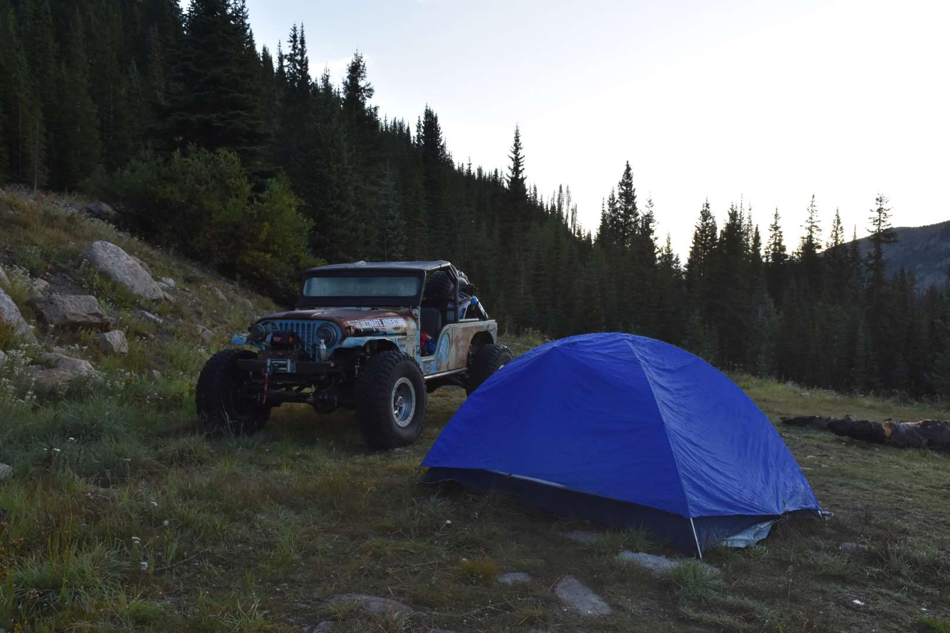
Ok, let’s run it!

Slide 19
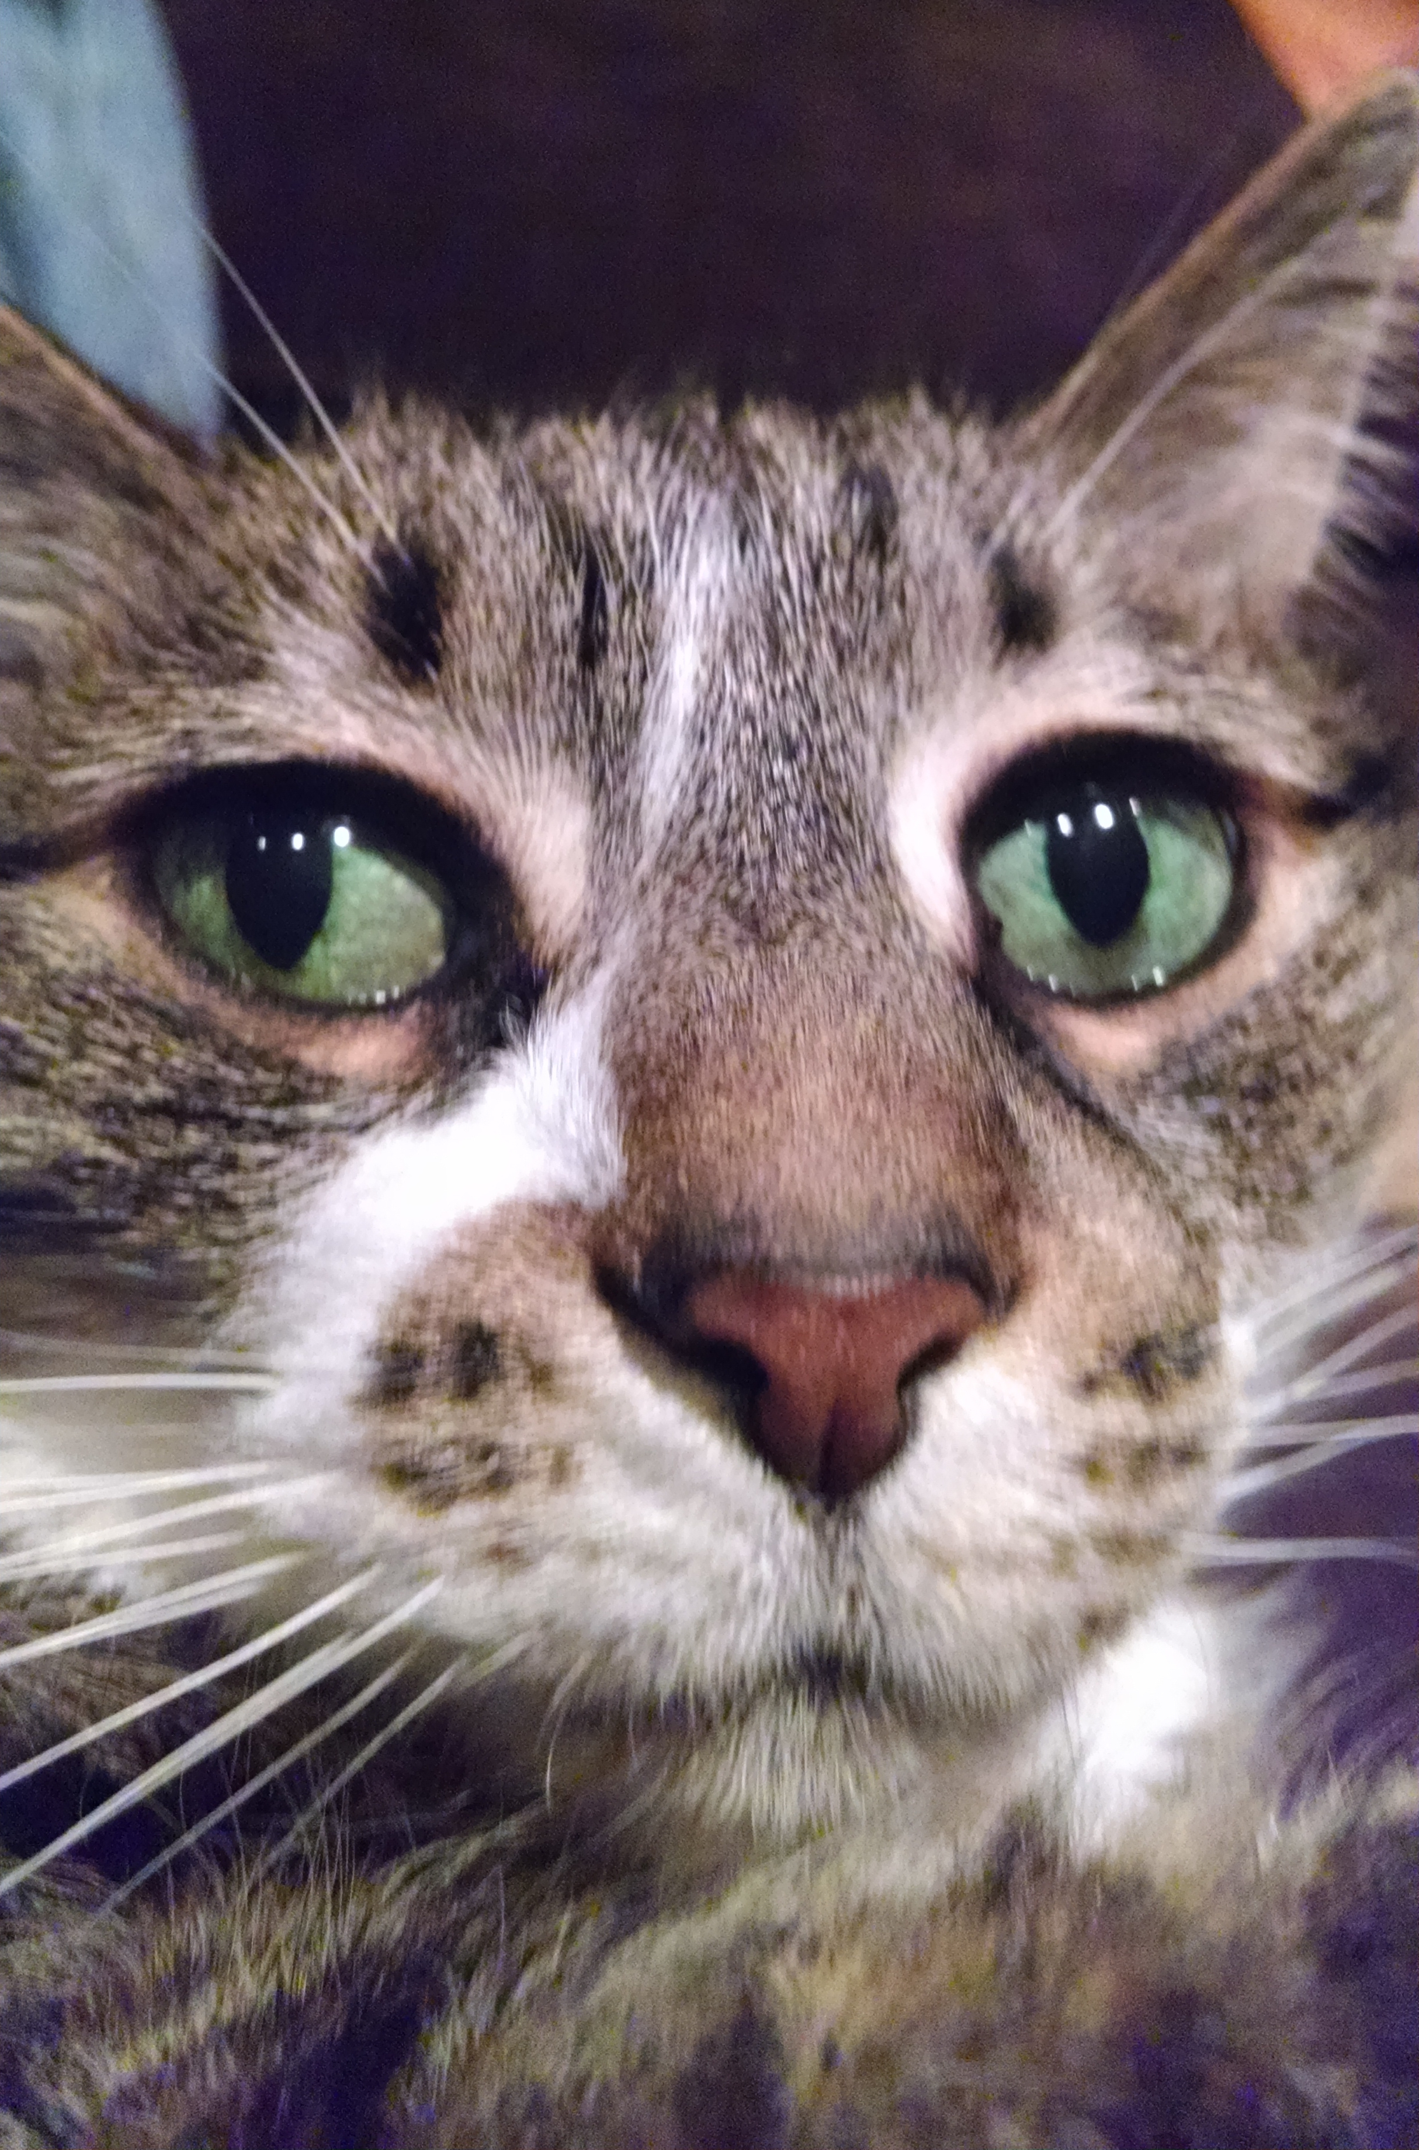
Thanks!

