Slide 1
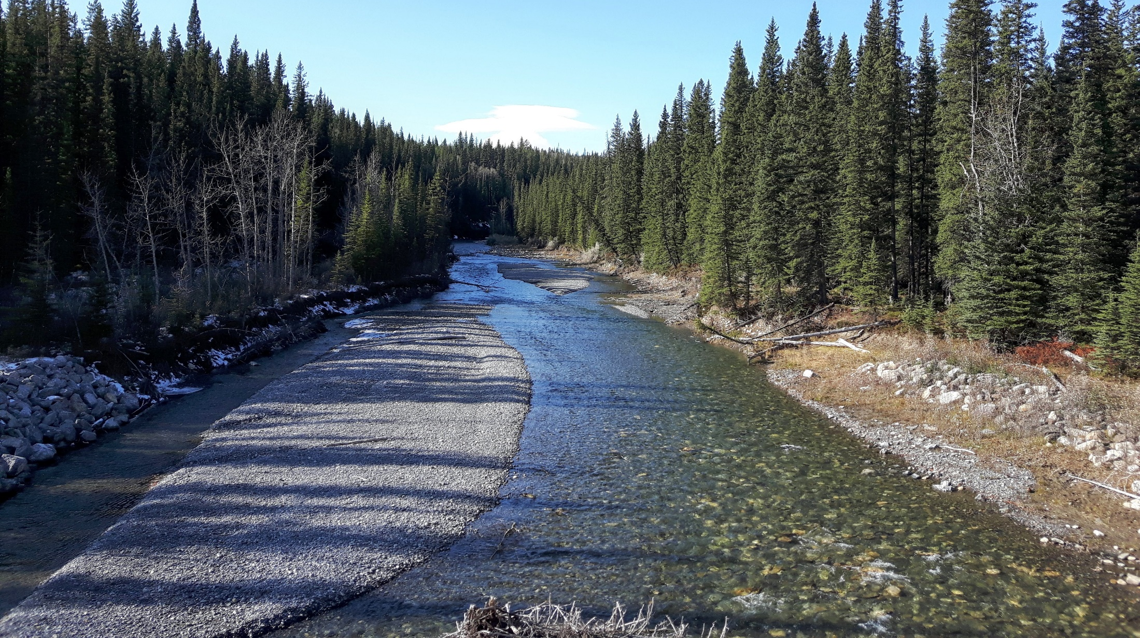
Joe Model Overview
Andrew J Paul
Fish and Wildlife
Alberta Environment and Parks
28 April 2021

Slide 2
Cumulative Effects Fish Model (Joe Model)
Quantify stressors (i.e., threats listed in each recovery plan)
Identify population response from the stressor (stressor-response curves)
Prioritize recovery efforts (what and where)

Slide 3
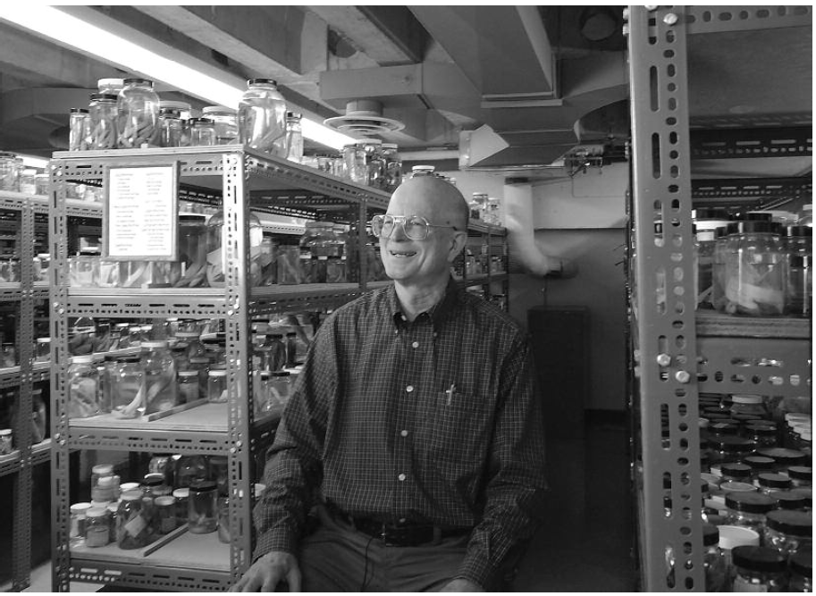
Named for Dr. Joseph Nelson; because if you want to know anything
about fishes, ask Joe!
Joe Modelling is a technique to explore HYPOTHESES

Slide 4
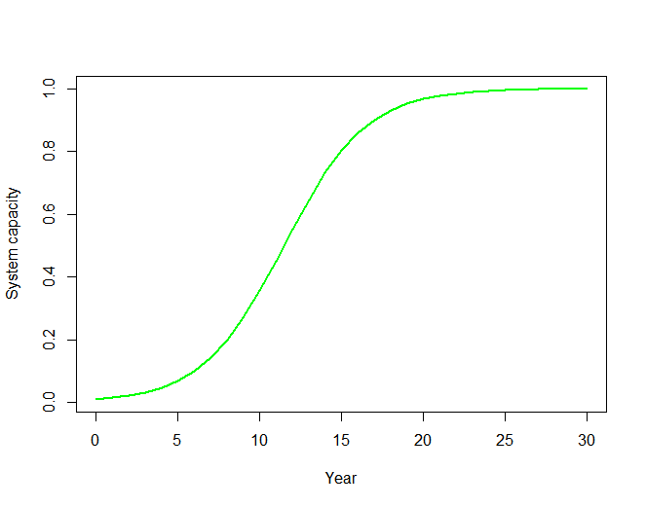
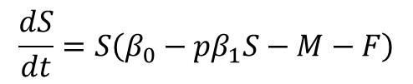

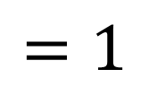
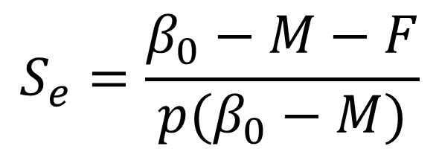
Examples
$$\frac{dS}{dt}=S\left(β_{0}−{pβ}_{1}S−M−F\right)$$
$$S=\frac{N}{K_{ideal}}$$
S(0) = 0.01
β₀ = 0.6
β₁ = 1
p = 1
M = 0.2
F = 0
$$S_{e}=\frac{β_{0}−M−F}{p(β_{0}−M)}$$
$$=1$$

Slide 5
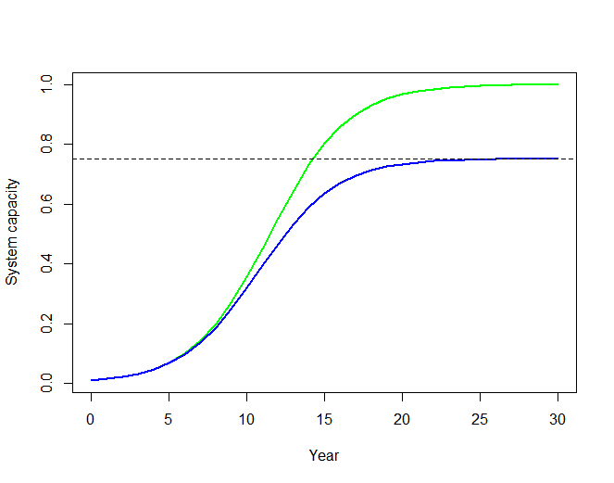
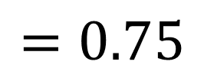
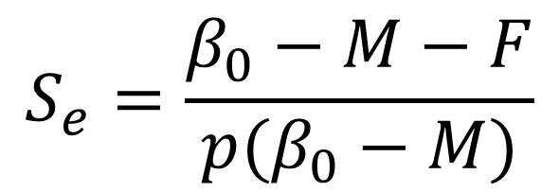
Examples
$$\frac{dS}{dt}=S\left(β_{0}−{pβ}_{1}S−M−F\right)$$
S(0) = 0.01
β₀ = 0.6
β₁ = 1
p = 1.3333
M = 0.2
F = 0
0.75
$$S_{e}=\frac{β_{0}−M−F}{p(β_{0}−M)}$$
$$=0.75$$

Slide 6
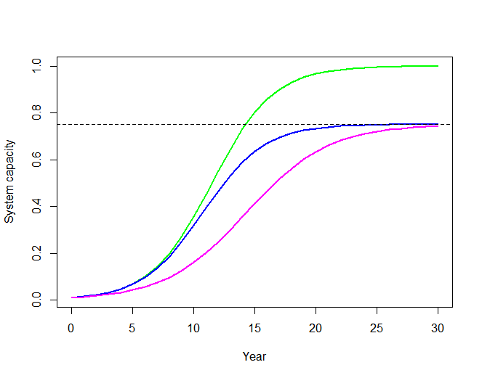
Examples
$$\frac{dS}{dt}=S\left(β_{0}−{pβ}_{1}S−M−F\right)$$
S(0) = 0.01
β₀ = 0.6
β₁ = 1
p = 1
M = 0.2
F = 0.1
0.75
$$S_{e}=\frac{β_{0}−M−F}{p(β_{0}−M)}$$
$$=0.75$$

Slide 7
Examples
$$\frac{dS}{dt}=S\left(β_{0}−{pβ}_{1}S−M−F\right)$$
S(0) = 0.01
β₀ = 0.6
β₁ = 1
p = 1.3333
M = 0.2
F = 0.1
Using the Joe model the prediction would be:
Cumulative S_{e} is:
multiply S_{e} from each individual stressor
S_{e} = 0.75*0.75 = 0.5625

Slide 8
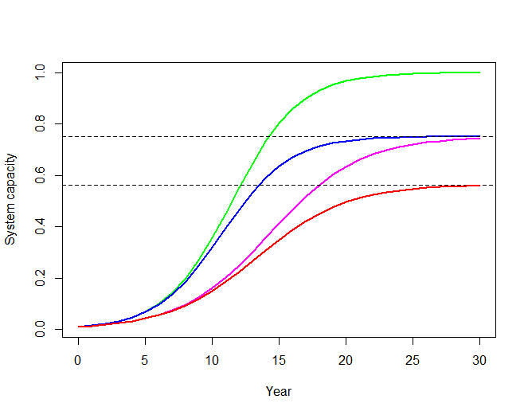
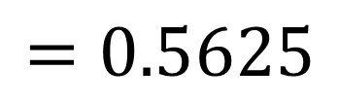
Examples
$$\frac{dS}{dt}=S\left(β_{0}−{pβ}_{1}S−M−F\right)$$
S(0) = 0.01
β₀ = 0.6
β₁ = 1
p = 1.3333
M = 0.2
F = 0.1
0.5625
$$S_{e}=\frac{β_{0}−M−F}{p(β_{0}−M)}$$
$$=0.5625$$

Slide 9
Joe model is:
A tool to estimate equilibrium conditions (static) and is not dynamic
Additively combines individual stressors by multiplying their respective system capacities
System capacity must be a proportion
Takes as input a relation between system capacity and each stressor plus the stressor magnitude

Slide 10
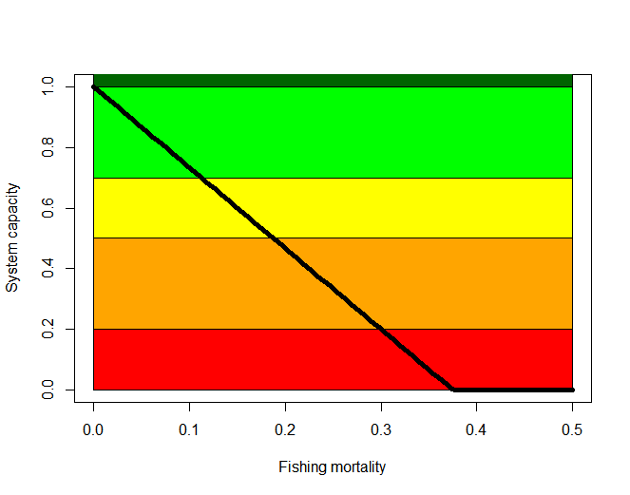
Takes as input a relation between system capacity and each stressor plus the stressor magnitude

Slide 11
Takes as input a relation between system capacity and each stressor plus the stressor magnitude
Truncated beta distribution
(mean, SD, low limit, up limit)

Slide 12
Takes as input a relation between system capacity and each stressor plus the stressor magnitude
Truncated normal or log-normal distribution (mean, SD, low limit, up limit)

Slide 13
Alberta Cumulative Effects Model (Joe Model)
Model workflow:
Excel file – stressor levels
Can include multiple scenarios
Spatial Polygons - Shapefile
Excel file – stressor-response relations
R/Shiny
Single scenario with basic graphics
Batch scenarios
Adjust stressor levels within a scenario
CSV output file
Stressor levels
Scenarios
Replicate simulations

Slide 14
Alberta Cumulative Effects Model (Joe Model)
Model workflow:
Spatial Polygons - Shapefile
Global.R
HUC.Map
HUC.MAP@data has a column named HUC_Name which is assigned a string
HUC_Name corresponds to a column called “HUC_ID” in the dose data.frame

Slide 15
Alberta Cumulative Effects Model (Joe Model)
Model workflow:
Excel file – stressor-response relations
main.sheet
reads the “main” tab
Global.R calls
Joe_curve.R
stressor.list
A list of data.frames
Each data.frame are columns for each stressor-response function

Slide 16
Alberta Cumulative Effects Model (Joe Model)
Model workflow:
Joe_curve.R
mean.resp.list
A primary list element for each stressor
Each primary element contains 4 approximation functions
The approximation functions interpolate mean, sd, low limit and upper limit for system capacity given a dose
main.sheet
reads the “main” tab
stressor.list
A list of data.frames
Each data.frame are columns for each stressor-response function

Slide 17
Alberta Cumulative Effects Model (Joe Model)
Model workflow:
Excel file – stressor levels
Can include multiple scenarios
Global.R calls
Joe_model.R
dose
A data.frame of stressor doses for the given scenario
For the initial run, the scenario is assigned to the object scn.run

Slide 18
Alberta Cumulative Effects Model (Joe Model)
Model workflow:
mean.resp.list
dose
Joe_model.R
Loop across every spatial unit (hucs)
And each stressor for the spatial unit
Calculate system capacity for each stressor
Calls function sys.cap.func
Stored in the 3D array sys.capacity
Rows – hucs
Columns – stressors
Sheets – simulations (MC.sims)

Slide 19
Alberta Cumulative Effects Model (Joe Model)
Model workflow:
sys.cap.func
Joe_functions.R
Input:
Dose data.frame for a single stressor
Additive stressors (mortality) can have multiple rows in data.frame
4 approx. functions for that stressor from mean.resp.list
Also, requires residual information for that stressor from main.sheet and stressor.list
Constraint to random doses
Scale (normal/log) of doses
Number of simulations MC.sims

Slide 20
Alberta Cumulative Effects Model (Joe Model)
Model workflow:
sys.cap.func
Joe_functions.R
Set random dose vector (length MC.sims)
For doses with multiple rows (ie. finite mortality rates) combines by:
1-apply(rnd.dose.mat,2,function(x) prod(1-x))
Calculate a random system capacity
For each dose in the vector
Calls function tbeta_rnd

Slide 21
Alberta Cumulative Effects Model (Joe Model)
Model workflow:
tbeta_rnd
Input:
Mean, sd, low limit and upper limit of system capacity for a given dose
Uses the 4 approximation functions to determine the inputs
Needs alpha and beta parameters for beta distrtibution
Calls beta_param to solve for alpha and beta given a mean and sd
Numerical solver (fsolve)
Has problems when mean near 0 and 1 or sd is large
If fails, tries 3 more times by reducing sd by 10%
On fourth fail, set alpha=beta=1 (uniform)
Still truncated between lower and upper limits
Joe_functions.R

Slide 22
Alberta Cumulative Effects Model (Joe Model)
Model workflow:
tbeta_rnd
Output:
A vector of system capacity scores for each rnd.dose
Joe_functions.R

Slide 23
Alberta Cumulative Effects Model (Joe Model)
Model workflow:
sys.cap.func
Joe_functions.R
Set random dose vector (length MC.sims)
Calculate a random system capacity for each random dose
Output system capacities and random doses
Store output in arrays:
sys.capacity, dose.values and dose.values.list

Slide 24
Alberta Cumulative Effects Model (Joe Model)
Model workflow:
System capacity for each stressor
And, each spatial unit
sys.capacity
Joe_model.R
Combine into a cumulative system capacity for each spatial unit
Call ce_func
this function accounts for minimum interaction
Output stored in ce.df

