Slide 1
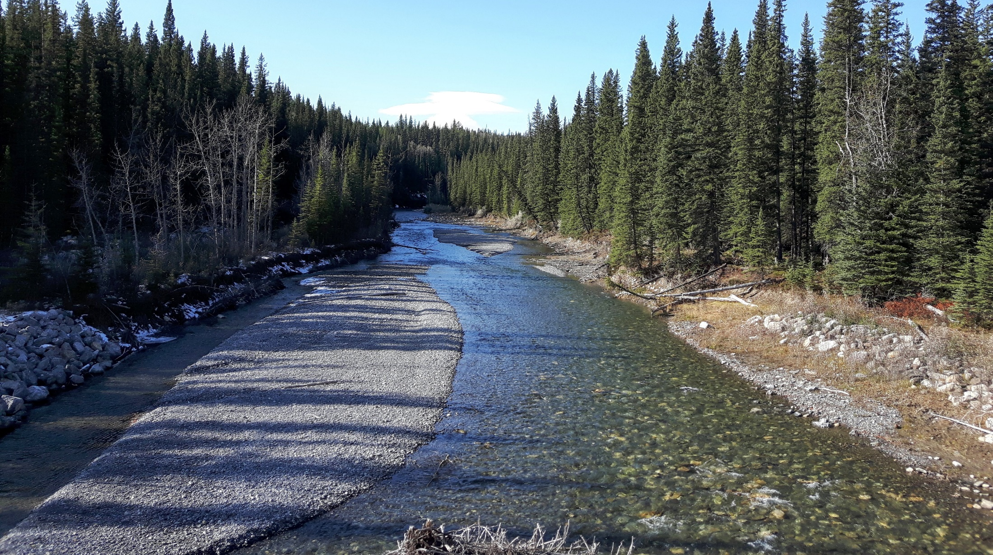
Joe Model Overview
Andrew J Paul
Fish and Wildlife
Alberta Environment and Parks
28 April 2021

Slide 2
Cumulative Effects Fish Model (Joe Model)
Quantify stressors (i.e., threats listed in each recovery plan)
Identify population response from the stressor (stressor-response curves)
Prioritize recovery efforts (what and where)

Slide 3
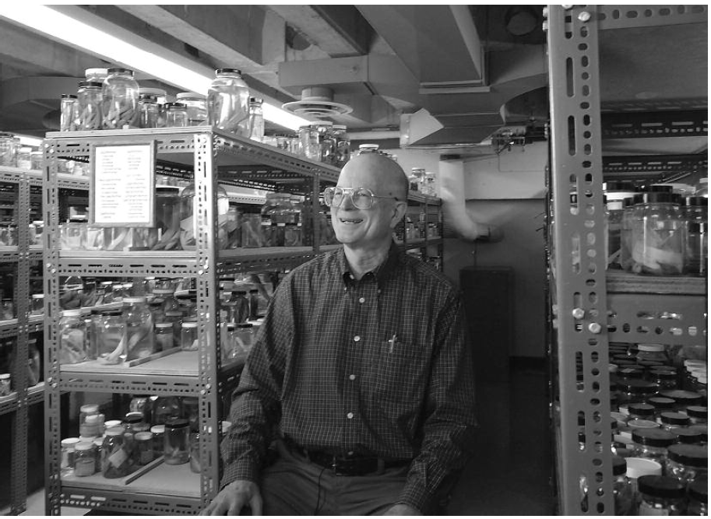
Named for Dr. Joseph Nelson; because if you want to know anything
about fishes, ask Joe!
Joe Modelling is a technique to explore HYPOTHESES

Slide 4
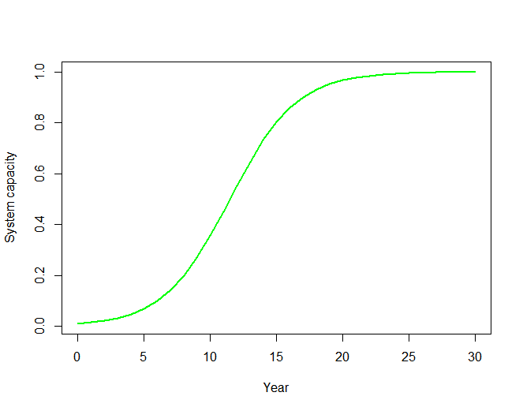
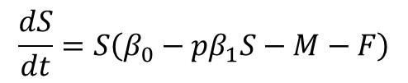

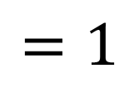
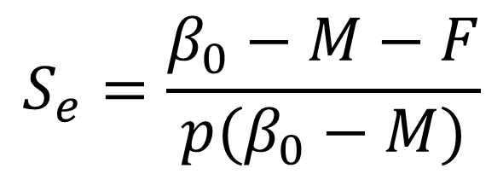
Examples
$$\frac{dS}{dt}=S\left(β_{0}−{pβ}_{1}S−M−F\right)$$
$$S=\frac{N}{K_{ideal}}$$
S(0) = 0.01
β₀ = 0.6
β₁ = 1
p = 1
M = 0.2
F = 0
$$S_{e}=\frac{β_{0}−M−F}{p(β_{0}−M)}$$
$$=1$$

Slide 5
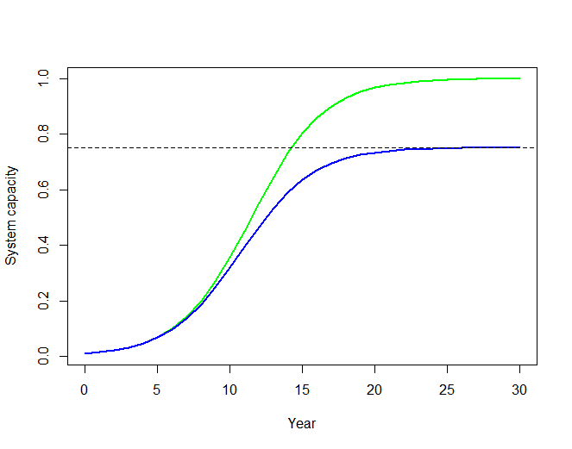
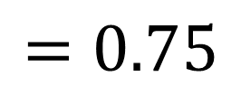
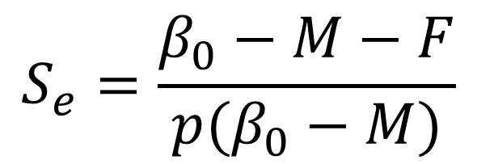
Examples
$$\frac{dS}{dt}=S\left(β_{0}−{pβ}_{1}S−M−F\right)$$
S(0) = 0.01
β₀ = 0.6
β₁ = 1
p = 1.3333
M = 0.2
F = 0
0.75
$$S_{e}=\frac{β_{0}−M−F}{p(β_{0}−M)}$$
$$=0.75$$

Slide 6
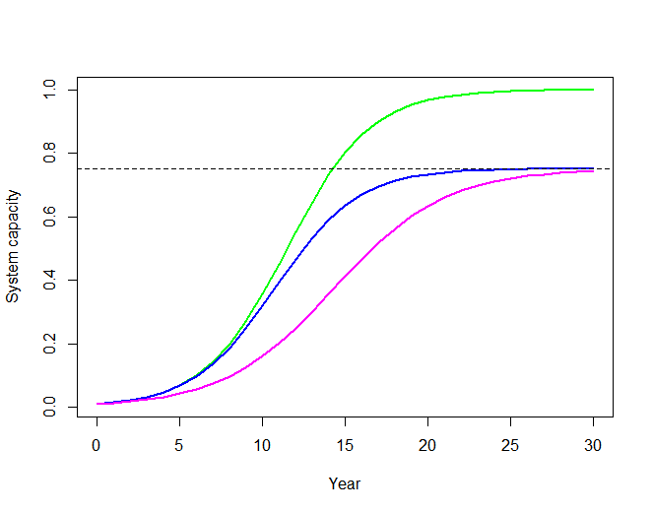
Examples
$$\frac{dS}{dt}=S\left(β_{0}−{pβ}_{1}S−M−F\right)$$
S(0) = 0.01
β₀ = 0.6
β₁ = 1
p = 1
M = 0.2
F = 0.1
0.75
$$S_{e}=\frac{β_{0}−M−F}{p(β_{0}−M)}$$
$$=0.75$$

Slide 7
Examples
$$\frac{dS}{dt}=S\left(β_{0}−{pβ}_{1}S−M−F\right)$$
S(0) = 0.01
β₀ = 0.6
β₁ = 1
p = 1.3333
M = 0.2
F = 0.1
Using the Joe model the prediction would be:
Cumulative S_{e} is:
multiply S_{e} from each individual stressor
S_{e} = 0.75*0.75 = 0.5625

Slide 8
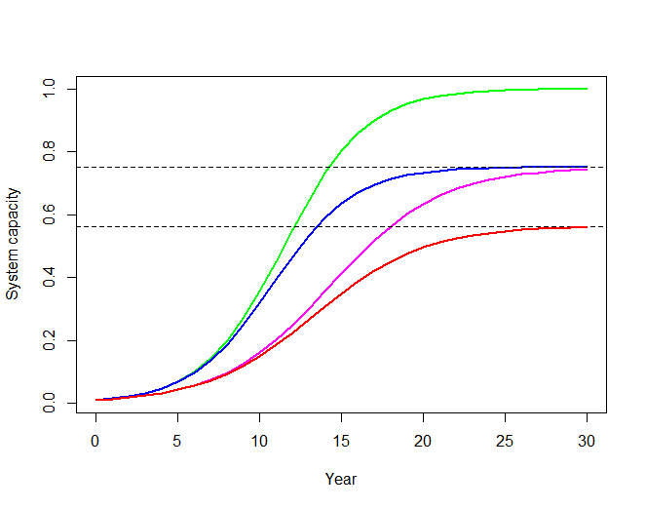
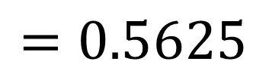
Examples
$$\frac{dS}{dt}=S\left(β_{0}−{pβ}_{1}S−M−F\right)$$
S(0) = 0.01
β₀ = 0.6
β₁ = 1
p = 1.3333
M = 0.2
F = 0.1
0.5625
$$S_{e}=\frac{β_{0}−M−F}{p(β_{0}−M)}$$
$$=0.5625$$

Slide 9
Joe model is:
A tool to estimate equilibrium conditions (static) and is not dynamic
Additively combines individual stressors by multiplying their respective system capacities
System capacity must be a proportion
Takes as input a relation between system capacity and each stressor plus the stressor magnitude

Slide 10
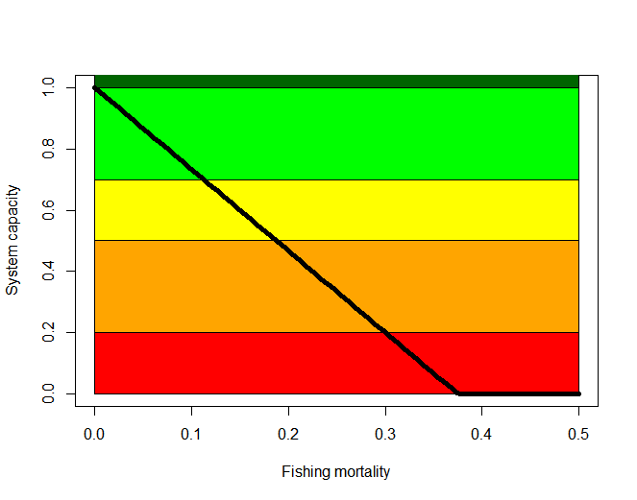
Takes as input a relation between system capacity and each stressor plus the stressor magnitude

Slide 11
Takes as input a relation between system capacity and each stressor plus the stressor magnitude
Truncated beta distribution
(mean, SD, low limit, up limit)

Slide 12
Takes as input a relation between system capacity and each stressor plus the stressor magnitude
Truncated normal or log-normal distribution (mean, SD, low limit, up limit)

Slide 13
Alberta Cumulative Effects Model (Joe Model)
Model workflow:
Excel file – stressor levels
Can include multiple scenarios
Spatial Polygons - Shapefile
Excel file – stressor-response relations
R/Shiny
Single scenario with basic graphics
Batch scenarios
Adjust stressor levels within a scenario
CSV output file
Stressor levels
Scenarios
Replicate simulations

