Slide 1
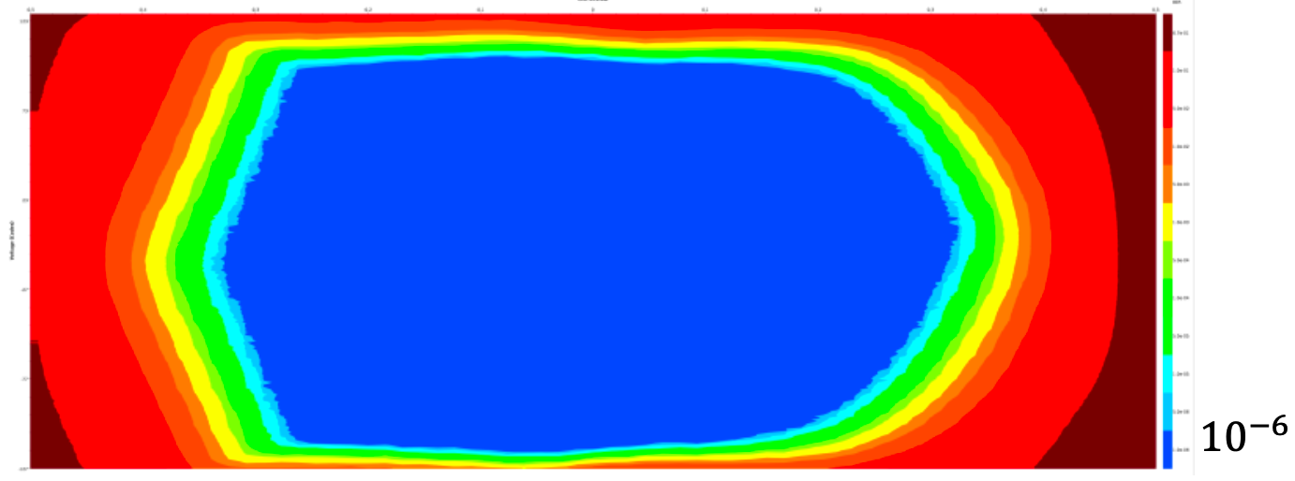












Unit Interval
BER
-0.5 -0.4 -0.3 -0.2 -0.1 0 0.1 0.2 0.3 0.4 0.5
-
-
-
-
-
-
-
-
-
-
-
127 -
73 -
-
-27 -
-77 -
-127 -
$$6.7×{10}^{−1}$$
$$1.0×{10}^{−1}$$
$$5.0×{10}^{−2}$$
$$1.0×{10}^{−2}$$
$$5.0×{10}^{−3}$$
Voltage Step
$$1.0×{10}^{−3}$$
$$5.0×{10}^{−4}$$
$$1.0×{10}^{−4}$$
$$5.0×{10}^{−5}$$
$$1.0×{10}^{−5}$$
$$5.0×{10}^{−6}$$
$$1.0×{10}^{−6}$$

