Slide 1
Wishlist
A carefully curated collection.

Slide 2


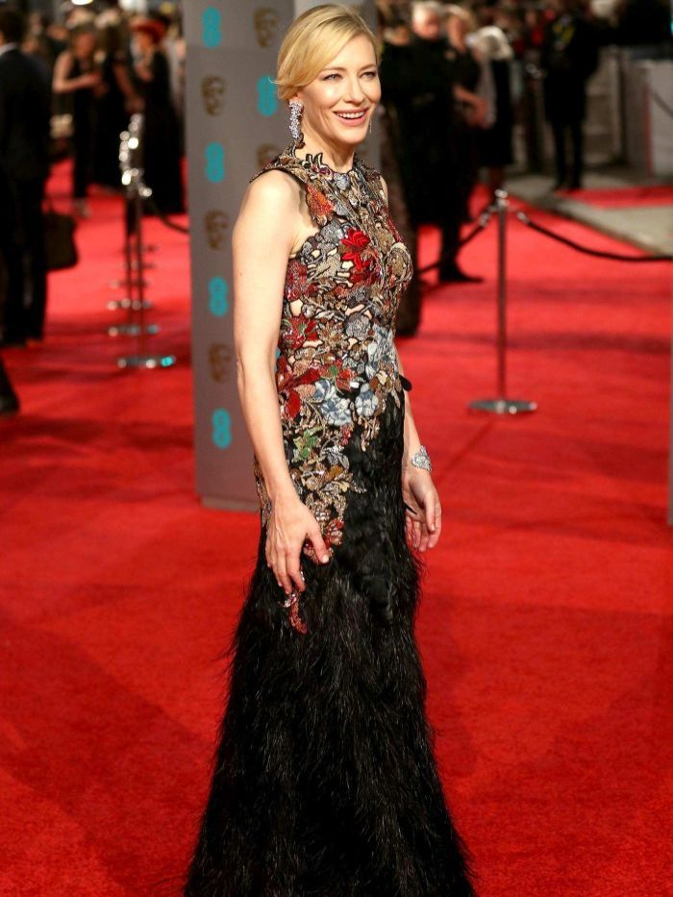

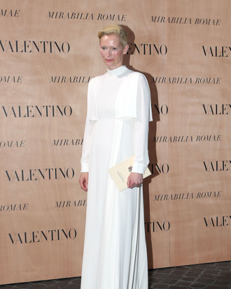




Wishlist
Wishlist

Slide 3

Wishlist
An online application that allows user to select and bookmark items of clothing from a curated selection of online retailers.

Slide 4
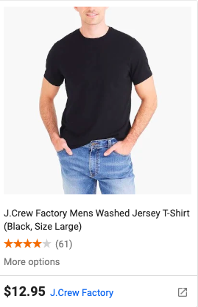
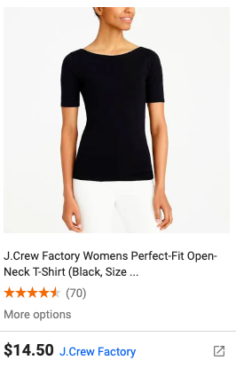
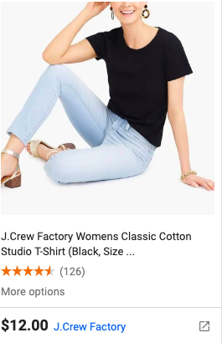

It’s easy! Create a sign-up name, login, and select an item from one of our partners to add to your Wishlist.

Slide 5
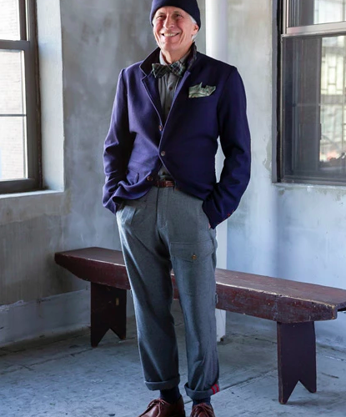


Slide 6
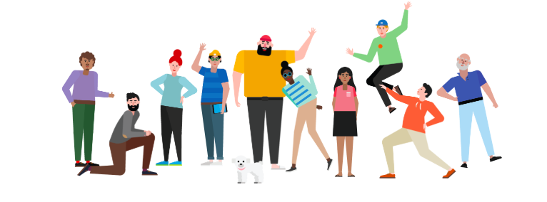
Meet the team
Adi | Abdel | Andrew | Charles | Idiatou | Matthew

Slide 7
Adi
Responsible for Co-Project Managing with Matthew as well as code-partnering with Idiatou. She worked closely with Idiatou and collaborated with Abdel and Charles to ensure Back End success!

Slide 8
Abdel
Abdel code-partnered with Charles and and collaborated closely with Adi and Idiatou to ensure Back End success!

Slide 9
Andrew
Andrew code-partnered with Matthew, sharing responsibility for UI/Front End design. He collaborated closely with Adi, Abdel, Charles and Idiatou, helping to bring the Front End/Back End together!

Slide 10
Charles
Charles code-partnered with Abdel and and collaborated closely with Adi and Idiatou to ensure Back End success!

Slide 11
Matthew
Responsible for Co-Project Managing with Adi as well code-partnering with Andrew, sharing responsibility for UI/Front End design. He collaborated closely with Adi, Abdel, Charles and Idiatou, helping to bring the Front End/Back End together!

Slide 12
Technologies used
HTML5, CSS, Materialize, Node and Express Web Server, MySQL database with sequelize ORM, and Heroku.

Slide 13
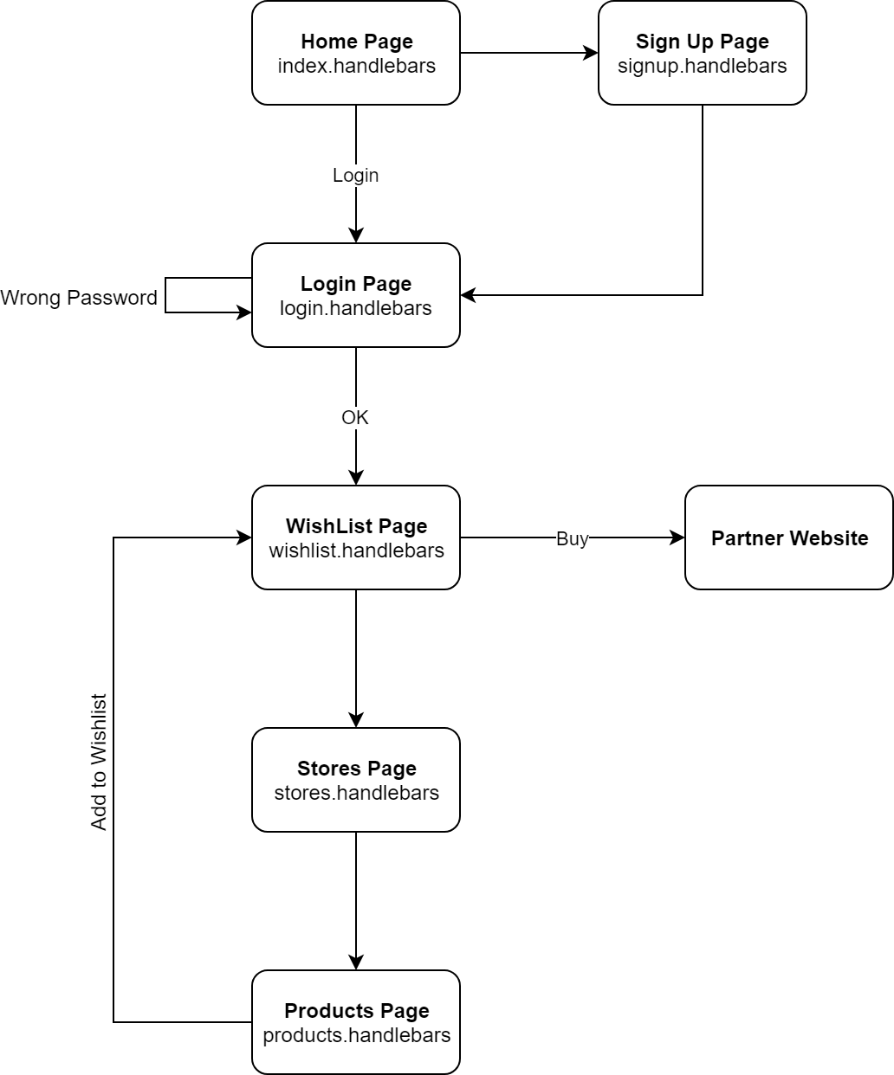

Slide 14
Wishlist
Our motivation was simple: to make one-stop shopping easier. Bringing users to our platform where they can bookmark items from a variety of online retailers into on large Wishlist. Rather than having multiple wishlists at multiple online retailers, we consolidated this concept into a simple and easy to use application.
Our design process was collaborative from day 1, with lots of creative input, feedback, and conversation about what, how, and why we should design this application the way we did!
Wishlist

Slide 15
What’s next with Wishlist?
We are currently in negotiations with a variety of other online retailers to partner with, and intend on offering a wider array of options including: housewares, electronics, vacation packages, and more!

Slide 16
Questions?

