Slide 1
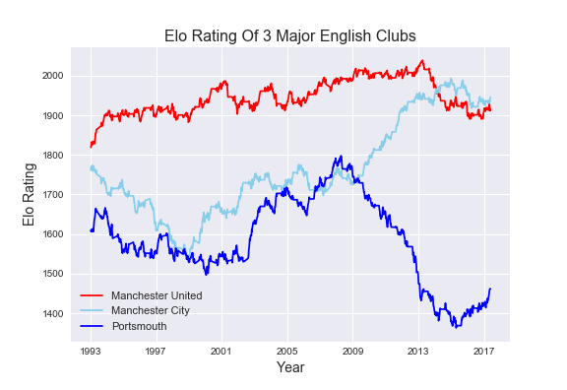
Manchester United win first Premier League title
Manchester United win treble
Manchester United win league with 89 points
Man City relegated from Premier League
Man City promoted to Premier League
Man City relegated from Championship
Man City win Premier League title
Portsmouth promoted from League Two
Portsmouth promoted to Premier League
Portsmouth relegated from Premier League
Portsmouth relegated from Championship/League One In successive seasons

