Slide 1

Compensation Plan
The most rewarding shopping experience ever created…
www.BestForWellness.com

Slide 2
Ways to Participate
VIP Customer – shops online at
www.BestForWellness.com
Ambassador – introduces people to sign up as
VIP Customers under his/her network
Affiliate Merchant – supplies the products &
services on BestForWellness.com

Slide 3
BV & GL
(2 different points systems)
BV – the point value attached to every product and service sold on BestForWellness.com
GL – the loyalty points for exchange of product and service, valid for 12 months
Commissions and GL are computed from BV

Slide 4
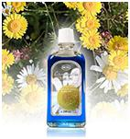
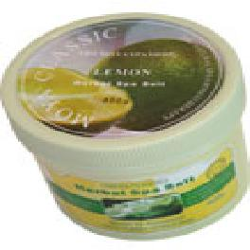
BV System
Example 1:
Example 2:
Camomile Bath Oil
Purchase Online: $100
BV: 50
Lemon Bath Salt
Purchase Online: $60
BV: 40
Every item has a BV
Ambassadors receives commission based on their group’s total BV
All members receives GL loyalty points based on the BV of their purchase

Slide 5
Why Shop Online?

Slide 6

TYPICAL RETAIL
SHOP ONLINE
Free Products + $$
Manufacturer
PLUS
mark ups
Advertising
Marketing
Promotion
Rentals
BestForWellness.com
Distributor
Sub-Distributors
Dealers
Retail Store
You
You

Slide 7
VIP Customers
You enjoy Health & Wellness products
Spot a product you like on BestForWellness.com
Buy online, using credit card or PayPal
Benefits
Earn points on credit card
Earn GL loyalty points on personal purchases
Exchange GL for free products & services

Slide 8
Ambassador
You know friends who enjoy wellness products
Register them as your VIP Customers
Monitor your group purchases online
Benefits
Start a business. No risk, no capital
Earn commission / Residual income
Earn GL loyalty points from personal
purchases & GL Bonus from group’s purchases

Slide 9
Senior Ambassador
Qualify in any ONE month with:
5 active Ambassadors in your team
Personal Purchase 500BV
Group Sales > 5,000 BV
Benefits
Highly Leverage Income from Affiliate merchants’ network

Slide 10
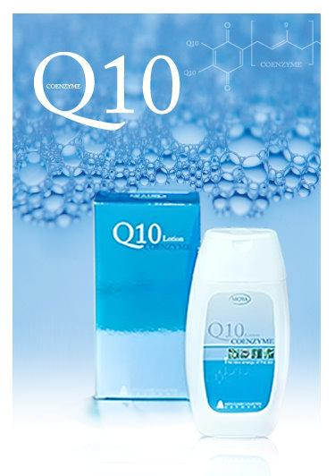
Common Terms
BV
GS
Orphan Pool
Company Pool
Group Sales
Total BV of VIP Customers who join without an Ambassador
Total Unpaid BV of inactive Ambassadors
The point value of each product and service you purchase from the Company (BestForWellness)
The monthly total BV of the products and services that your direct referrals purchase from the Company
(GS excludes personal purchase)
The monthly total BV of the products and services that these orphan shoppers purchase from the Company
Company pays out commissions from these sales to qualified Senior Ambassadors.
Ambassadors without 50BV personal purchase do not qualify for commission.
Their commissions are parked under the Company Pool for distribution to qualified Senior Ambassadors.

Slide 11
BestForWellness.com
Personal > 500 BV
A
Personal < 50 BV
SA
A
V
V
V
A
V
V
V
V
A
V
A
A
A
A
A
All purchases go into Orphan Pool
Group Sales > 5,000BV
Group Sales goes into Company Pool
SA
Promote to Senior Ambassador : (a) personal purchase >500 BV (b) group sales >5,000 BV (c) group has >5 active Ambassadors
A
Cannot receive commission because personal purchase is less than 50 BV. Group Sales goes into Company Pool
V
These VIP sign up without an introducer. All their purchases go into Orphan Pool.
A
Active Ambassador : maintains at least 50 BV of personal consumption

Slide 12
10% Cash Rebate for Personal Purchase (PP) above 50 BV
  Only for Ambassadors & Senior Ambassadors
10% Cash Rebate is given back
as Commission for the month

Slide 13
Ambassador: Basic Requirement to Earn Commission
  Purchase minimum 50 BV worth of product or service every month
  Earn commission on all purchases
  made by your Group
  (everybody in Level 1)

Slide 14
Very Simple – “One Level” Payout
  Every Ambassador gets paid on ONE LEVEL Group Sales *
  No limit how many people on first level
  * Note: The Ambassador’s 50BV personal maintenance is excluded from Group Sales computation
Refer to Table 1 >>

Slide 15
Table 1 – Earn from Group Sales
Requirement: Total monthly Group Sales | Amb. / Snr Amb. Commission Pay Out | Amb. / Snr Amb. GL Bonus Loyalty Points Pay Out
Below 1,000 BV | 12% | 15%
1,001 – 2,000 BV | 14% | 18%
2,001 – 5,000 BV | 16% | 21%
5,001 – 10,000 BV | 18% | 24%
10,001 – 15,000 BV | 20% | 27%
15,001 – 25,000 BV | 22% | 30%
Above 25,001 BV | 24% | 33%

Slide 16
Exclusive Benefits
for Senior Ambassadors
  Only Senior Ambassadors are entitled
  to payouts from:
  1. Company Pool
  2. Orphan Pool
  3. Affiliate Merchant’s group sales

Slide 17

Senior Ambassadors
Earn from Company Pool
Requirement:
Group Sales >3,000BV
Size of Payout is tied to the performance of individual Senior Ambassador
See Table 2 >>

Slide 18
Table 2 – Company Pool
Example:
4 Senior Ambassadors qualify this month,
and the Company Pool is 100,000 BV
Senior Ambassador | Group Sales | Percentage of Company Pool Entitled | Pay Out in BV
A | 6,000 | 6/40= 15% | 15% x 100,000 = 15,000 BV
B | 8,000 | 8/40= 20% | 20% x 100,000 = 20,000 BV
C | 12,000 | 12/40=30% | 30% x 100,000 = 30,000 BV
D | 14,000 | 14/40=35% | 35% x 100,000 = 35,000 BV
Total | 40,000 | 100% | 100,000 BV

Slide 19
Earn from Orphan Pool
Requirement:
Group Sales >5,000BV
On the last working day of each month, Senior Ambassadors are ranked by GS performance.
The sales from orphan pool in the next month will be distributed accordingly.
See Table 3 >>

Slide 20
Table 3 – Orphan Pool
Example:
4 Senior Ambassadors qualified last month,
and the total Orphan Pool this month is 80,000 BV
Senior Ambassador | Group Sales | Percentage of Company Pool Entitled | Pay Out in BV
A | 6,000 | 6/40= 15% | 15% x 80,000 = 12,000 BV
B | 8,000 | 8/40= 20% | 20% x 80,000 = 16,000 BV
C | 12,000 | 12/40=30% | 30% x 80,000 = 24,000 BV
D | 14,000 | 14/40=35% | 35% x 80,000 = 28,000 BV
Total | 40,000 | 100% | 80,000 BV

Slide 21
Create Leverage Income
(with Affiliate Merchants)
Senior Ambassadors refers Affiliate
Merchant to BestForWellness
BestForWellness approves the Affiliate
Merchant’s products & services for sale on
website
BestForWellness provides marketing support
to Affiliate Merchants
See Table 4 >>

Slide 22
Table 4 – Earn from Referred Affiliate Merchant Sales
Total Monthly Group Sales of the Senior Amb. | Pay Out from referred Affiliate Merchant’s Group #
1,000 – 2,000 BV | 1.5 %
2,001 – 5,000 BV | 2.0 %
5,001 – 10,000 BV | 2.5 %
10,001 – 15,000 BV | 3.0 %
15,001 – 20,000 BV | 3.5 %
Above 20,001 BV | 4.0 %
# Based on first level (up to 5,000 members) per Affiliate Merchant’s Group that the Senior Ambassador has referred.

Slide 23


Benefits Compared
 | Senior Amb. | Amb. | VIP Cust.
10% rebate on personal purchase
Commission from Level One group
GL Loyalty Points
GL Bonus Loyalty Points
Company Pool pay out
Orphan Pool pay out
Affiliate Merchant pay out

Slide 24
Business Success Factors
E-Commerce Transactions growing
Expensive rentals force businesses to go
online/join affiliate marketing sites
More people seeking extra income
opportunity
Everybody needs Wellness products,
especially aging population
Consumable Products create stable, long
term income

Slide 25
Company Supports You
World class e-commerce website
Secure online payment & collection
Company handles logistics & delivery
Easy 50 BV monthly personal
consumption

Slide 26
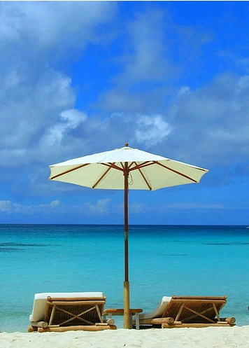
A Great Business!
Recession Proof
No Capital, No Risk
No inventory
Flexible working hours
Control Your Own Time
RESIDUAL INCOME from sale of consumable products & services

Slide 27

TIME TO DECIDE
CONSUMER?
OR
ENTREPRENEUR?

Slide 28
Getting Started
Join as VIP Customer or Ambassador
Achieve Personal 500BV, with 5 active Ambassadors & Group Sales >5000BV in any month
SENIOR AMBASSADOR
Accumulate Personal 150BV
+ $30 Enrollment Fee
AMBASSADOR
VIP CUSTOMER
Amb/Snr Amb
Must maintain 50BV monthly to receive benefits
JOIN
Free

Slide 29

Experience The
Best For Wellness
~~~~~~~~~~
Talk to the person who invited you to view this presentation.

