Slide 1

Startup Crash Course
Introduction to iPhone App Development
Notes:
Neil gives his intro

Slide 2
Overview
Getting everything installed
Introduction to iOS Development
Overall Introduction to Objective-C
Writing your first app!
Show off to anyone who will listen

Slide 3
iOS SDK
Downloading the SDK http://developer.apple.com to download the SDK. Takes about an hour to download, large file. With free download, you can test on the Simulator but not the device.
Xcode The IDE you use to develop iOS Applications “Interface Builder” is now built into Xcode
Instruments A runtime performance analysis and debugging tool. Helps you find things like memory leaks.

Slide 4
iOS SDK
iOS Simulator A Mac App that simulates your code running on an actual device. Behaves a little differently than device in key places
iOS Developer Library Reference and conceptual documentation about iOS technologies. Also: http://developer.apple.com has helpful documentation A lot of googling!

Slide 5
Xcode Navigation
Every view controller has a header file (FirstViewController.h)
Header File provides an outline of sorts for what will be going on in the view
Variables
Methods(Functions)
Etc.

Slide 6
Implementation Files
The Implementation File (.m) will be where you actually write most of the code controlling the app
Where you add all of the functionality of the UI Elements and put content into the methods (functions)

Slide 7
Key Points
Header File (.h)
Implementation (.m)
Interface Builder File (.xib)
These are the core pieces to each view.

Slide 8
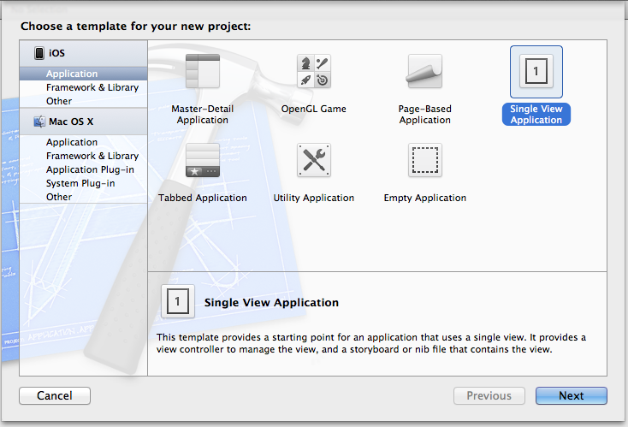
Hello World
Open Xcode…Choose “Single View Application”

Slide 9
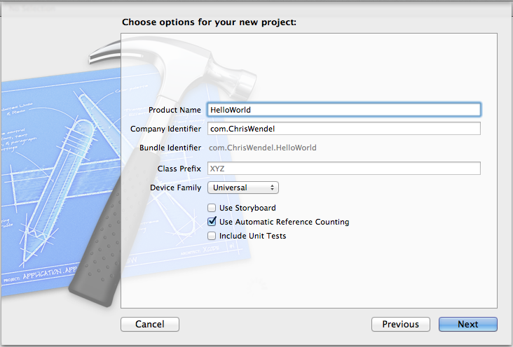
Hello World
Name project “HelloWorld”, de-select “use storyboard” and “include unit tests”, then pick destination.

Slide 10
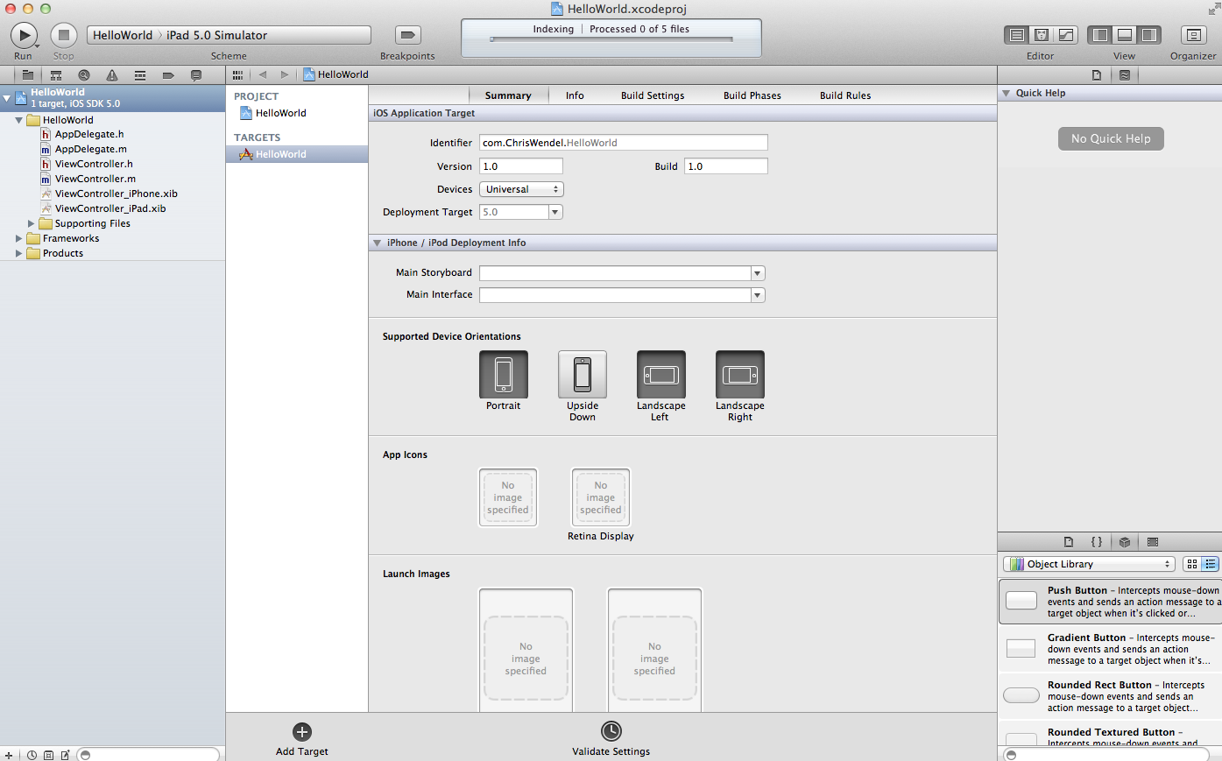
Hello World
The main Xcode interface, file tree on left, editor in middle.

Slide 11
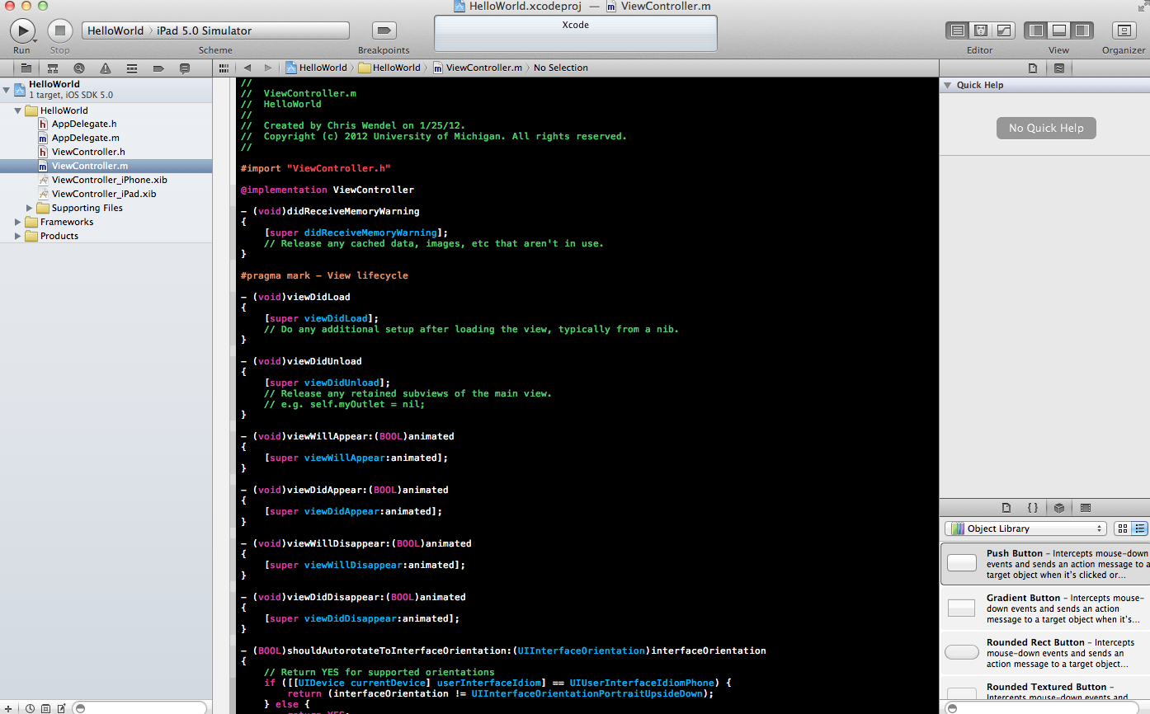
Hello World
Ignore AppDelegate for now, click “ViewController.h”

Slide 12
Hello World
Ignore AppDelegate for now, click “ViewController.h”

Slide 13

ViewController.h
#import <UIKit/UIKit.h>
@interface ViewController: UIViewController {
IBOutlet UILabel *hello_label;
}
@property(nonatomic,retain) IBOutlet UILabel *hello_label;
@end
Declares a UILabel that corresponds to one you put in your XIB file
Declares the property “hello_label”

Slide 14
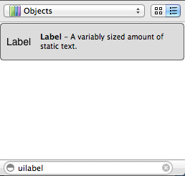
ViewController.xib
Interface builder file for the main view, in bottom right: search for “UILabel”

Slide 15
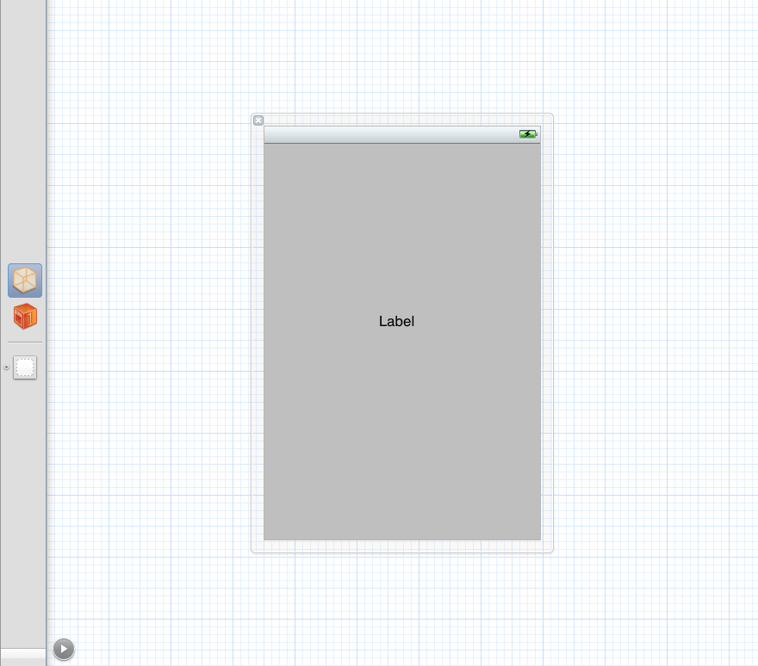
ViewController.xib
Drag UILabel to center of grey view

Slide 16
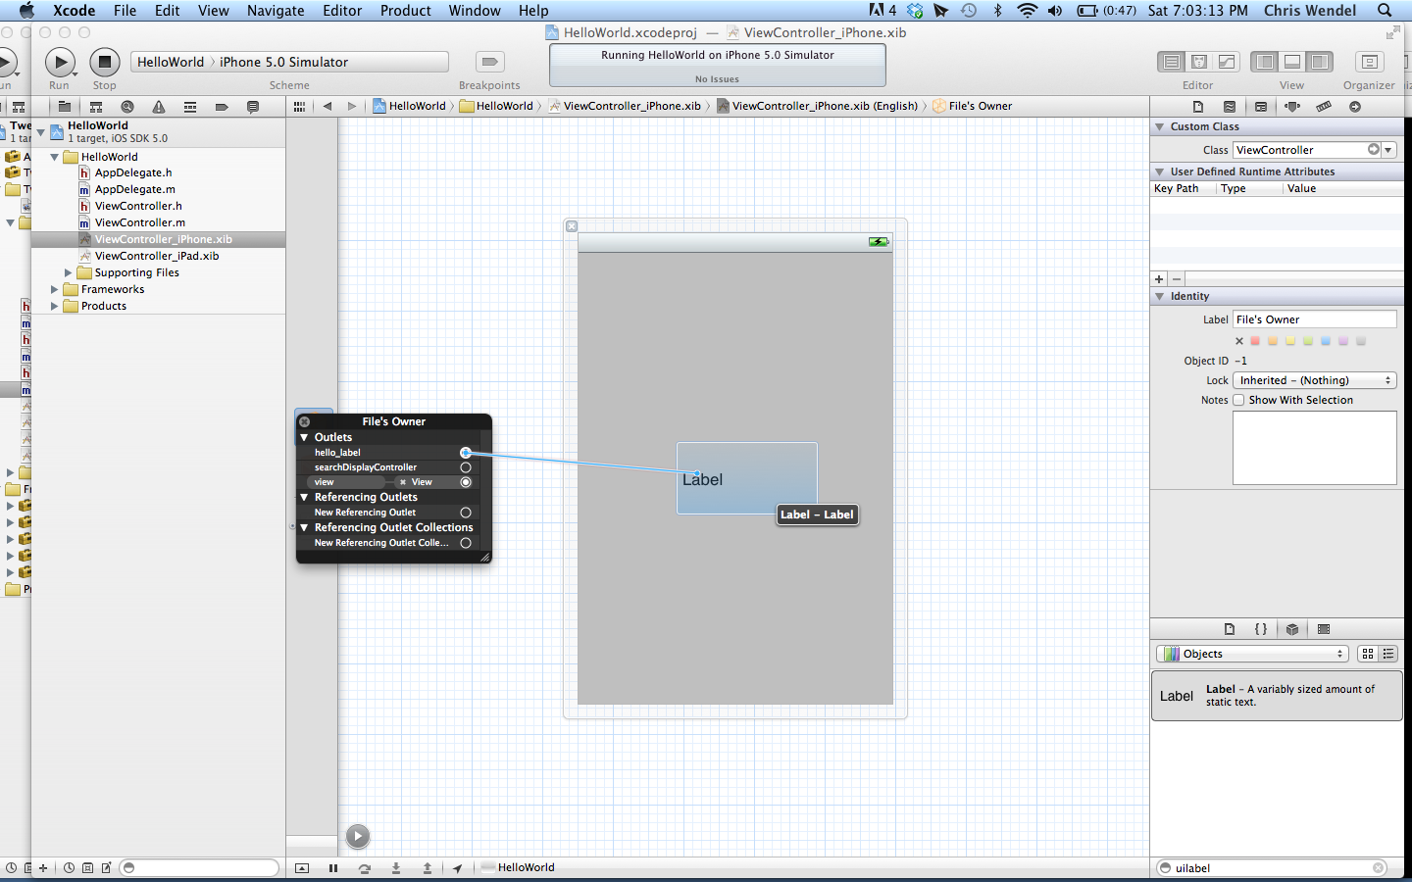
ViewController.xib
Right click on yellow cube icon “File’s Owner”. Drag “hello_label” outlet to UILabel on the view.

Slide 17
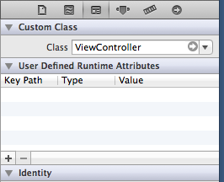

File’s Owner?
Each .xib file has a file’s owner
Corresponds to source file that “IBOutlets” and “IBActions” are in
For example, in “ViewController.xib” click the file owner and then “Show the identity inspector” on the right of the screen. Under “Custom Class” should be the name of the file that contains the “ViewController” class

Slide 18
ViewController.m
#import “ViewController.h” @implementation ViewController @synthesize hello_label;
-(void)viewDidLoad {
[super viewDidLoad];
[self.hello_label setText:@”Hello World!”];
}
@end
Creates getter and setter methods for a property
Calls UILabel’s “setText” method to set the text of the label to “Hello World!”

Slide 19
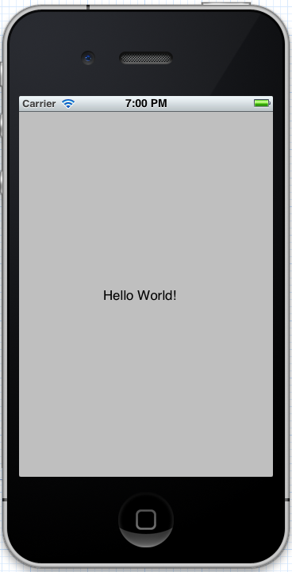
Hello World
If everything worked correctly…..the label on the screen should read “Hello World!”. Congratulations, you made your first app!

Slide 20
iPhone App Success Stories
http://www.slideshare.net/impigermobile/7-iphone-app-millionaires

Slide 21
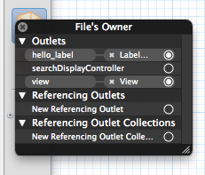
Common Problems
The “File’s Owner” does not point to the right file Check by clicking the “File’s Owner” yellow cube icon in your XIB file and looking at it’s “Custom Class”
You forgot to link up your IBOutlet with the UI Element on the view Right click on the “File’s Owner” yellow cube icon in you XIB file.
“hello_label” connected to “Label” on View
“view” connected with “View” (this should be set up automatically by Xcode)

Slide 22
More on Objective C
Reflective, object-oriented programming language
Similar to Smalltalk, so it brings messaging to the family of C programming languages.
Messaging? A form of communication used in object-oriented programming. Objects send and receive messages to other objects.
The most unique/different language out of all the C’s.
Some similar aspects to C++, but very different syntax.

Slide 23
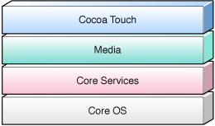
Layers of iOS
Bottom layer of iOS Operating system
Core OS: OSX Kernel Power Management Mach 3.0 Keychain Access BSD Certificates Sockets File System Security Bonjour

Slide 24
Layers of iOS
Second layer of iOS Operating system
Core Services: Collections Core Location Address Book Net Services Networking Threading File Access Preferences SQLite URL Utilities

Slide 25
Layers of iOS
Third layer of iOS Operating system
Media: Core Audio JPEG,PNG,TIFF OpenAL PDF Audio Mixing Quartz(2D) Audio Recording Core Animation Video Playback OpenGL ES

Slide 26
Layers of iOS
Top layer of iOS Operating system
Cocoa Touch: Multi-Touch Alerts Core Motion Web View View Hierarchy Map Kit Localization Image Picker Controls Camera

Slide 27
iOS-Object Oriented
Cocoa Touch is object oriented at it’s core. You need to know the core concepts of object orientation VERY WELL.
Modal-View-Controller (later courses)
Be Familiar With: Classes Instances Methods(Functions) Inheritance Protocols

Slide 28
Cocoa Touch Layer
We will mostly be using the Cocoa Touch layer to communicate with lower layers of the OS.
Example: Using Web View(Cocoa Touch) which in turn uses Core Location(Core Services)
We always prefer using higher-level frameworks over lower-level frameworks whenever possible.
The higher level frameworks(Cocoa Touch) are there to provide object-oriented abstractions for lower level constructs.

Slide 29
Resources
Stackoverflow.com
http://www.icodeblog.com/
http://mobileorchard.com/ios-development-tutorial-series-beginning-ios-development/
http://maniacdev.com/
http://maniacdev.com/2011/02/tutorials-how-to-grea-looking-ios-apps-even-if-you-are-a-design-noob/

Slide 30
andrew@andrewrauh.com

