Slide 1
Inheritance
Got code to share?

Slide 2
Why use inheritance?
Oftentimes we have many classes that contain functionality that is related.
Inheritance allows us to share code that is common and optionally extend or override that code for specific needs.

Slide 3
Extending Classes Via Inheritance
You use an existing class, called the base class as the basis for a new class, called the derived class.
The derived class can access members of its own class and members of the base class
Declaring a derived class requires a colon followed by the type of the base class
A derived class is said to extend the base class because it can add additional functionality.
A derived class can not delete any of the members it has inherited
You can access members of the base class the same way you access other members

Slide 4
Inheritance vs Interfaces
A class can only inherit from one class, but it can implement as many interfaces as it desires, separated by commas.
Inherited classes can share their members with their derived (children) classes. Interfaces have no implementation code.

Slide 5
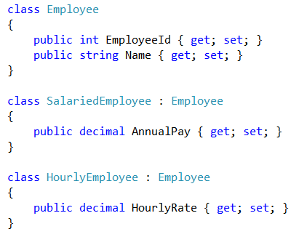

Sharing Code via Inheritance
A derived class gets access to all public and protected members of the base class.
From a developers perspective, it is as if they are embedded in the class.

Slide 6
Virtual and Override
There are two keywords we can use with Inheritance for extending behavior.
By declaring a method virtual you can allow derived classes to override it and provide their own implementation.
You can have many overrides down the inheritance chain, the highest override will win. You can call up the chain using the base keyword.

Slide 7
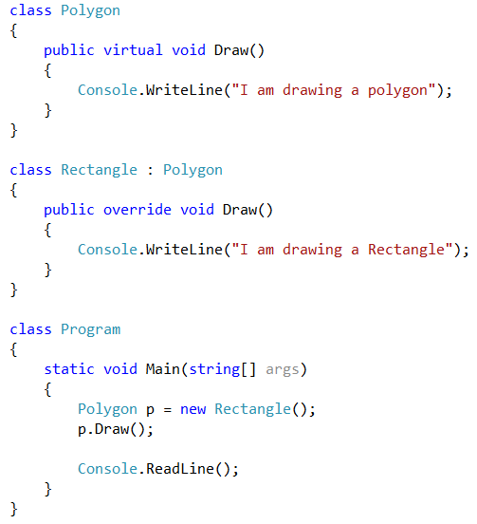
Virtual and Override Sample
In the example to the right, we have a Polygon base class which defines a draw method with the virtual keyword.
The rectangle class overrides the Draw() method and outputs something different to the Console.
In main, we declare a variable of type polygon and assign a new rectangle to it (polymorphism).
What will the Draw() method print?
“I am drawing a Rectangle”.

Slide 8
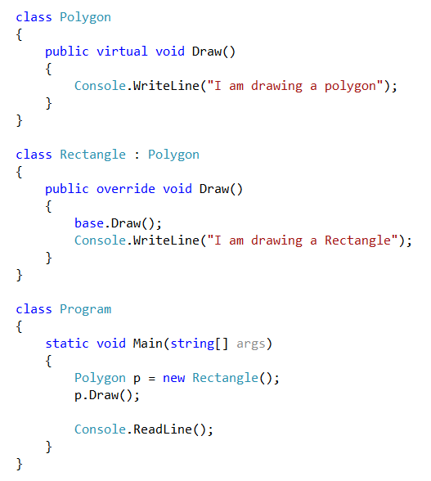
Using base
Now we have added a call to base.Draw() from the Rectangle’s Draw() method.
It will now output:
“I am drawing a polygon”
“I am drawing a Rectangle”

Slide 9
Abstract Members
Abstract Members are function members marked with the abstract keyword.
They must not have an implementation. The signature ends with a semicolon.
Any class that is derived must implement the abstract member.
Abstract members can only exist in abstract classes
Since there is no implementation code, you can not instantiate an abstract class directly, only the derived class(es)

Slide 10
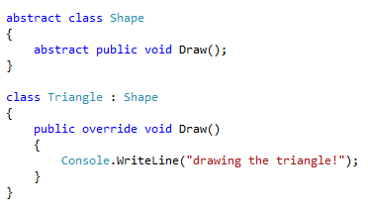
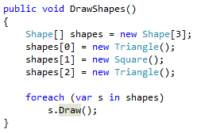
Abstract Class Example
Imagine that we expanded our shape program to have many shapes, and we wanted to be able to call the draw method an on array of shapes.
Without inheritance and polymorphism we would have to create an array of each type of shape. A better solution would be to create a base class and put all the derived shapes into an array.

Slide 11

Sealed Classes
Whereas an abstract class can not be instantiated and must be inherited from, a sealed class can not be inherited from.
Most developers don’t do this unless they’re doing API coding and don’t want other people tampering with their classes

Slide 12
The protected keyword
If you declare a class member private, even classes that inherit from the class can not see them.
If you want to make a member private to external classes but public to derived classes use the protected keyword in place of public or private.

