Slide 1
Value vs Reference Types
The stack and the heap

Slide 2
Introduction to Memory Management
When your program is running, the data is stored in memory. A C# program uses two regions of memory storage:
The Stack is an array of memory that acts as a last-in, first-out (LIFO) structure
The Heap is organized into memory “chunks” and can be accessed in any order.

Slide 3
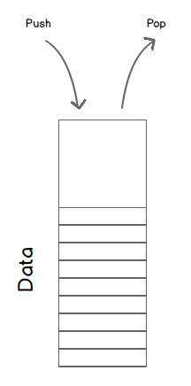
All about the Stack
The stack stores several types of data:
The values of certain variables
The program’s current execution environment
Parameters passed into methods
The system handles all of the stack manipulation, so we only need to understand conceptually how it works.
Placing an item onto the stack is called pushing
Deleting an item from the stack is called popping

Slide 4
All about the Heap
The heap is a chunk of memory space that uses pointers to reference memory locations that are currently in use.
.NET has something called the Garbage Collector which determines which heap objects are no longer being used and deletes them.
Garbage Collection is a big deal, back in the old days we would have to manage cleanup ourselves, and if you forgot to do it your program would eventually overflow and crash the system.

Slide 5
Value vs Reference Types
Value types are always stored on the stack. Common value are the primitive types (int, decimal, double, etc)
Reference types require two segments of memory storage:
The actual data, which is stored on the heap.
The memory address of the data, which is stored on the stack.

Slide 6
Why do we care?
Because when we assign reference types or pass them as parameters to methods, we aren’t passing the actual data, we’re only passing pointers to the data. So any changes we make affect all of the others.
When we pass value types a copy of the value is made, so any changes made do not impact the outer value.

Slide 7
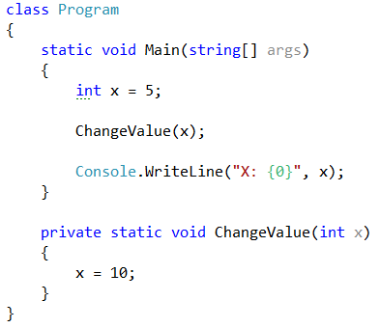
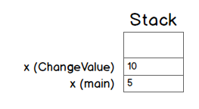
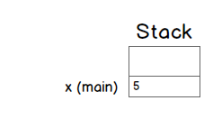
Value Types Illustrated

Slide 8
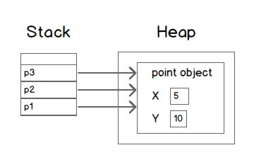
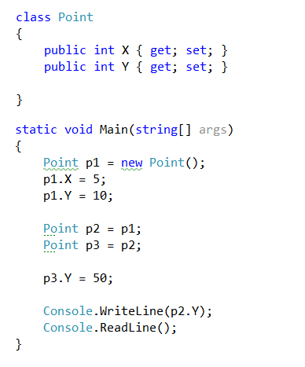
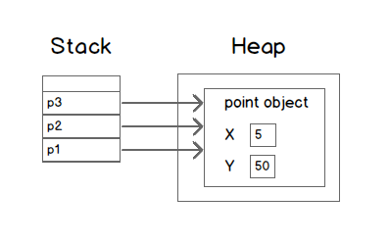
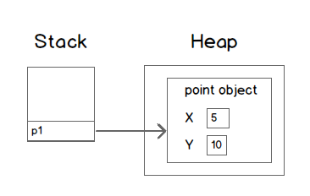
Reference Type Illustrated

Slide 9
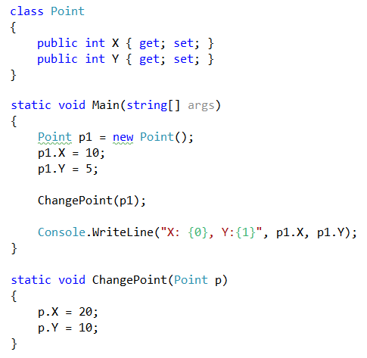
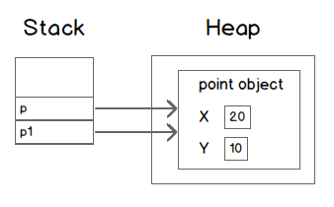
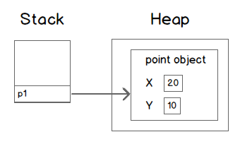
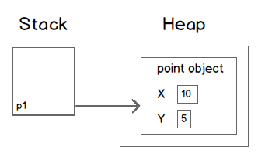
Reference Type Illustrated - 2

Slide 10
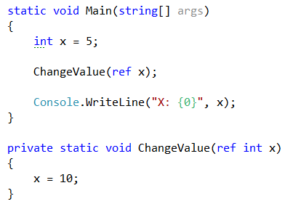
The ref keyword
The ref keyword can be used to force a value type to be treated like a reference type:

