Slide 1
Arrays in C#

Slide 2
Why do we use arrays?
Sometimes we need to store multiple values of the same type in a single structure.
For example, maybe we want to store a list of numbers, or the names of the 50 U.S. states.

Slide 3
What is an array?
An array has the following constraints:
All of the types of data in an array must be the same type.
An element is an individual item in an array.
An array’s dimensions (a.k.a rank) is the number of indices needed to access an element.
The length of an array is the number of elements in all dimensions.
Once defined, the size of an array can NOT change.

Slide 4
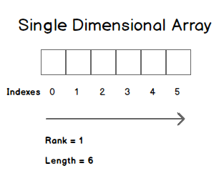
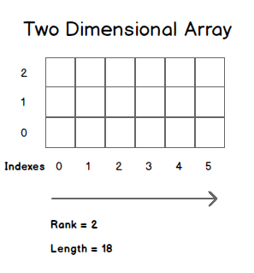
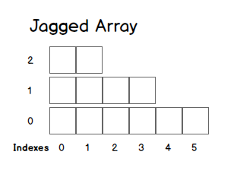
Types of Arrays
A Single Dimensional Array only has one dimension, so all values are in a straight line.
A Multi-Dimensional array has more dimensions, and can be rectangular (same number of elements in all dimensions) or jagged (an array of arrays)
Arrays always start at position 0.
When you create an array, all of the elements are filled with their default values (0 for numbers, false for booleans, null for classes, etc)

Slide 5

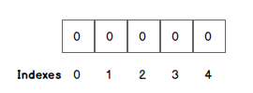
Declaring a Single Dimensional Array
To declare an array we need the type followed by empty square brackets. When we instantiate the array, we tell C# how big it is.

Slide 6
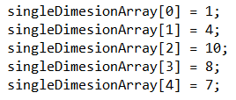

Assigning values by index
We can assign values to a position in the array by using square brackets with the numerical position of the element.

Slide 7
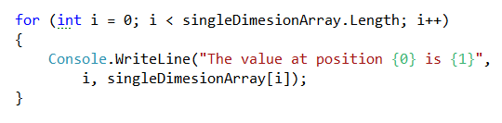
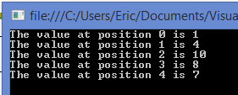
Iterating an array’s elements
A for loop is a good structure for looping all of the elements in the array. We can read data out of a position by using the square brackets and numeric coordinate (index).

Slide 8
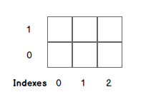
Declaring a Multi-Dimensional Array
To declare an array we need the type followed by square brackets with a comma for each dimension greater than one. When we instantiate the array, we tell C# the size of each dimension.

Slide 9
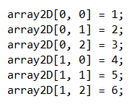
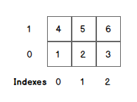
Assigning values by index
We can assign values to a position in the array by using square brackets with the numerical position of the element. With multi-dimensional arrays we have to specify the coordinates in order.

Slide 10
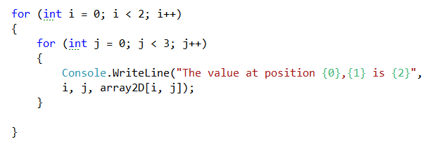
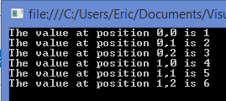
Iterating an array’s elements
For a multi-dimensional array we need nested for loops… one for each dimension.

Slide 11


Asking an array for its size
The Rank and Length properties of the array class will tell you how large it is.

