Slide 1
Classes vs Objects
What’s the difference?

Slide 2
What is a class?
A class is a blueprint for creating an object. It defines all of the data members and function members that belong to a created object.
Class code on its own is only a definition. We can use it to create one to many object instances.

Slide 3
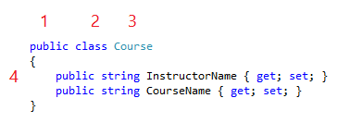
Defining a class
To create a new class, all we need to do is specify the following items:
An accessor determines who may use the class.
The class keyword tells C# that the upcoming code is a class.
The name of the class, which is used to create object instances
The code block that contains all of the data (adjectives) and function members (verbs) the class has access to.

Slide 4
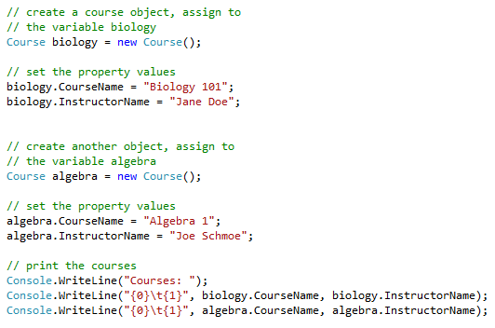

Instantiating an Object
The primary purpose of our class definition is to create (instantiate) object instances.
This is an important concept… the class is a template, the object is a real thing, much as a blueprint describes a real building.
To instantiate an object, we need to use the new keyword and assign the object to a variable.
Once we have created an object, we can get to the public class members using the dot notation.

Slide 5
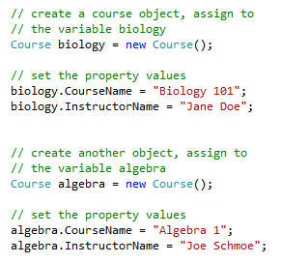
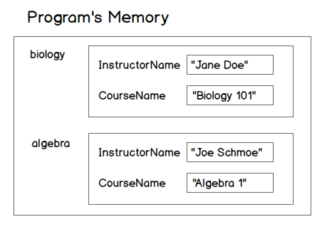
Objects in memory

