Slide 1
For Loops

Slide 2
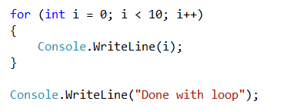
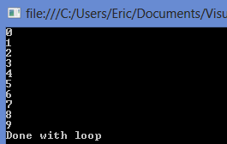
using the for loop
A for loop is intended to execute a set number of times.
With a while loop, you often do not know how many times the loop will run, but with a for loop you always know what the maximum number of times run will be.
For this reason for loops are often used to count things or loop through a list of items whose size is known.

Slide 3
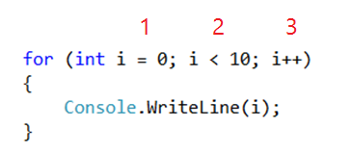
The Three Parts of For Loops
Initializer- Declares a variable and sets its starting value.
Test Expression- Decides when the loop will stop.
Incrementer- How much to add or subtract from the variable each time through the loop.

Slide 4

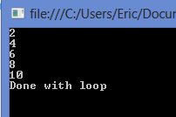

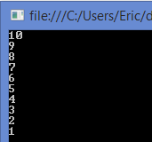
Changing the Incrementor
We can count by twos
We can also count down

Slide 5
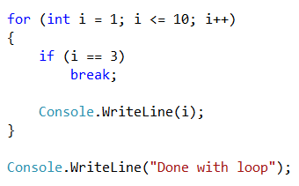

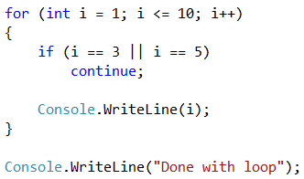
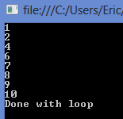
Break and Continue
The break statement will immediately exit the current (innermost) loop.
The continue statement will immediately jump to the top of the current (innermost) loop
Note that break and continue work for any type of loop, not just for loops.

