Slide 1
Conditionals: The if Statement

Slide 2
The purpose of the if statement
Oftentimes we only want to perform actions if certain conditions are met. The If statement uses boolean expressions to direct our program to run statements only when something is true or false.

Slide 3

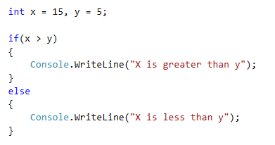
The if…else statement
The if statement executes code only if the test expression is true.
The test expression is put into parenthesis and can be simple or complex. The statements are organized into code blocks.
We can also use the else statement to do something different if the test expression is false.
If you only have one statement, the code block is optional, but when starting out I recommend always using it.

Slide 4
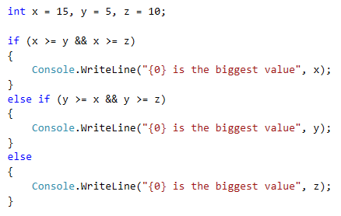
The else if statement
Sometimes we need to check more than two conditions.
After you write the if statement, you can have as many (or none) else if conditions as you want.

Slide 5
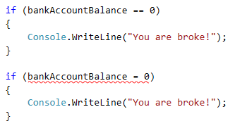
Reminder
Don’t forget the difference between the equality operators
= (assignment)
and
== (comparison)

