Slide 1
While Loops

Slide 2
What is a loop?
A loop is a statement or series of statements that you want to repeat some number of times.
A real life example of looping could be scrubbing a dirty dish until it is clean.
Generally a loop will run until some condition is met (the dish is clean)

Slide 3
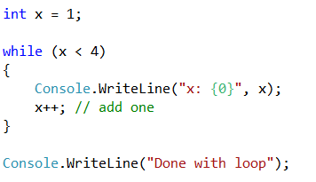
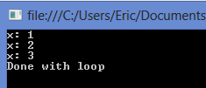
using while to loop
The test expression is evaluated before the loop starts. The loop executes only if the expression evaluates to true and will continue to execute until the test expression become false.
We must always be careful in loops like this that change the value of the test expression (x) at some point. If we forget to add one to x, the loop will continue running forever and eventually crash the program!
This situation is called an infinite loop.

Slide 4
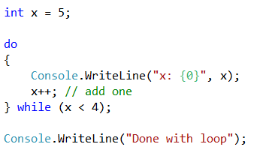

The do…while loop
Unlike the while loop, the do loop evaluates at the bottom, thus a do loop will always execute at least one time.
So we use a while loop whenever we might not want any of the code to execute if the test condition fails right away. We use the do loop when we want the code to execute at least once regardless of the test condition.
A good example is a menu, typically we want to show the menu at least once and only exit if the user inputs the quit option.

