Slide 1
Pilot Project: Internet Access, Computer Access and Healthcare Providers
Andrew Laws

Slide 2
Contents
Objectives
Workflow
Obstacles/Challenges
Results/Discussion
Implications
Future Goals

Slide 3
Objectives
Download data using API’s and speed up data refinement (4 x per year)
Use API to perform geocoding
Using American Community Survey (Census) data, Core Based Statistical Areas (CBSA), and healthcare provider locations, explore access to internet among Nebraskans and identify healthcare providers in low internet access areas
Note: Healthcare providers & providers of service (POS) are synonymous

Slide 4
Workflow
POS Data Retrieval/Manipulation
Geoprocessing
Request: Use CMS API to retrieve POS data (10/491 columns)
Pandas: Filter to POS of interest and create geocoding address
Excel: Manually edit out PO boxes and suites from addresses
Geopy: Geocode addresses using Nominatum (OSM) API
Pandas: Extract lat/long from geocoder and drop rows without lat/long
Geopandas: Spatial join to add CBSA category to POS
Geopandas: Buffer POS locations (10 km for rural, 1 km M1, M2)
Geopandas: Use intersect and groupby to sum census data per POS
Geopandas: Calculate stats and create maps
Geopandas/Pandas: Join census tract spatial and tabular data

Slide 5
Obstacles/Challenges
Street addresses include suites and P.O. boxes
Extracting lat/long from geocoding response (tuples of tuples and looping in Pandas)
Locations geocoded outside of Nebraska though they have Nebraska address
Replicating known workflows from ArcGIS Pro to geopandas
Select by Location (different distances) -> Sum selected polygons
Spatial joins
CRS and buffer

Slide 6
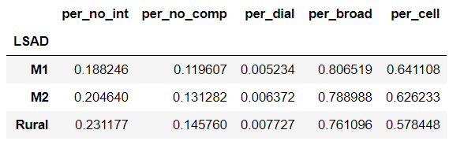


Results/Discussion

Slide 7
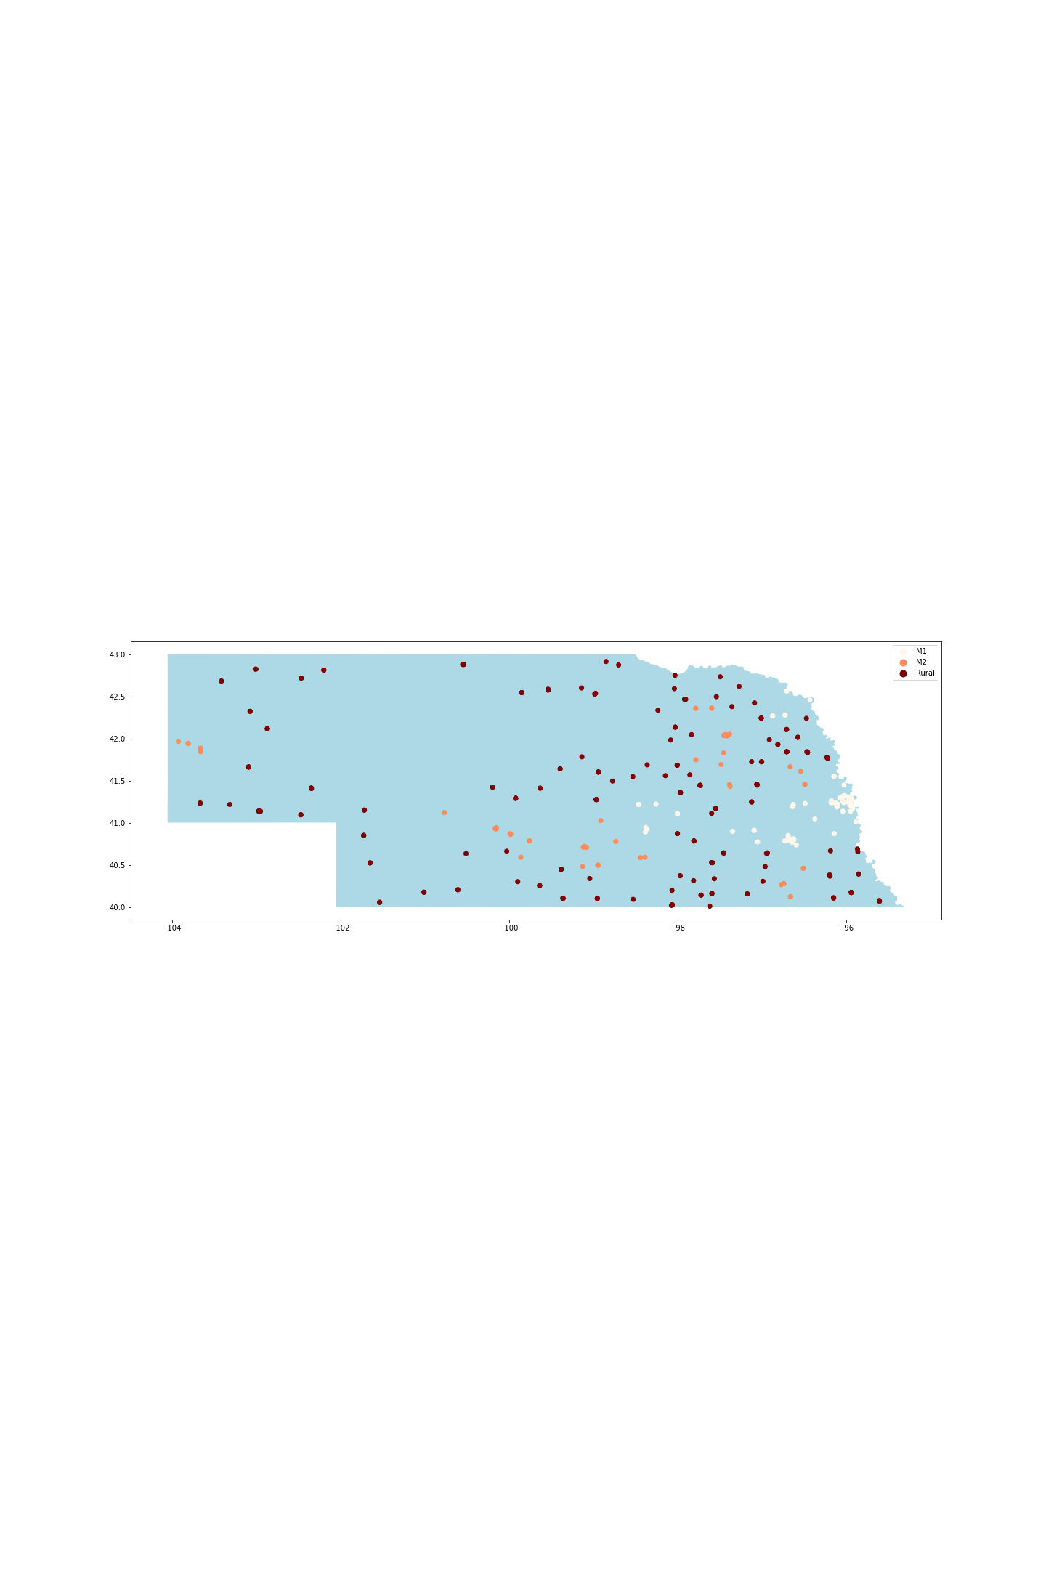
Results/Discussion
Providers of Service

Slide 8
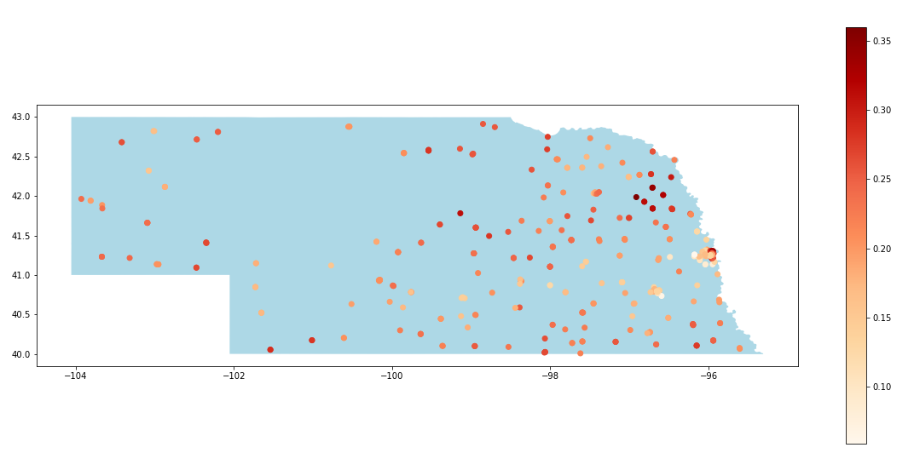
Results/Discussion
Percent with No Internet

Slide 9

Results/Discussion
Percent with No Computer

Slide 10
Results/Discussion
Data Retrieval
Geocoding API’s work efficiently and provide mostly accurate results
Pandas allow for efficient tabular data manipulation
Measuring success
Reduced provider of service dataset cleaning from 8 hours to 1.5 hours
All geoprocessing done using open-source libraries
Reproducible!!!

Slide 11
Implications
Recent work by Berger et al. 2021
Rural Nebraskans have less access to healthcare providers
Rural Nebraskans had less access to broadband internet in 2014
Analysis of internet access
Rural Nebraskans are less likely to have internet access
Dial-up internet is more prevalent in rural Nebraska whereas broadband and cellphone internet are most prevalent in metropolitan areas
Rural healthcare is made more difficult by less access to the internet and healthcare providers
Computer access is less a factor than internet access

Slide 12
Future Goals
Change buffer of POS to neighbors of intersecting census tracts
Further explore demographics (income, education level, race) in relation to internet access
Identify overlap between areas with less access to doctors and to the internet
Identify healthcare clinics that are less accessible and seek mHealth pilot projects

