Slide 1
Spatial analysis of historical cranial measurements
Project Update
Andrew Laws

Slide 2
Project Overview
Topic area
Developing identifiers of geographic origin using cranial measurements
Forensic anthropology
Data with 162 observations from 17 Indian states from 1909
Novel data for time period and geography
Used for updating database and future work
Pilot study
Questions
Do cranial measurements exhibit spatial autocorrelation at the state-level in India?
Do cranial measurements exhibit spatial autocorrelation at the tribal/group-level in India?
(Future)

Slide 3
Methods
R/R-studio
Tidyverse
sf
spdep
tmap
Microsoft Excel
ArcGIS Online
Data
State boundaries – India and Sri Lanka
Cranial measurement observations

Slide 4
Methods
Aggregating values to state level
Mean and median
Distance-band neighbor and weights
Non-contiguous geometries
Minimum threshold calculation
ESDA
Tested weight matrix and neighbor formalization
Custom function
Dataframe of moran.test results
Dataframe of moran.mc results

Slide 5
Challenges
Draft tabular data
Changes in Indian states
Spatial scale and quantity of observations
Aggregation required
Spatial data availability
ArcGIS Online workaround
Methodology for field
Component/discrimination analysis vs Spatial Autocorrelation
Learning purr::map functions
Seba

Slide 6
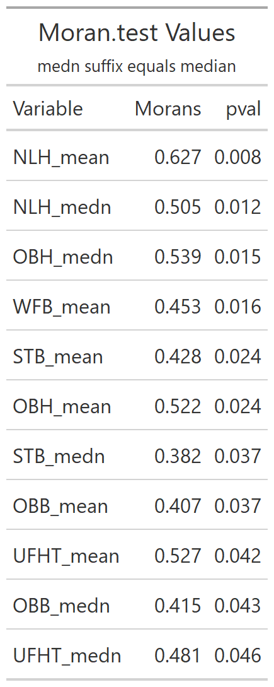
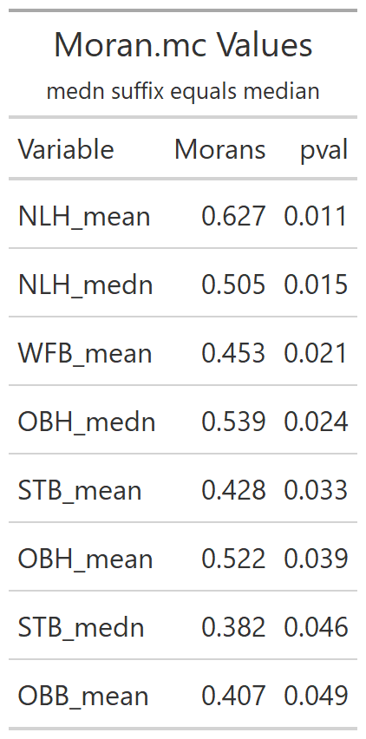
Results
Comparing Methods
Lower p-values in MC, shorter list
Moran’s I
Moderate spatial clustering
NLH highest clustering (both aggregations)

Slide 7
Results
NLH Mean LISA
NLH Median LISA

Slide 8
Implications

Slide 9
Future Goals
Increasing granularity of data
PI using cultural atlases
Different geometries (tribal/cultural/villages)
Official data from governments
Spatial autoregression or other techniques?
Methodology from other fields
1-2 publications

