Slide 1
Spatial analysis of historical cranial measurements
Project Update
Andrew Laws

Slide 2
Project Overview
Topic area
Developing identifiers of geographic origin using cranial measurements
Forensic anthropology
Data with 162 observations from 17 Indian states from 1909
Novel data for time period and geography
Used for updating database and future work
Pilot study
Questions
Do cranial measurements exhibit spatial autocorrelation at the state-level in India?
Do cranial measurements exhibit spatial autocorrelation at the tribal/group-level in India?
(Future)

Slide 3
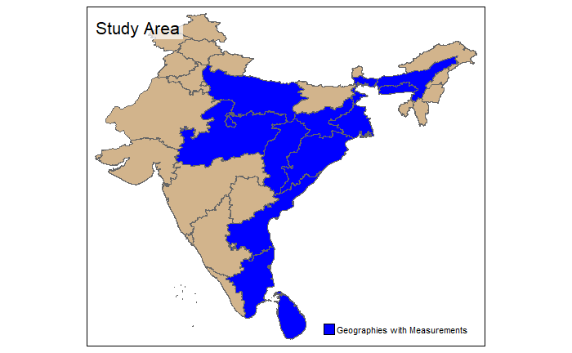
Methods
R/R-studio
Tidyverse
sf
spdep
tmap
Microsoft Excel
ArcGIS Online
Data
State boundaries – India and Sri Lanka
Cranial measurement observations

Slide 4
Methods
Did not parse values by sex
Aggregating values to state level
Mean and median
Distance-band neighbor and weights
Non-contiguous geometries
Minimum threshold calculation
ESDA
Tested weight matrix and neighbor formalization
Custom function
Dataframe of moran.test results
Dataframe of moran.mc results

Slide 5
Challenges
Draft tabular data
Changes in boundaries (1909 vs 2020)
Spatial scale and quantity of observations
Aggregation required
Spatial data availability
ArcGIS Online workaround
Methodology in forensic anthropology
Component/discrimination analysis vs Spatial Autocorrelation
Learning purr::map functions
Seba

Slide 6
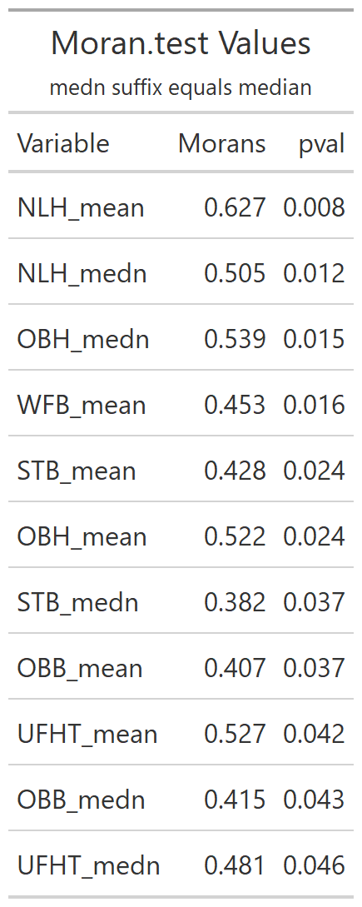
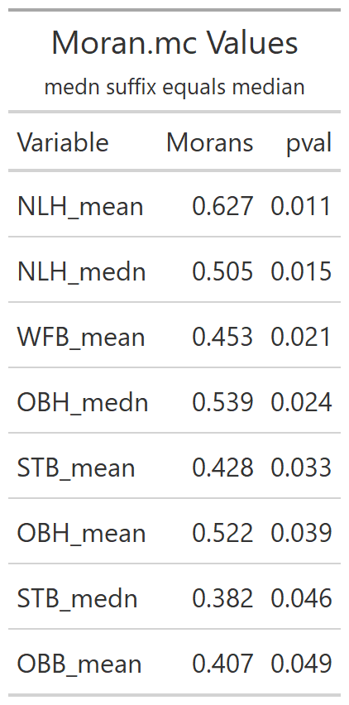
Results/Discussion
Comparing Methods
6 cranial measurements in moran.test
5 cranial measurements in moran.test
Lower p-values in moran.test
Shorter list in moran.mc
Moran’s I
Moderate spatial clustering
NLH highest clustering (both aggregations)
NA’s in some states

Slide 7
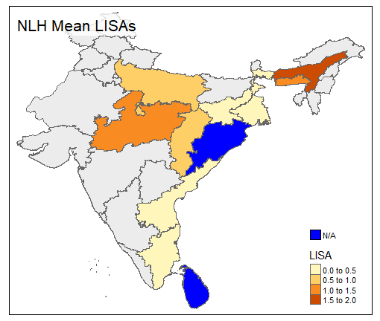
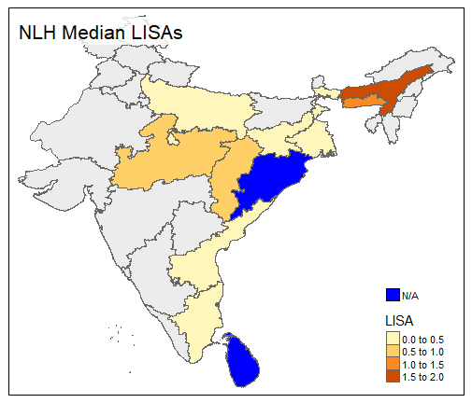
Results/Discussion

Slide 8
Implications
Some cranial measurements show low to moderate spatial clustering at state-level
Okay for pilot study
Narrows focus for next stage of study
Increase granularity
Limited definite conclusions
Further examination of impacts of sex needed
Not delineated in this study

Slide 9
Future Goals
Move functions to other scripts
Increasing granularity of data
PI using cultural atlases
Different geometries (tribal/cultural/villages)
Official data from governments
Spatial autoregression or other techniques?
Methodology from other fields
1-2 publications

