Slide 1
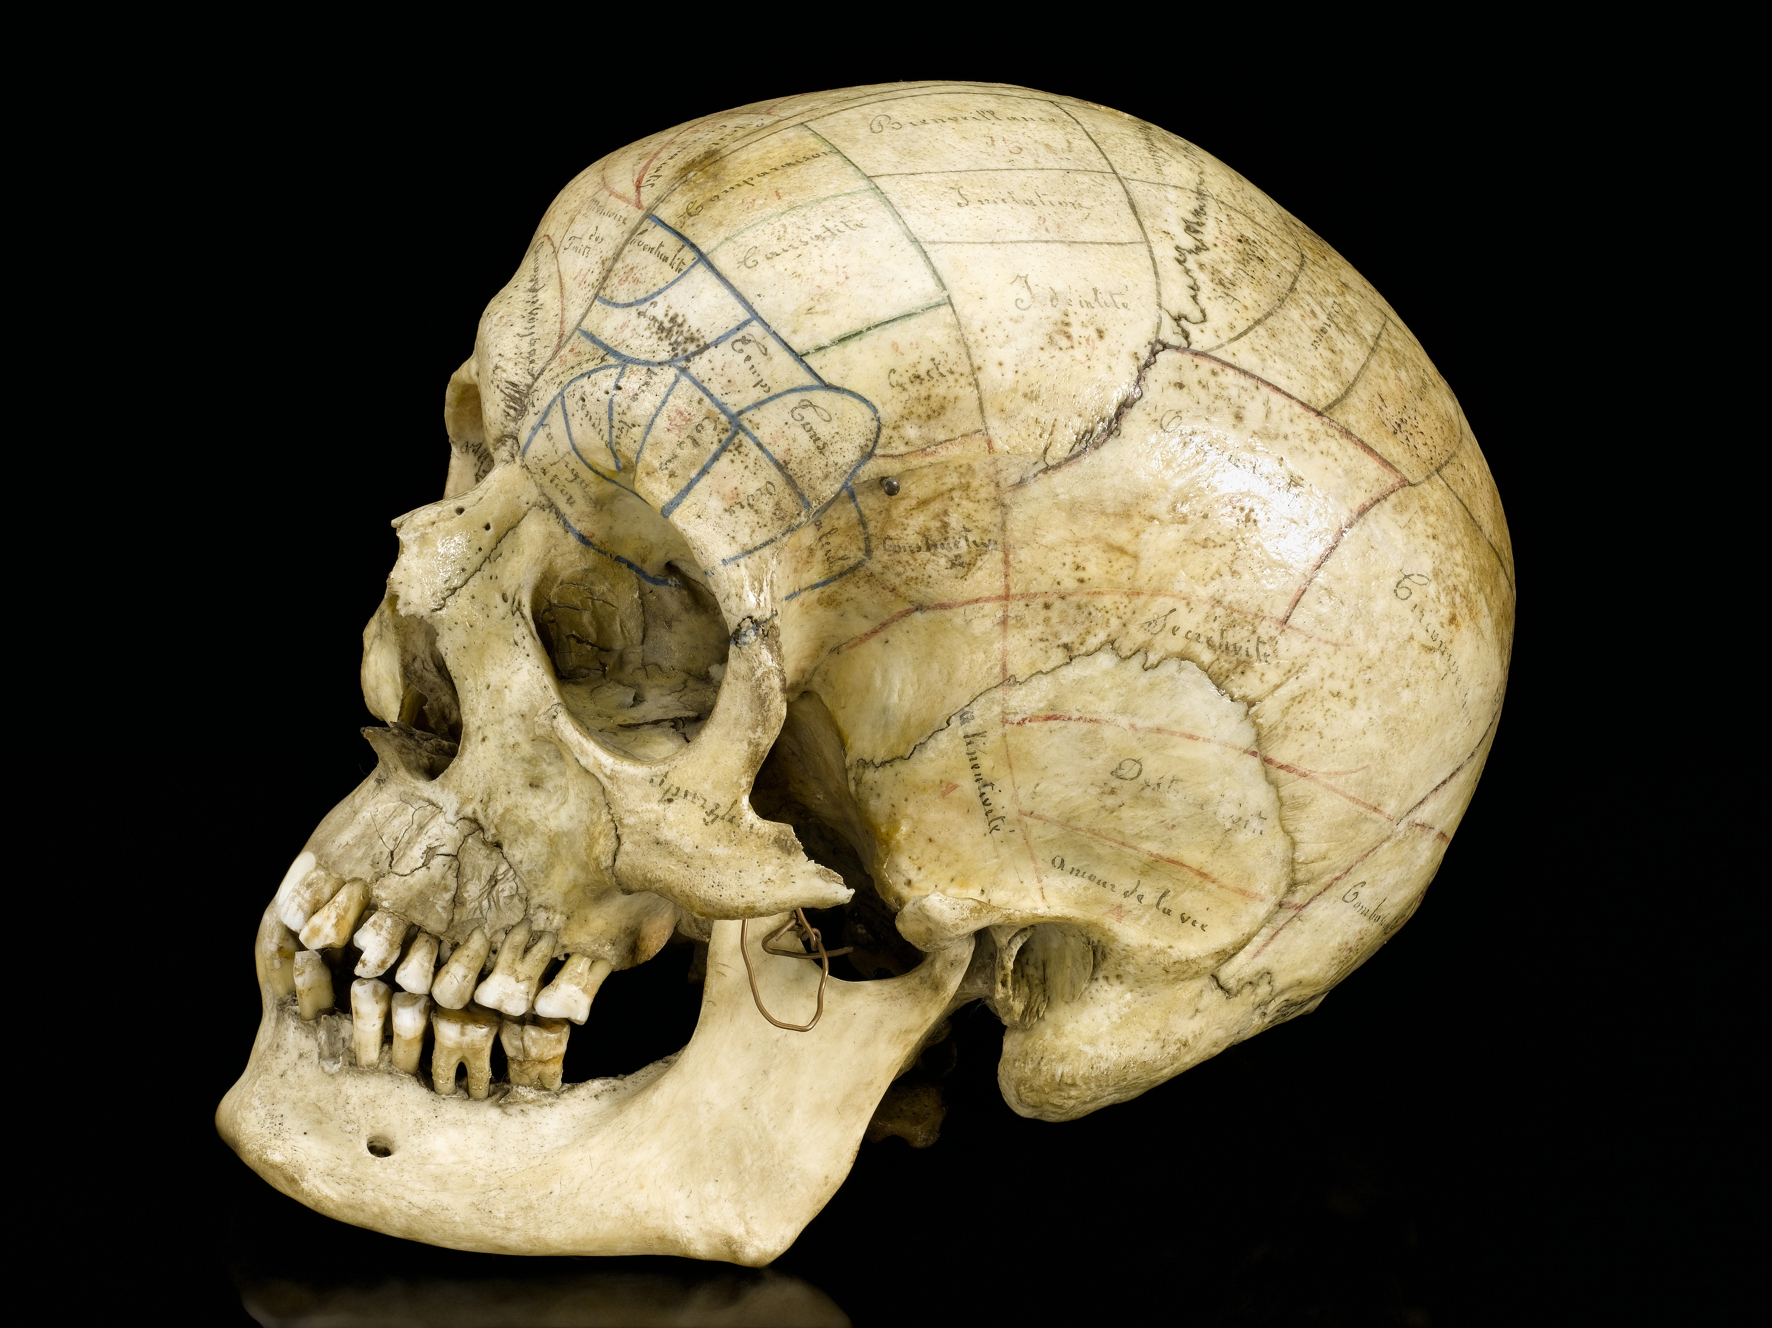
Spatial analysis of historical Indian cranial measurements
Final Project Presentation
GEOG 897 Spatial Analysis with R
Fall 2021
Andrew Laws

Slide 2
Project Overview
Topic area
Forensic anthropology
Developing identifiers of geographic origin using cranial measurements
Cranial measurements linked to distinct cultural/ethnic/tribal groups
Indian cranial measurements (1909)
Novel data for time period and geography
Used for updating database and future work
Pilot study
Questions
Do cranial measurements exhibit spatial autocorrelation at the state-level in India?
Do cranial measurements exhibit spatial autocorrelation at the tribal/group-level in India?
(Future)

Slide 3
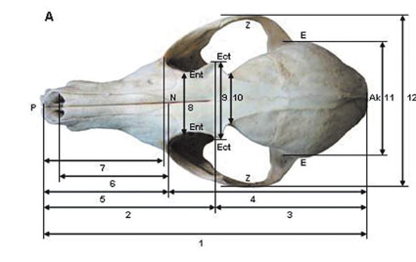
Methods
R/R-studio
Tidyverse
sf
spdep
tmap
Microsoft Excel
ArcGIS Online
Data
Cranial measurement observations
162 observations from 17 Indian states from 1909
State boundaries – India and Sri Lanka
This Photo by Unknown Author is licensed under CC BY-NC

Slide 4
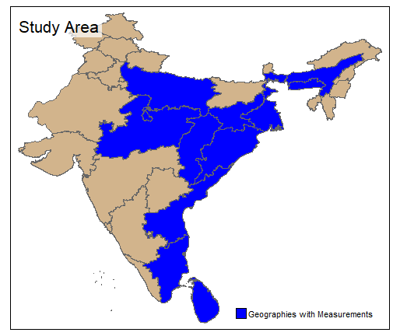
Methods
Aggregating values to state level
17 measurements x mean and median
34 aggregate values
Distance-band neighbor and weights
Non-contiguous geometries
Minimum threshold calculation
ESDA
Tested weight matrix and neighbor formalization
Custom function
Dataframe of moran.test results
Dataframe of moran.mc results
10,000 iterations
Calculate LISA’s

Slide 5
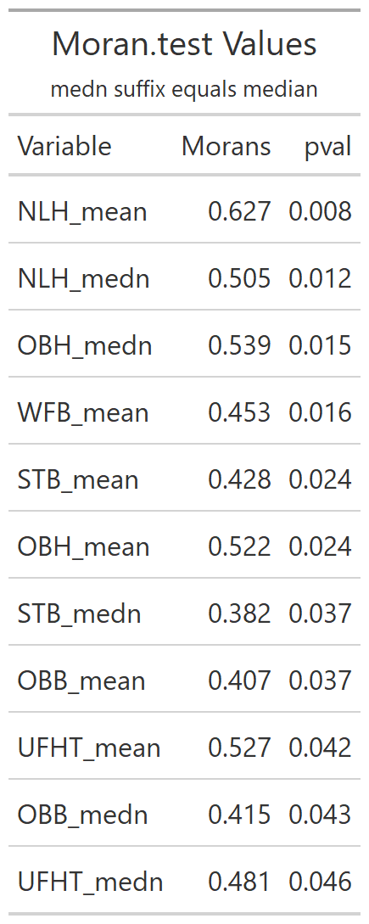
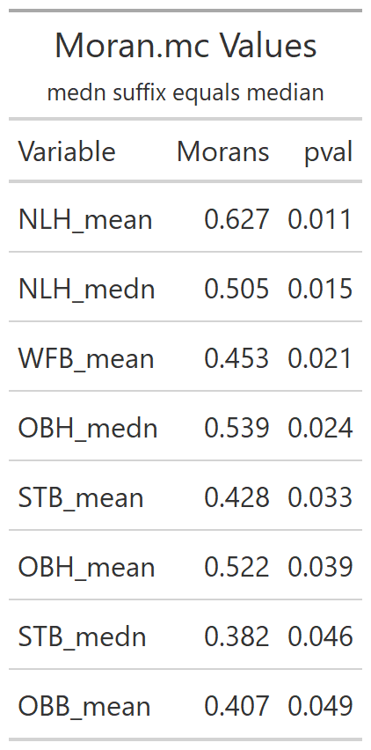
Results/Discussion
Comparing Methods
6 cranial measurements in moran.test
5 cranial measurements in moran.mc
Lower p-values in moran.test
Shorter list in moran.mc
Moran’s I
Moderate spatial clustering
NLH highest clustering (both aggregations)
NA’s in some states

Slide 6
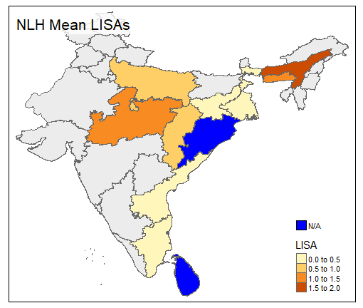
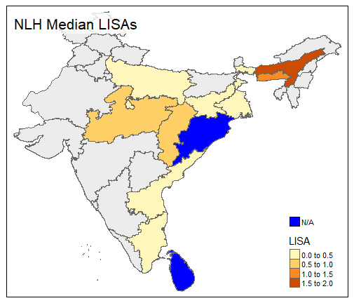
Results/Discussion

Slide 7
Implications
Some cranial measurements show low to moderate spatial clustering at state-level
Okay for pilot study
Help narrow focus for next stage of study
Limited definitive conclusions
Warrants further study/other methodology
Unable to determine influence of sex
Not parsed in this study

Slide 8
Challenges
Draft tabular data
Changes in boundaries (1909 vs 2020)
Spatial scale and quantity of observations
Aggregation required
Spatial data availability
ArcGIS Online workaround
Methodology in forensic anthropology
Component/discrimination analysis vs Spatial Autocorrelation
Learning purr::map functions
Seba

Slide 9
Future Goals
Move functions to other scripts
Increasing granularity of data
PI using cultural atlases
Different geometries (tribal/cultural/villages)
Official data from governments
Spatial autoregression or other techniques?
Methodology from other fields
Publication

Slide 10
References
Danino, M. (n.d.). Aryans and the Indus Civilization: Archaeological, Skeletal, and Molecular Evidence. In A Companion to South Asia in the Past (pp. 205–224). John Wiley & Sons, Inc. https://doi.org/10.1002/9781119055280.ch13
Harding, R. M. (1990). Modern European Cranial Variables and Blood Polymorphisms Show Comparable Spatial Patterns. Human Biology, 62(6), 733–745.
Lovell, N. C. (n.d.). Bioarchaeology of the Indus Valley Civilization: Biological Affinities, Paleopathology, and Chemical Analyses. In A Companion to South Asia in the Past (pp. 169–186). John Wiley & Sons, Inc. https://doi.org/10.1002/9781119055280.ch11
Maestri, R., Fornel, R., Gonçalves, G. L., Geise, L., Freitas, T. R. O., & Carnaval, A. C. (2016). Predictors of intraspecific morphological variability in a tropical hotspot: Comparing the influence of random and non‐random factors. Journal of Biogeography, 43(11), 2160–2172. https://doi.org/10.1111/jbi.12815
Mushrif-Tripathy, V., Chakraborty, K. S., & Lahiri, S. (2016). Where Are They Now? The Human Skeletal Remains from India. In G. R. Schug & S. R. Walimbe (Eds.), A Companion to South Asia in the Past (pp. 496–533). John Wiley & Sons, Inc. https://doi.org/10.1002/9781119055280.ch32
Ross, A. H., & Williams, S. E. (2021). Ancestry Studies in Forensic Anthropology: Back on the Frontier of Racism. Biology, 10(7), 602. https://doi.org/10.3390/biology10070602
Sivaramakrishnan, A., Tahara-Eckl, L., & Madhavan, S. (2016). Spatial localization and distribution of the TMS-related ‘hotspot’ of the tibialis anterior muscle representation in the healthy and post-stroke motor cortex. Neuroscience Letters, 627, 30–35. https://doi.org/10.1016/j.neulet.2016.05.041
Spradley, M. K. (2013). Project IDENTIFICATION: Developing Accurate Identification Criteria for Hispanics (Research No. 2008-DN-BX-K464; p. 69). US Department of Justice.
Spradley, M. K. (2014). TOWARD ESTIMATING GEOGRAPHIC ORIGIN OF MIGRANT REMAINS ALONG THE UNITED STATES-MEXICO BORDER: Origin of Migrant Remains Along the United States-Mexico Border. Annals of Anthropological Practice, 38(1), 101–110. https://doi.org/10.1111/napa.12045
Spradley, M. K., Jantz, R. L., Robinson, A., & Peccerelli, F. (2008). Demographic Change and Forensic Identification: Problems in Metric Identification of Hispanic Skeletons. Journal of Forensic Sciences, 53(1), 21–28. https://doi.org/10.1111/j.1556-4029.2007.00614.x

Slide 11
Thank you for your time!
Questions?

