Slide 1

Capt. Hook
A git-hook for meaningful file diffs
Andrew Salveson
Matthew Dahlhausen
Luc Deckinga

Slide 2

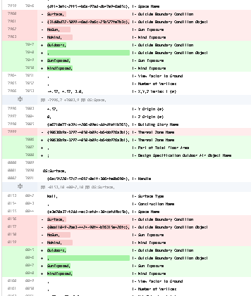
The Problem
Versioning software and diffs were written for code, where seeing single line changes are easy to see
This isn’t helpful for block text changes (e.g. OpenStudio models) or non-text, graphical files (e.g. Grasshopper files)
<- Github OpenStudio diff
Github Grassopper diff ->

Slide 3
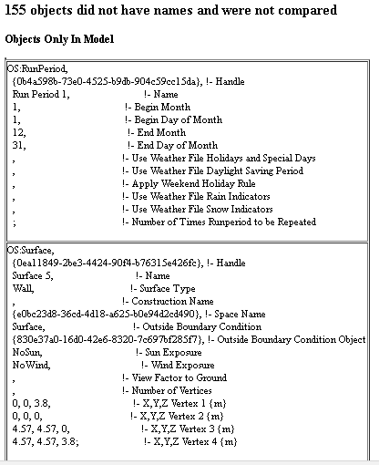
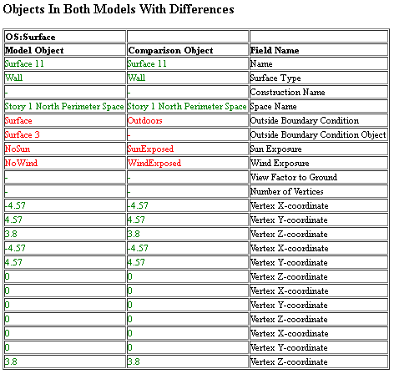
Our Solution:
Take these meaningful diffs…

Slide 4
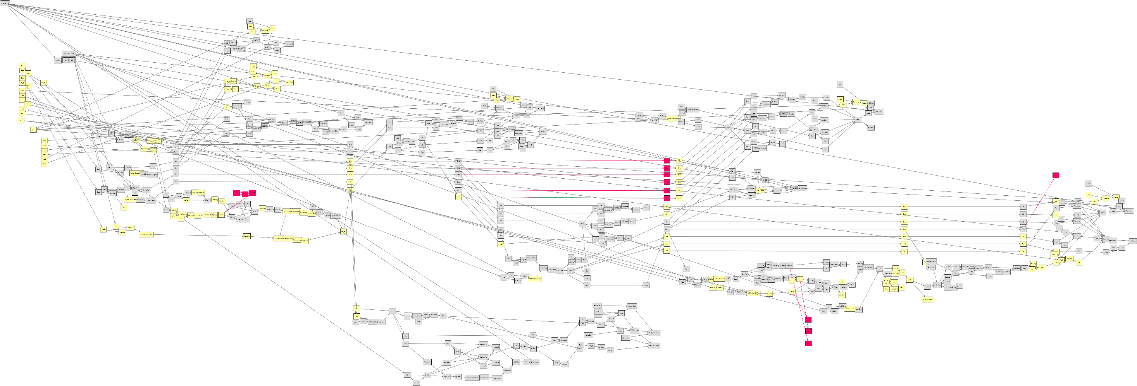
Our Solution:
Take these meaningful diffs…

Slide 5
Our Solution:
…and generate them on pushing to github

Slide 6
Tech Stack:
OpenStudio + ReportModelChanges Measure
Grasshopper
VVD (diff engine for grasshopper files from Thornton Tomasetti AEC Hackathon 2015)
Node.js + Docker
All code free/opensource (MIT License)
github.com/andrewsalveson/CaptainHook/
github.com/andrewsalveson/CaptainHook-service/

Slide 7
What We Learned:
Just because you can run a ruby gem on your server doesn’t mean Node.js can find it - Andrew
Shell Scripting! – Luc
OpenStudio Command Line Interface and Node.js - Matt

Slide 8
Next Steps:
Enable as local service
This can be extended to run more than diffs on files, e.g. run openstudio models and report energy use differences

