Slide 1
HouseMate
Andrew Sarracini Craig Adlam

Slide 2


Introduction
Tinder for Houses – helping you find your new home!
Create/Read/Update/Delete and securely store a User Profile
Validate User profile credentials
Recommend a suitable property
Choose a recommended property
List all available houses – for user

Slide 3
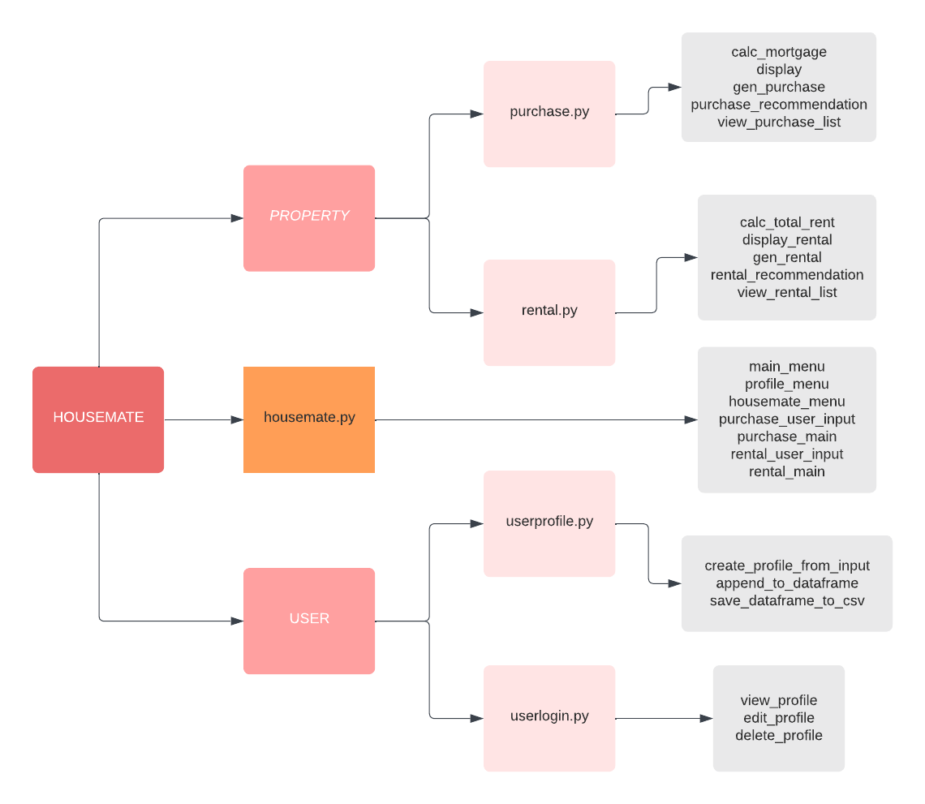

Slide 4
Sub-Package 1: User, Module 1: userprofile.py
Where the user creates a profile
name
age
email
username
password
username and password are encrypted using a hash function
Appended to a dataframe, which is then saved locally to a .csv file

Slide 5
userprofile.py Functions
create_profile_from_input(): user creates their profile
append_to_dataframe(): sends user profile information to dataframe
If no dataframe exists, one will be created
save_dataframe_to_csv(): saves user profile info to a .csv file
If no .csv file exists, one will be created
string_hash(): hash function that encrypts username and password –before storing

Slide 6
Sub-Package 1: User, Module 1: userlogin.py
Module that allows a user to login using saved credentials
Loads the .csv file containing user logins
Matches the username and password to correct user
Upon successful login, user is able to view, and edit their profile
Also have the option to delete their profile

Slide 7
userlogin.py Functions
view_profile(): allows user to view their profile
Username and password are hidden with the hash value
edit_profile(): allows user to edit their profile
Can edit name, age, email, username or password
If username or password are edited, the user will be logged out (to log back in)
delete_profile(): allows user to completely delete their profile
This includes the deleting it from the .csv file where all profiles are securely stored
Upon deletion, the user is sent back to the main menu

Slide 8
Sub-Package 2: Property, Module 1: Purchase
Property is a superclass that has attributes:
num_beds
num_baths
sqft
Purchase is a subclass that inherits from Property, that has unique attributes:
price, mortgage, interest
Instantiates ‘Purchase-type’ objects
Includes children: Condo, TownHome, Duplex, Bungalow, TwoStory, Mansion
Calculates cost of ownership – through price, taxes and mortgage
If Profile attributes align with user attributes, recommend Purchase-Property x

Slide 9
purchase.py Functions
calculate_mortgage(): calculates each Purchase-type’s mortgage payment
gen_purchase(): randomly generates n (user specified) amount of Purchase-type properties
purchase_recommend(): recommends Purchase based on user attributes
display(): overall look at the attributes of the purchase-type object
Purchase type can be: Condo, TownHome, Duplex, Bungalow, TwoStory, Mansion
price
mortgage
sqft
num_beds
num_baths

Slide 10
Sub-Package 2: Property, Module 2: Rental
Property is a superclass that has attributes:
num_beds
num_baths
sqft
Rental is a subclass that inherits from Property, that has unique attributes:
rent, utilities, lease_term, pet
Functions to instantiate ‘Rental-type’ objects
Calculates cost of renting, monthly utilities, duration of lease terms
If Rental-type attributes align with user attributes, recommend Rental-Property x

Slide 11
rental.py Functions
gen_rental(): randomly generates n (user specified) amount of Rental-type properties calc_rent(): calculates cost of monthly rent
calc_utilities(): calculates cost of monthly utilities
rental_recommend(): recommends Rental based on user attributes
dispay_rental(): overall look at the attributes of the Rental object
Rental type can be: RentalCondo, RentalTownHome, RentalDuplex, RentalBungalow, RentalTwoStory, RentalMansion
monthly_rent
monthly_utilities
annual_total
num_beds
num_baths

Slide 12
Standalone Module: housemate.py
Imports all subpackages
Create Purchase and Rental type objects via random number generation
Displays the Main Menu, Profile Menu and HouseMate Menu
Structures the layout of submenu and control of flow
Displays randomly generated property types of user specification
Functions:
main_menu(): allows user to create profile, login or exit
profile_menu(): allows user to view edit and delete profile
View available homes
Ability to log out

