Slide 1
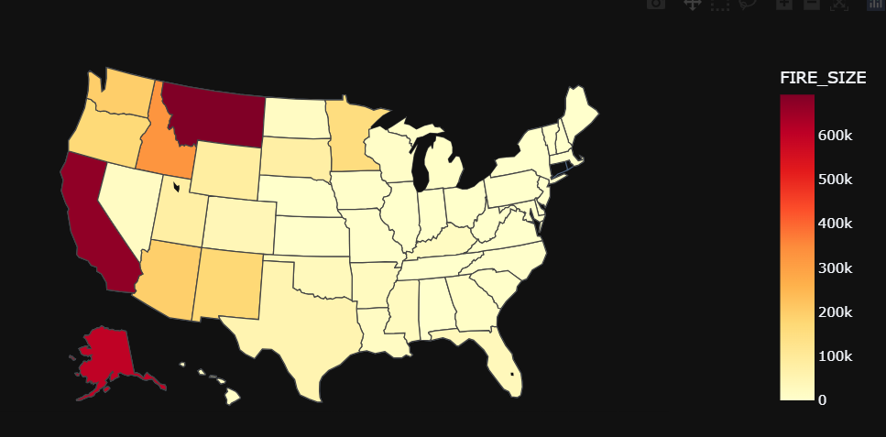
HISTORICAL ANALYSIS OF WILDFIRES IN THE UNITED STATES
Wildfires Across USA
Trend of Wildfire Intensity
A,B,C,D,E,F,G represents the area of fire
YEAR
2004 2010
STATE
Frequency of Wildfires per area
Count and total area affected by Wildfires
NOTE: This is a dropdown that where we can select the states
All the plots are dynamic and linked with the filters and has tool tip for better understanding.

