Slide 1
Housing Data Analysis
Ames Iowa
Springboard - Second Capstone
Andrew Seal

Slide 2
Dataset
Publicly available dataset with 2,930 unique sales between 2006 and 2010.
82 columns each representing a feature of the home.
Includes categorical data:
Zoning
Neighborhood
Condition of the home…etc
And numerical data:
Square footage
Lot size
Number of Bedrooms…etc

Slide 3
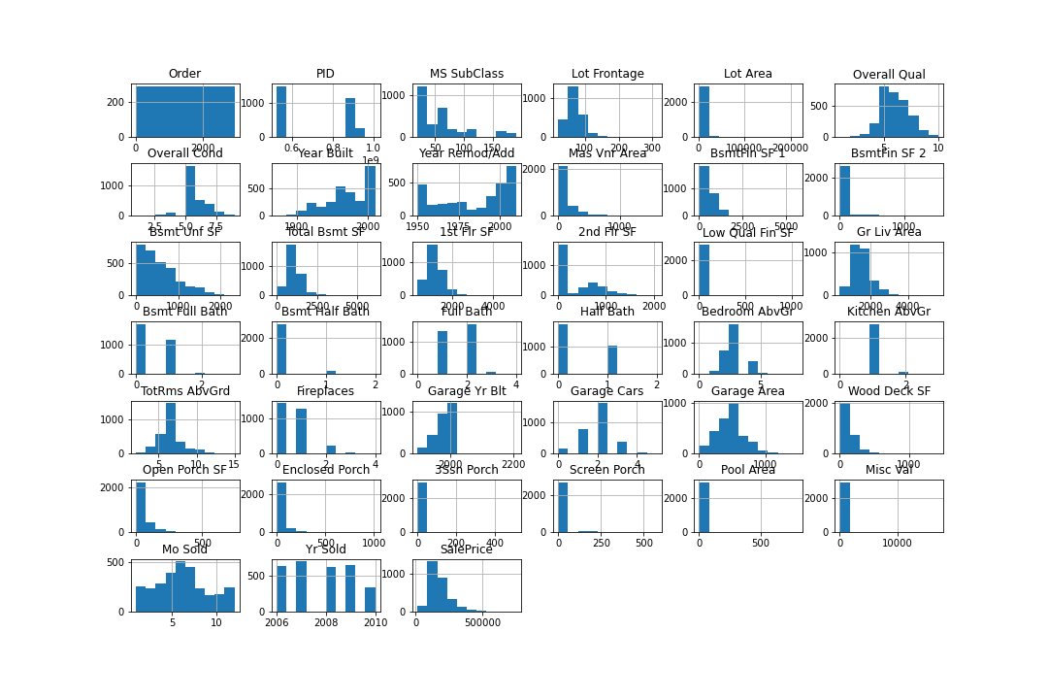
Notes:
Each home in our dataset was assigned a ‘Parcel ID’ which is a unique identifier that I used to ensure no home sales showed up in our dataset more than one time.
With no duplicated data in our dataset, I graphed all of the numerical data into histograms in order to visually inspect the data for outliers or other anomalies. Some of our data showed outliers, for example the lot frontage on a few parcels was around 300 feet. While wider than most, a lot width of 300 feet seemed reasonable for a smaller town in Iowa and unlikely to be an error.

Slide 4
Data Cleaning and Data Wrangling
Check for Duplicates (Parcel ID)
Visually inspect histograms for outliers or errors (previous slide)
Columns with mostly missing data
Columns with mostly homogeneous data
Notes:
The dataset included four variables where more than 80% of the data was missing. These were examined individually and one variable “Misc Feature” was deleted as it was determined that the value of each miscellaneous feature identified in this column was reported in a separate column.
Similarly, some variables were dropped because the data was exceedingly homogenous. For example, a column named ‘Utilities’ was dropped since all but three of the 2,930 sales had the same value indicating they were connected to public utilities.

Slide 5
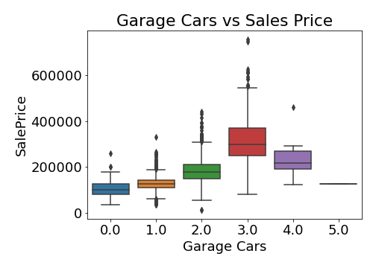
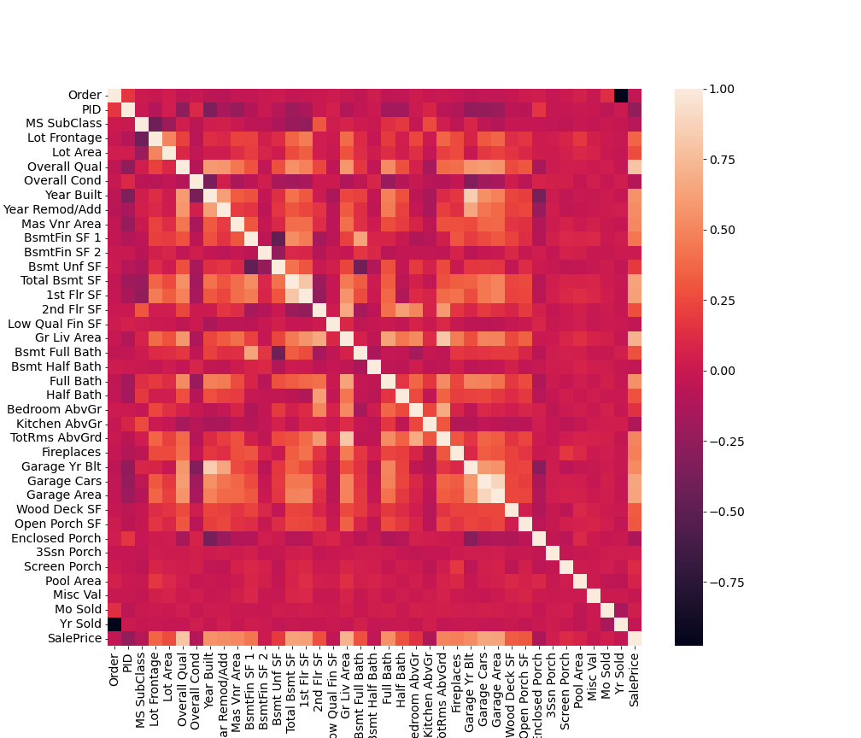
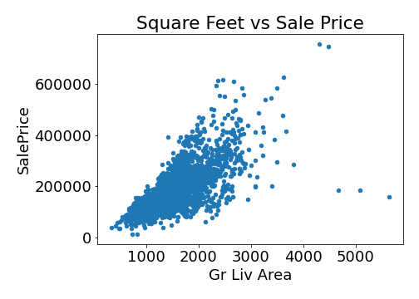
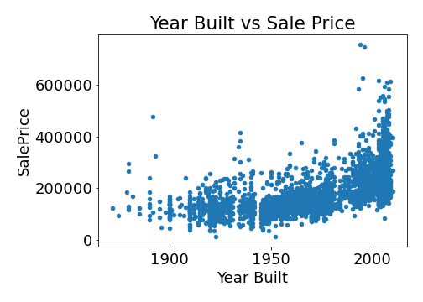
Exploratory Data Analysis
Notes:
In the exploratory data analysis step, the relationship between variables is assessed. Of particular importance is the relationship between Sales Price and other variables. In the above heatmap we can see a positive correlation between Sales Price and a few variables including Overall Qual, Gr Liv Area, Full Bath, Garage Cars and others.
A strong positive relationship between Gross Livable Area (square feet) and sales price is apparent in the scatter plot above.
Likewise, a logical relationship is found between sales price and the number of cars the garage will hold where homes without garages sell for a discount while those with three-car garage command a higher sales price.

Slide 6
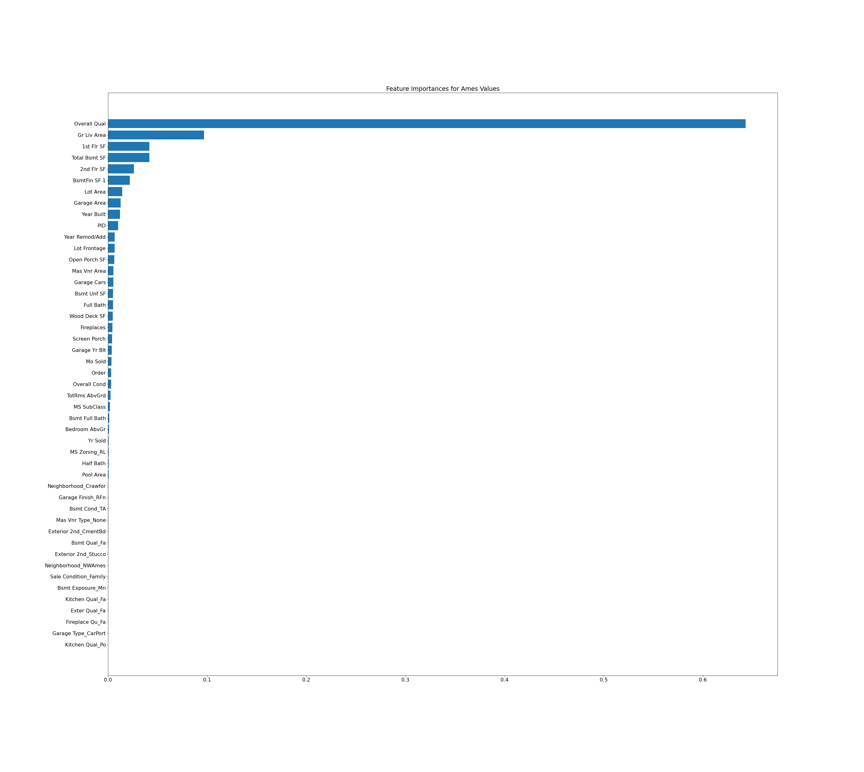
Exploratory Data Analysis Continued
Random Forest Feature Importance
Overall Qual had outsized importance
Lack of information about what this variable is
Ultimately Removed this Variable

Slide 7
Preprocessing and Training
Imputing Values:
Imputed MEAN for Square Footage, Lot Area and Lot Frontage
Imputed MODE for a few categorical variables
DID NOT Impute data for Garage, Air Conditioning, 2nd floor and other features that may not be present in each home
Create Dummy Variables
K-1 Variables to avoid unnecessary collinearity
NOW Drop Missing Data – Results in 2,747 Rows and 244 Columns
Address Multicollinearity – VIF Analysis AND Simple Collinearity
Standardize data using Robust Scaler

Slide 8
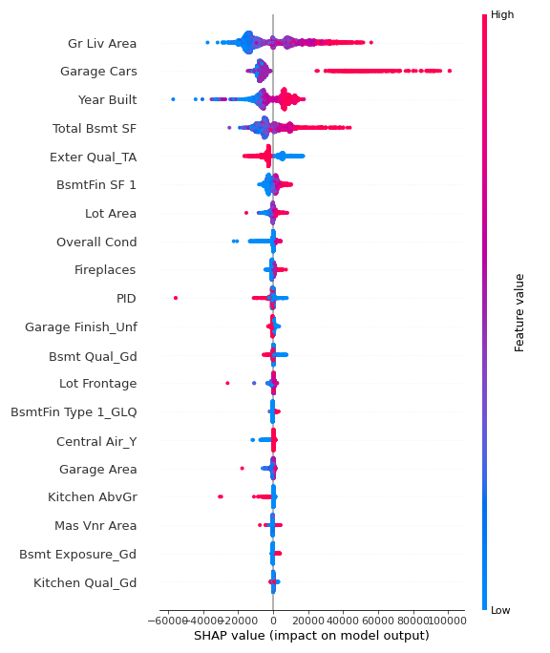
Feature Importance
Coefficients from OLS Regression
SHAP Feature Importance (right)
Notes:
the features identified as most important on the OLS model did not match what we had previously identified as important in the Random Forest Feature Importance. It should be noted that many of the variables identified as important in the OLS model were relatively rare features like a swimming pool. It may not make sense to build a model around these fairly rare features so a second Feature Importance analysis was conducted.
The second Feature Importance Analysis that I utilized is called the Shapley Additive Explanations (SHAP) which is a measure of the average marginal contribution of a feature across all the possible combination of features.

Slide 9
Train Test Split
Training Set with 75% of the Sales
Test Set with remaining 25% of the Data

Slide 10
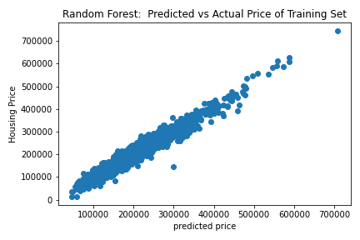
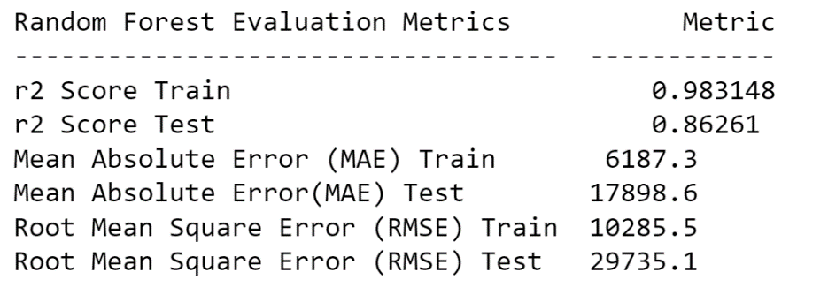
Random Forest Model
Optimized Hyperparameters:
N_estimators
Max_depth
Used Random Search for CV

Slide 11
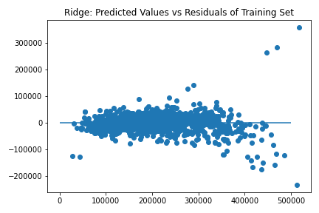
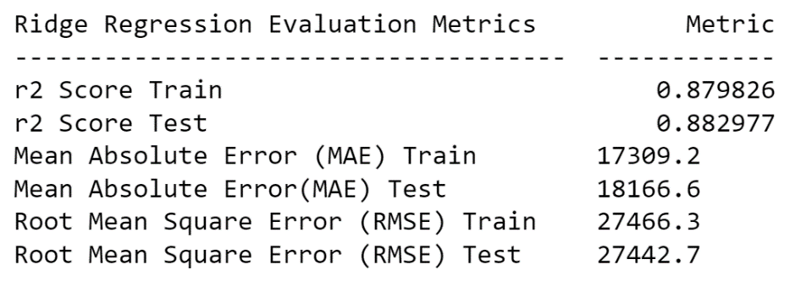
Ridge Regression
Useful when multicollinearity exists.
Grid Search CV to optimize Alpha
Notes:
For the ridge regression I went ahead and plotted the residuals to visually ensure linearity, and a constant variance. As shown above, nothing unusual was detected in the plot of the residuals.

Slide 12
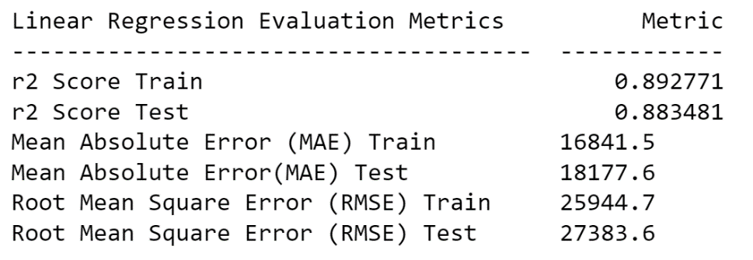
Linear Regression
No hyperparameters to Tune
Instead ran with reduced number of features
Best model was with ALL features

Slide 13
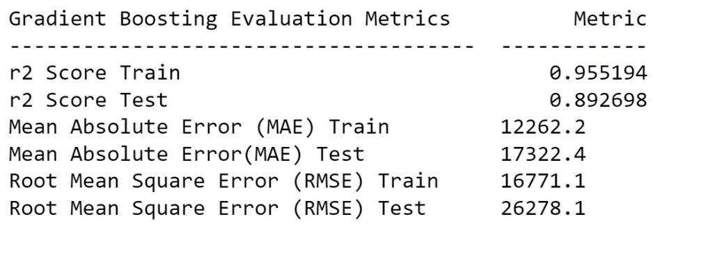
Gradient Boosting
Grid Search Cv
To optimize Learning Rate

Slide 14
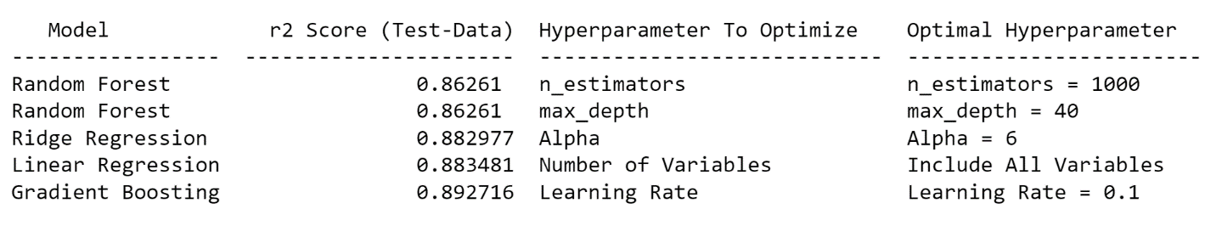
Comparing The Models

Slide 15
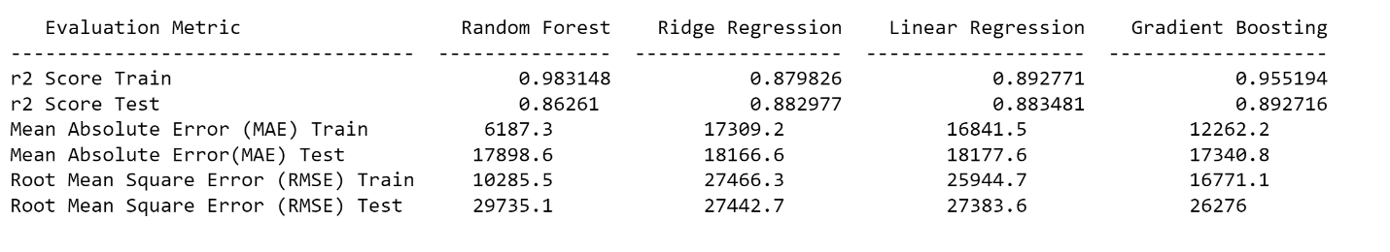
Comparing The Models
Random Forest performs best on Training Data
Gradient Boosting has highest R-squared and Lowest RMSE on test data
Expect Gradient Boosting to most accurately predict Sales Price

Slide 16
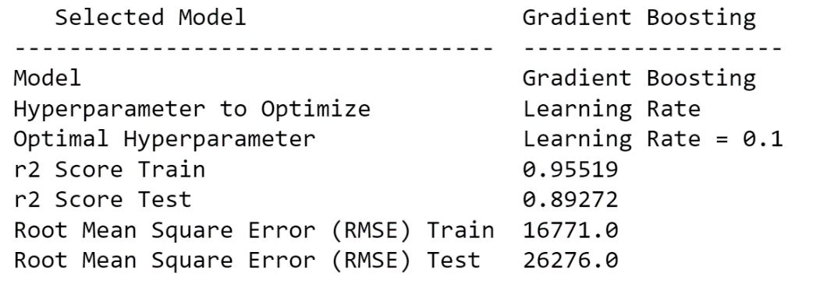
Gradient Boosting
Selected as best model

Slide 17
Test Case
Randomly Selected ONE property from our Test Data
Applied Gradient Boosting Model to predict Sales Price
Model predicted Sales Price of $133,746
Actual Sales Price of $124,500
Notes:
a single sale is not a good indicator of the performance of the model, it is nonetheless fun to put the model to use in a manner that simulates its real-world application!

