Slide 1
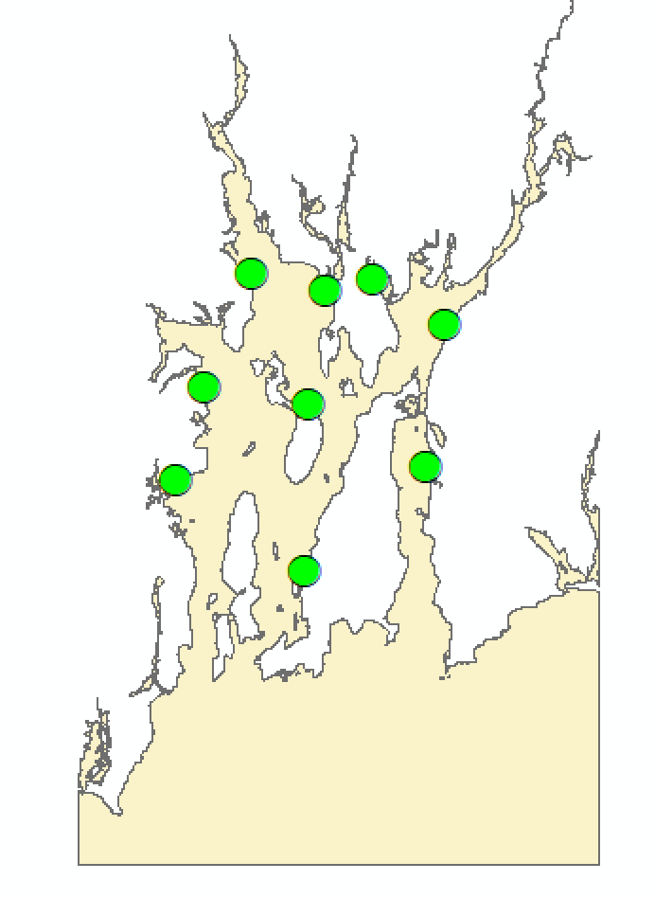
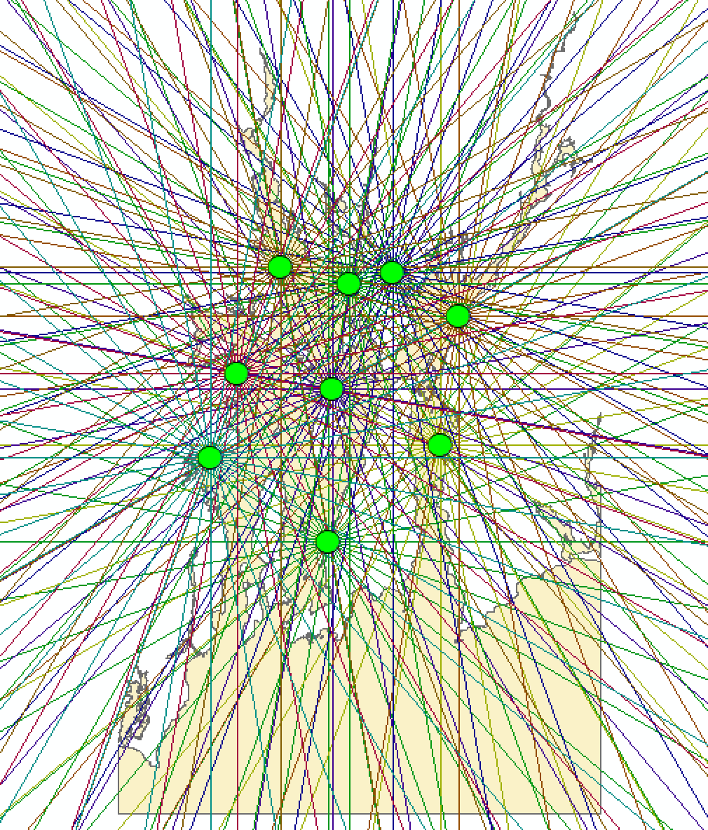
Step 1 – Draw the radiating lines for each site
Use the trig code provided to generate the radiating lines. If you do all points in a loop then you may hit issues with the lines not being assigned to an origin ”Site_ID” code hence you may encounter issues later on. So make sure that you label each radiating line with the site ID.
Or run the whole code for each location as a top level loop.
You will need to change spatial reference and distance measurement to reflect that of the input locations. Our example code used WGS84, whilst the location file uses a RI reference in Feet.

Slide 2
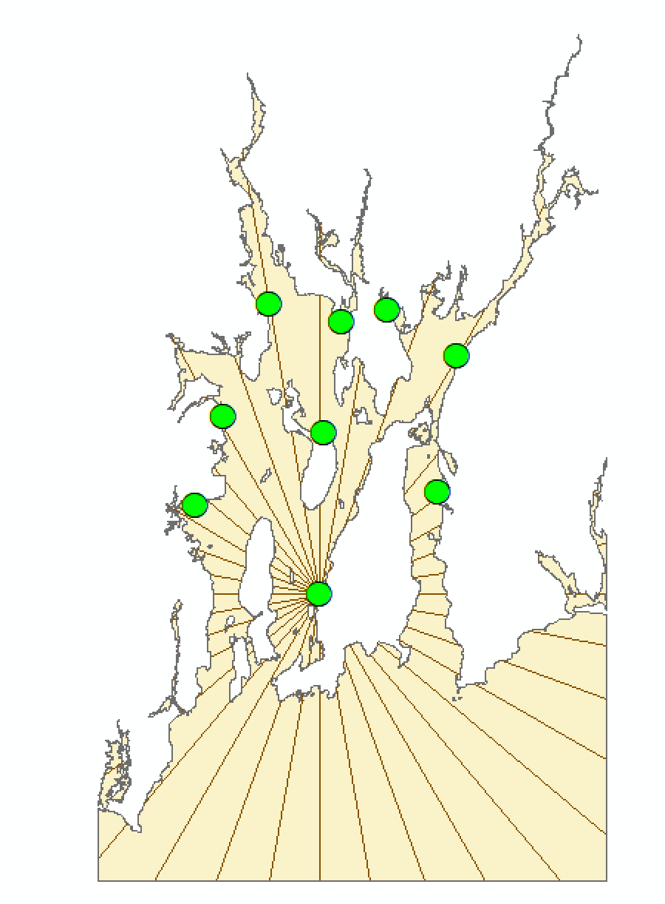
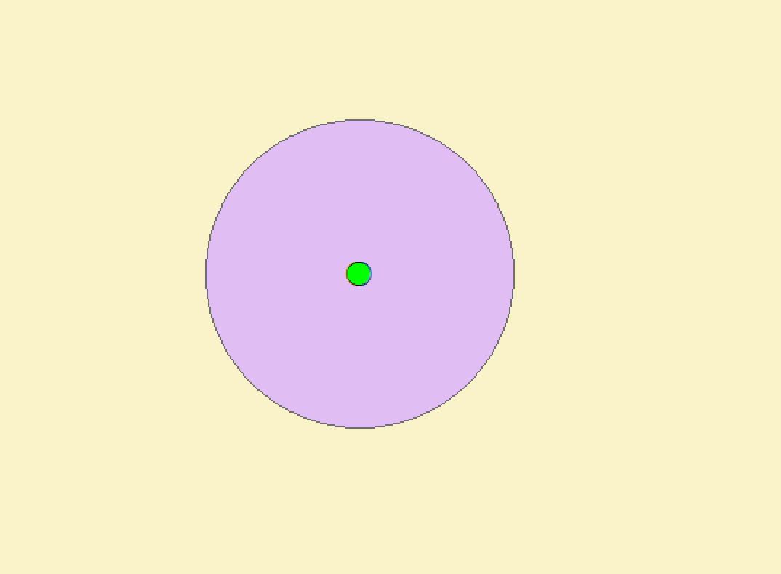
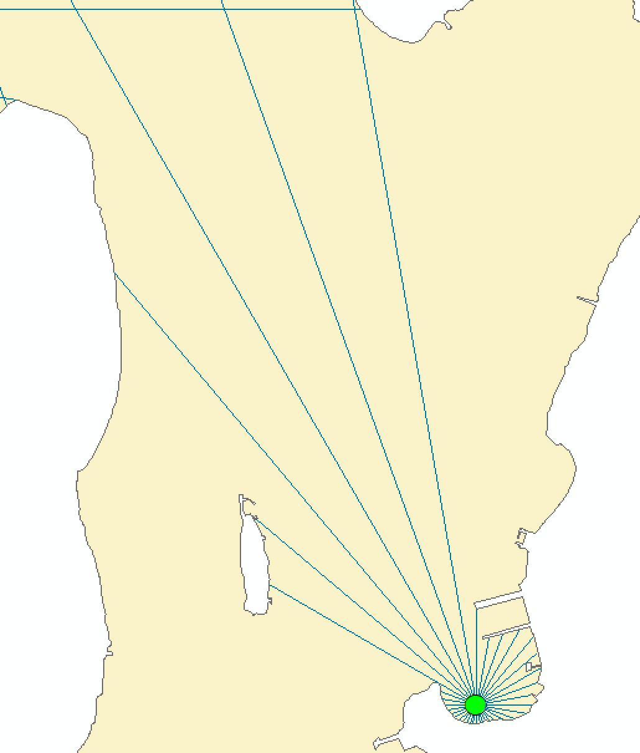
Step 2 – Clip the lines by the coastline
Step 3 – Keep only lines connected to origin point
Clip will remove any line that moves
over land but will not remove lines
that are no longer
part of the origin
line.
Use Single to
Multipart conversion to split the line and then move to Step 3.
Use a buffer and then
SelectByLocation (warning, select by location will only work on “Make Feature Layer”, i.e. a feature layer in memory. Not on an external shapefile), as sometimes you can’t accurately match up the starting location with the
lines due to rounding.
Beware that if you do not set your line long enough, it will not reach land.

