Slide 1
SOME WALKTHROUGH IDEAS

Slide 2
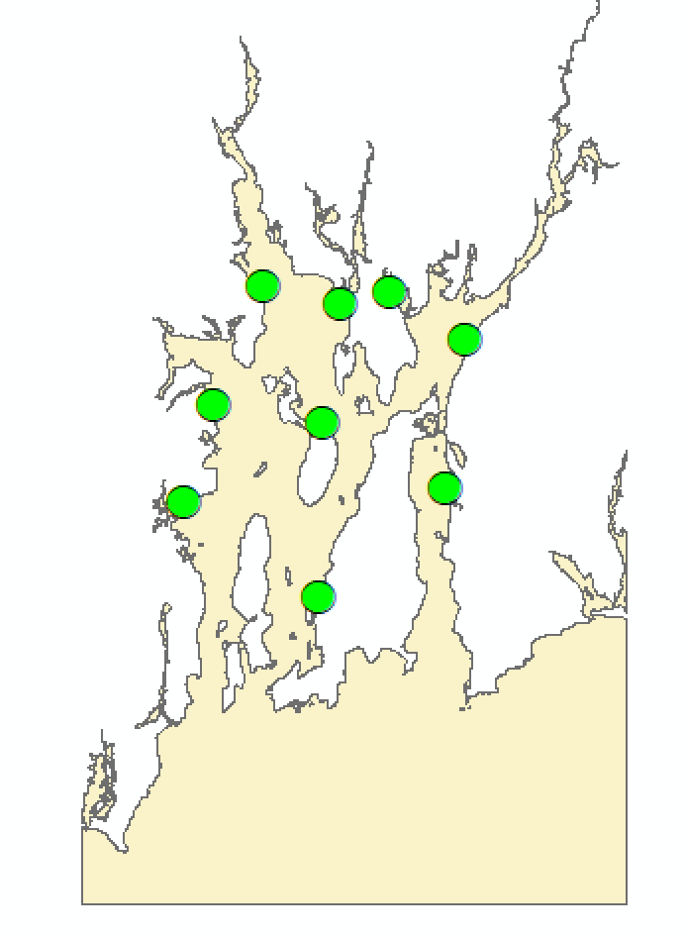
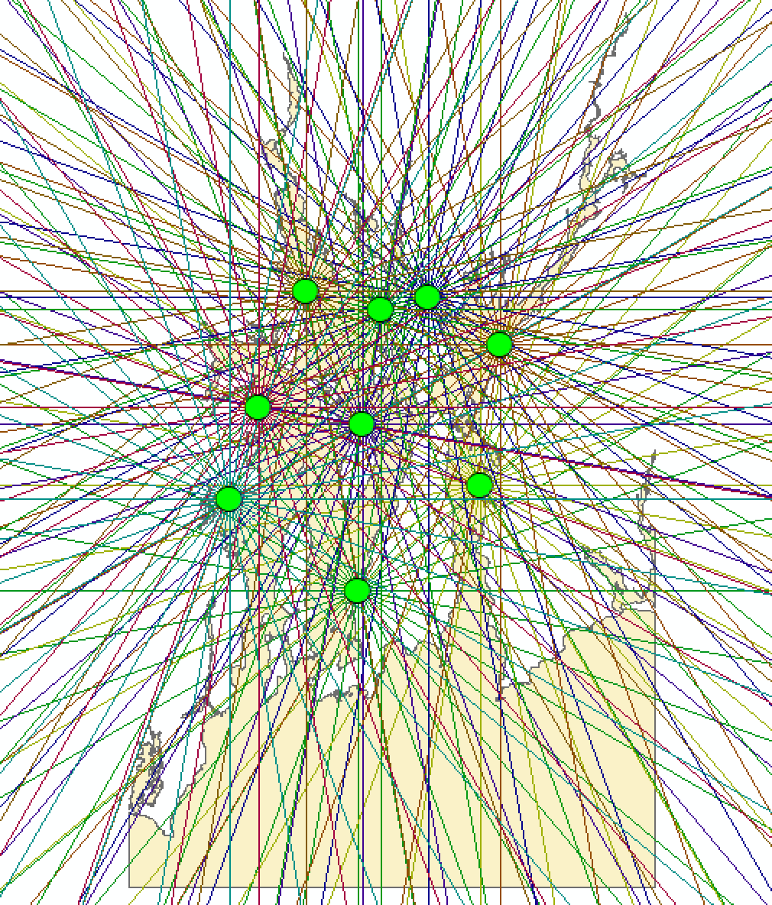
Step 1 – Draw the radiating lines for each site
Use the trig code provided to generate the radiating lines. If you do all points in a loop then you may hit issues with the lines not being assigned to an origin ”Site_ID” code hence you may encounter issues later on. So make sure that you label each radiating line with the site ID.
Or run the whole code for each location as a top level loop.
You will need to change spatial reference and distance measurement to reflect that of the input locations. Our example code used WGS84, whilst the location file uses a RI reference in Feet.

Slide 3
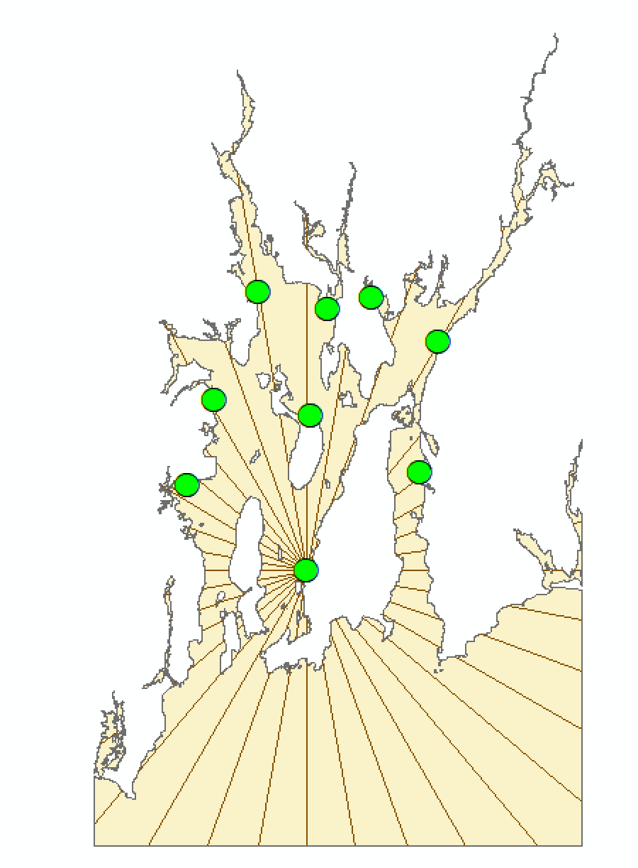
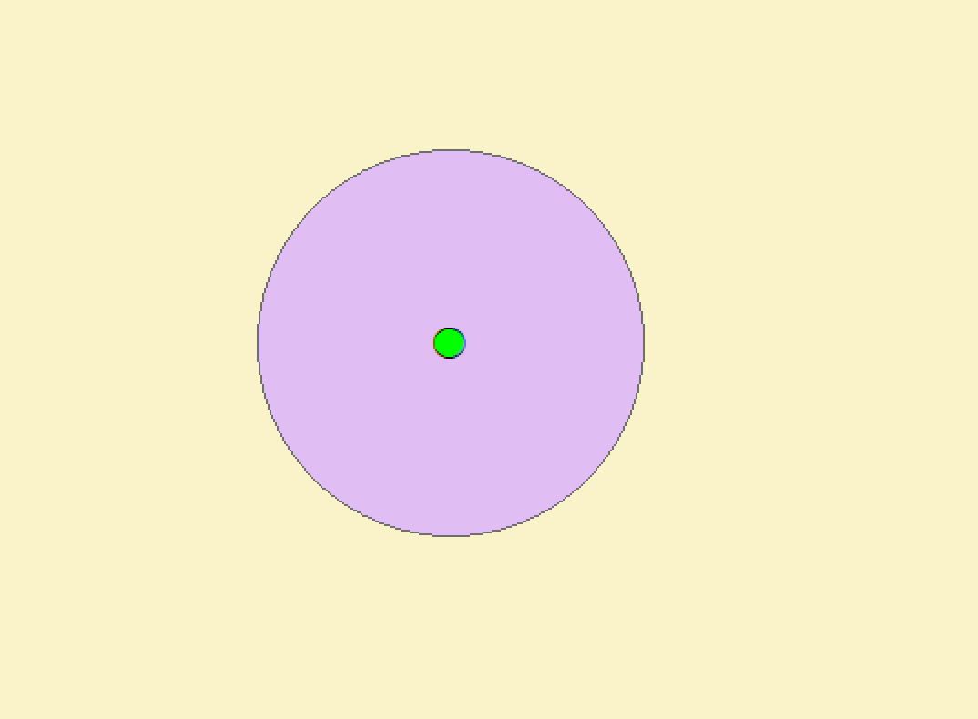
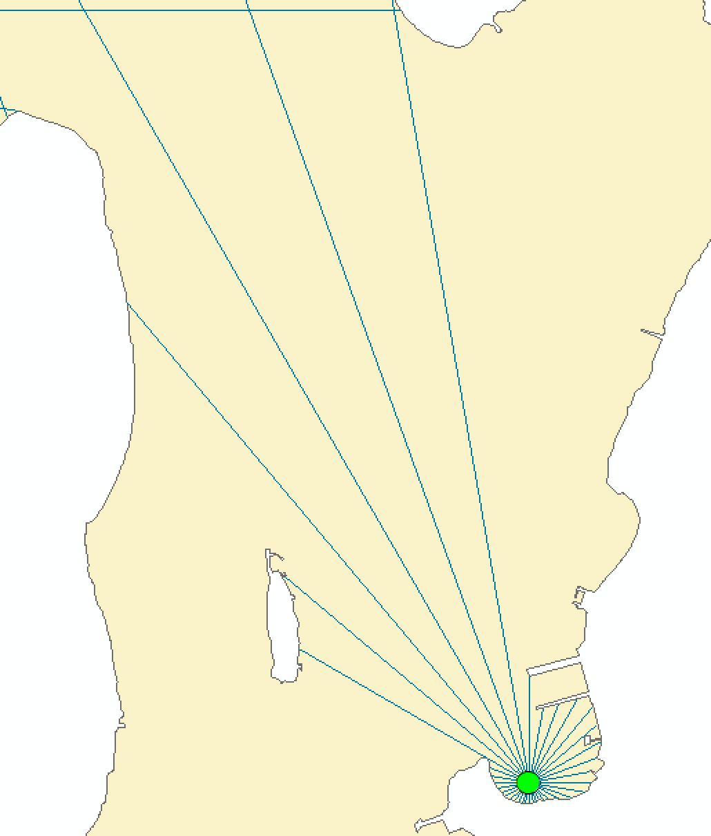
Step 2 – Clip the lines by the coastline
Step 3 – Keep only lines connected to origin point
Clip will remove any line that moves
over land but will not remove lines
that are no longer
part of the origin
line.
Use Single to
Multipart conversion to split the line and then move to Step 3.
Use a buffer and then
SelectByLocation (warning, select by location will only work on “Make Feature Layer”, i.e. a feature layer in memory. Not on an external shapefile), as sometimes you can’t accurately match up the starting location with the
lines due to rounding.
Beware that if you do not set your line long enough, it will not reach land.

Slide 4
AFTER THIS ARE HINTS AND SOLUTIONS

Slide 5
How to carry site ID to your radiating lines?
Not at all that tricky. In your code, you are pulling out the X and Y locations and assigning that as your start and end point in your code. All we are going to do is extend our input file to include an “ID” column and propagate through to the final radiating lines file.
Essential the same as a SearchCursor output
# Simulated input file, same format as what would be produced by a SearchCursor site_locations = [[(-71.42, 41.47), "ID1"], [(-71.42, 41.47), "ID2"]] # Create Radiating Lines Shapefile out_path = arcpy.env.workspace out_name = "radiating_line.shp" geometry_type = "POLYLINE" template = "#" has_m = "DISABLED" has_z = "DISABLED" # Should Use Describe to get a SpatialReference object from your input file spatial_ref = 4326 arcpy.CreateFeatureclass_management(out_path, out_name, geometry_type, template, has_m, has_z, spatial_ref) arcpy.AddField_management(out_name, "SITE_ID", "TEXT", field_length="5") OutputFeature = os.path.join(out_path, out_name) for site in site_locations: origin_x, origin_y = site[0][0], site[0][1] distance = 1 angle = 10 # in degrees angles = range(0, 360,angle) for ang in angles: # calculate offsets with trig angle = float(int(ang)) (disp_x, disp_y) = (distance * sin(radians(angle)), distance * cos(radians(angle))) (end_x, end_y) = (origin_x + disp_x, origin_y + disp_y) (end2_x, end2_y) = (origin_x + disp_x, origin_y + disp_y) # Draw Line lineArray = arcpy.Array() start = arcpy.Point() (start.ID, start.X, start.Y) = (1, origin_x, origin_y) lineArray.add(start) end = arcpy.Point() (end.ID, end.X, end.Y) = (2, end_x, end_y) lineArray.add(end) line = arcpy.Polyline(lineArray) with arcpy.da.InsertCursor(OutputFeature, ['SITE_ID', 'BEARING', 'SHAPE@']) as cur: cur.insertRow([site[1], ang, line]) lineArray.removeAll() del cur
Add the SITE_ID field
Changed way to add the line to the Shapefile, as we now need to add other data
Not tested!

Slide 6
How to intersect using SelectByLocation?
This is a way to retain only lines that meet our requirements. In this example, I am using pure location code, not doing anything with each site here.
Will cut the line by the coast, but each line will remain connected if it continues after hitting the coastline
Have to do this to create lines that are split when moving across coastline.
I buffer my input sites to help with the SelectByLocation. Point to line matching doesn’t work well.
arcpy.Clip_analysis("Radiating_Lines.shp", "NB_Coastline.shp", "Radiating_Lines_Clipped.shp", xy_tolerance) arcpy.MultipartToSinglepart_management(in_features="Radiating_Lines_Clipped.shp", out_feature_class="Single_to_Multi_Output.shp") arcpy.Buffer_analysis(in_features="Site_Locations.shp", out_feature_class="Sites_10m_Buffer.shp", buffer_distance_or_field="10 Meters", line_side="FULL", line_end_type="ROUND", dissolve_option="NONE", dissolve_field="", method="PLANAR") arcpy.MakeFeatureLayer_management("Single_to_Multi_Output.shp","single_part") arcpy.MakeFeatureLayer_management("Sites_10m_Buffer.shp","buffer") arcpy.SelectLayerByLocation_management(in_layer="single_part", overlap_type="INTERSECT", select_features="buffer", search_distance="", selection_type="NEW_SELECTION", invert_spatial_relationship="NOT_INVERT") arcpy.CopyFeatures_management("single_part", "Single_to_Multi_out_Select_Per_Site.shp")
SelectByLocation only works on FeatureLayers
Intersect your buffer with the lines, keeping only lines that cross your individual buffer.
This is your final output file. You do your stats on this.

Slide 7
How to calculate statistics for the lines?
This assumes that each site has 36 lines and each line has a SITE_ID code for you to sum based on that column.
arcpy.AddGeometryAttributes_management("Radiating_Lines_Per_Site.shp", properties, length_unit, area_unit, coordinate_system)
out_table = "stats_table.dbf”
stat_fields = [['LENGTH', 'SUM'], ['LENGTH', 'STD']] arcpy.Statistics_analysis(in_table, out_table, stat_fields, ‘SITE_ID') with arcpy.da.SearchCursor(out_table, ['FREQUENCY', 'SUM_LENGTH', 'STD_LENGTH']) as cursor: for row in cursor: print(row)
Set SITE_ID column to calculate statistics for each site.
Prints out the stats for each site, i.e. 36 radiating lines summed and SD’d, total of 9 sites should yield 9 rows only.

